Slide 1
これまでの手法
(1) パッチリストからパッチを取り出す．
(2) 頂点をx軸の昇順に$P_{min},P_{mid},P_{max}$
$$P_{mid}$$
(3) 下の図の各区間で体積を
次頁の８パターンにより計算する．
$$P_{min}$$
$$P_{max}$$
$$P_{mid}$$
$$P_{min}.x≤P_{mid}.x≤P_{max}.x$$
$$P_{min}$$
$$P_{max}$$
$$⋯$$
Section(k)
Section(k+1)
Section(k+N)
(4) (1)に戻る

Slide 2
$$z$$
p_xmid
p_xmax
p_xmin
$$y$$
$$x$$

Slide 4
-
=

Slide 5
-
=

Slide 6
x = start_idx+1
x = start_idx
volume(start_idx) に加える

Slide 7
-
=
x = start_idx+2
x = start_idx+2
x = start_idx+1
x = start_idx+1
volume(start+1) に加える

Slide 8
-
=
x = start_idx+3
x = start_idx+3
x = start_idx+2
x = start_idx+2
volume(start_idx+2) に加える

Slide 9
-
=
x = end_idx
x = end_idx
x = end_idx-1
x = end_idx-1
volume(end_idx-1) に加える

Slide 10
-
=
x=p_xmid(1)
x = p_xmid(1)
x = end_idx
x = end_idx
volume(end_idx) に加える

Slide 11
Slice_lx
Slice_rx
Slice_lx
Slice_rx
８パターン

Slide 12
p_xmin(1) = 20.4
old_volume = 0
slice_edge で求める．
current_volumeに代入
volume(20) = volume(20) + current_volume – old_volume
次に備えて上書き
old_volume = current_volume
slice_X = floor(p_xmin(1)) +1 = 20+1=21
x = floor(p_xmin(1)) = 20

Slide 13
current_volume
old_volume
p_xmin
p_xmin
p_xmin
-
=
volume(21) = volume(21) + (current_volume – old_volume)
slice_edge で求める．
old_volume =current_volume
slice_X = 22
slice_X = 22
x= 21
x = 21

Slide 14
current_volume
old_volume
p_xmin
p_xmin
p_xmin
-
=
volume(22) = volume(22) + (current_volume – old_volume)
slice_edge で求める．
old_volume =current_volume
slice_X = 23
slice_X = 23
x = 22
x= 22

Slide 15
current_volume
old_volume
p_xmid(1)=59.8
p_xmid(1)=59.8
slice_edge で求める．
-
=
volume(58) = volume(58) + (current_volume – old_volume)
old_volume =current_volume
slice_X = 59
slice_X = floor(59.8)=59
x= 58
x = 58

Slide 16
current_volume
old_volume
p_xmid(1)=59.8
p_xmid(1)=59.8
p_xmid(1)=59.8
slice_edge で求める．
-
=
volume(59) = volume(59) + (current_volume – old_volume)
x = 60
x = 59.8
x= 58
x = 59

Slide 17
slice_edge で求める
p_xmid
p_xmax(1) = 80.3
old_volume = 0
current_volumeに代入
volume(80) = volume(80) + current_volume – old_volume
old_volume = current_volume
slice_X = ceil(p_xmax(1)) – 1 = 81 - 1 = 80

Slide 18
current_volume
old_volume
p_xmid
p_xmid
p_xmid
p_xmax
p_xmax
p_xmax
-
=
slice_edge で求める
volume(79) = volume(79) + (current_volume – old_volume)
old_volume =current_volume
x = 80
slice_X = 79
x= 80
slice_X = 79

Slide 19
current_volume
old_volume
p_xmid(1) = 59.8
p_xmid(1)=59.8
p_xmid
-
=
slice_edge で求める
volume(60) = volume(60) + (current_volume – old_volume)
old_volume =current_volume
x = 61
x= 61
slice_X = 60
slice_X = ceil(59.8) = 60

Slide 20
current_volume
old_volume
p_xmid(1) = 59.8
p_xmid(1) = 59.8
p_xmid(1) = 59.8
-
=
slice_edge で求める
volume(59) = volume(59) + (current_volume – old_volume)
old_volume =current_volume
x = 60
x= 60
x = 59.8
x = 59

Slide 21
(1) 頂点リストからパッチを取り出す．
(2) 頂点をx軸の昇順に$P_{min},P_{mid},P_{max}$
(3) 下の図の各区間の体積を計算する．
$$P_{mid}$$
$$P_{mid}$$
$$P_{min}$$
$$P_{max}$$
$$P_{min}.x≤P_{mid}.x≤P_{max}.x$$
$$P_{min}$$
$$P_{max}$$
$$⋯$$
Section(k)
Section(k+1)
Section(k+N)
(4) (1)に戻る

Slide 22
$$y$$
新手法
$$x$$
$$P_{mid}$$
$$P_{mid}$$
$$P_{mid}$$
$$⨀$$
$$z$$
$$P_{min}$$
$$P_{min}$$
$$P_{min}$$
$$P_{max}$$
$$P_{max}$$
$$P_{max}$$
V(k) += -
V(k+1) += -
V(k+2) += -
$$P_{mid}$$
$$P_{min}$$
$$P_{max}$$
V(k+3) += -

Slide 23
$$y$$
新手法
$$P_{mid}$$
$$P_{mid}$$
$$P_{mid}$$
$$x$$
$$⨀$$
$$z$$
$$P_{min}$$
$$P_{min}$$
$$P_{min}$$
$$P_{max}$$
$$P_{max}$$
$$P_{max}$$
V(k+6) += -
V(k+5) += -
V(k+4) += -
$$P_{mid}$$
新手法のメリット
パターン分けが不必要．
区間毎に並列に処理可能
$$P_{min}$$
$$P_{max}$$
V(k+4) += -

Slide 24
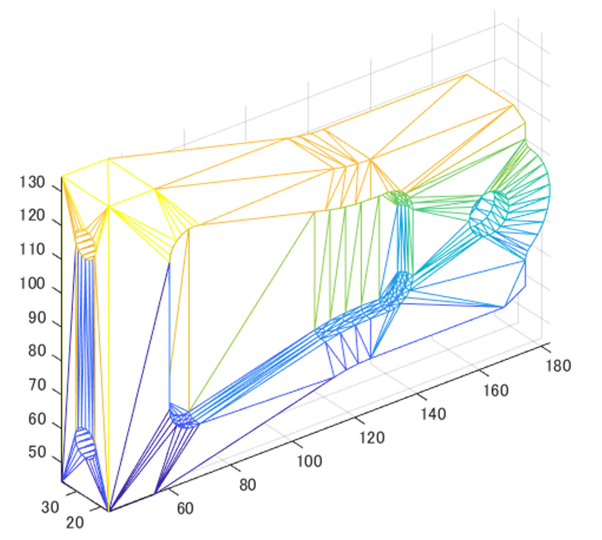
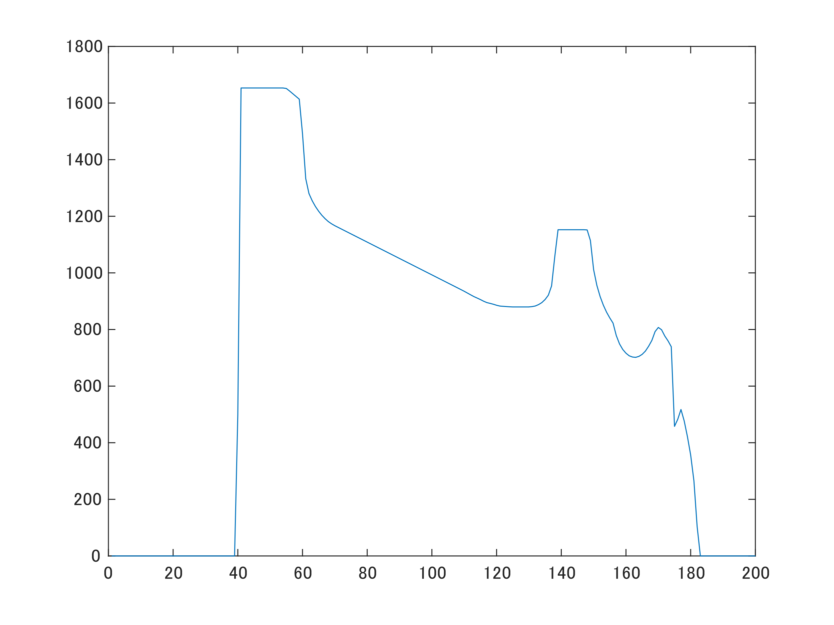
旧手法との比較
旧手法
新手法
0.098292秒
0.362545秒

