Slide 1
CAPSTONE 1: BITCOIN PRICE PREDICTION
AUTHOR: Akinkunle Akinola

Slide 2

Background
Top 10 cryptocurrencies are shown on the graph.
Average daily trading in the market is enormous especially for Bitcoin
Bitcoin seems to have the highest Market capitalization which is why it is the focus in this project.
Top Ten Cryptocurrencies Chart - Bing

Slide 3
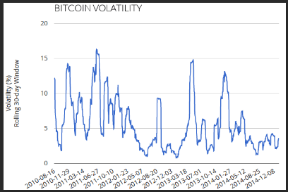
Background
price volatility bitcoin - Bing images
Cryptocurrencies Downfalls:
Price volatility.
Inability to predict the price.
Instability of the price trend.
Traders may lose money if not trade carefully

Slide 4

Goals
bitcoin better decisions - Bing images
Use a time series analysis to predict the price of Bitcoin over a period
Build various trading models to maximize return on investment capital.
Create trading strategies to help traders make better trading decisions

Slide 5
DATASETS
bitcoin better decisions - Bing images
A market dataset and alert dataset from a proprietary saas was used
Market data:
Kaggle market data was used
Observations: 942,297, Features: 13
Has rows of daily observations between 04/28/2013 and 11/29/2018.
Alert data:
Observations: 102,225, Features: 23
Has rows of daily alert between 04/28/2013 and 11/29/2018.

Slide 6
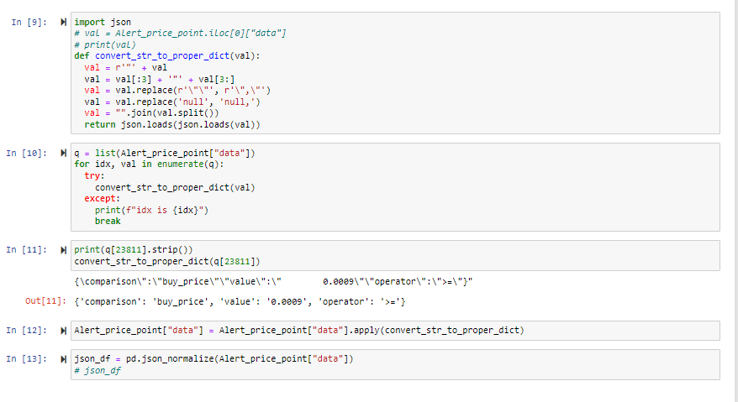
Data Cleaning
Low signal columns like updated_at, deleted_at, last_checked, and last_sent were removed from the alert dataset.
JSON format was converted to the appropriate format and splitted to get additional columns like “comparison”, “value”, and “operator”
Missing values were dropped.
Date column was converted to datetime.

Slide 7
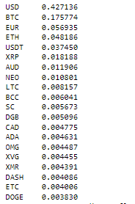
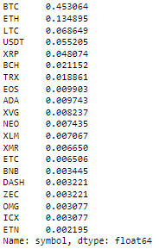
Data Cleaning
Subsetted the dataset over bitcoin to get only the bitcoin data.
BTC consists of about 45 percent of the Alerts.
USD consists of about 43 percent of the Alerts.

Slide 8
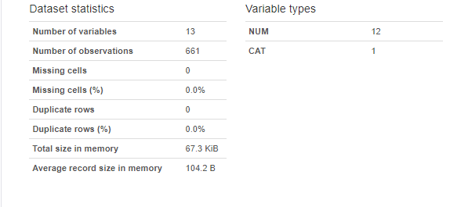
Exploratory Data Analysis
Pandas profiling
Technique to examine, analyze, and create useful summaries of the data
Percentage change of each variables were generated.
High Daily Percent Change.
Low Daily Percent Change
Volume Daily Percent Change
Close Daily Percent Change.
market Daily Percent Change.
Open Daily Percent Change.

Slide 9
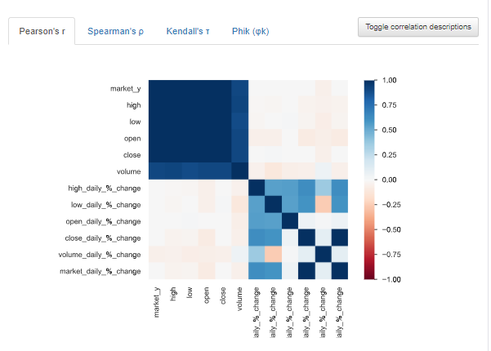
Exploratory Data Analysis
Correlation plot

Slide 10
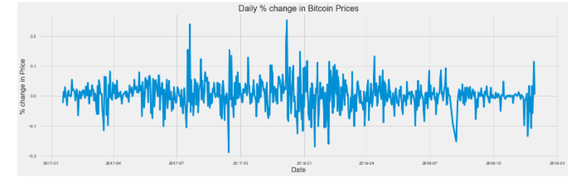
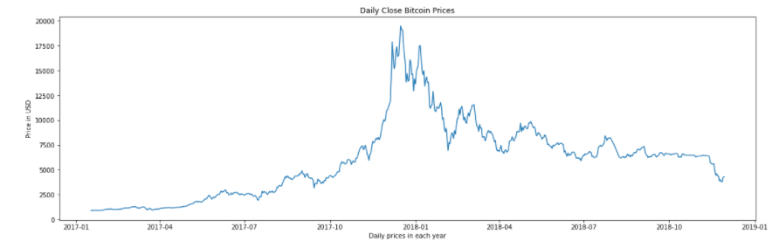
Exploratory Data Analysis
Daily Percent change in Close price
Daily Close price plot

Slide 11
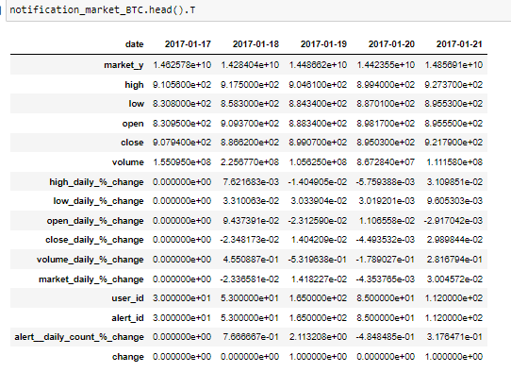
Feature Engineering
First row of dataset after feature extraction.

Slide 12
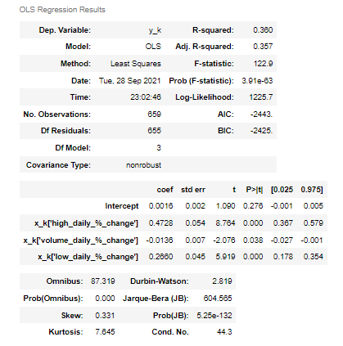
Modeling
Trading Strategy 0: Baseline Model using market data
Linear regression.
Added features
high_daily_%_change
volume_daily_%_change
low_daily_%_change
Dependent Variable
close_shift_daily_%_change
Metric:
R-squared: 36%

Slide 13
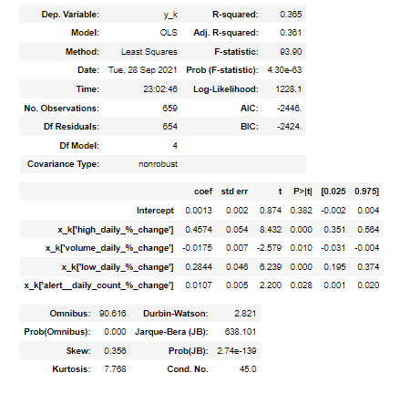
Modeling
Trading Strategy 0: Baseline Model + Model with Alerts Feature
Linear regression.
Added features
high_daily_%_change
volume_daily_%_change
low_daily_%_change
alert_daily_%_change
Dependent Variable
close_shift_daily_%_change
Metric:
R-squared: 36.5%

Slide 14
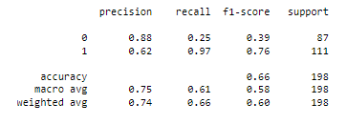
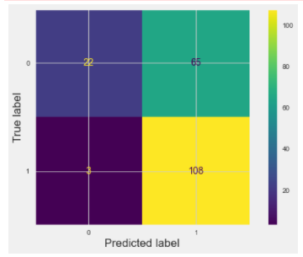
Modeling
Trading Strategy 1: Model with Alerts Feature
Logistic Model.
Added features
high_daily_%_change
volume_daily_%_change
low_daily_%_change
alert_daily_%_change
Dependent Variable
Change (Class 0 or 1)
Metric:
R-squared: 66%

Slide 15
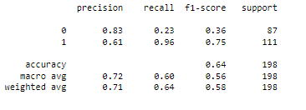
Modeling
Trading Strategy 1: Model using market data
Logistic Model.
Added features
high_daily_%_change
volume_daily_%_change
low_daily_%_change
Dependent Variable
Change (Class 0 or 1)
Metric:
R-squared: 64%

Slide 16
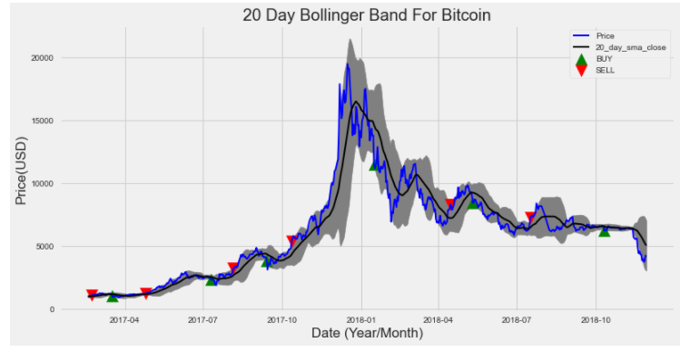
Modeling
. Trading Strategy #2:
Bollinger Band.
Indicators:
Buy or sell stocks

Slide 17
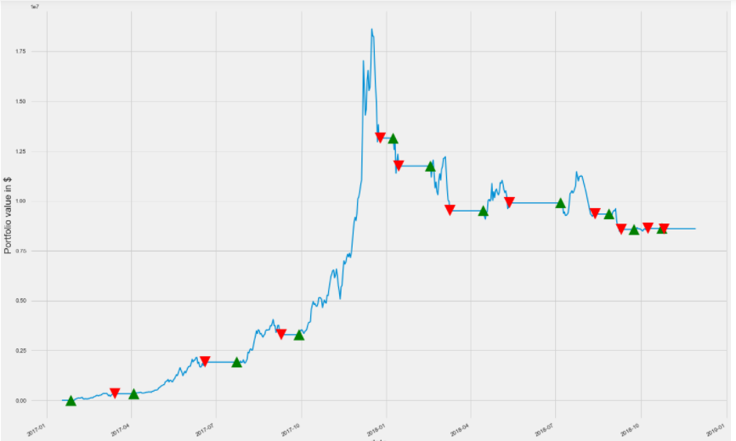
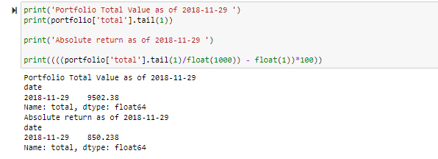
Results
Quantified Automated Trading Performance
Indicators:
Buy or sell stocks

Slide 18

Conclusion
Logistic and linear regression model were evaluated to predict when to buy/sell bitcoin
Logistic regression model with alert feature outperformed the linear regression with alert feature with 66% accuracy versus 36.5%
Other trading strategies that can lead bitcoin traders to the right path are:
bollinger bands
Z-score
the simple moving average crossover(SMAC)
Quantified Automated Trading Performance

