Slide 1
CAPSTONE 3: BITCOIN PRICE PREDICTION
AUTHOR: Akinkunle Akinola

Slide 2

Background
Top 10 cryptocurrencies are shown on the graph.
Average daily trading in the market is enormous especially for Bitcoin
Bitcoin seems to have the highest Market capitalization which is why it is the focus in this project.
Top Ten Cryptocurrencies Chart - Bing

Slide 3
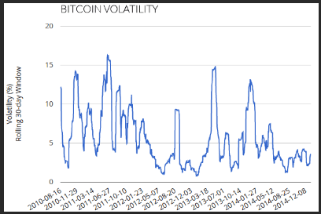
Background
price volatility bitcoin - Bing images
Cryptocurrencies Downfalls:
Price volatility.
Inability to predict the price.
Instability of the price trend.
Traders may lose money if not trade carefully

Slide 4

Goals
bitcoin better decisions - Bing images
Use a recurrent neural network-LSTM model to predict the price of Bitcoin over a period
Build an LSTM and evaluate its performance on 60 mins and 30 mins simple moving average of an absolute change.
Use the mean squared error and mean absolute error to evaluate its performance.

Slide 5
DATASETS
bitcoin better decisions - Bing images
Market data:
kaggle market data was used
Observations: 2283519, Features: 8
Has rows of 1-minute observations between 2015/10/08 and 2020/04/09 .

Slide 6
Data Cleaning
Missing values were dropped.
Date column was converted to datetime.

Slide 7
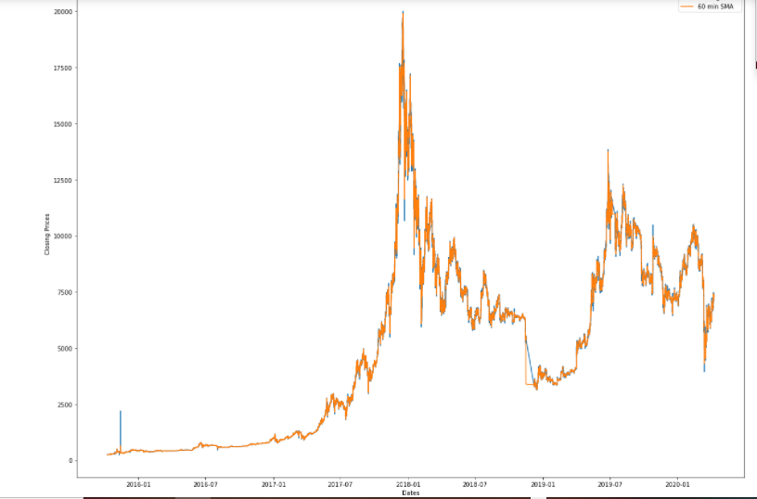
Exploratory Data Analysis
Visualizing the price at the minute level.
Notice the intensity of the price volatility.

Slide 8
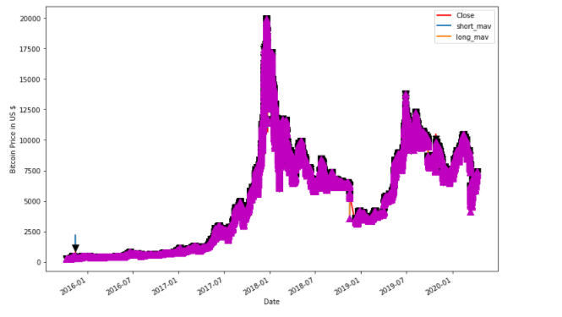
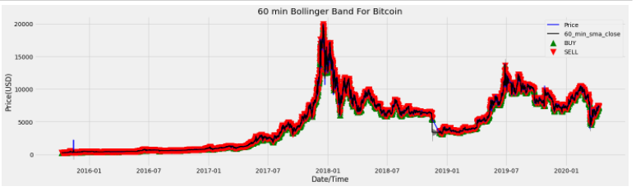
Exploratory Data Analysis
Both graphs showing the Bollinger bands of Bitcoin.

Slide 9
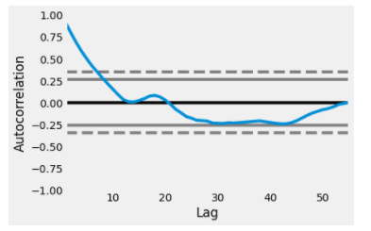
EXPLORATORY DATA ANALYSIS
From the Autocorrelation plot, about more than 50% of the data line shows a significant correlation with time.

Slide 10
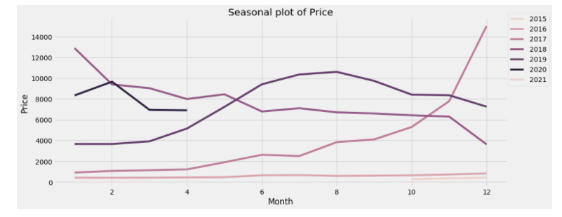
EXPLORATORY DATA ANALYSIS
There seems to be high bitcoin price after the month of June then a slight drop.
And other years except for 2020 and 2015.
In 2017, there was an upward trend in price.

Slide 11
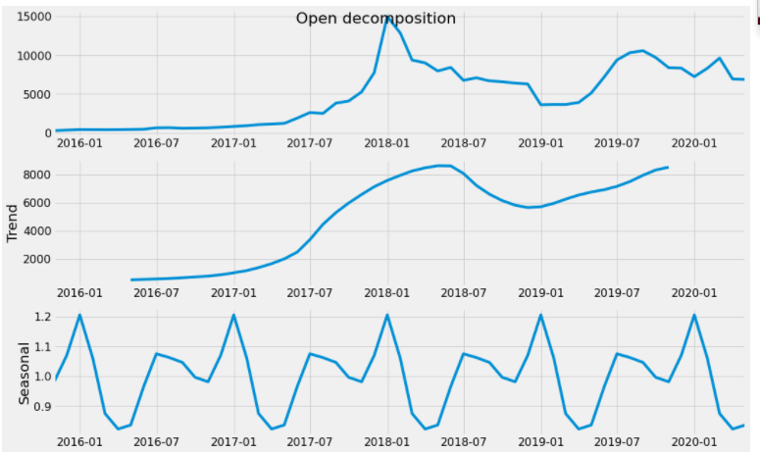
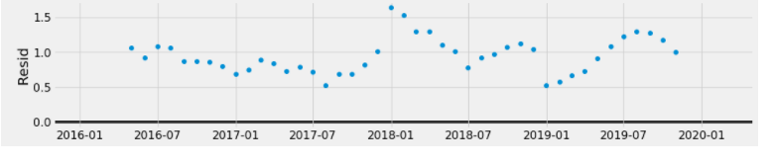
EXPLORATORY DATA ANALYSIS
Trend, Seasonal, and Residual plots to show the recurring variations
Shows the ups and downs of time-series data, pattern across the season and the residual.

Slide 12
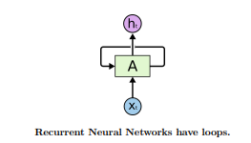
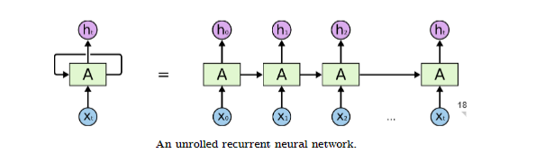
Modeling
Long Short Term Memory
A recurrent neural network (RNN)model called Long Short Term Memory (LSTM) was used for bitcoin price prediction
LSTMs are explicitly designed to avoid the problem of long-term dependency.

Slide 13


Modeling
LSTM Model with 60 minutes SMA of Absolute change
Added features:
60-minute SMA of absolute change of absolute change of Open, Close, Low, High, and Volume
LSTM Model with 30 minutes SMA of Absolute change
Added features:
30-minute SMA of absolute change of absolute change of Open, Close, Low, High, and Volume

Slide 14
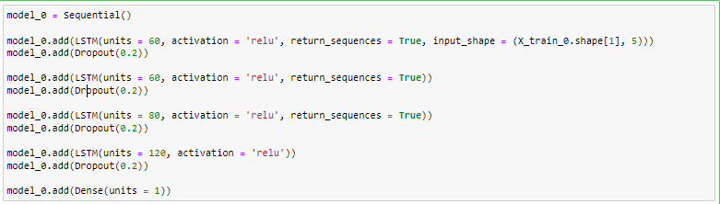
Modeling
The model was trained on a 30-min and 60-min SMA of absolute change of absolute change .
A relu activation function was used and an input shape of 5.
Adam optimizer was used.

Slide 15
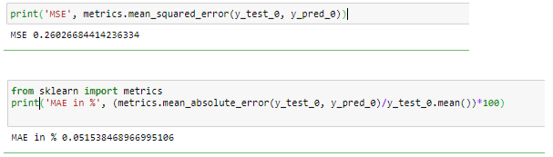

Results
60 min SMA model
The mean absolute error indicates that we are deviating from the mean at about 0.05% when predicting the price at 60 minutes moving average of absolute change.
MSE : 0.26
30 min SMA model
The mean absolute error indicates that we are deviating from the mean at about 0.03% when predicting the price at 30 minutes moving average of absolute change.
MSE:0.0000034

Slide 16

Conclusion
The results above show the mean square error and mean absolute error of 30 minutes and 60 minutes moving average of absolute change.
Even though the LSTM performs better, there are lots of factors that might have affected the model such as the number of layers in the model, neurons in each layer, and the number of epochs trained.

