Slide 1
Classification of Stability of Power Systems using deep learning models
AASD 4016 Full Stack Data Science Systems
Prof. Vejey Gandyer
Group Members:
Jose Anicio Pereira Junior ID: 101506160 Himanshu Kakkar ID:101510716 Mansour Salari ID: 101519350
Aug 16, 2024

Slide 2
Agenda
Problem
Significance
Past projects
Methodology – ML Canvas
Model Benchmarking
Model Deployment
Demo
Q&A

Slide 3
Problem Statement
Objective: Develop a RNN model to classify the transient stability of power systems after fault conditions.
Challenge: Traditional methods for stability assessment are slow and unsuitable for real-time applications.
Need: There is a need for a fast and accurate model that can predict system stability immediately following fault clearance.
Approach: Utilize RNNs to analyze time-series data, focusing on multiple time frames after the fault to detect instability quickly.

Slide 4
Why this problem
Critical Impact: Power system instability can lead to widespread blackouts and significant damage to equipment.
Real-Time Needs: Operators require rapid and accurate tools for stability assessment to ensure the reliability of the power grid.
Limitations of Existing Methods: Traditional stability assessment methods are often too complex and time-consuming for real-time use.
Advancement Potential: A RNN-based approach offers the potential for faster and more accurate stability detection, enhancing the security and efficiency of power systems.

Slide 5
Literature Review
Past Available Projects
Focus: Traditional methods (SVM, Decision Trees, simple neural networks) for power system stability classification.
Examples: SVM on IEEE bus systems, Decision Tree-based stability analysis.
Similar Projects
Focus: Deep learning models like CNNs and RNNs for stability prediction using time-series data.
Examples: CNNs for real-time stability assessment, LSTM-CNN hybrids for enhanced prediction.
Drawbacks
Complexity: High model complexity can hinder interpretability and real-time deployment.
Computational Demands: Significant resources needed, limiting practicality.
Data Dependency: Model performance is heavily reliant on data quality and quantity.
Latency: Some models may not meet real-time requirements, causing delays.
Overfitting Risk: Complex models may overfit, leading to poor generalization.

Slide 6
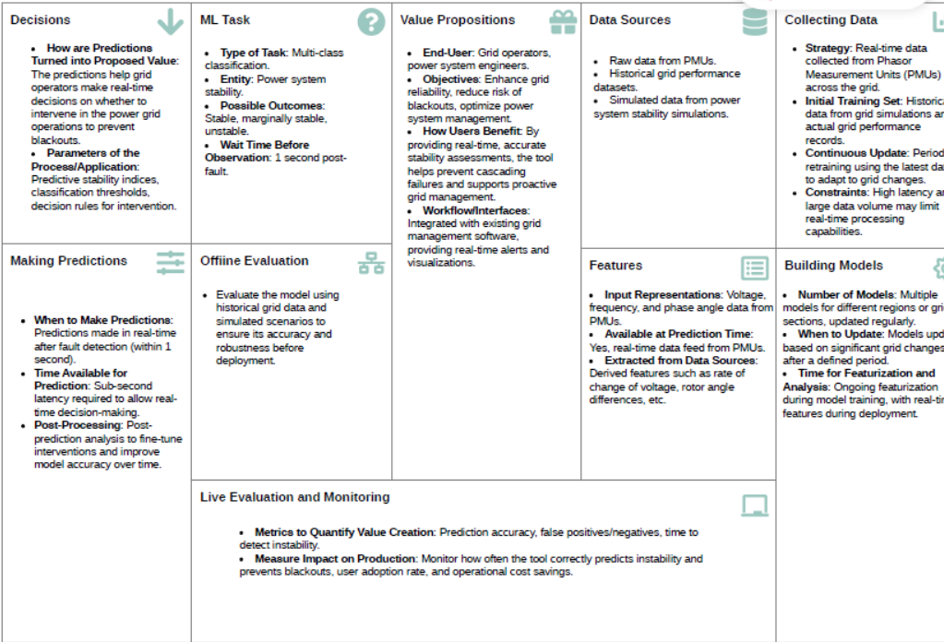
ML Canvas

Slide 7
Model Benchmarking
Time-Domain Simulation: Traditional method using detailed physical simulations for stability assessment.
Support Vector Machines (SVM): A popular AI-based approach for classification tasks in power systems.
FRecurrent Neural Networks (RNN): AI model that captures temporal dependencies, often used for time-series data.

Slide 8
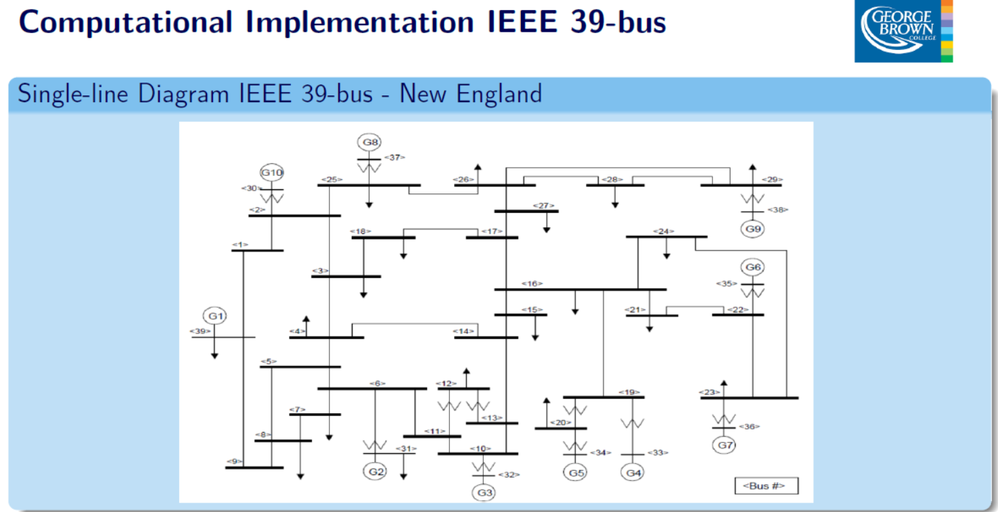

Slide 9
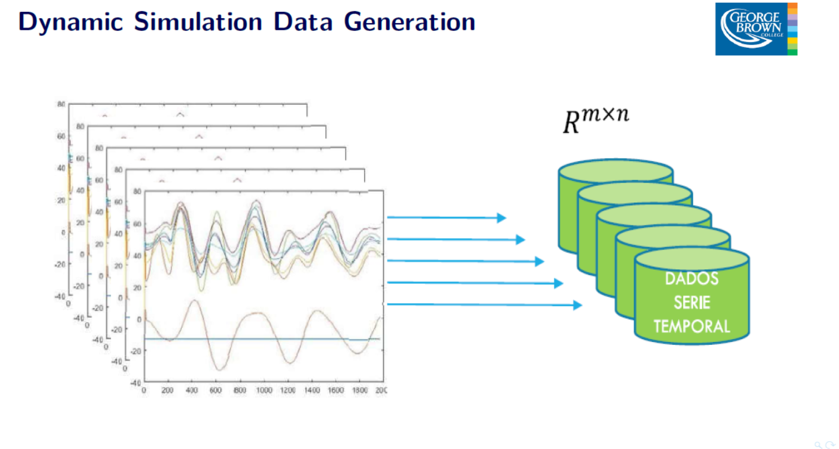

Slide 10
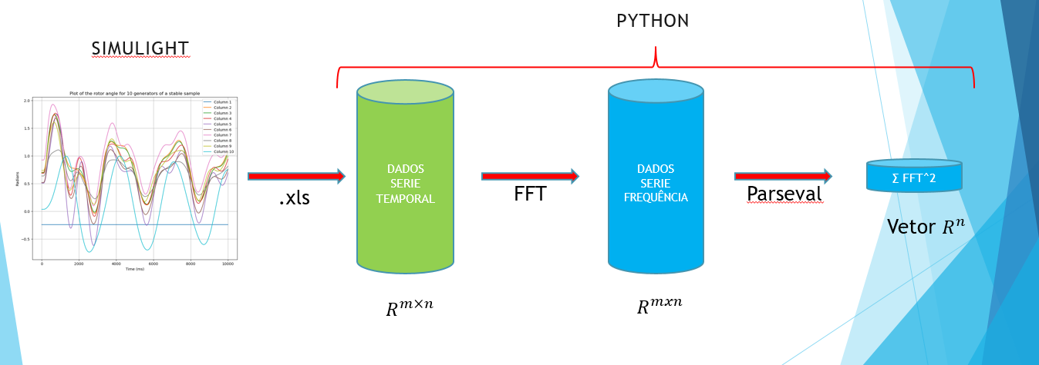

Slide 11
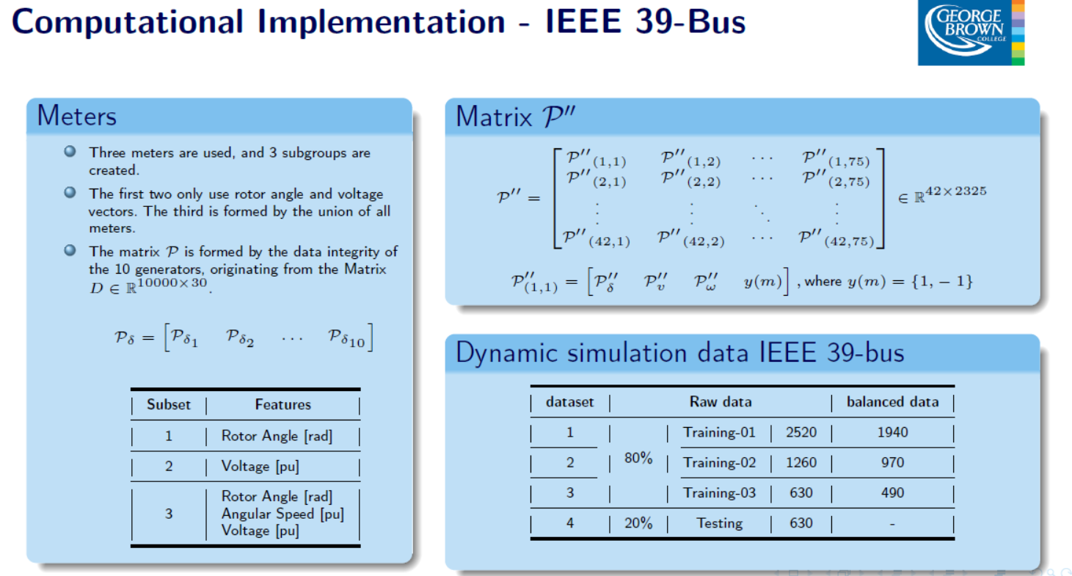

Slide 12
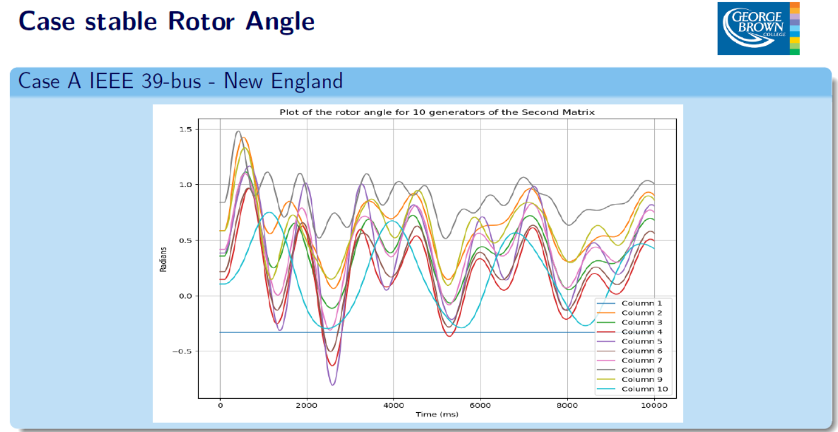

Slide 13
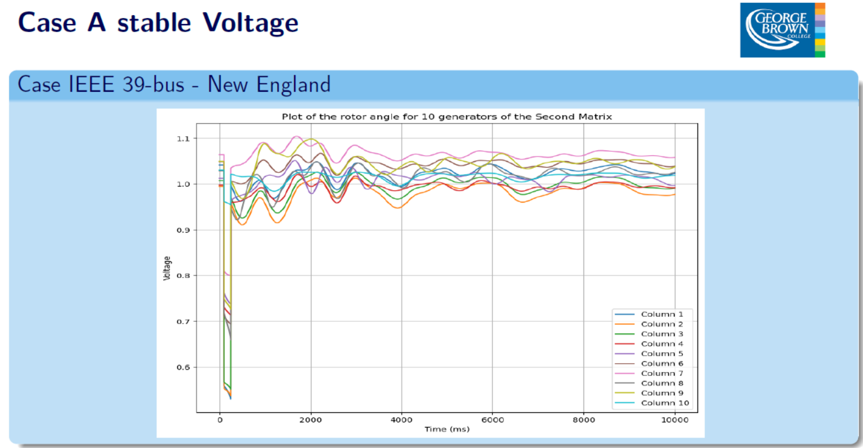

Slide 14
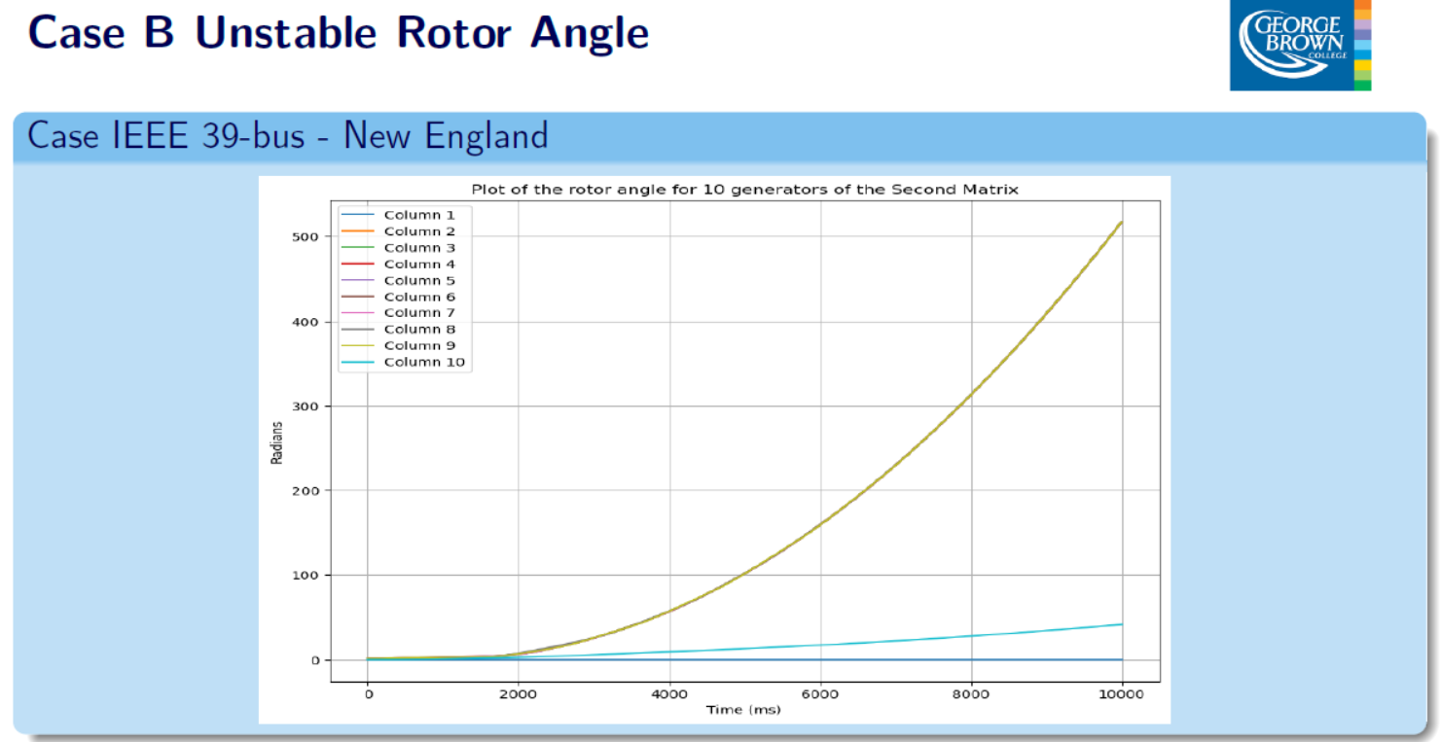

Slide 15
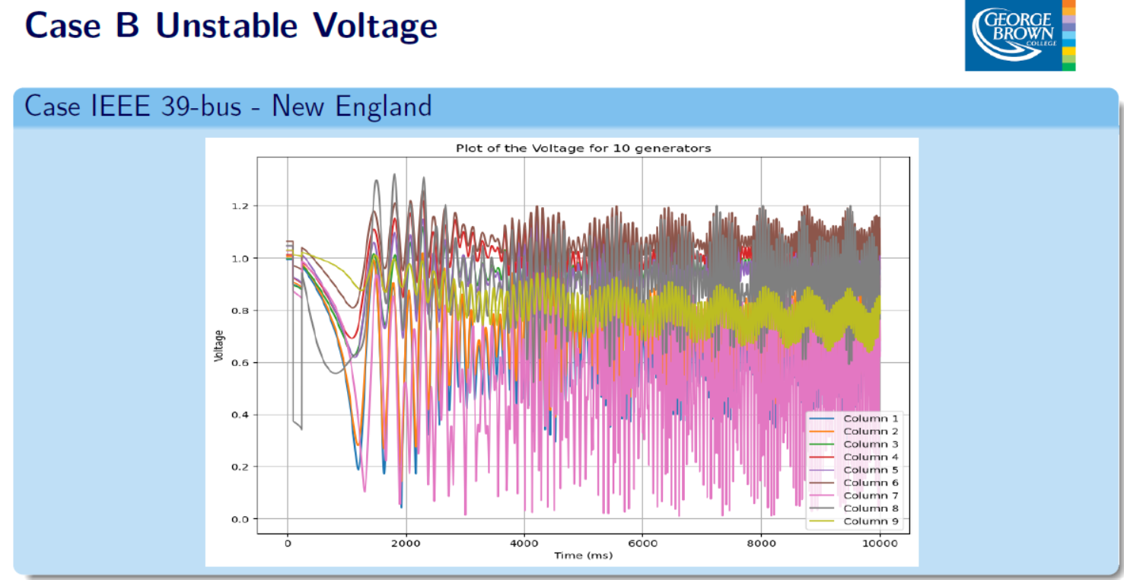

Slide 16
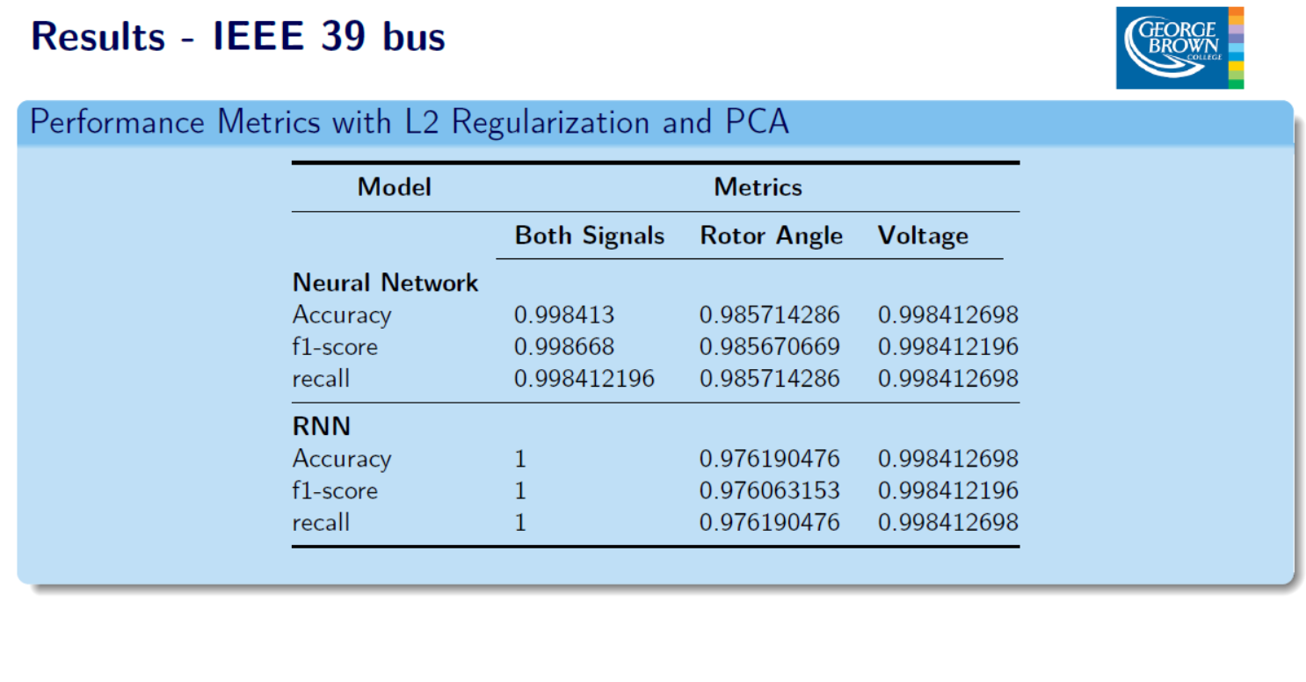

Slide 17
Challenges & Issues encountered
1. Obtaining a Real Dataset
Challenges:
Data Availability: Securing a dataset that is representative of real-world scenarios can be difficult.
Data Privacy: For domains involving personal or sensitive information, there are legal and ethical considerations, including compliance with regulations like GDPR or HIPAA.
Implications:
Model Performance: Poor quality or insufficient data can lead to models that are overfitted or underfitted, affecting their accuracy and reliability.
Cost and Time: Gathering and cleaning high-quality data can be time-consuming and expensive, impacting the overall project timeline.
2. Getting Real Results
Challenges:
Benchmarking: Evaluating the model’s performance against real-world benchmarks can be difficult. Synthetic or simulated data may not perfectly replicate real-world conditions, leading to discrepancies between training and actual performance.
Deployment Context: The model’s performance in a development or testing environment may not reflect its performance in a production setting due to differences in data distribution or environmental factors.
Implications:
Validation Issues: Real-world validation is crucial to ensure that the model performs well in practical scenarios, but achieving this can be challenging and resource-intensive.
User Feedback: Gathering and interpreting user feedback on model performance can be complex, particularly if the results are subjective or influenced by external factors.
3. Modeling Difficulties
Challenges:
Algorithm Selection: Choosing the right machine learning algorithm and tuning its parameters can be challenging. Different algorithms have different strengths and weaknesses depending on the nature of the data and the problem.

Slide 18
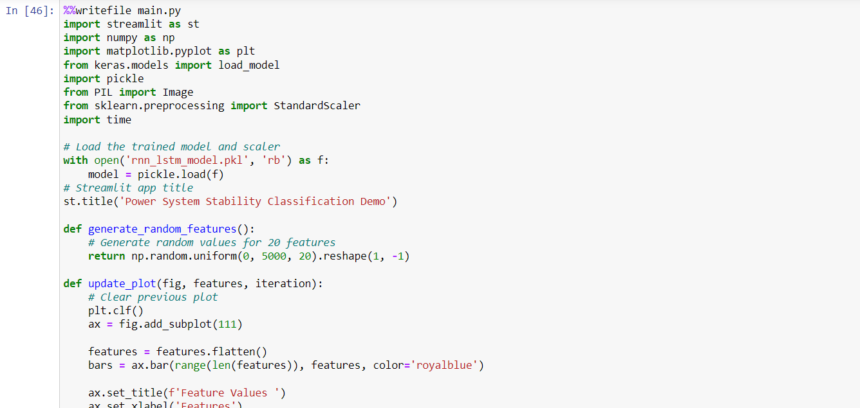
Model Deployment
1. Converting Jupyter Notebook to Script
Objective:
Transform your notebook-based code into a Python script suitable for production.
Steps:
Extract Code: Copy the core logic from your Jupyter Notebook, including data preprocessing, model training, and evaluation.
Modularize Code: Refactor the notebook code into functions or classes for better organization.
Handle File Paths and Parameters: Ensure paths and parameters are configurable, possibly via command-line arguments or configuration files.

Slide 19
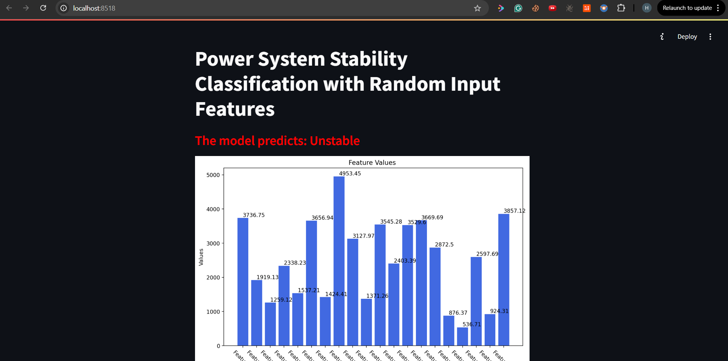
2. Developing the Web Application with Streamlit
Objective:
Create a user-friendly web interface for your model using Streamlit.

Slide 20
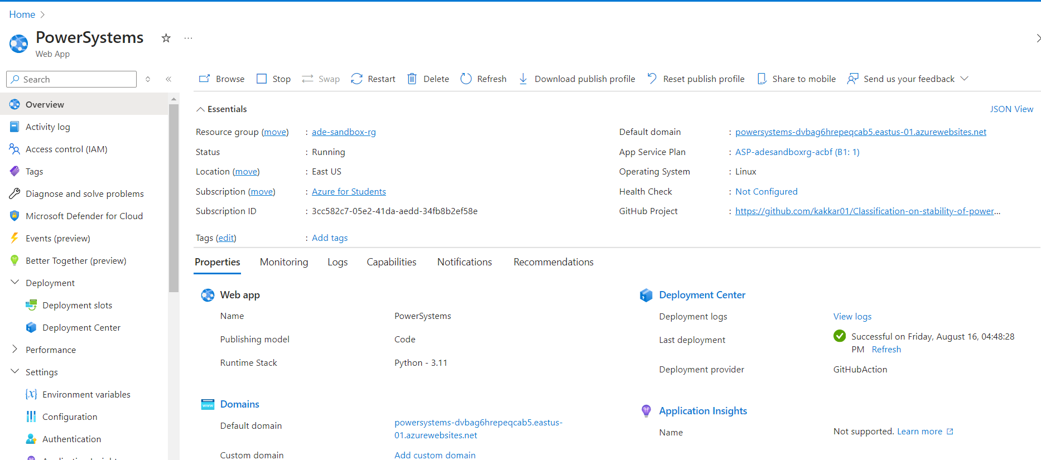
Deploying to Azure
Objective:
Deploy your Dockerized application to Azure for public access.
Steps:
Set Up Azure Resources:
Create an Azure Container Registry: Store your Docker images.
Create an Azure App Service or Azure Kubernetes Service: Host your containerized application.

Slide 21
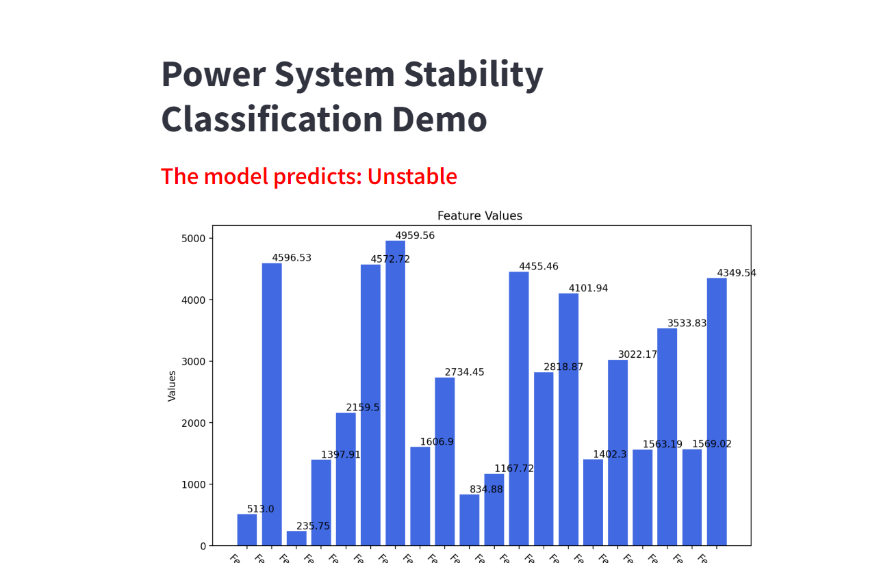
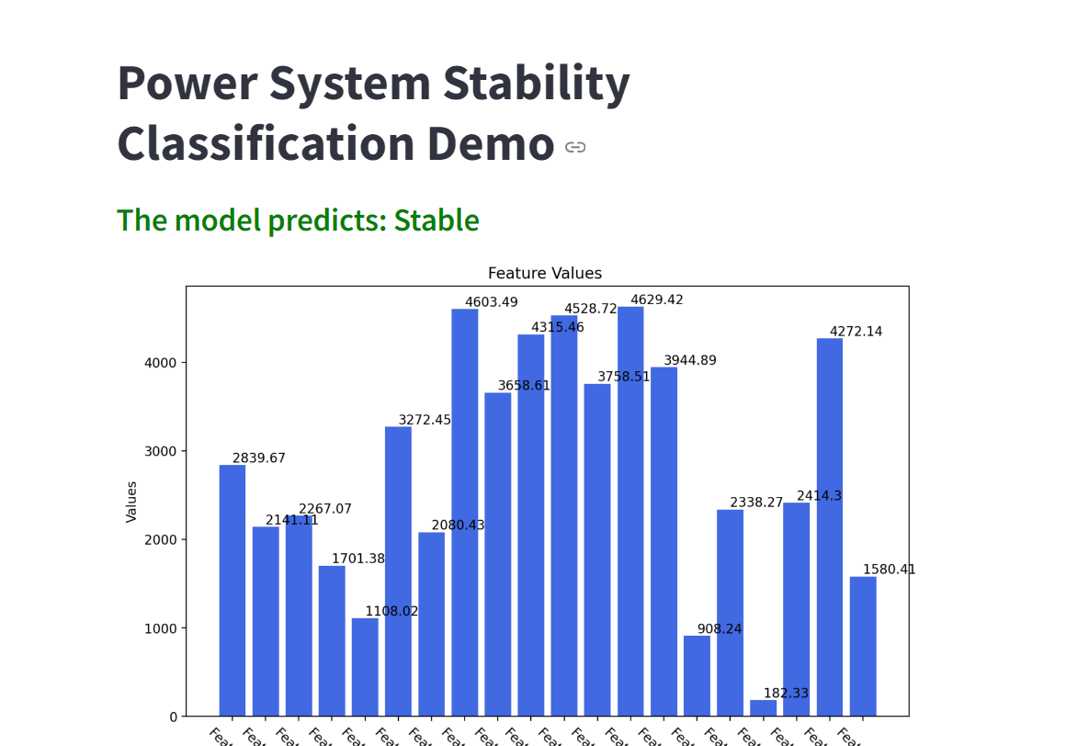
Demo

