Slide 1

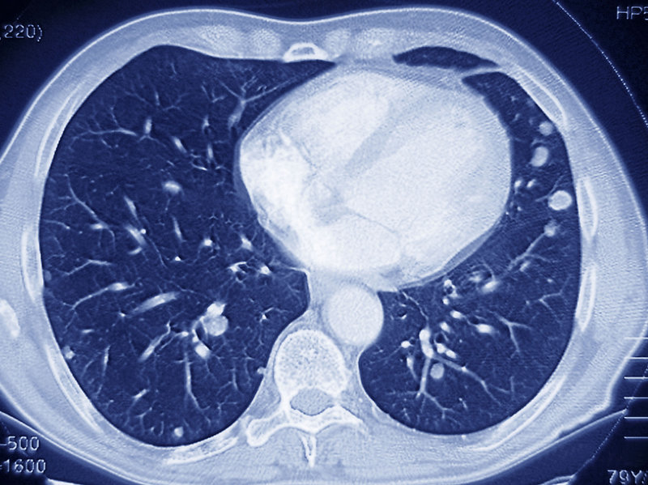
A novel binary feature descriptor to discriminate normal and abnormal chest CT images

Slide 2
THE PROJECT IS DIVIDED INTO TASKS INCLUDING
TASK 1:
1.Identify type of noise
2.Input, Grayscale and Noise removal
TASK2:
1.Converting the Greyscale Image to a Binary Image
2.Create a morphological structuring element (STREL)
3.Inversion of the Opened Image
4.Creating an initial Contour and implementing segmentation
TASK 3:
1.Combination Image and Find Circles
2.Segment cirlces

Slide 3
IDENTIFY TYPE OF NOISE
This noise throughout most of these images is reffered to as salt pepper noise
this type of noise consists of certain amounts of the pixels in the image either being black or white.
the most common method of removing such noise is known to be through a median filter.

Slide 4
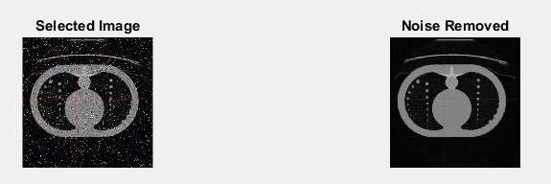

Slide 5
Input, Grayscale and Noise removal
In initial image, amount of noise present is very high which needs to be removed
removal of any noise within the images inputted into the program.
First step to this task was to read the image into the program
“Selected_Image = imread(image_jpg);
This allows for the desired input images to be read,
then converted from RGB to grayscale using the rgb2gray function, this allows for the
removal of hue and saturated information while allowing for the ability to keep the images
desired luminance

Slide 6
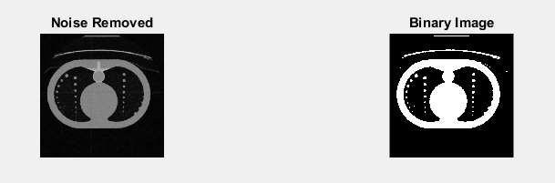

Slide 7
image is read and converted , then noise is removed.
The noise is removed using The median filter,
this is done through a separate function called “customfilter
The function applies a medium filter to the grayscale image, which then allows
or each outputted pixel to contain a medium value in the 3-by-3 region around the
corresponding pixels within the image.
After the noise has removed the image is then implemented into a subplot to output the
image with its corresponding input image,
this is done throughout the project to all later images implemented within the project,
an example of the noise removal and subplot is shown above

Slide 8
The Median Filter
follows a similar approach to that
of smoothing techniques, the technique of using corresponding pixels allows for the better
ability of the removal of noise without reducing the sharpness of an image therefore making
this the appropriate function to reduce the salt and pepper noise within the images for this
assignment using the medium filtering,

Slide 9
Worked 1D example
To demonstrate, using a window size of three with one entry immediately preceding and following each entry, a median filter will be applied to the following simple 1D signal:
x = (2, 3, 80, 6).
So, the median filtered output signal y will be:
y1 = med(2, 3, 80) = 3,
y2 = med(3, 80, 6) = med(3, 6, 80) = 6,
y3 = med(80, 6, 2) = med(2, 6, 80) = 6,
y4 = med(6, 2, 3) = med(2, 3, 6) = 3,
i.e. y = (3, 6, 6, 3).

Slide 10
2D median filter pseudo code
Code for a simple 2D median filter algorithm might look like this:
allocate outputPixelValue[image width][image height]
allocate window[window width * window height]
edgex := (window width / 2) rounded down
edgey := (window height / 2) rounded down
for x from edgex to image width - edgex
for y from edgey to image height - edgey
i = 0
for fx from 0 to window width
for fy from 0 to window height
window[i] := inputPixelValue[x + fx - edgex][y + fy - edgey]
i := i + 1
sort entries in window[]
outputPixelValue[x][y] := window[window width * window height / 2]

Slide 11
Converting the Greyscale Image to a Binary Image
The reason behind converting the image into a binary image is it allows for
the better ability to detect objects within an image (circles) the reason behind this is due to the fact now only two different colours exist within the image (black, white)
The image is converted into a binary image by using the im2bw function “binary_picture = im2bw(median_filtering_Image, 0.2);”
This function uses the filtered image as an input and
then converts the pixels within the image dependent upon the luminance level of each pixel to either the value 1 (white) or the value 0 (black).

Slide 12
Create a morphological structuring element (STREL)
This step involves creating a structuring element in the form of a rectangle “se1 = strel('disk',2);”
This specific function creates a flat disk shape structure where “2” specifies the radius.
This is done twice to create two separate structures which are applied to the initial binary image, creating two separate images “postOpenImage_1” and “postOpenImage_2”
Once these structures have been applied the first image is applied into the subplot and shown to the user while the other is saved for later image processing to help solve to problem in later stages.

Slide 13
Inversion of the Opened Image
This step involves the inversion of the binary image which is completed by simply using a ones function, this function basically creates an array of all ones, this is implemented to the binary image
“inverted = ones(size(binary_picture));”
“invertedImage_1 = inverted – postOpenImage_1;”
This line basically takes the inverted image with the array of ones and takes the Open image from this which in turn inverts the image by swapping all previous 0 pixels to 1 pixels and 1 pixels to 0, creating an inverted
image as shown below
.

Slide 14
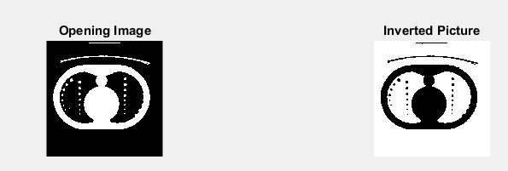

Slide 15
Creating an initial Contour and implementing segmentation
This step initially involves creating and specifying the initial contour
“mask = zeros (size(invertedImage_1)); mask (50: end-50, 50:end-50) = 1;”
The mask is a binary image that specifies the initial state of the active contour,
this involves the boundaries of the images regions in this case the white background and black regions outside the main part of the Image,
this all allows for contour evolution to occur to allow for segmentation of the imageto occur.
Once the image is segmented it will produce a more clear way of finding the circles within the lung as this means the foreground and background no longer cause an issues when attempting to find the circles as seen above in the screenshot.

Slide 16
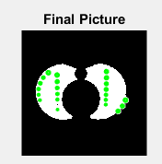

Slide 17
Combination Image and Find Circles
The next process required is to find the circles within the lung,
within this program the image is created using a combination of
the inverted image and contour segmentation
“mix_Image_1 =invertedImage_1 + bw_1;”
This creates an initial image that the circles can be found upon, from this the image is then converted into black and white using “im2bw”
then the final image uses the medium filter “medfilt2” to further filter the image to allow for the best possible ability to find any circles within the lung.

Slide 18
The main process within this step is now to find the circles this is done using the imfindcircles function
“[centers,radii] = imfindcircles(final_1,[19],'ObjectPolarity','dark','Sensitivity',0.88);
This function looks for dark sensitivity within the above image using the parameters of centres and radius with a sensitivity specification,from this the circles are then displayed using green circles
“viscircles(centers,radii,'EdgeColor','g'); “
After this is completed the image is then displayed as seen above in the screenshot with the circles all being highlighted in green.
The circles are also counted “display(size(centers, 1), ' Numbers of Circles');”
this allows for all circles found to have a centre to be counted and outputted into the command window.

Slide 19
Segment Circles
After the circles have been counted and found the circles need to be Segmented and then
detected.
This is done by firstly creating a segmented picture “segment_pic = final_2 -final_1;”
This is done by taking a picture without the circles located to a picture with the
circles located, therefore leading to an image with the circles totally segmented away from
the picture allowing for a precise way to find the boundaries of each circle
“[B] = (prebwboundaries _colour_pic,'holes');“
This code basically finds all circles within the image and the boundaries and
then colours each circle with a fill of green to identify they have been found as seen in the screenshot above.
Therefore solving all problems indicated within the brief as the circles have been counted found and all noise has been removed.

Slide 20
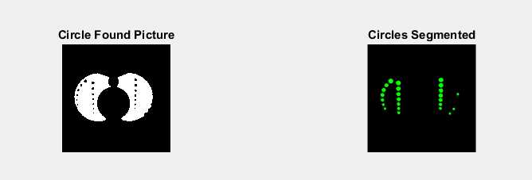

Slide 21
References
Bovik, A. (2009) The essential guide to image processing. [Online] Available from:
http://links.uwaterloo.ca/amath391w13docs/bovik_image_processing.pdf [Accessed
13/10/2019]
Matlab (2019) Remove Salt and Pepper Noise from Images. [Online]
Available from: http://uk.mathworks.com/help/vision/ug/remove-salt-and-
pepper-noise-from- images.html?refresh=true [Accessed 13/10/2019]

Slide 22
Submitted by:
Abhishek Singh 401703002
Mallika Pushkarna 401703013
Pranav Kakkar 401703019
Arantish Singh 401883001

