Slide 1
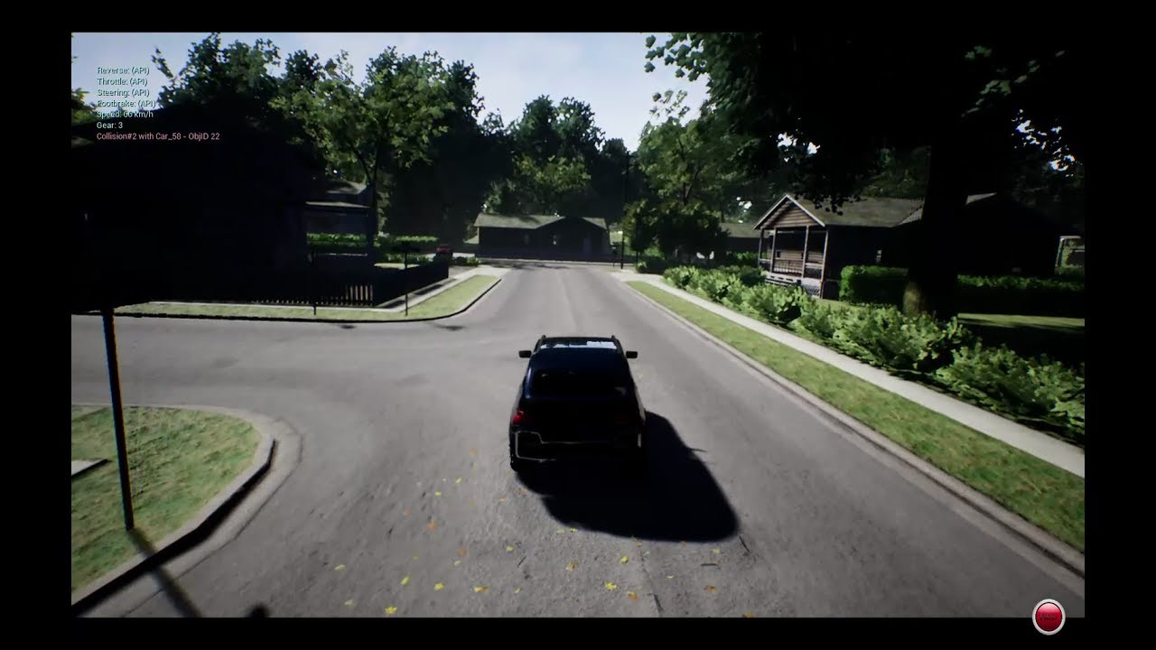
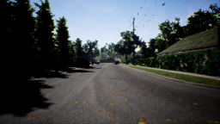
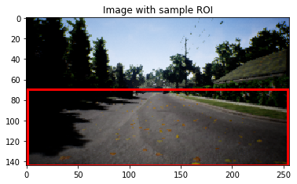
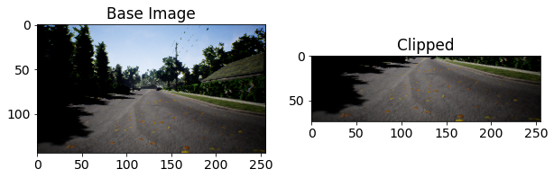
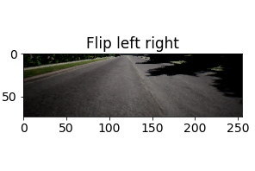
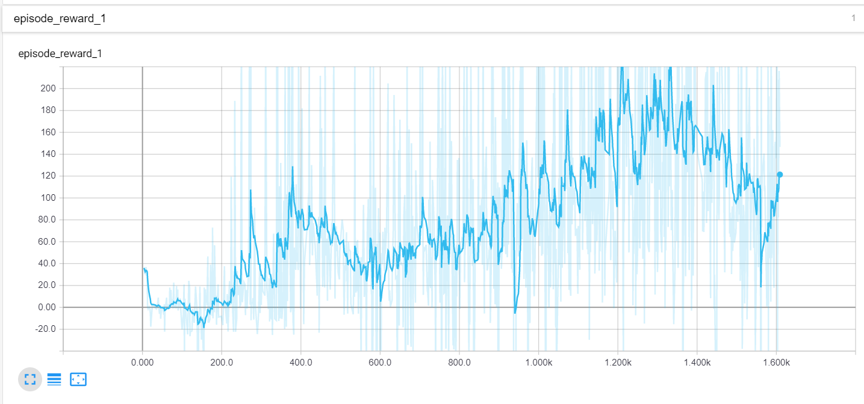
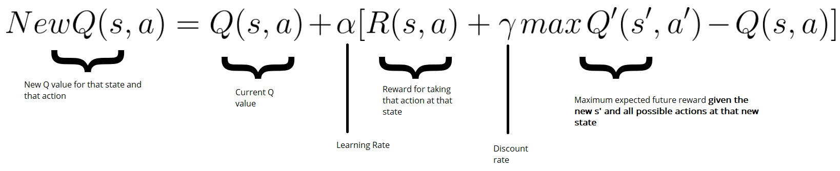
Deep RL in AirSim Simulator
Debayan Sen, Anupam Kakkar
AirSim Neighborhood Environment
AirSim is a simulator built on Unreal Engine and can be used for drones, cars and more.
Manual drive mode – use keyboard to control the car.
Programmatic control – use AirSim’s APIs to programmatically interact with the car.
NH Environment – small urban neighbourhood block.
Task – to navigate around the block & avoid obstacles.
Approach 1 – Imitation Learning
Manually collect training data and include data for normal driving as well as swerve driving pattern.
Extract “region of interest” from collected data during pre-processing. (from 144x256 pixels to 74x255 pixels)
Augment the data with images flipped along the y-axis, as the dataset exhibits vertical flip tolerance.
Formulate the problem as a regression task using CNN.
Predict the steering angle of the vehicle during test run.
Approach 2 – Deep Q-Learning
Implemented Deep Q-Learning network with a target network following Greedy Policy and a behavioural network following Epsilon-Greedy Policy.
Helpful implementation strategies – using frame skip, frame history, and an experience replay buffer.
Designed a simple additive reward function that encourages forward movement and discourages collision and frequent braking.
Used a 3-layer CNN network as a function approximator.
Network training time requires more than 20 hours of training.
Notes:
1

