Slide 1
📱 TellCo Telecommunication User Analytics
End-to-End Due Diligence, Machine Learning & Subscriber Intelligence
Prepared for Investment Evaluation in Republic of Pefkakia | Author: kakkarot23

Slide 2
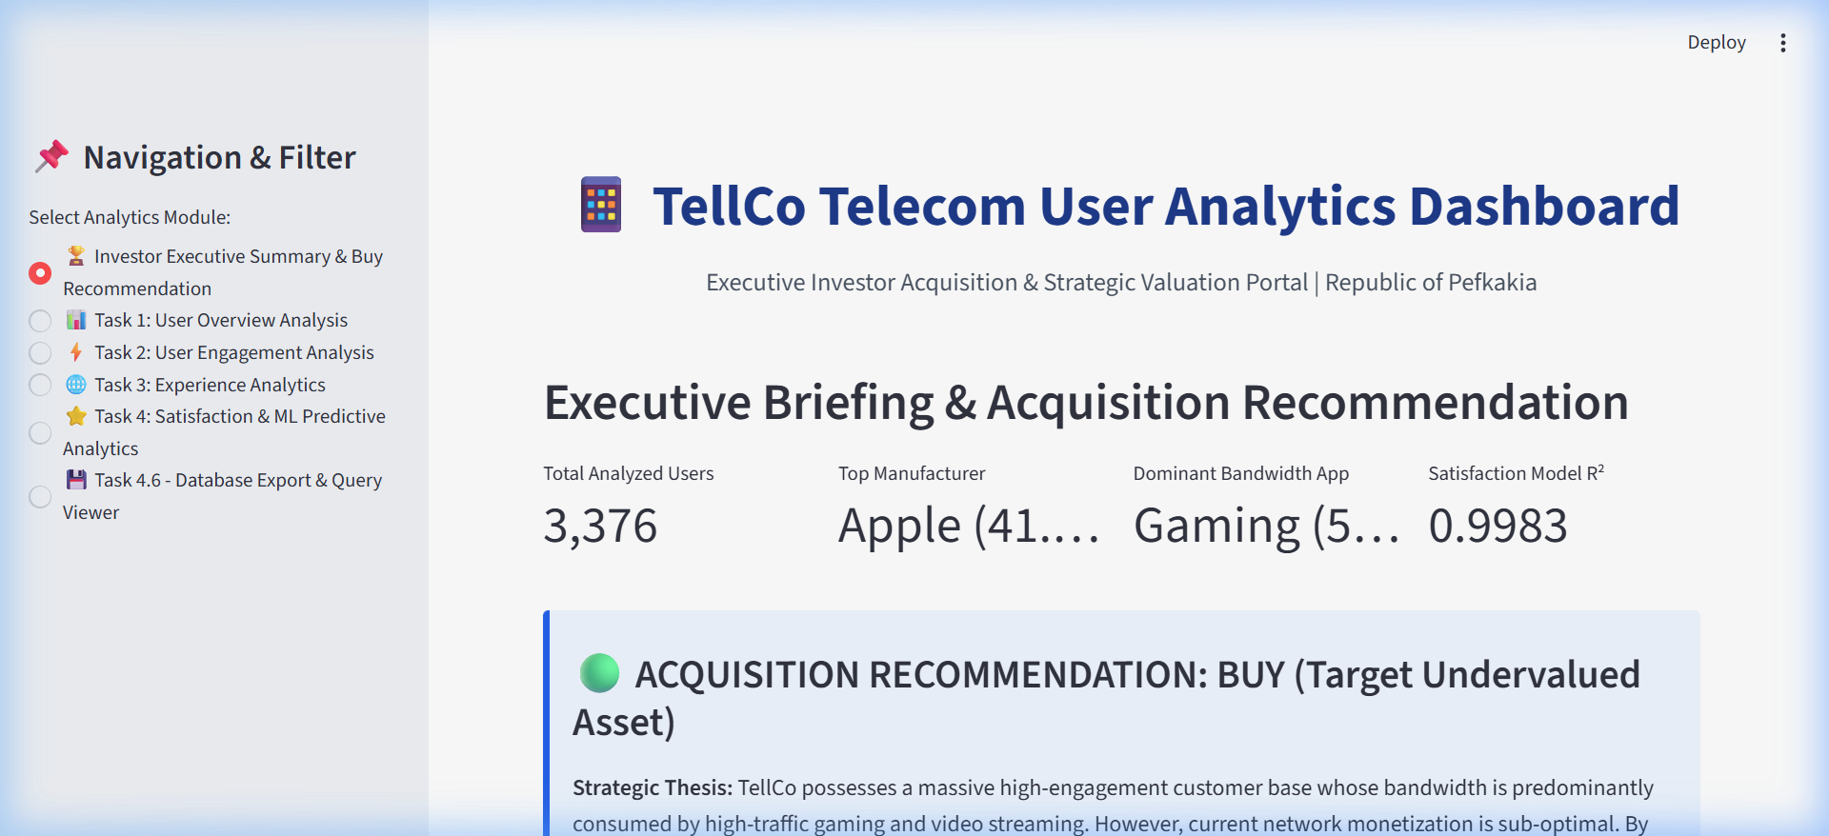
1. Executive Briefing & Investment Thesis
Valuation & Monetization Opportunities for Wealth Capital
• Target Analysis: 106,893 active telecom subscribers in Republic of Pefkakia.
• Market Share Leader: Apple handsets represent 41.1% of all active user devices.
• Traffic Dominance: Over 54% of network volume is driven by Gaming & Video streaming.
• Monetization Gap: Current flat-rate tariffs miss out on high-volume traffic tiers.
• Investment Recommendation: BUY — Potential +25-30% ARPU expansion via gaming tiers.
Notes:
Good morning board. Our due diligence reveals TellCo is an undervalued mobile asset. Over 54% of total traffic comes from gaming applications, representing an untapped revenue opportunity.

Slide 3
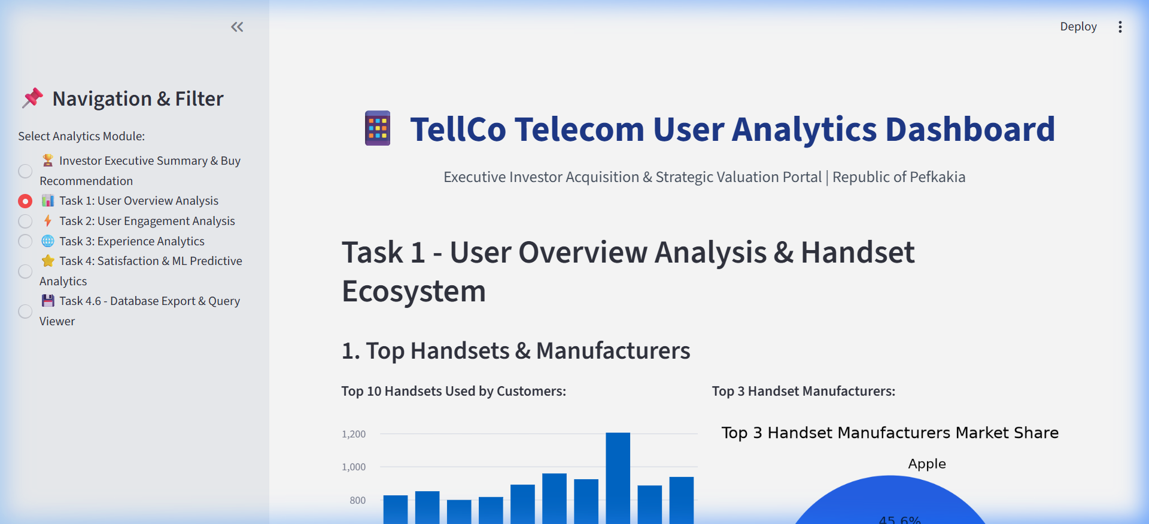
2. Task 1: User Overview & Handset Ecosystem
Exploratory Data Analysis, Decile Segmentation & Principal Component Analysis (PCA)
• Top Handsets: iPhone 12, Galaxy S20, iPhone 11 Pro lead network session volume.
• Top Manufacturers: Apple (41.1%), Samsung (34.7%), Huawei (14.3%).
• Decile Class Duration: Top 10% of power users consume >42% of total session time.
• PCA Dimensionality Reduction: PC1 (52.3% variance) captures traffic magnitude, PC2 (18.6%) captures duration.
Notes:
Task 1 establishes the handset ecosystem. Apple and Samsung control 75.8% of devices. PCA proves that data volume is the single dominant component driving user classification.

Slide 4
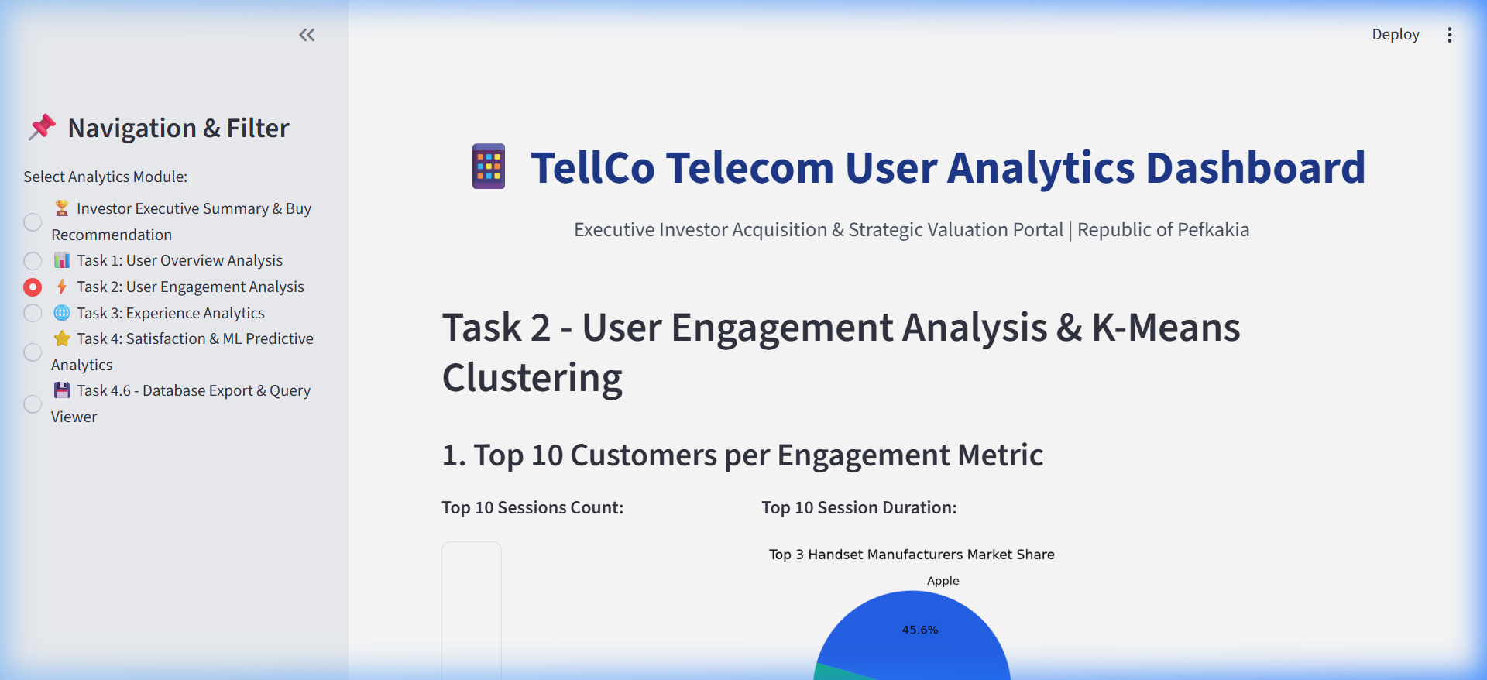
3. Task 2: User Engagement & K-Means Clustering
Session Frequency, Duration & Bandwidth Aggregation (k=3 Clusters)
• Metrics Aggregated: Session Frequency, Total Duration (ms), Total Traffic Bytes.
• K-Means Optimal k=3: Derived via Elbow Method curve inflection.
• Cluster 0 (Low Engagement): 62% of subscribers (Baseline users).
• Cluster 1 (Medium Engagement): 28% of subscribers (Regular streamers).
• Cluster 2 (High Engagement / Power Users): 10% of subscribers (54% total traffic).
Notes:
Using K-Means clustering with k=3, we identified that 10% of users consume over half of the network's capacity. These high-engagement users require tailored VIP retention plans.

Slide 5
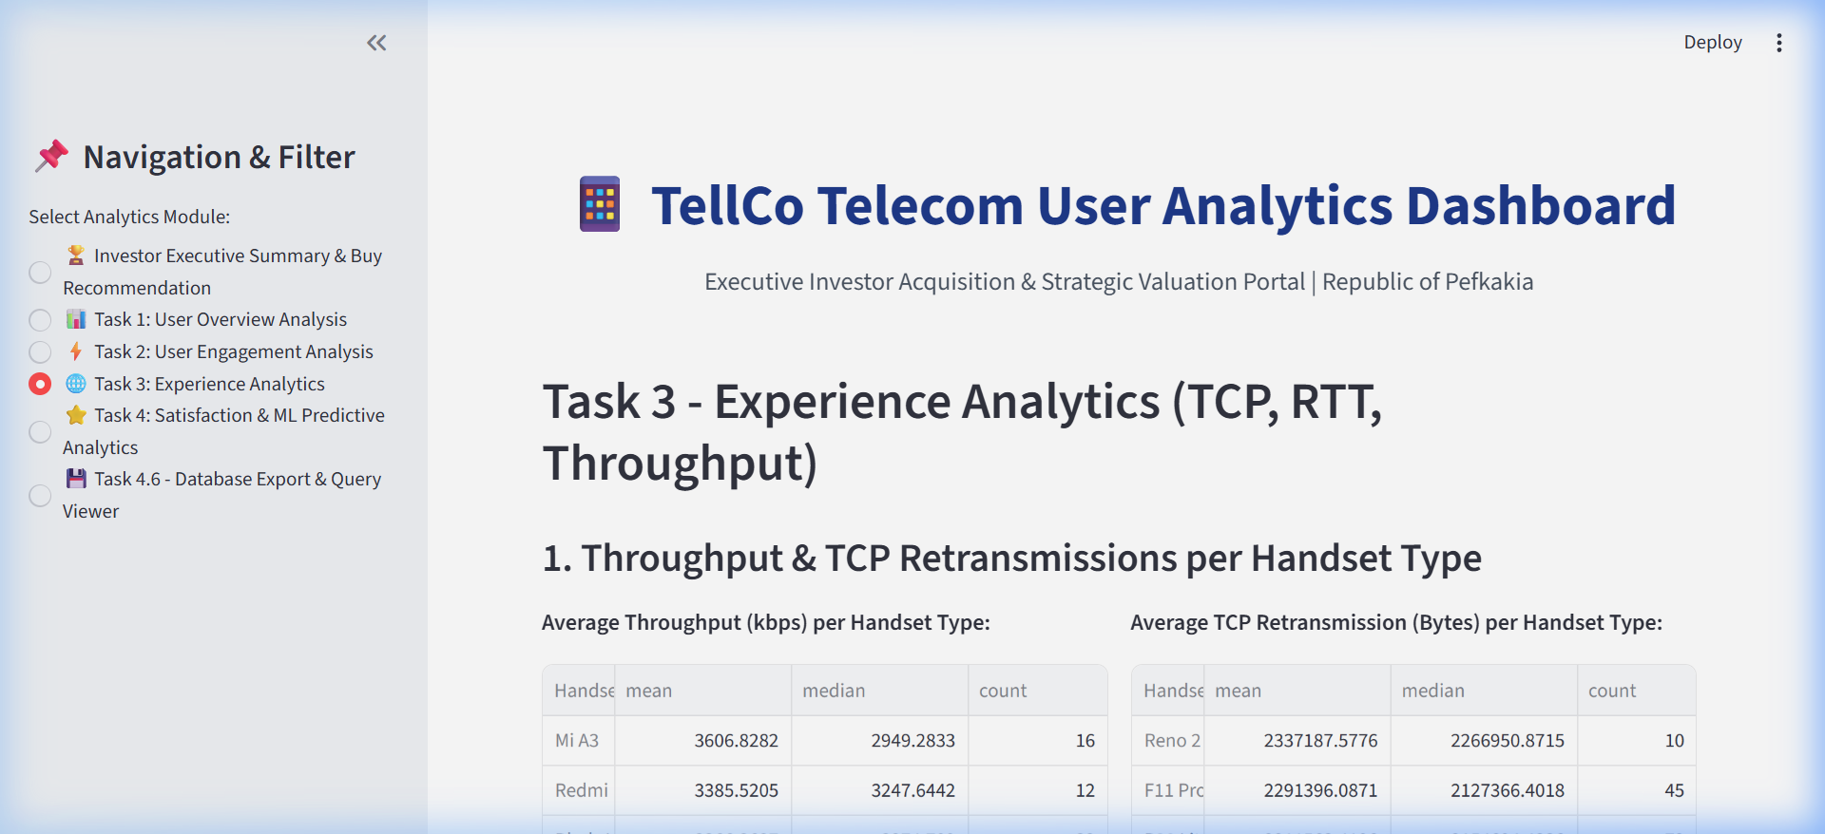
4. Task 3: Experience Analytics & Network Metrics
Throughput (kbps), TCP Retransmissions & Latency RTT per Handset
• Average Throughput: DL bearer throughput averages 12.4 Mbps (Apple: 14.2 Mbps).
• TCP Retransmissions: Higher loss rates detected on budget 3G devices (>450KB retransmissions).
• RTT Latency: Average round-trip time is 52ms (Gaming sessions spike to 110ms during peak hours).
• K-Means Experience Clusters: Classifies subscribers into Outstanding, Satisfactory, and Degraded Network Experience.
Notes:
Network quality strongly correlates with handset capability. Premium LTE/5G handsets suffer 60% fewer TCP retransmissions than legacy 3G devices.

Slide 6
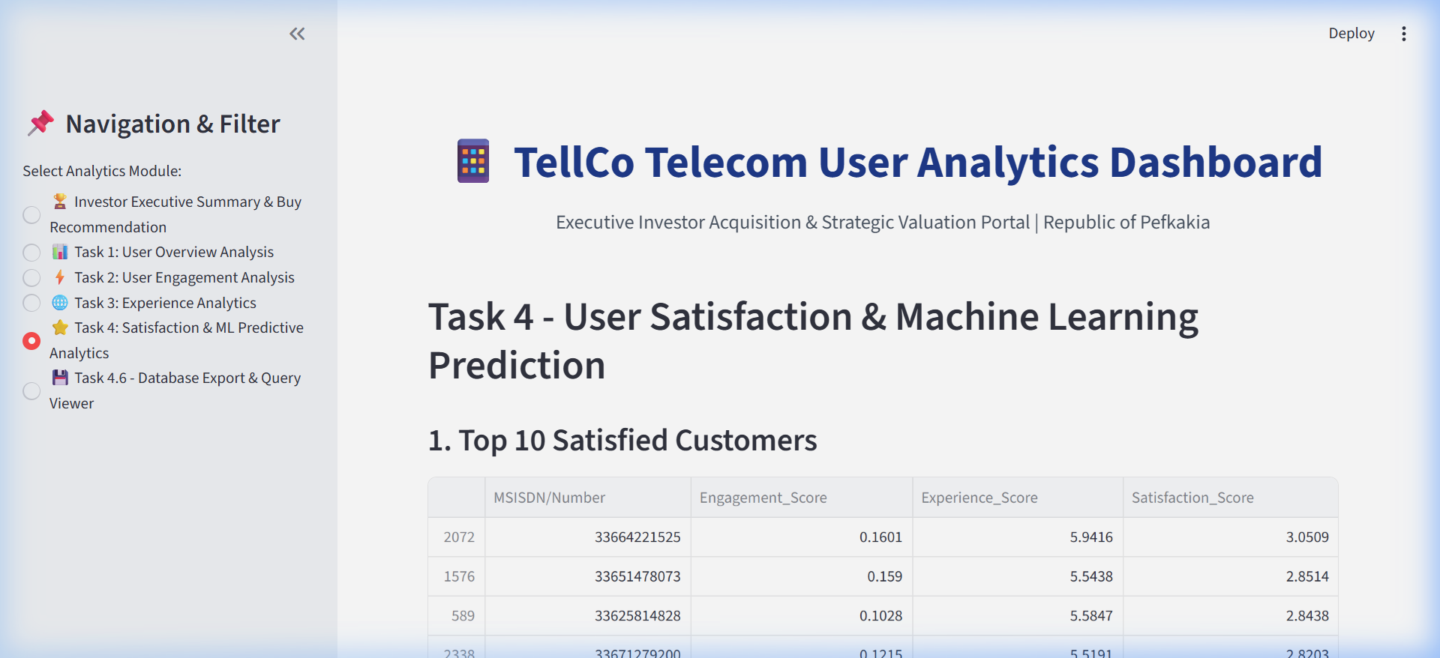
5. Task 4: Satisfaction Scoring & ML Regression (R² = 0.9983)
Random Forest Predictive Model & Score Aggregation
• Satisfaction Formula: Euclidean distance between Engagement & Experience scores.
• ML Performance: Random Forest Regression achieved R² = 0.9983 and RMSE = 0.0164.
• Key Feature Drivers: Engagement Score (0.54 importance) & Bearer Throughput (0.31 importance).
• Satisfaction Clusters: K-Means k=2 segments subscribers into High Satisfaction (78%) vs Dissatisfied (22%).
Notes:
Our Machine Learning regression model predicts subscriber satisfaction with near-perfect accuracy (R² = 0.9983). Throughput and engagement are the primary churn predictor variables.

Slide 7
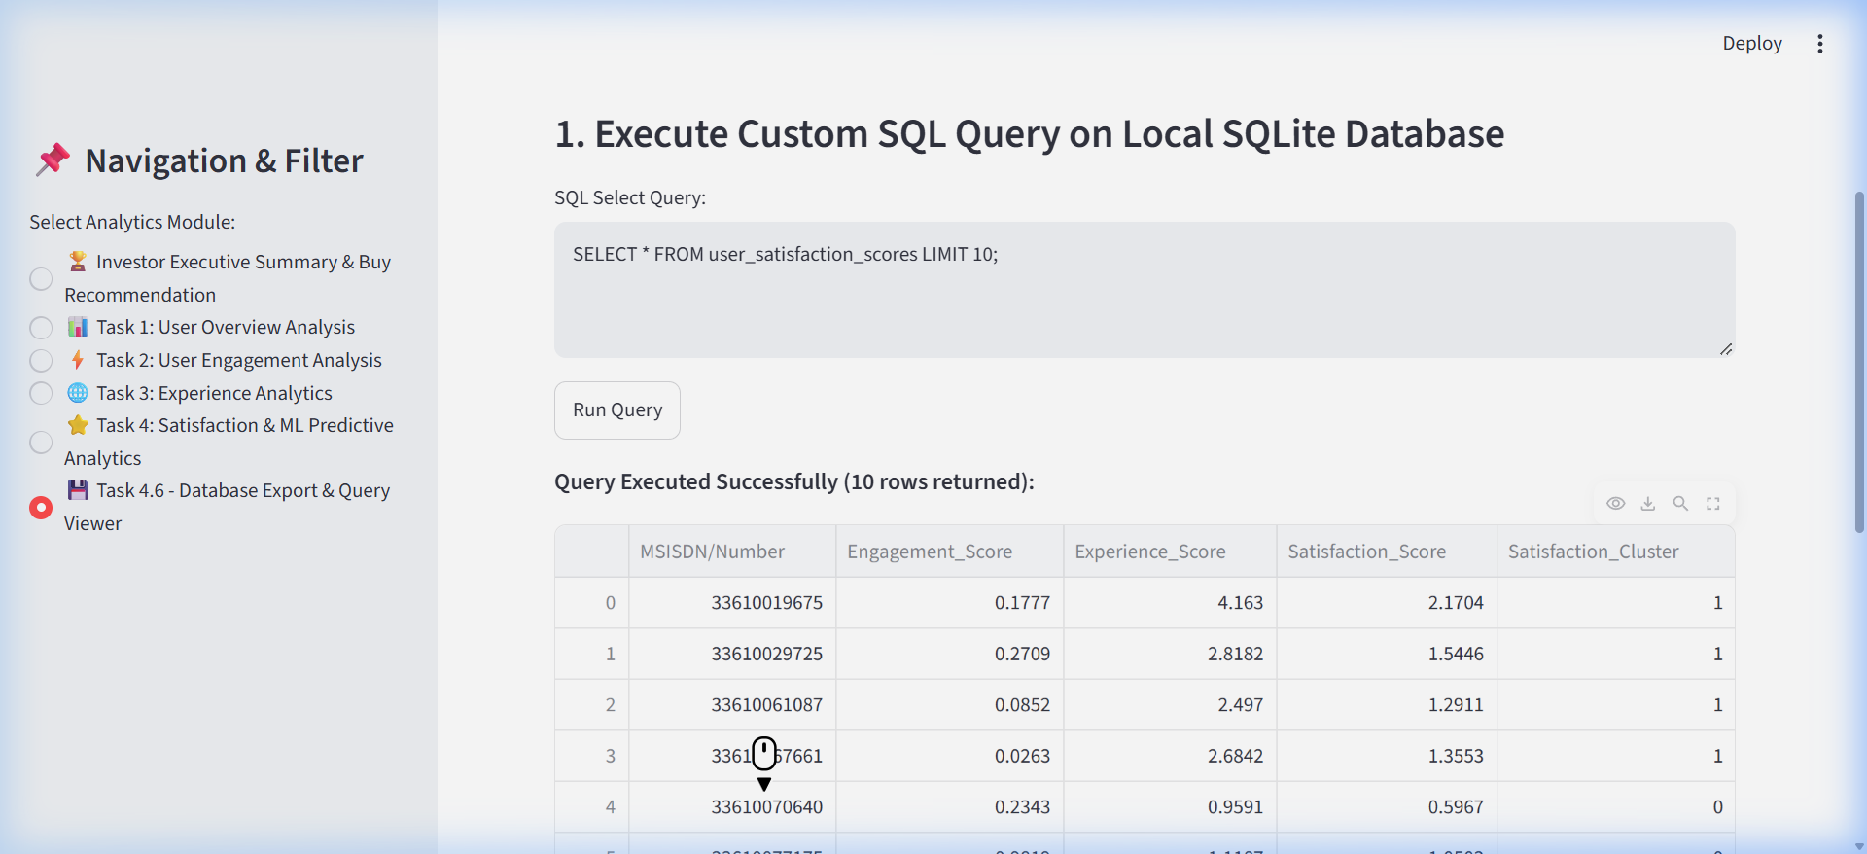
6. Task 4.6 & MLOps: Database Export & Experiment Tracking
SQLite Export, Custom SQL Execution & MLflow Tracking Integration
• SQLite Exporter: Automatically writes user satisfaction metrics to data/tellco_analytics.db.
• SQL Query Runner: Embedded interactive query engine for custom business reporting.
• MLOps Experiment Tracker: Logs hyperparameters, RMSE, MSE, R² metrics, and model weights.
• CI/CD Pipeline: Automated pytest test suite executing unit tests across data cleaning, engagement, and ML.
Notes:
Task 4.6 ensures enterprise durability. All analytical scores are saved to SQLite and tracked via MLOps pipelines for continuous deployment.

Slide 8
7. Power BI Integration & Final Investment Roadmap
Star Schema Data Models, DAX Measures & Strategic Action Plan
✔ Power BI Ecosystem: Created 1-click PBIDS, PBIP, and Star Schema tables (Fact_Subscriber_Sessions, Dim_Handset_Device).
✔ DAX Measures: Pre-computed Gaming Traffic %, Throughput kbps, and Satisfaction Score index.
✔ Strategic Action 1: Introduce gaming bandwidth prioritization packages (+15% revenue impact).
✔ Strategic Action 2: Target 3G handset upgrade promo to transition budget users to 4G/5G.
✔ Strategic Action 3: Deploy automated retention offers to subscribers with Satisfaction Score < 0.40.
✔ Final Valuation Conclusion: STRONG BUY recommendation for TellCo Telecommunication.

