Slide 1
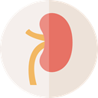

Chronic Kidney Disease and Diabetes Visualization & Analysis
Group 5: Alexander Nguyen, Donghwi Park, Yangwenyi Jing, Mohammad Zarei

Slide 2
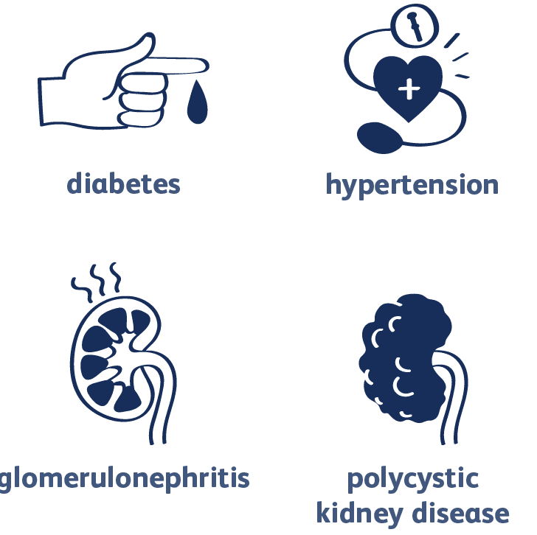

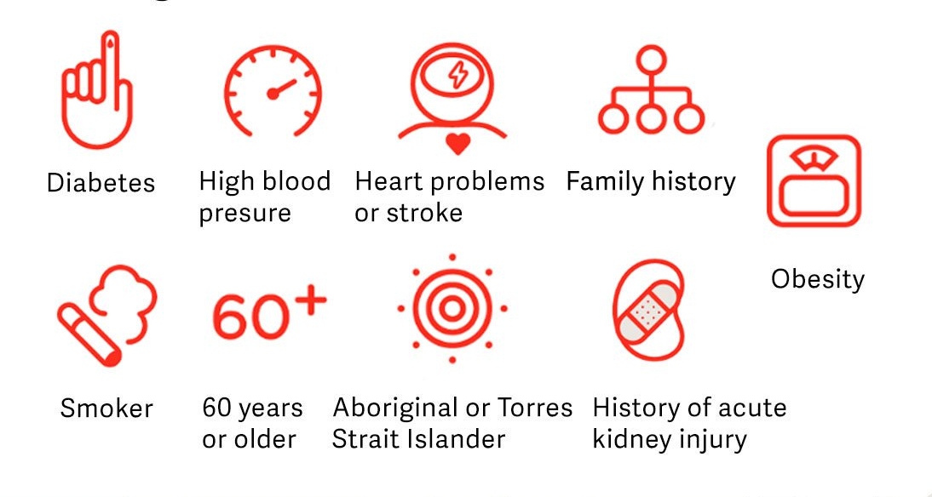
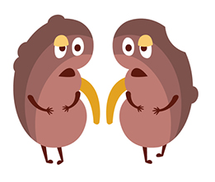
Motivation & Objective
?
Notes:
identify important predictor variables
Determine relationships between diseases
Predict patient risks\

Slide 3
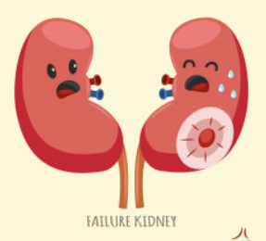
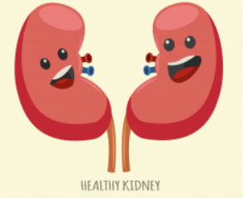
Terminology
Chronic Kidney Disease
CKD
CKD+
CKD-

Slide 4
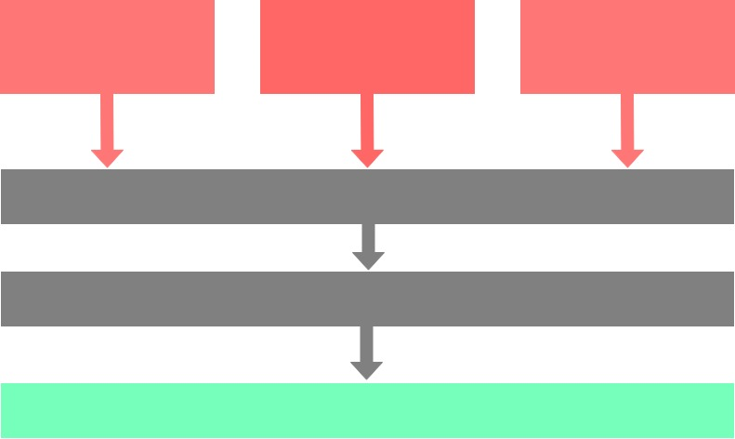
Methodology
National Inst. of Diabetes and Digestive Kidney
NYS Patient Characteristics Survey
CKD Data Set from UCI ML Repository
Data Cleaning
Data Visualization
Data Comparison and Analysis

Slide 5
Is there any selection bias of unhealthy patients?
Notes:
When dealing with medical data, more data exists for unhealthy people than healthy people. Can be seen by larger % captured by CKD patients
n=400
Interestingly, enough for the same population, there exists MORE people with diabetes
We show diabetes + with red and diabetes - with green

Slide 6
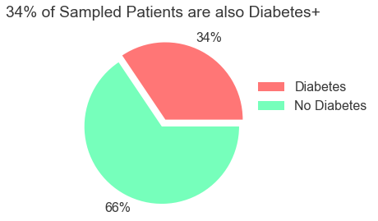
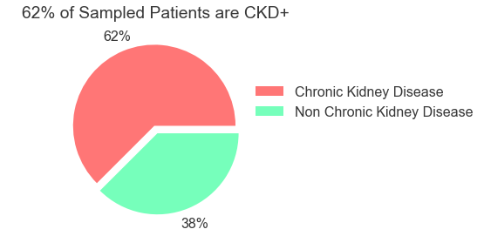
Selection bias skews towards observed class (CKD)
Notes:
When dealing with medical data, more data exists for unhealthy people than healthy people. Can be seen by larger % captured by CKD patients
n=400
Interestingly, enough for the same population, there exists MORE people with diabetes
We show diabetes + with red and diabetes - with green

Slide 7
Are there any relationships between other diseases and CKD?
Notes:
When dealing with medical data, more data exists for unhealthy people than healthy people. Can be seen by larger % captured by CKD patients
n=400
Interestingly, enough for the same population, there exists MORE people with diabetes
We show diabetes + with red and diabetes - with green

Slide 8
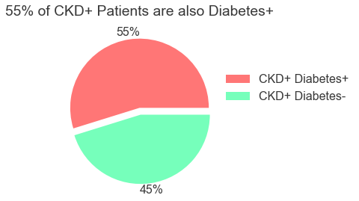
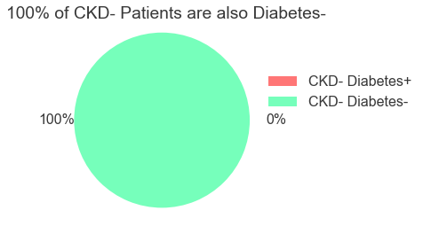
All CKD- patients are also diabetes-, most CKD+ are diabetes+
Notes:
Similarly, 100% of CKD- patients are also hypertension-

Slide 9
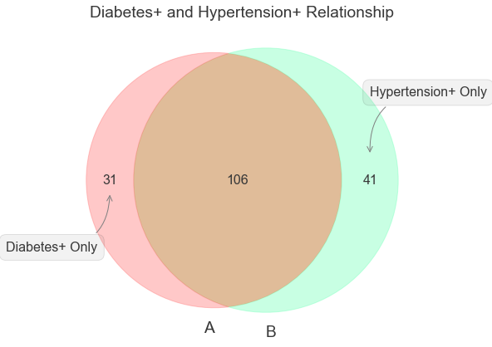
Most diabetes+ patients are also hypertension+
Notes:
Hypertension and Diabetes are often synonymous with CKD (some resource online)

Slide 10
Are the feature values among healthy and unnhealthy patients similar?
Notes:
When dealing with medical data, more data exists for unhealthy people than healthy people. Can be seen by larger % captured by CKD patients
n=400
Interestingly, enough for the same population, there exists MORE people with diabetes
We show diabetes + with red and diabetes - with green

Slide 11
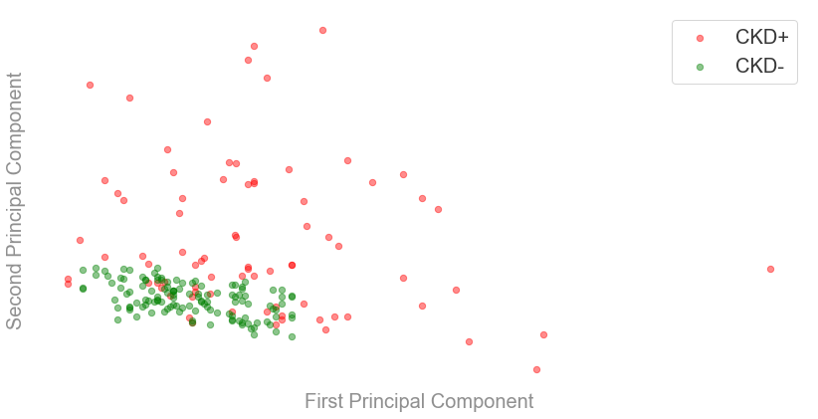
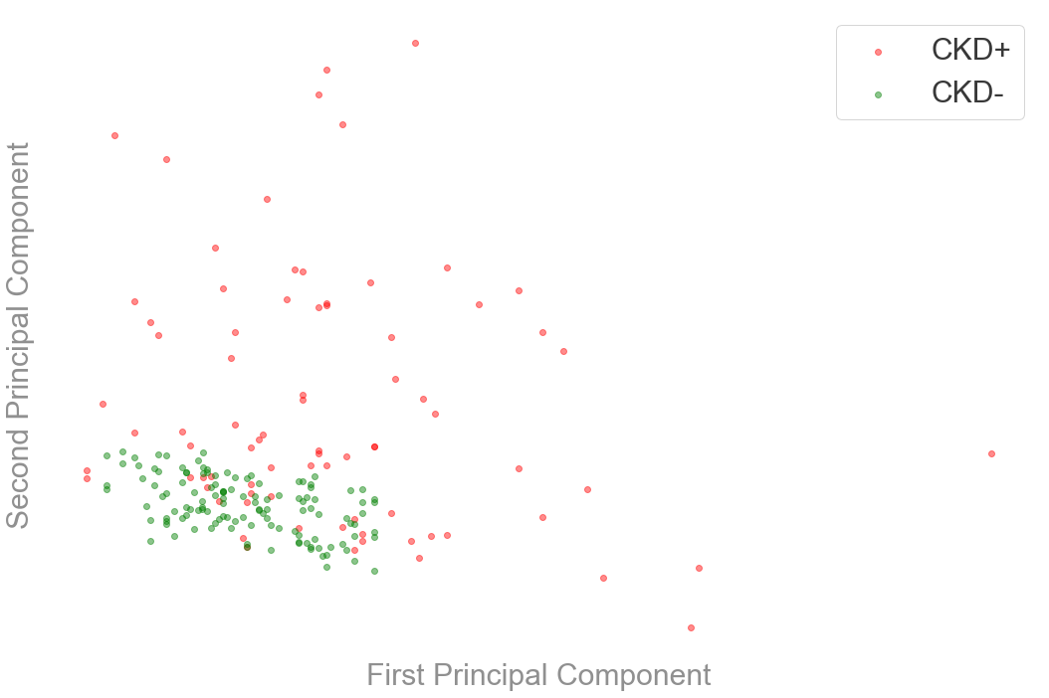
Clear clustering of CKD- class with 2 principal components
Notes:
These principal components are calculated only from features and no information from classes are considered. So PCA is unsupervised method and it’s difficult to interpret the two axes as they are some complex mixture of the original features.

Slide 12
How different are the feature values between healthy and unhealthy? Biologically logical?
Notes:
When dealing with medical data, more data exists for unhealthy people than healthy people. Can be seen by larger % captured by CKD patients
n=400
Interestingly, enough for the same population, there exists MORE people with diabetes
We show diabetes + with red and diabetes - with green

Slide 13
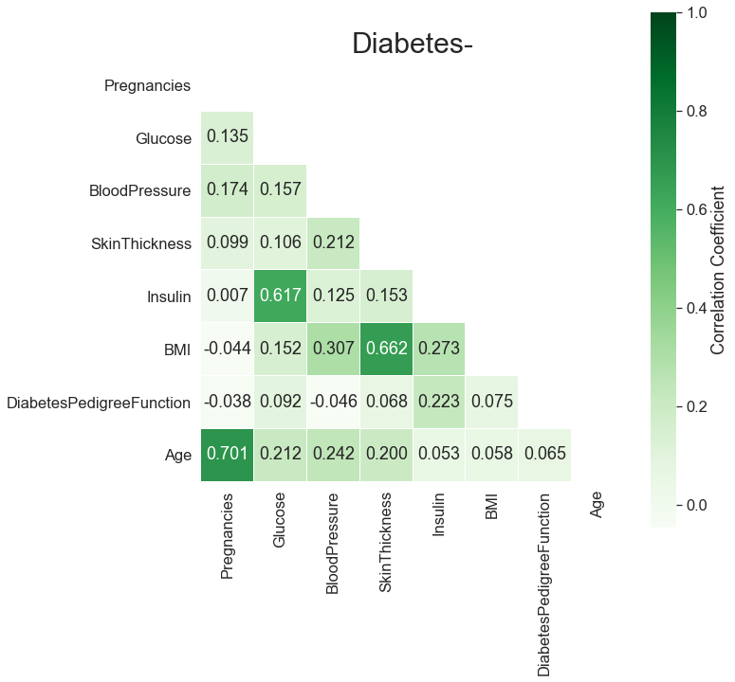
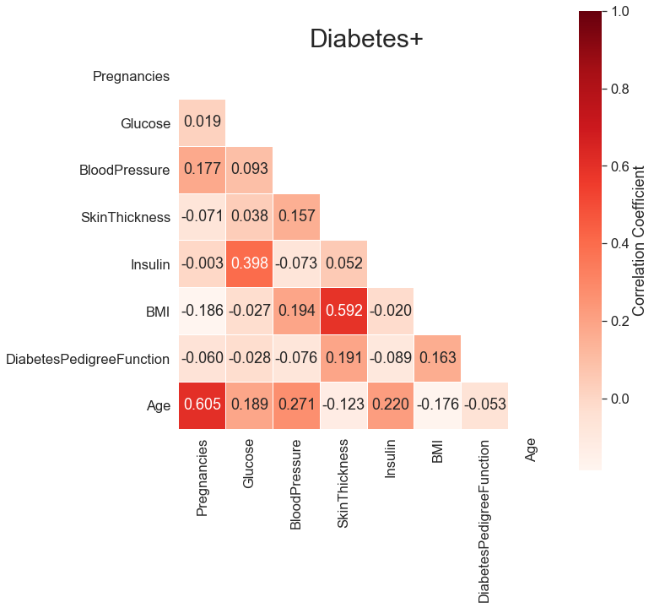
Glucose has a higher correlation with insulin in diabetes-
Notes:
Diabetes pedigree function is a function which scores likelihood of diabetes based on family history
Different degrees of diabetes pathologies, pancreas cells die so they don’t create and respond with the same amount of insulin in response to glucose (in blood) yada yada

Slide 14
Are there trends between interesting features such as age and pregnancy?
Notes:
When dealing with medical data, more data exists for unhealthy people than healthy people. Can be seen by larger % captured by CKD patients
n=400
Interestingly, enough for the same population, there exists MORE people with diabetes
We show diabetes + with red and diabetes - with green

Slide 15
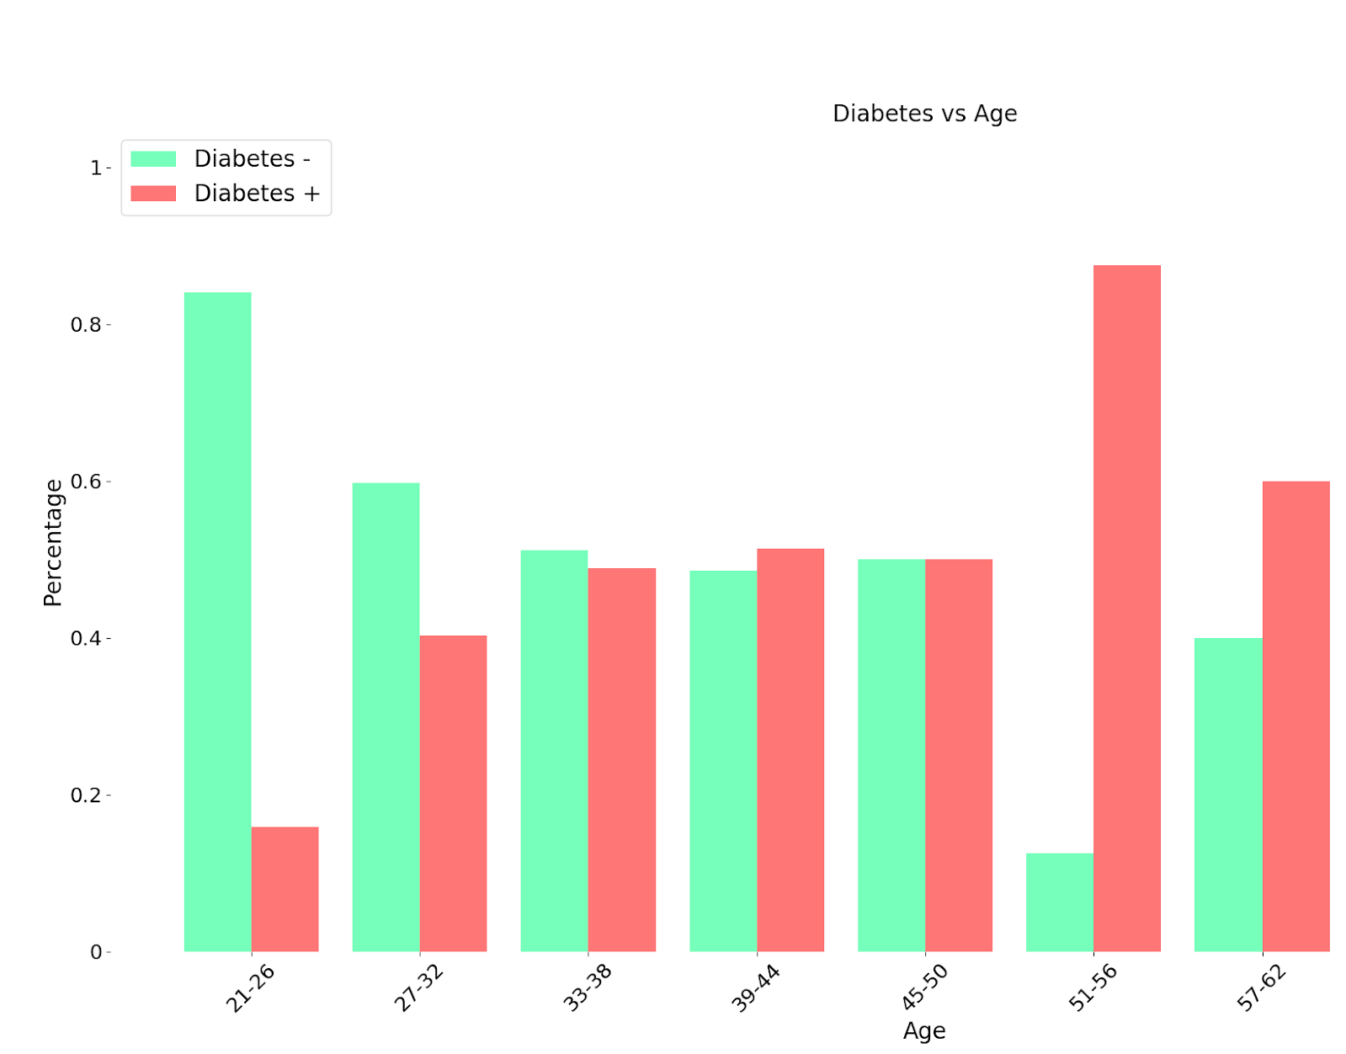
At older ages, diabetes+ is greater than diabetes-
Notes:
Diabetes pedigree function is a function which scores likelihood of diabetes based on family history

Slide 16
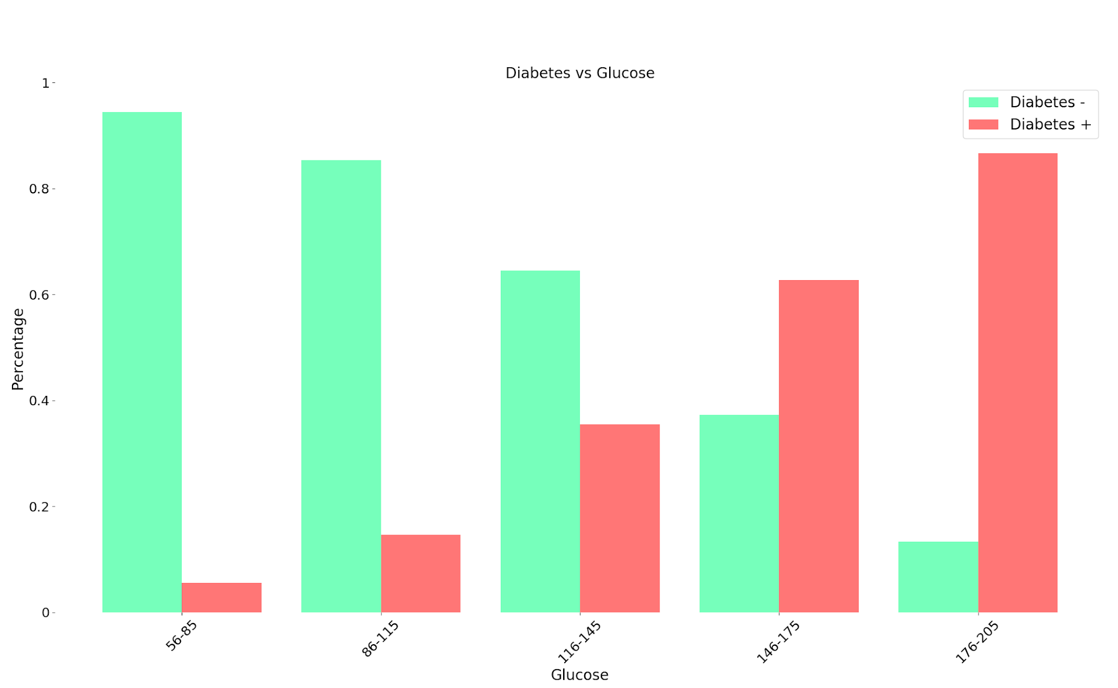
As glucose levels increase, percentage of diabetes- decreases, while diabetes+ population increases
Notes:
Diabetes pedigree function is a function which scores likelihood of diabetes based on family history

Slide 17
Answered Questions
Some degree of selection bias of observed feature
CKD+ patients often exhibit another disease (diabetes)
Feature values of CKD- are well-grouped
Age and pregnancy have a role in diabetes
Correlation between insulin and glucose decrease for CKD-

Slide 18
Questions?

Slide 19
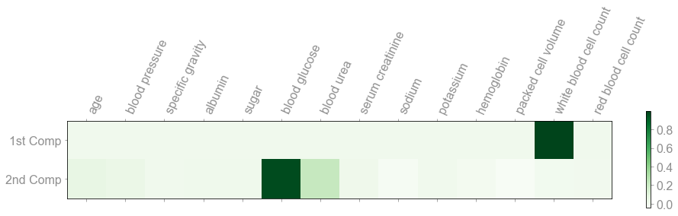
White blood cell count and blood glucose contribute the most variance to 1st and 2nd PC respectively
Explained Variance Ratio
Notes:
These principal components are calculated only from features and no information from classes are considered. So PCA is unsupervised method and it’s difficult to interpret the two axes as they are some complex mixture of the original features.
PC composed of those that contribute the most variance (basically check correlation to outcome and only select highest)
https://www.ncbi.nlm.nih.gov/pubmed/28699033

Slide 20
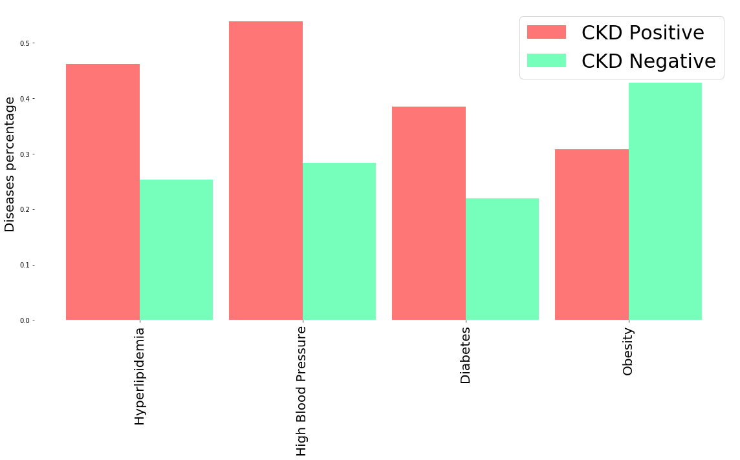
Further association between other diseases and CKD
Notes:
Hypertension and Diabetes are often synonymous with CKD (some resource online)

