Slide 1
Tanzanian Water Wells
Predictive Maintenance Analysis
Data-Driven Insights for Water Infrastructure Management
January 2026

Slide 2
Project Overview
📊 Objective: Predict water well functionality to optimize maintenance
🌍 Scope: 59,400 water wells across Tanzania
🎯 Target: 3-class classification (functional, needs repair, non-functional)
📈 Approach: Exploratory data analysis and predictive insights
💡 Goal: Enable proactive maintenance and resource allocation

Slide 3
Data Landscape
Training Data: 59,400 wells with 40 features
Test Data: 14,850 wells for evaluation
Feature Types: 9 numeric, 31 categorical
Geographic Coverage: Multiple regions across Tanzania
Temporal Range: Construction years 1960-2013
Data Quality: Some missing values in funder, installer, scheme_name

Slide 4
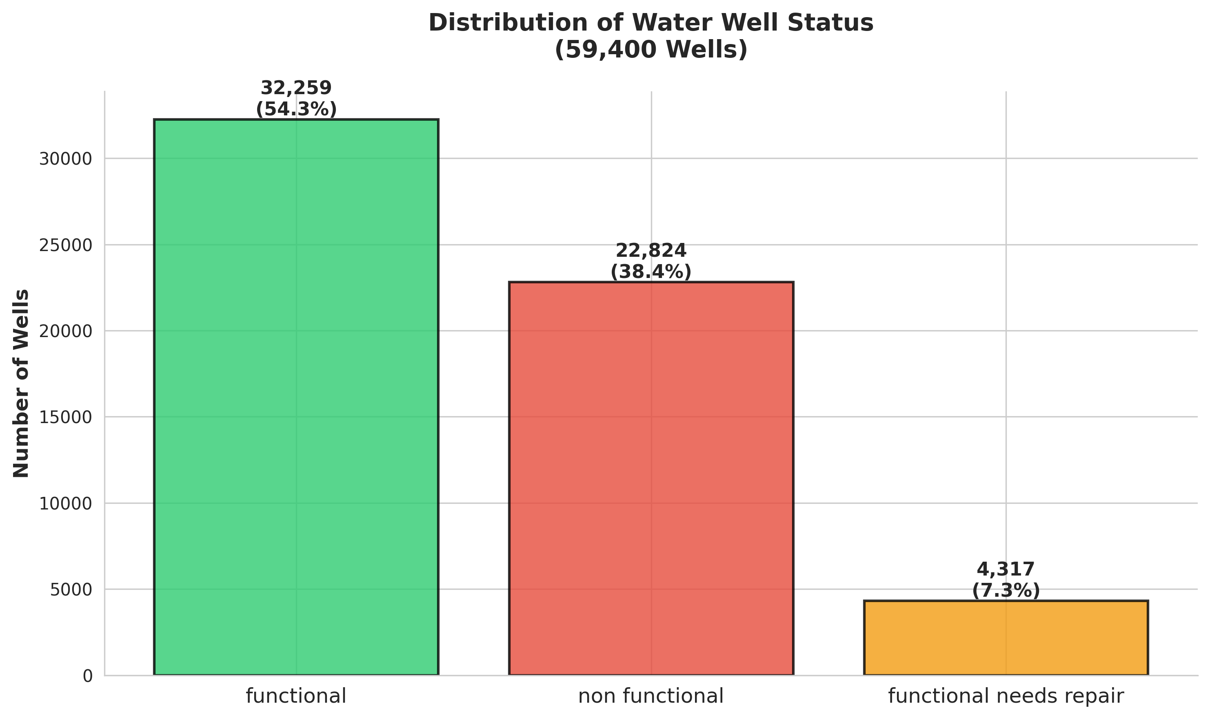
Target Distribution: Well Status Breakdown

Slide 5
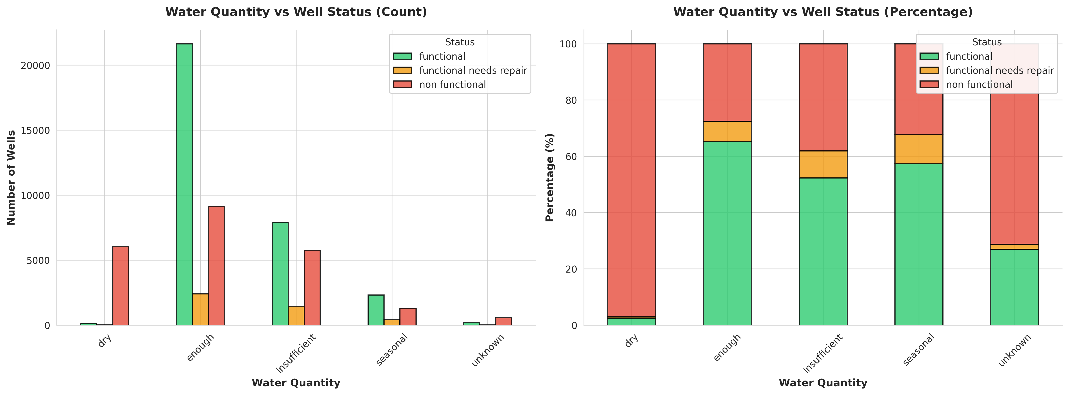
Key Finding: Water Quantity as Primary Predictor

Slide 6
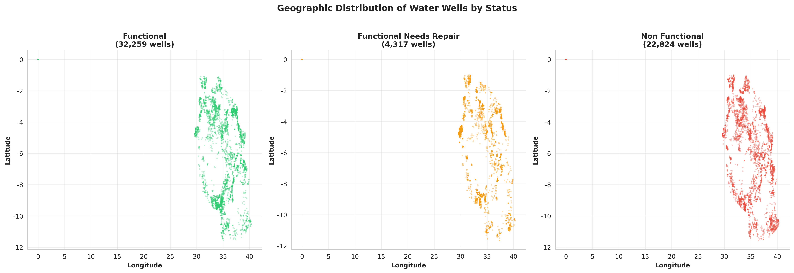
Geographic Distribution of Water Wells

Slide 7
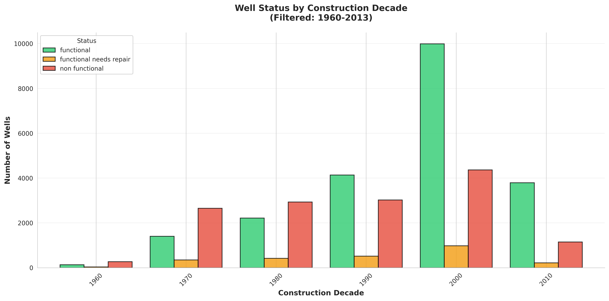
Temporal Analysis: Well Status by Construction Era

Slide 8
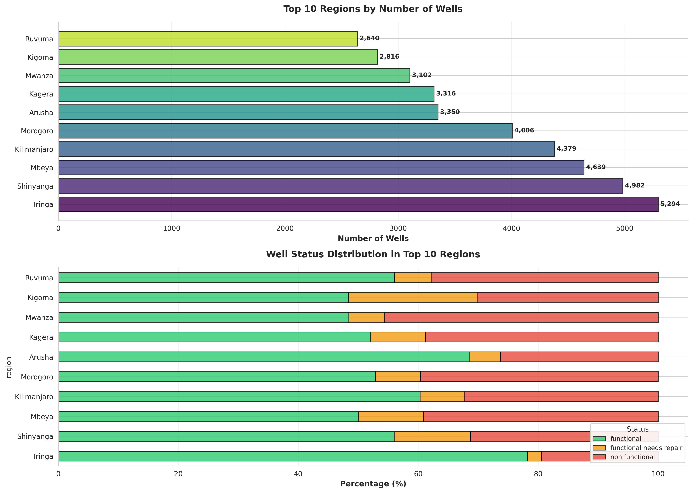
Regional Distribution and Status Patterns

Slide 9
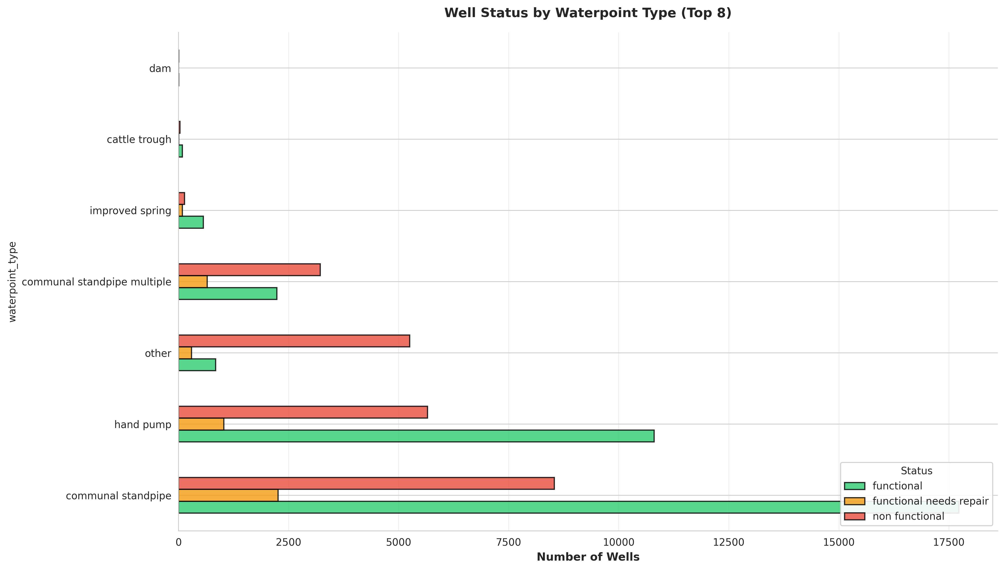
Infrastructure Analysis: Waterpoint Types

Slide 10
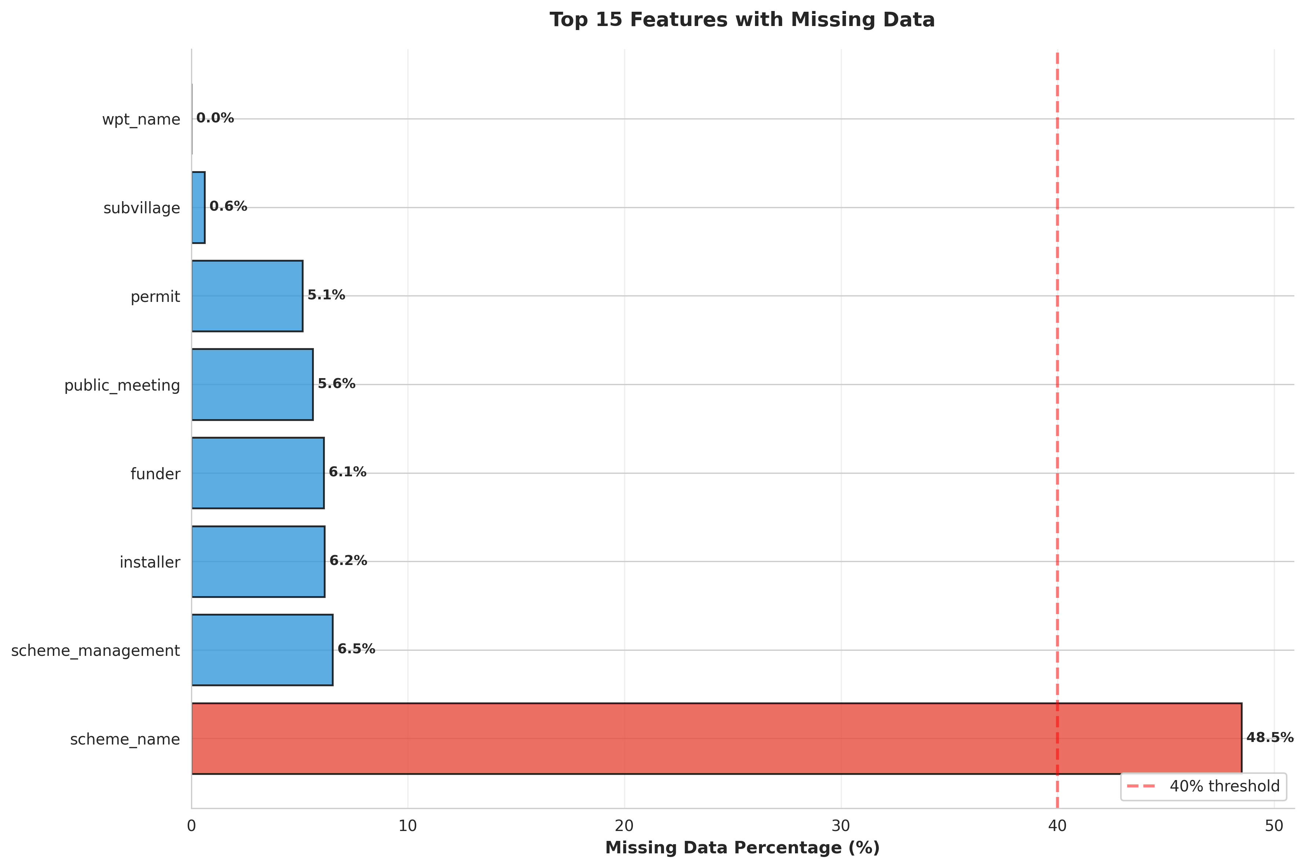
Data Quality Assessment: Missing Values

Slide 11
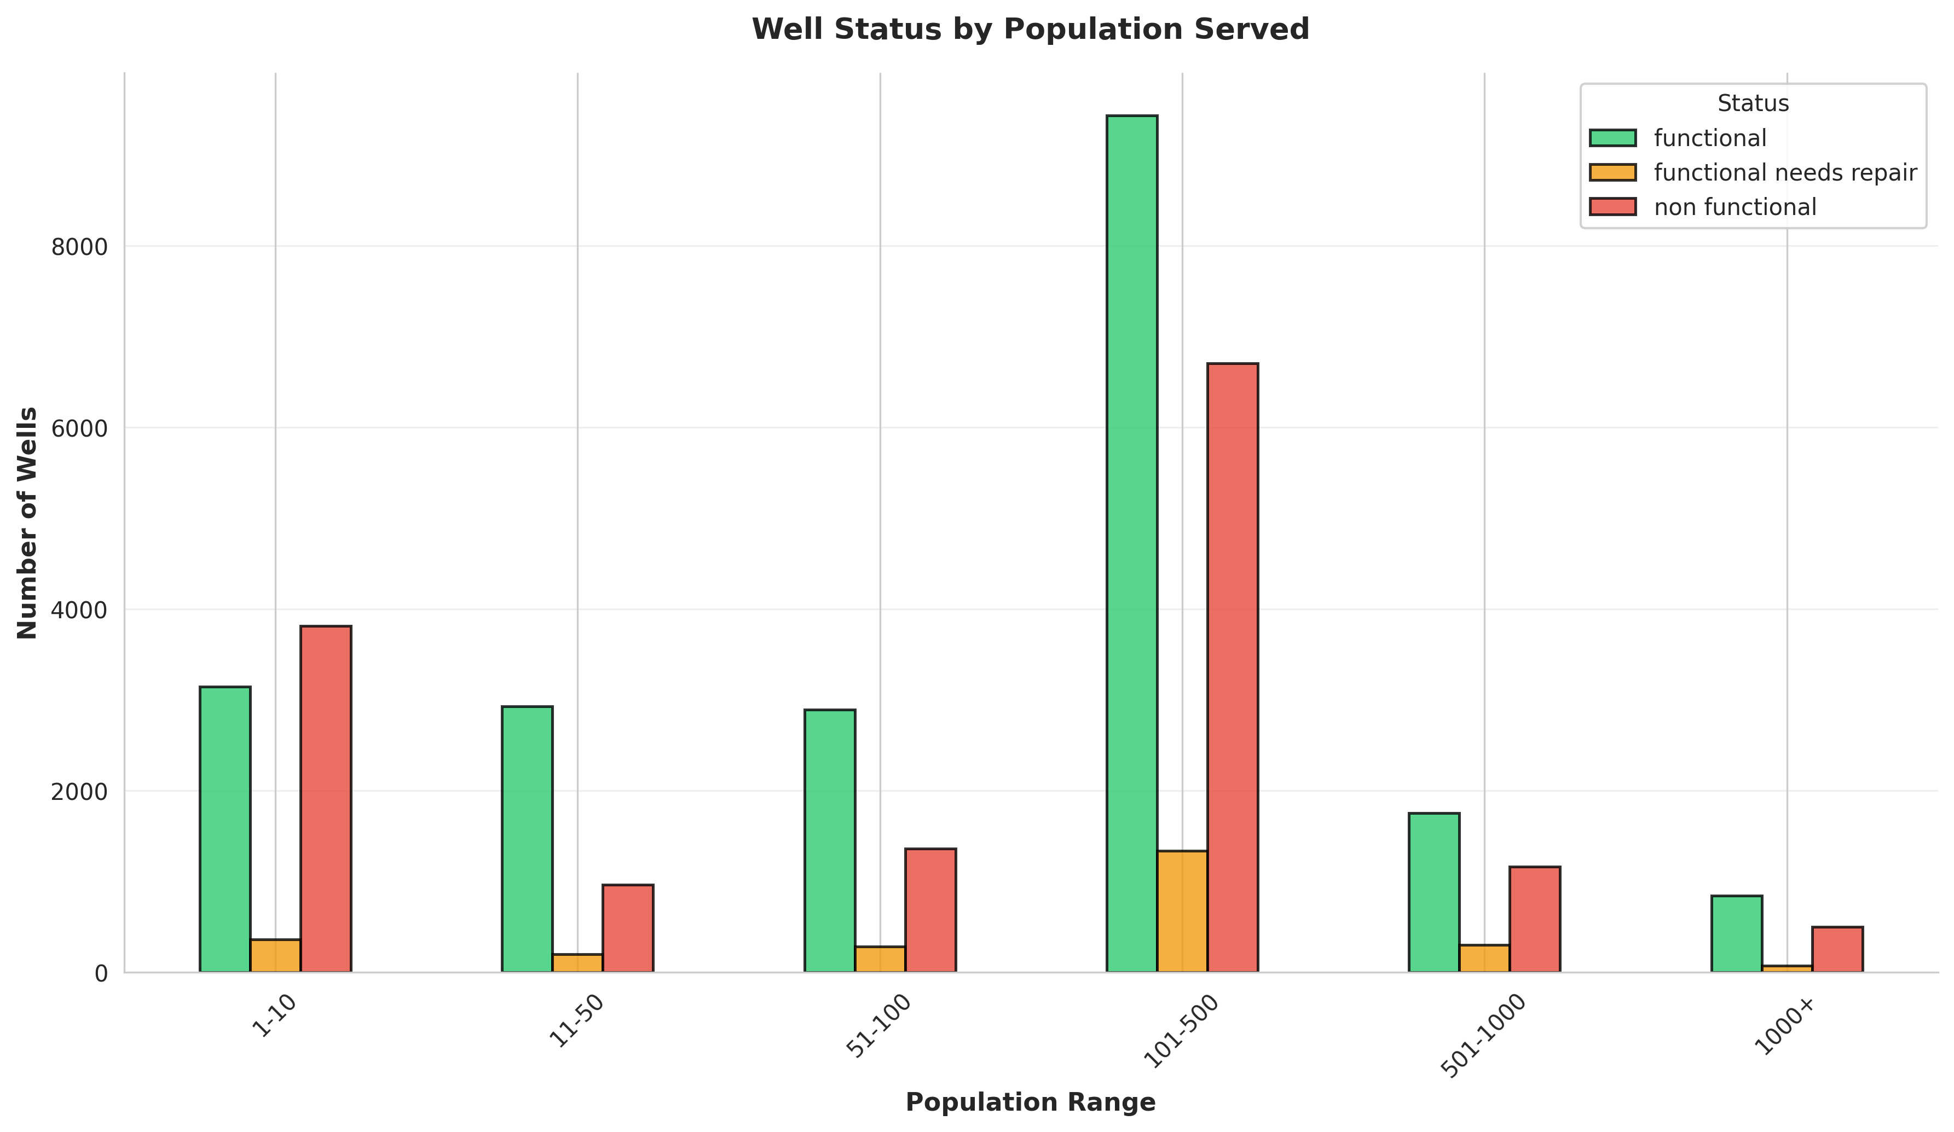
Population Served Analysis

Slide 12
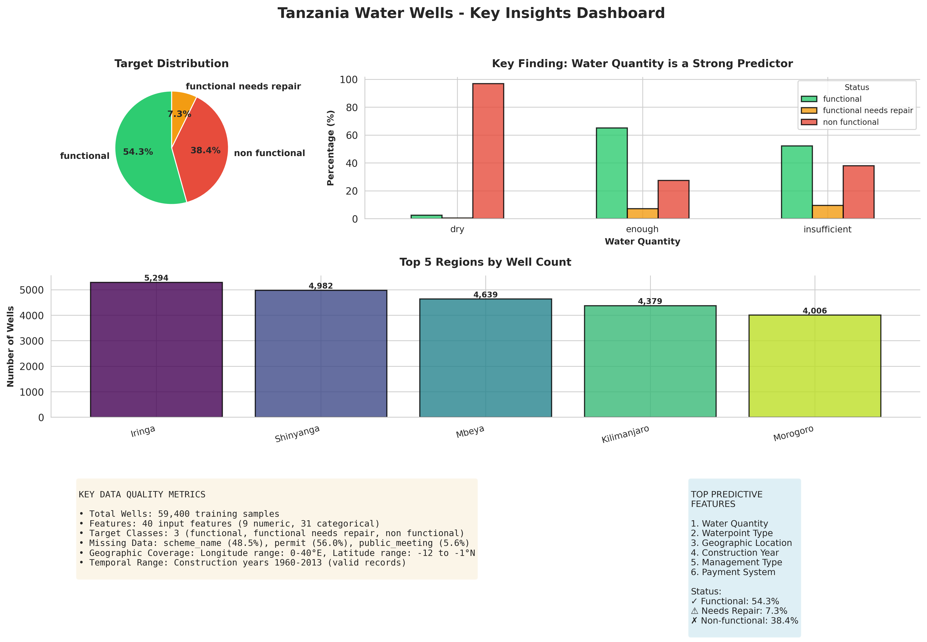
Executive Dashboard: Key Insights

Slide 13
Key Insights Summary
🔑 Water Quantity is the strongest predictor: 96.9% of 'dry' wells are non-functional
📍 Geographic clustering: Certain regions show higher failure rates
⏰ Age matters: Older wells (pre-1990) have higher failure rates
🏗️ Infrastructure type impacts reliability: Communal standpipes most common
👥 Population dependency: 54.3% of wells are functional, serving millions
📊 Data gaps: 48.5% missing scheme_name, 56.0% missing permit data
🎯 Actionable: Focus maintenance on dry/insufficient water quantity wells

Slide 14
Business Impact & Value Proposition
💰 Cost Optimization: Target maintenance resources to high-risk wells
⚡ Proactive Intervention: Predict failures before they occur
📈 Service Reliability: Improve functional well percentage from 54.3%
🎯 Resource Allocation: Prioritize regions with highest failure rates
📊 Data-Driven Decisions: Evidence-based infrastructure planning
🌊 Water Security: Ensure continuous access to clean water for communities
🔄 Maintenance Scheduling: Optimize repair cycles based on predictive signals

Slide 15
Strategic Recommendations
1. Immediate Action: Inspect all wells with 'dry' or 'insufficient' water quantity
2. Geographic Focus: Deploy teams to high-failure regions (Iringa, Mbeya, Arusha)
3. Age-Based Maintenance: Prioritize wells constructed before 1990
4. Data Collection: Improve tracking of scheme_name, permits, and maintenance logs
5. Monitoring Systems: Implement real-time water quantity sensors
6. Community Engagement: Train local managers on early warning signs
7. Predictive Models: Deploy classification models for ongoing risk assessment

Slide 16
Data Collection & Quality Improvements
📝 Standardize Data Entry: Consistent formats for funder, installer, scheme_name
🔍 Reduce Missing Values: Target <10% missingness for critical features
📱 Digital Tools: Mobile apps for field data collection and validation
🗓️ Regular Updates: Monthly status checks for all wells
📊 Quality Metrics: Track data completeness and accuracy over time
🔗 Integration: Link well data with maintenance records and community feedback
🎓 Training: Field staff education on data quality importance

Slide 17
Next Steps & Roadmap
✅ Phase 1: Validate insights with domain experts and field teams
✅ Phase 2: Deploy pilot maintenance program in top 3 high-risk regions
✅ Phase 3: Implement monitoring dashboard for real-time status tracking
✅ Phase 4: Build and deploy predictive model for failure forecasting
✅ Phase 5: Scale successful interventions nationwide
✅ Phase 6: Establish feedback loop for continuous improvement
📅 Timeline: 6-12 months for full implementation

Slide 18
Thank You
Impact: Improving water access for millions of Tanzanians
Approach: Data-driven predictive maintenance
Status: Analysis complete, ready for implementation
Contact: Ready for stakeholder review and deployment planning

