Slide 1


Retail Database Architecture
A 3NF relational schema with automated inventory reconciliation, strict transactional constraints, and immutable audit logs.

Slide 2


Core Entities & Relational Scope
Entity Ecosystem
Structural Principles
The schema focuses on seven interrelated entities designed to handle commercial retail transactions cleanly without redundant coupling:
To ensure high database health and prevent performance degradation:
•
3rd Normal Form (3NF): Elimination of transitive dependencies; non-key attributes strictly depend on primary keys.
•
Customers & Suppliers: Foundational master entities providing demographic and vendor source data.
•
Deterministic Execution: Base catalog tables are defined prior to dependent transaction tables to guarantee clean DDL runs.
•
Products & InventoryLog: Separation of live stock state from historical audit trail events.
•
Generated Math: Persistent generated column LineTotal calculated automatically at the database level.
•
Orders & OrderDetails: Normalized header-to-line-item structure modeling order cardinality.
•
Reviews: Customer feedback mechanism restricted by relational uniqueness.

Slide 3
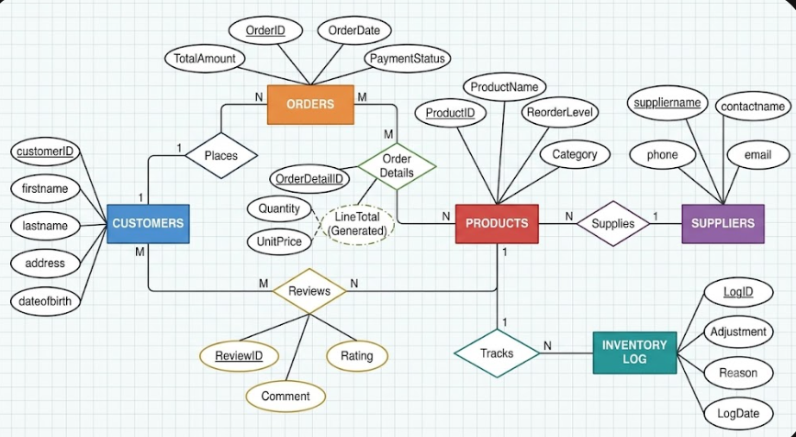
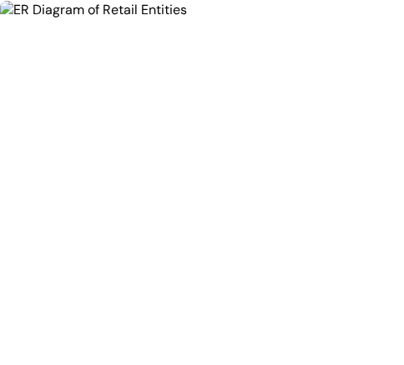
Entity Relationship Topography
Relational Connections in Retail Operations:
Customers to Orders (1:N): One customer places multiple orders; each order links to exactly one valid customer record.
Orders to OrderDetails (1:N): Each order header branches into line items, breaking the many-to-many relationship with Products.
Products to Suppliers (N:1): Products reference single suppliers, maintaining clear vendor accountability.
Dual Parentage on Reviews: Links CustomerID and ProductID with a composite unique rule.

Slide 4
Catalog & Master Tables
Table | Key Field | Type & Constraints | Referenced Parent | Business Purpose
Customers | customerID | INT, AUTO_INCREMENT, PK | None (Master) | Stores buyer identities, names, DOB, and mailing addresses.
Suppliers | supplierID | INT, UNIQUE(suppliername) | None (Master) | Houses vendor partners, reliability scores, and contact information.
Products | ProductID | INT, AUTO_INCREMENT, PK | supplierID → Suppliers | Tracks merchandise, cost vs. retail price, and live shelf stock.
Products Rules | Constraints | CHECK (Price > 0), StockQuantity ≥ 0 | Database Engine | Guarantees inventory counts and unit pricing never drop negative.

Slide 5
Transactional & Ledger Tables
Table | Primary Key | Foreign Keys | Computed / Special Fields | Integrity Rule
Orders | OrderID | CustomerID → Customers | UUID() TrackingNumber, CURRENT_TIMESTAMP | CHECK (TotalAmount ≥ 0), PaymentStatus enum-check
OrderDetails | OrderDetailID | OrderID, ProductID | LineTotal = (Quantity * UnitPrice) STORED | CHECK (Quantity > 0), INDEX IX_OrderDetails_Product
Reviews | ReviewID | CustomerID, ProductID | CURRENT_TIMESTAMP ReviewDate | CHECK (Rating BETWEEN 1 AND 5), UNIQUE(CustID, ProdID)
InventoryLog | LogID | ProductID → Products | Adjustment INT, Reason VARCHAR | Immutable write-only audit trail logging delta movements

Slide 6


Live State vs. Immutable Ledger
Products: The Live State
InventoryLog: The Ledger
Represents the exact physical count available for immediate sale at the current second.
Acts as an append-only financial journal reflecting every inventory delta over time.
•
Mutable Value: StockQuantity is directly updated whenever an order is submitted or restocked.
•
Immutable Rows: Existing log rows are never updated or deleted; each adjustment is recorded as a signed integer.
•
Concurrency Gate: Protected by CHECK (StockQuantity ≥ 0), preventing over-selling in race conditions.
•
Delta Attribution: Deductions record negative deltas (e.g. -2) along with Order references.
•
Fast Lookups: Allows instantaneous availability queries for user checkout flows without aggregating past history.
•
Discrepancy Audits: Comparing the sum of InventoryLog.Adjustment against StockQuantity validates data integrity.

Slide 7







Automated Inventory Trigger Flow
1. Order Placed
2. Trigger Fires
3. Stock Deducted
4. Log Appended
Customer checkout inserts a new item row into OrderDetails with a verified Quantity and UnitPrice.
After_New_Order_Placed activates atomically AFTER INSERT on each individual line item row.
The trigger updates Products, subtracting NEW.Quantity from StockQuantity where ProductID = NEW.ProductID.
An audit entry is written to InventoryLog storing -NEW.Quantity and reason CONCAT('Sold on Order #', NEW.OrderID).

Slide 8

Strict Data Integrity Safeguards
Database-Engine Level Enforcement
To eliminate reliance on application-layer logic, business invariants are hardcoded directly into table definitions:
Financial Boundary: TotalAmount ≥ 0 and Price > 0 prevent negative currency values.
7
Stock Depletion Wall: StockQuantity ≥ 0 prevents inventory sub-zero anomalies.
Enforced Constraints
Rating Guardrail: Rating BETWEEN 1 AND 5 enforces valid qualitative metrics.
Anti-Spam Uniqueness: UNIQUE (CustomerID, ProductID) restricts one review per product.

Slide 9
Populated Operational Data
Table Context | Sample Record Data | Computed / Trigger Output
Customer #1 | John Doe (DOB: 1982-05-14), 104 Market Blvd | Primary Customer Identity Key assigned
Product #101 | Pro Wireless Headset | Price: $120.00 | Cost: $75.00 | Initial Stock: 50 units (Reorder: 10)
Order #5001 | Customer: 1 | Date: 2026-09-15 | Status: Completed | Generated UUID Tracking Number
OrderDetails | Order: 5001 | Product: 101 | Qty: 2 | Price: $120.00 | LineTotal = $240.00 (STORED)
Products Result | ProductID 101 updated after trigger execution | StockQuantity: 50 → 48
InventoryLog | ProductID: 101 | Adjustment: -2 | Reason: 'Sold on Order #5001' | Audit Trail Appended

Slide 10
Reporting & Analytical Views
Customer Lifetime Value & Age Filtering: Querying customers older than 40 with lifetime expenditures exceeding target thresholds by joining Customers, Orders, and OrderDetails.
Automated Reorder Threshold Alerts: Identifying products where StockQuantity ≤ ReorderLevel combined with supplier delivery performance ratings to trigger immediate purchase orders.
Inventory Reconciliation View: Cross-checking live Products.StockQuantity against historical SUM(InventoryLog.Adjustment) to pinpoint shrinkage or stock discrepancies.
Product Sentiment & Sales Matrix: Correlating customer ratings from Reviews against sales volume in OrderDetails to detect underperforming product lines.

Slide 11
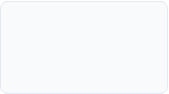


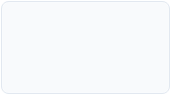


Implementation Roadmap
Phase 2: MySQL DDL
Phase 4: Triggers
Phase 6: Optimize
Build 7 tables, generated columns, and ordered execution script.
Deploy stock deduction and automated inventory log entries.
Index verification and transaction concurrency testing.
Phase 1: Design
Phase 3: Integrity
Phase 5: Reports
Identify entities, 3NF normalization, define PK/FK relationships.
Apply CHECK constraints, populate realistic test data.
Construct complex join views for order history & audits.

Slide 12
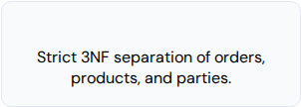
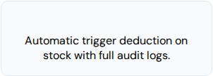
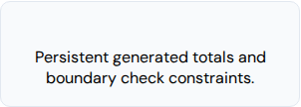
Technical Q&A
A solid, production-grade foundation for transactional retail data management.
Zero Redundancy
Real-Time Sync
Guaranteed Math

