Slide 1
PRESENTATION III
Retail Inventory and
Sales Management System
Frontend • Backend • MySQL Database • UI Demonstration
Krish Chhotoo Ghadge | 25WU0102132
Presentation III — Retail Inventory and Sales Management System 1/6

Slide 2
System Overview
How the frontend, backend and database work together
1. Frontend
HTML, CSS and JavaScript provide the screens, forms, tables, navigation and user interaction.
2. Backend
Python Flask handles requests, validates form data and executes SQL operations.
3. Database
MySQL stores the seven relational tables and maintains persistent data.
• Browser → Flask → MySQL → Flask → Updated UI
• Parameterized SQL is used for database operations.
• Changes made through the UI are committed to MySQL.
Presentation III — Retail Inventory and Sales Management System 2/6

Slide 3
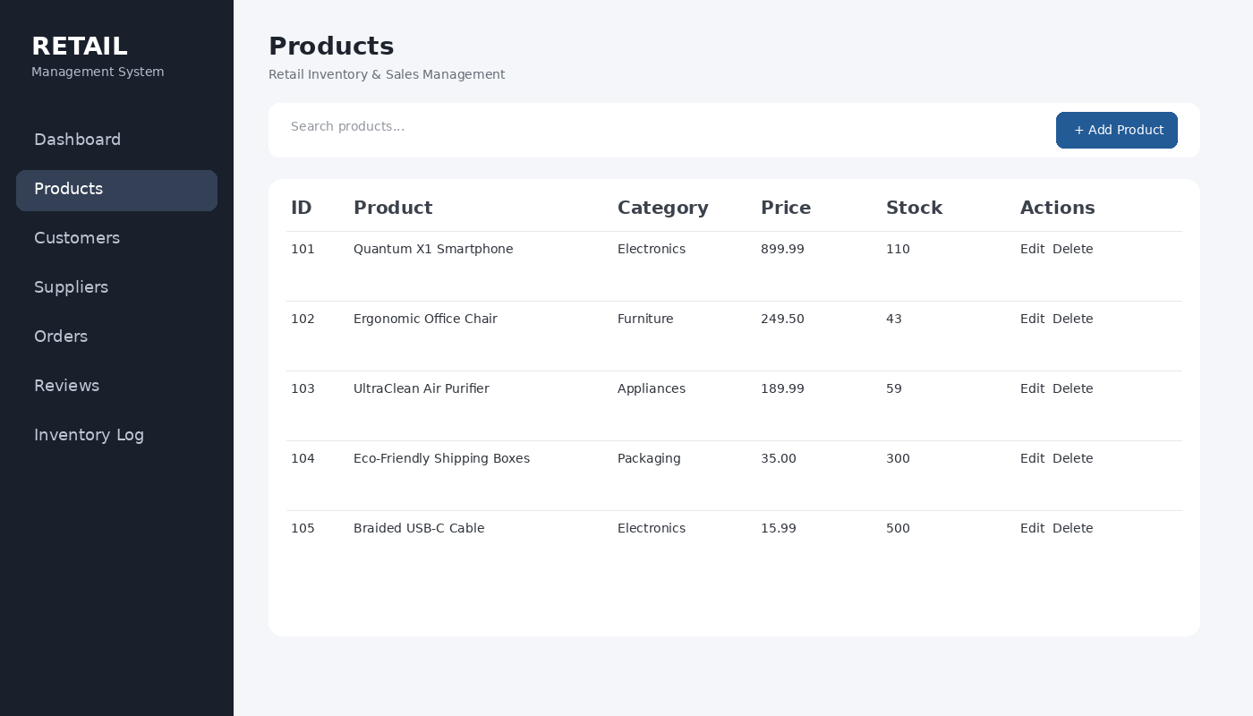
Frontend
The user-facing layer of the system
• HTML templates define the dashboard, forms and data tables.
• CSS provides the layout, cards, buttons, forms and responsive styling.
• JavaScript supports client-side interaction where required.
• Navigation provides access to Products, Customers, Suppliers, Orders, Reviews and Inventory Log.
• Forms allow users to perform database operations without directly writing SQL.
Product management interface
Presentation III — Retail Inventory and Sales Management System 3/6

Slide 4
Backend
Flask connects the frontend to MySQL
• app.py contains the Flask application and database connection.
• Routes receive GET/POST requests from the frontend.
• mysql-connector-python connects Flask to the retailmanagement database.
• INSERT, UPDATE and DELETE statements modify records.
• SELECT queries retrieve records for display.
• commit() makes successful changes persistent in MySQL.
Example: Insert
User submits form → Flask route → parameterized INSERT → commit() → refreshed table
Example: Update
User edits record → Flask route → UPDATE ... WHERE ID → commit() → updated UI
Example: Delete
User confirms deletion → Flask route → DELETE ... WHERE ID → commit() → record removed
Presentation III — Retail Inventory and Sales Management System 4/6

Slide 5
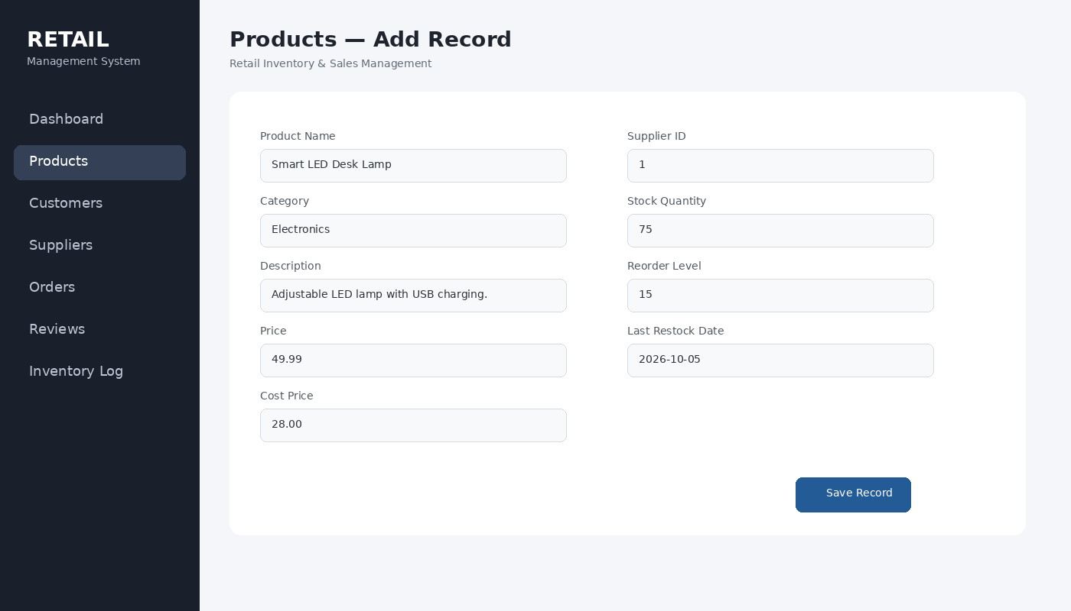
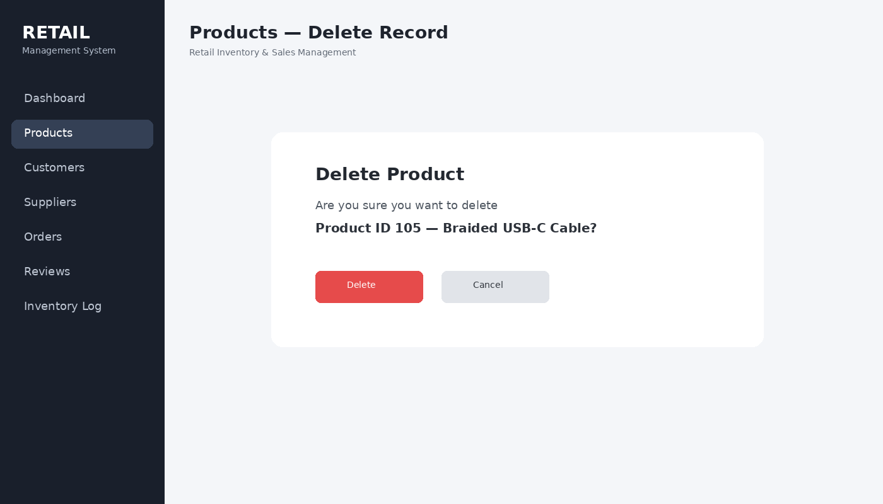
UI + Database Demonstration
The important part of Presentation III
• Insert: add a new record through the form.
• View: confirm the new record appears in the table.
• Update: change a value and verify the database reflects it.
• Delete: remove the test record and verify it is gone.
Presentation III — Retail Inventory and Sales Management System 5/6

Slide 6
Conclusion
A working database-backed web application
Frontend
Provides a clear interface for viewing and managing retail records.
Backend
Processes requests and performs database operations using Flask and SQL.
MySQL
Stores products, customers, suppliers, orders, reviews and inventory data.
• The application demonstrates CRUD-style database interaction.
• The UI is directly connected to the MySQL database.
• The system can be extended with authentication, analytics, low-stock alerts and reporting.
Thank You
Presentation III — Retail Inventory and Sales Management System 6/6

