Slide 1

BITCOIN
SINKARI KASSIM

Slide 2

QUICK FACT
PAPER AUTHOR, SATOSHI NAKAMOTO’S IDENTITY IS UNKNOWN … ?

Slide 3
PROBLEM
No means to conduct financial transactions digitally without the use of a trusted third party
Cash can be directly exchanged between 2 individuals in a transaction without the need of a trusted 3rd party
Bitcion aims to provide a means to do what cash enables us to do in the physical world.

Slide 4
BACKGROUND
1. Hash Function
‘Black box’ that takes and input string and returns a fixed size output string e.g. “hello world” -> “00b0f4a363af4aceb81bc42fd81117e1”
Same input always returns same output
Quick to get output but hard to reverse engineer input from output
Small change in input results in large change in output
Hashes(thumbprints) important for data integrity verification

Slide 5
BACKGROUND
2. Asymmetric Cryptography(private, public keys)
Encrypt a message with an entity’s public key so that only that entity can decrypt and read it with there private key
Decrypt a digital signature with an entity’s private key to verify their identity

Slide 6
BACKGROUND
DOUBLE SPENDING
Digital currency(token) is usually easy to duplicate or falsify
Solving that usually involves a trusted 3rd party which knows all tokens in circulation to verify (centralized)
Decentralized solutions include proof-of-work, proof-of-stake

Slide 7
BITCOIN
For digital currency without trusted 3rd party to be possible,
Digital signatures
Solve double spending(Proof of Work)

Slide 8
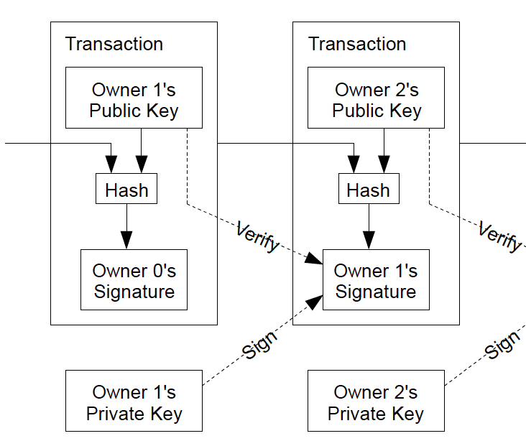
TRANSACTIONS
Chain of digital signatures

Slide 9
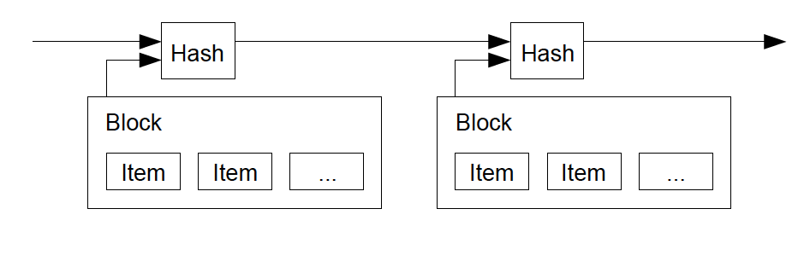
TIMESTAMP SERVER
Takes the hash of black of items to be timestamped and widely publicizing it
Each timestamp includes the previous timestamp in its hash, forming a chain
each additional timestamp reinforcing the ones before it

Slide 10
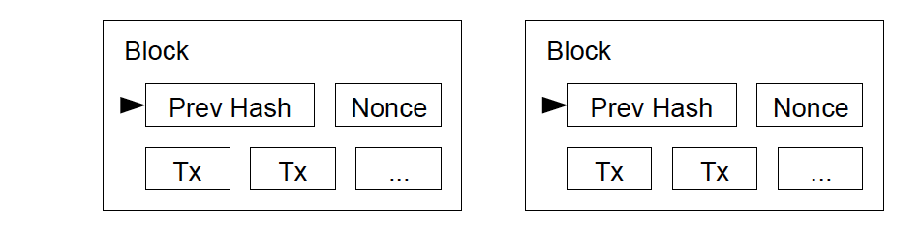
PROOF OF WORK
Implementing a distributed timestamp server on a peer-to-peer basis
Similar to Adam Back's Hashcash
Scan for a value that when hashed, such as with SHA-256, the hash begins with a number of zero bits
The average work required is exponential in the number of zero bits required and can be verified by executing a single hash
increment a nonce in the block until a value is found that gives the block's hash the required zero bits

Slide 11
PROOF OF WORK
The majority decision is represented by the longest chain
To modify a past block, an attacker would have to redo the proof-of-work of the block and all blocks after it and then catch up with and surpass the work of the honest nodes
probability of a slower attacker catching up diminishes exponentially as subsequent blocks are added
To compensate for increasing hardware speed and varying interest in running nodes over time, the proof-of-work difficulty is determined by a moving average targeting an average number of blocks per hour. If they're generated too fast, the difficulty increases

Slide 12
NETWORK
New transactions are broadcast to all nodes.
Each node collects new transactions into a block.
Each node works on finding a difficult proof-of-work for its block.
When a node finds a proof-of-work, it broadcasts the block to all nodes.
Nodes accept the block only if all transactions in it are valid and not already spent.
Nodes express their acceptance of the block by working on creating the next block in the chain, using the hash of the accepted block as the previous hash.

Slide 13
NETWORK
New transaction broadcasts do not necessarily need to reach all nodes.
As long as they reach many nodes, they will get into a block before long. Block broadcasts are also tolerant of dropped messages.
If a node does not receive a block, it will request it when it receives the next block and realizes it missed one

Slide 14
INCENTIVE
first transaction in a block is a special transaction that starts a new coin owned by the creator of the block
adds an incentive for nodes to support the network
way to initially distribute coins into circulation
incentive can also be funded with transaction fees
once a predetermined number of coins have entered circulation, the incentive can transition entirely to transaction fees
An attacker needs to choose between defrauding people by stealing back his payments, or generating new coins

Slide 15
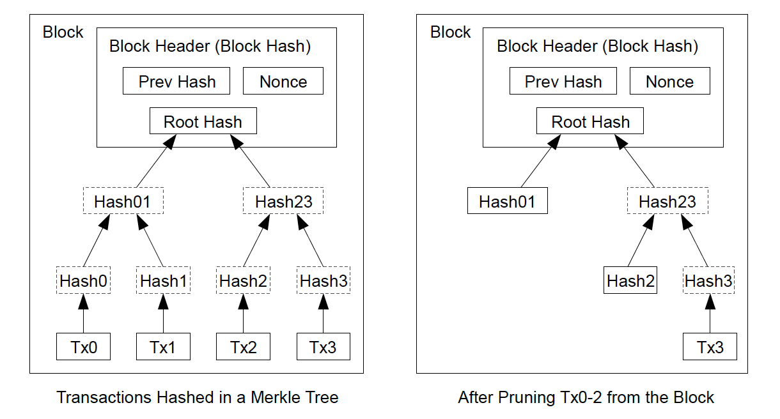
RECLAIMING DISK SPACE
once the latest transaction in a coin is buried under enough blocks, the spent transactions before it can be discarded to save disk space.
to facilitate this without breaking the block's hash, transactions are hashed in a Merkle Tree
only the root included in the block's hash
old blocks can then be compacted by stubbing off branches of the tree
The interior hashes do not need to be stored

Slide 16
SIMPLIFIED PAYMENT VERIFICATION
possible to verify payments without running a full network node
user only needs to keep a copy of the block headers of the longest proof-of-work chain
obtain the Merkle branch linking the transaction to the block it's timestamped in
user can see that a network node has accepted it, and blocks added after it further confirm the network has accepted it.

Slide 17
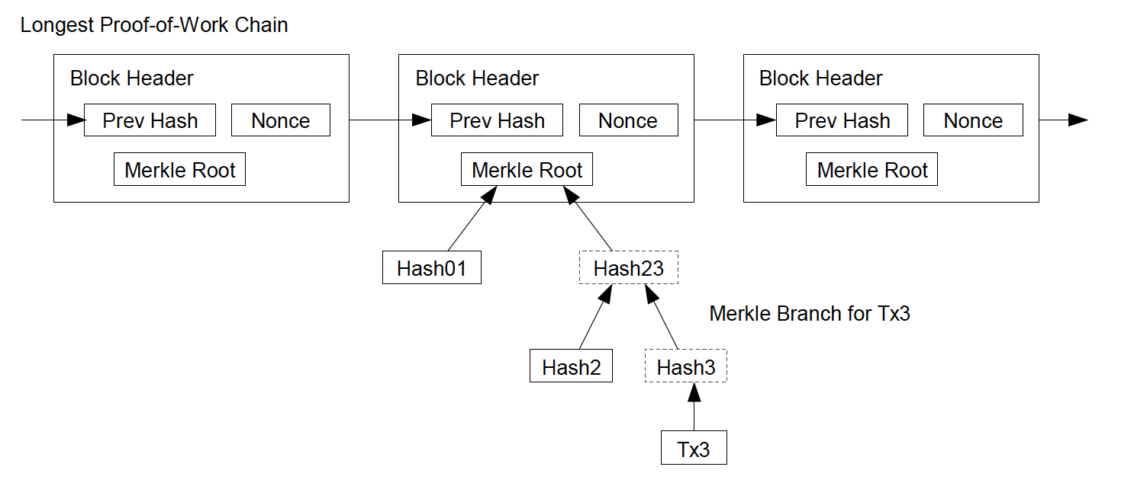
SIMPLIFIED PAYMENT VERIFICATION

Slide 18
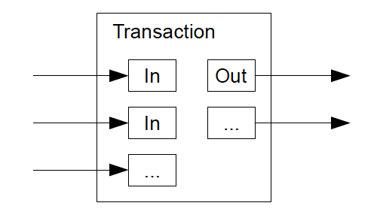
COMBINING AND SPLITTING VALUE
transactions contain multiple inputs and outputs
normally there will be either a single input from a larger previous transaction or multiple inputs combining smaller amounts
There are at most two outputs: one for the payment, and one returning the change, if any, to sender

Slide 19
PRIVACY
even though all transactions are announced publicly, some level of privacy can be achieved by keeping public keys anonymous
everyone can see that someone is sending an amount to someone else, but without information linking the transaction to anyone
as an additional firewall, a new key pair should be used for each transaction to keep them from being linked to a common owner
however, multi-input transactions, reveal that their inputs were owned by the same owner
if the owner of a key is revealed, linking could reveal other transactions that belonged to the same owner

