Slide 1

Artificial Intelligence for
Fraud Detection at HDFC Bank
Business
AI/ML
Case Study
Protecting 100+ million customers in India's digital banking economy
Course: Introduction to Artificial Intelligence & Machine Learning
Section: BBA Fintech &AI (i1)
Chitkara University, Rajpura, Punjab

Slide 2
Company Overview: HDFC Bank
2
India's largest private sector bank by assets
100.6 mn
9,689
₹31.0 tn
₹52.6 tn
Customers served
Branches across 4,175 cities
Total deposits (Mar 2026)
Total assets (Mar 2026)
What the bank does
Operates across retail banking, wholesale banking and treasury. Following the 2023 merger with HDFC Ltd, it also offers housing finance, life and general insurance, asset management and broking through group companies.
Who its customers are
Salaried and self-employed retail individuals, semi-urban and rural households (50.2% of branches), SMEs, and large corporate and institutional clients.
Products and services
Savings and deposit accounts, home and personal loans, credit and debit cards, UPI and net banking, cash management, trade finance, mutual funds and insurance distribution.
Source: HDFC Bank Form 20-F, FY2026 (SEC filing); HDFC Bank Q4 FY26 earnings presentation.

Slide 3
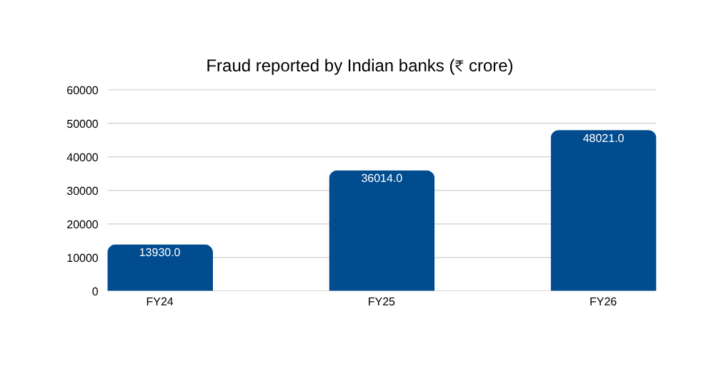
The Business Problem
3
Detecting fraudulent transactions in real time, at scale
THE PROBLEM
Financial loss
Regulatory exposure
Rule-based fraud systems cannot keep pace with digital payment fraud. They miss new fraud patterns and block too many genuine transactions.
Fraud losses and customer compensation hit the bank's profit directly.
RBI mandates fraud reporting, monitoring and customer protection norms.
Loss of trust
Operational cost
A single fraud incident can push a customer to close the relationship.
Every false alert consumes an investigator's time and a call-centre contact.
Why this matters now
  Fraud reported by Indian banks rose to ₹48,021 crore in FY2025-26, from ₹36,014 crore in FY2024-25 (RBI Annual Reports).
  Private sector banks account for the largest number of fraud cases — mainly small-value card and internet transactions.
  UPI recorded 185.8 billion transactions in FY25, up 41.7% year on year, expanding the attack surface.
  RBI notes a significant time lag between when a fraud occurs and when it is detected.
Note: each year's figure is as reported in that year's RBI Annual Report; totals include cases reclassified from earlier years.

Slide 4
Data Required
4
What an ML fraud model would need to learn from
1
Transaction data
2
Customer profile
3
Behavioural history
Amount, timestamp, channel (UPI / card / net banking), merchant category, beneficiary account, device and IP address.
Age, occupation, income band, account vintage, KYC details, product holdings, risk category.
Typical spending amounts, usual transaction times, frequent merchants, home location, historic velocity of payments.
4
Device & session data
5
Historic fraud labels
6
External signals
Device fingerprint, SIM change, login location, typing and swipe patterns (behavioural biometrics).
Past confirmed fraud cases and disputed transactions — the labelled examples the model trains on.
Mule account lists, RBI and NPCI fraud advisories, blacklisted VPAs and merchant IDs.
Key data challenge: fraud is extremely rare — typically well under 1% of all transactions. This class imbalance means a model that labels everything "genuine" would still appear over 99% accurate, so recall and precision matter far more than accuracy.

Slide 5
The Proposed AI/ML Solution
5
Supervised classification, supported by unsupervised anomaly detection
Why this approach fits the problem
Primary approach: Binary classification
Each transaction is scored as genuine or fraudulent, producing a fraud probability between 0 and 1. The bank sets a threshold above which a transaction is challenged or blocked.
Labelled history already exists
The bank holds years of confirmed fraud and dispute records, which is exactly what supervised learning requires.
Suitable algorithms
Decisions must be made in milliseconds
  Logistic regression — interpretable baseline, easy to explain to regulators
  Random Forest / XGBoost — handles non-linear patterns and mixed data types well
  Isolation Forest / autoencoders — unsupervised, flags never-before-seen fraud patterns without labels
  Recurrent neural networks — model the sequence of a customer's transactions over time
A trained model scores a transaction before the payment is authorised — humans cannot review at that speed.
Fraud patterns keep changing
Models are retrained on new fraud cases; static rules have to be rewritten manually each time.
A hybrid design covers both cases
Supervised models catch known fraud types; anomaly detection catches novel ones the labels have never seen.
HDFC Bank has publicly described AI and ML as an active area for fraud detection, including behavioural analysis and real-time anomaly detection.

Slide 6
How the AI Solution Works
6
From transaction to business outcome in under a second
1
2
3
4
5
Business Data
AI/ML System
Prediction
Business Action
Business Outcome
Transaction, customer,
device and history data
streamed in real time
Model scores the
transaction and returns a
fraud probability
Low risk → approve
Medium → OTP or
step-up check
High → block
Alert the customer,
freeze the account,
route to investigators
Fraud prevented,
genuine payments pass,
customer trust retained
Worked example
Human oversight stays in the loop
A customer who normally transacts for ₹2,000–₹5,000 in Chandigarh during the day attempts a ₹95,000 transfer at 3:10 a.m. from a new device logged in from another state, to a beneficiary added twelve minutes earlier.
  The model recommends; the fraud operations team decides on high-value and disputed cases.
  Every confirmed case is fed back as a new training label, so the system improves with each fraud attempt.
  Analysts stop screening millions of alerts and focus on the genuinely complex ones.
The model combines amount deviation, time, device novelty, location and beneficiary age into a single fraud score of 0.93 — the transaction is held and the customer is called before any money moves.

Slide 7
Business Impact
7
What changes for HDFC Bank if the solution works
Reduced fraud losses
Fewer false declines
Lower operating cost
Fewer completed fraudulent transactions means lower write-offs and lower customer compensation.
Behaviour-aware scoring lets genuine payments through instead of blocking them on rigid rules.
Investigators stop triaging noise; alert volumes fall and each analyst handles higher-value work.
Faster detection
Stronger customer trust
Regulatory confidence
Scoring happens before authorisation, closing the lag between fraud occurring and being caught.
Customers who are protected — and not needlessly blocked — stay with the bank longer.
Auditable, monitored fraud controls support RBI reporting and supervisory expectations.
Where the value sits
Fraud detection is a cost-avoidance investment, not a revenue line. Its return is measured as fraud value prevented, plus the revenue retained from genuine transactions that are no longer wrongly declined, minus the cost of running and monitoring the model.

Slide 8
Risks, Ethics & Responsible AI
8
What can go wrong, and how the bank should control it
Risk
Mitigation
Data privacy
Fraud models use sensitive personal and location data.
Comply with the DPDP Act 2023; minimise, encrypt and restrict data by purpose.
Bias & fairness
Models may over-flag customers from particular regions, income groups or transaction styles.
Test false-positive rates across customer segments; audit and retrain where gaps appear.
False positives
Blocking genuine payments frustrates customers and can cost the relationship.
Tune thresholds on business cost, not accuracy; offer instant step-up verification instead of hard blocks.
Opacity
A complex model cannot easily explain why a transaction was blocked.
Use explainability tools (e.g. SHAP) and keep an interpretable fallback model for audit.
Model drift
Fraudsters change tactics, so performance silently decays over time.
Monitor live precision and recall; retrain on a fixed schedule and after major incidents.
Responsible AI principle: the model advises, a human decides. No customer account should be permanently frozen on an algorithmic score alone.

Slide 9
AI Tools & Prompts Used
9
Part B — How Generative AI supported this research
Tool used
Only one tool was used for this project — stated plainly rather than implying multi-tool use that didn't happen.
Claude
Used for structuring the case study, running live searches against RBI and HDFC's own filings, cross-checking figures, and generating this deck.
Research prompts used
1
“HDFC Bank AI fraud detection machine learning”
Broad first pass — find what HDFC has publicly said about AI/ML use
2
“RBI annual report bank frauds amount FY2025 digital payment fraud India statistics”
Get authoritative, sourced fraud figures
3
“HDFC Bank number of customers branches FY2026 annual results total deposits”
Verify company scale from a primary source

Slide 10
Prompt Improvement & AI Evaluation
10
How a sharper prompt changed the quality of the research
BASIC PROMPT
IMPROVED PROMPT
“HDFC Bank AI fraud detection machine learning”
“RBI annual report bank frauds amount FY2025 digital payment fraud India statistics”
Returned marketing-style blogs describing “behavioural biometrics” and “instant blocking” with no citations and no way to verify the claims.
Named the authoritative source (RBI) and asked for numbers instead of a description — returned citable, verifiable figures.
Why the improved prompt produced a better result
Naming a specific, authoritative source and asking for data — instead of a general topic and a description — moved the research from anecdotal claims to citable evidence.
Critical evaluation of AI-generated output
Problem found:
Two search results claimed specific HDFC fraud-detection features (“behavioural biometrics”) with no source from the bank itself.
Verified against:
HDFC Bank's own Form 20-F (FY2026) — which discusses risk management in general terms but does not confirm these specific techniques.
Process improved:
The deck frames these as industry-standard approaches suitable for the problem, not as confirmed HDFC features — and states no invented performance number.

Slide 11
Recommendations & Conclusion
11
Advising the management of HDFC Bank
1
Run a hybrid model, not a single one
2
Optimise for business cost, not accuracy
Pair a supervised classifier for known fraud types with unsupervised anomaly detection for emerging ones.
Set thresholds using the rupee cost of a missed fraud against the cost of a false decline.
3
Build explainability in from the start
4
Audit for fairness every quarter
Every blocked transaction should come with a human-readable reason for the customer and the regulator.
Track false-positive rates by region, age and income segment, and act on the gaps.
5
Keep investigators in the loop
6
Close the feedback loop
Use AI to prioritise the queue, not to replace judgement on high-value cases.
Feed every confirmed fraud and every customer dispute back into the next training cycle.
Conclusion: fraud detection is one of the clearest cases for AI in banking — the data already exists, the decision has to be made in milliseconds, and the pattern keeps changing. HDFC Bank's advantage is its data scale; the discipline it needs is governance.

Slide 12
Learning Reflection, References & GitHub
12
Final slide
3 Key Learnings
References (APA 7th ed.)
1
A prompt naming a specific, authoritative source produces citable evidence; a general topic prompt produces confident-sounding but unverifiable claims.
HDFC Bank Limited. (2026). Annual report on Form 20-F for FY2026. U.S. SEC.
HDFC Bank Limited. (2026). Q4 FY26 earnings presentation.
2
Secondary sources can describe a real company's AI use in specific technical language without that language coming from the company itself — always check the primary filing.
Reserve Bank of India. (2025). Annual report 2024-25.
Reserve Bank of India. (2026). Annual report 2025-26.
3
The most defensible move when data doesn't exist in a primary source is to say so, not to fill the gap with a plausible-sounding number.
Business Standard. (2025, May 30). Bank fraud cases fell in FY25, amount rose threefold to ₹36,014 cr: RBI.
George, M. Z. H., Alam, M. K., & Hasan, M. T. (2023). Machine learning for fraud detection in digital banking: A systematic literature review. WCSDI, 3(1), 37–61.
Academic integrity note
All figures verified against primary sources — HDFC's SEC filing and RBI annual reports — rather than secondary summaries. AI tools assisted research; analysis and conclusions reflect the student's own understanding.

Slide 13
GITHUB REPOSITARY
  Kakul-
  Dikshan-
  Akhilesh-
  Kartik-
  Chesta-
  Dev-
  Divyansh

