Slide 1
Classifying IoT Devices in Smart Environments Using Network Traffic Characteristics
Phanindra Kakumanu
School of Computing, University of Georgia

Slide 2
Abstract
Goal:
Replicate and extend Sivanathan et al.'s work
Approach:
Rigorous replication of original experiment.
Expanded dataset with diverse IoT devices.
Exploration of alternative machine learning algorithms.
Optimization of data preprocessing pipeline.
Contribution:
Robust and efficient method for IoT device identification and classification.
Enhanced network management capabilities.

Slide 3
Introduction
IoT has transformed domains like smart homes and industrial automation, offering enhanced convenience, efficiency, and productivity.
Growth in IoT devices introduces risks such as unauthorized access, data breaches, and attacks.
Device identification and classification are vital for security measures like intrusion detection and access control.
Limitations of Traditional Methods:
Relies on device signatures or Ips
Vulnerable to spoofing and manipulation

Slide 4
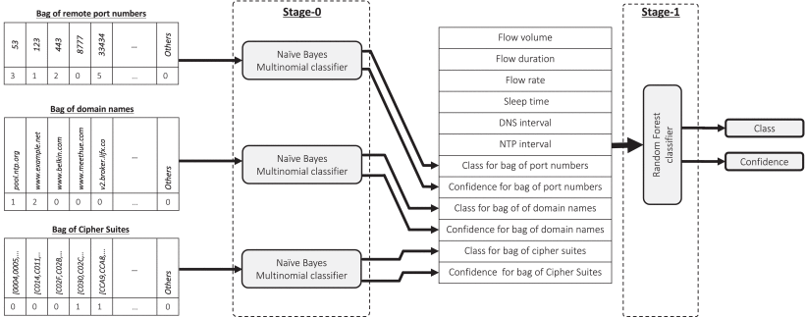
Related Work
A. Sivanathan et al. (2019):
Classified IoT devices using features like packet size, inter-arrival time, and protocol usage.
Achieved high accuracy but with computational overheads.
Limitations in existing techniques:
High computational cost.
Dependence on hourly data processing.

Slide 5
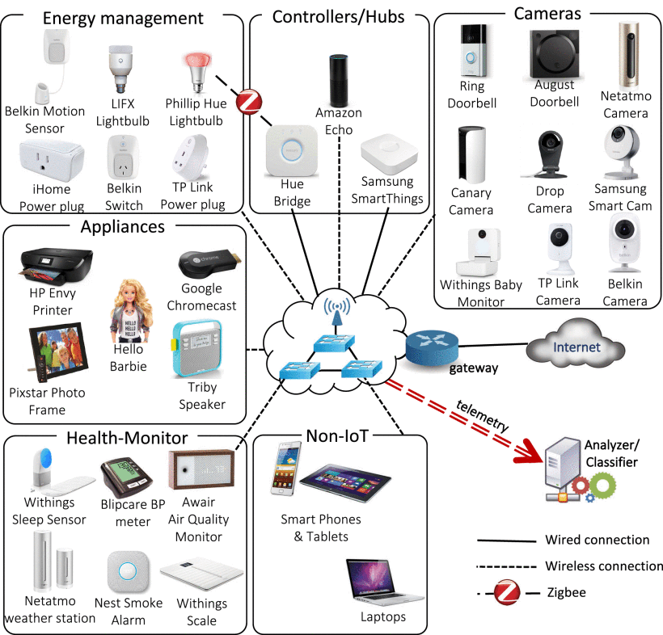
Dataset and Testbed
Dataset:
We are using publicly available data collected from 28 different devices.
Includes cameras, sensors, hubs, and light bulbs.
Data Collection:
Captured in PCAP format using tcpdump scripts.
Features extracted directly from network packets.
Key Features:
Flow volume, Flow duration, average flow rate, device sleep time, dns queries, and cipher suites.
Fig.1. Testbed architecture showing connected 28 different IoT devices along with several non-IoT devices, and telemetry collected across the infrastructure is fed to our classification models referring from [1].

Slide 6
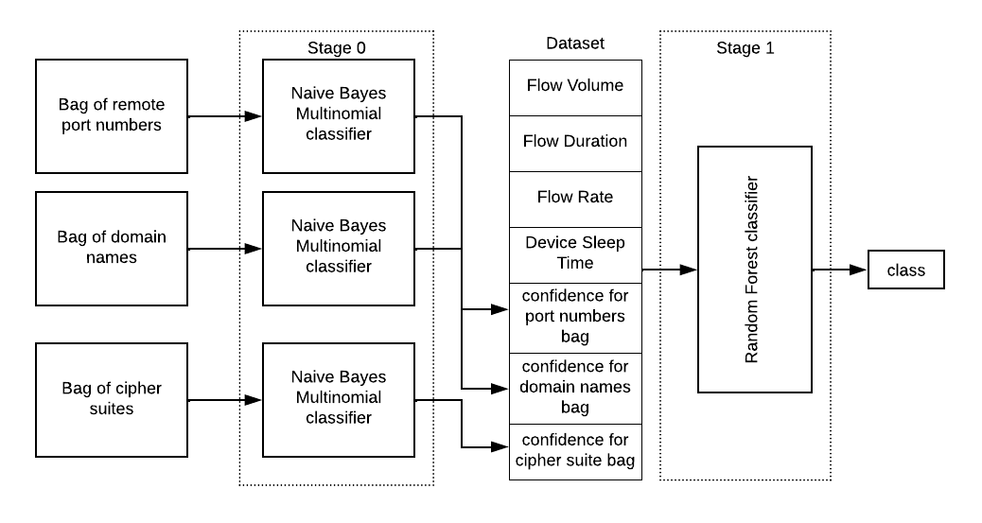
Methodology
Proposed Multi-Stage Machine Learning Framework:
Stage 0: Naive Bayes for confidence value extraction (remote ports, domain names, cipher suites).
Stage 1: Advanced ML models (Random Forest, Gradient Boosting, XGBoost).
Preprocessing Improvements:
Feature extraction directly from PCAP files
Eliminated complex imputation techniques by assigning default values.
Fig.2. Architecture diagram representing multi-stage machine learning approach.

Slide 7
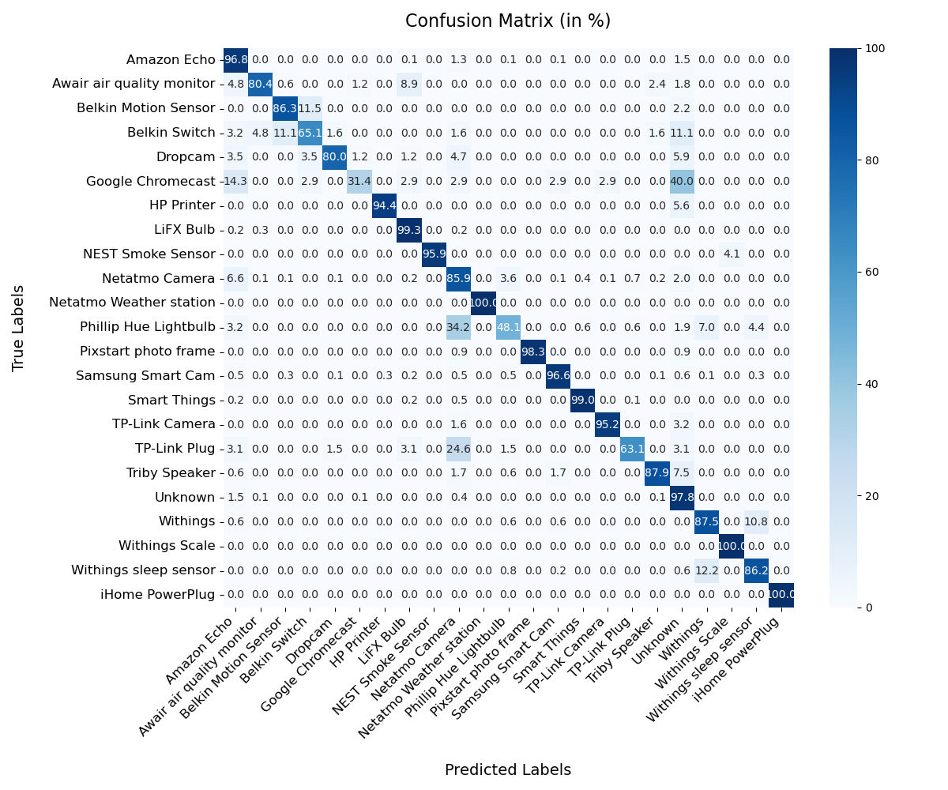
Machine Learning Models
Random Forest
Robustness: Combines multiple decision trees to reduce overfitting and improve generalization.
Feature Handling: Effectively manages both numerical and categorical features without extensive preprocessing.
Interpretability: Provides insights into feature importance, aiding in understanding key drivers of classification.
Fig.3.1. Confusion matrix of IoT device classification using random forest (accuracy: 95.86971 percent, RRSE: 28.60379 percent)

Slide 8
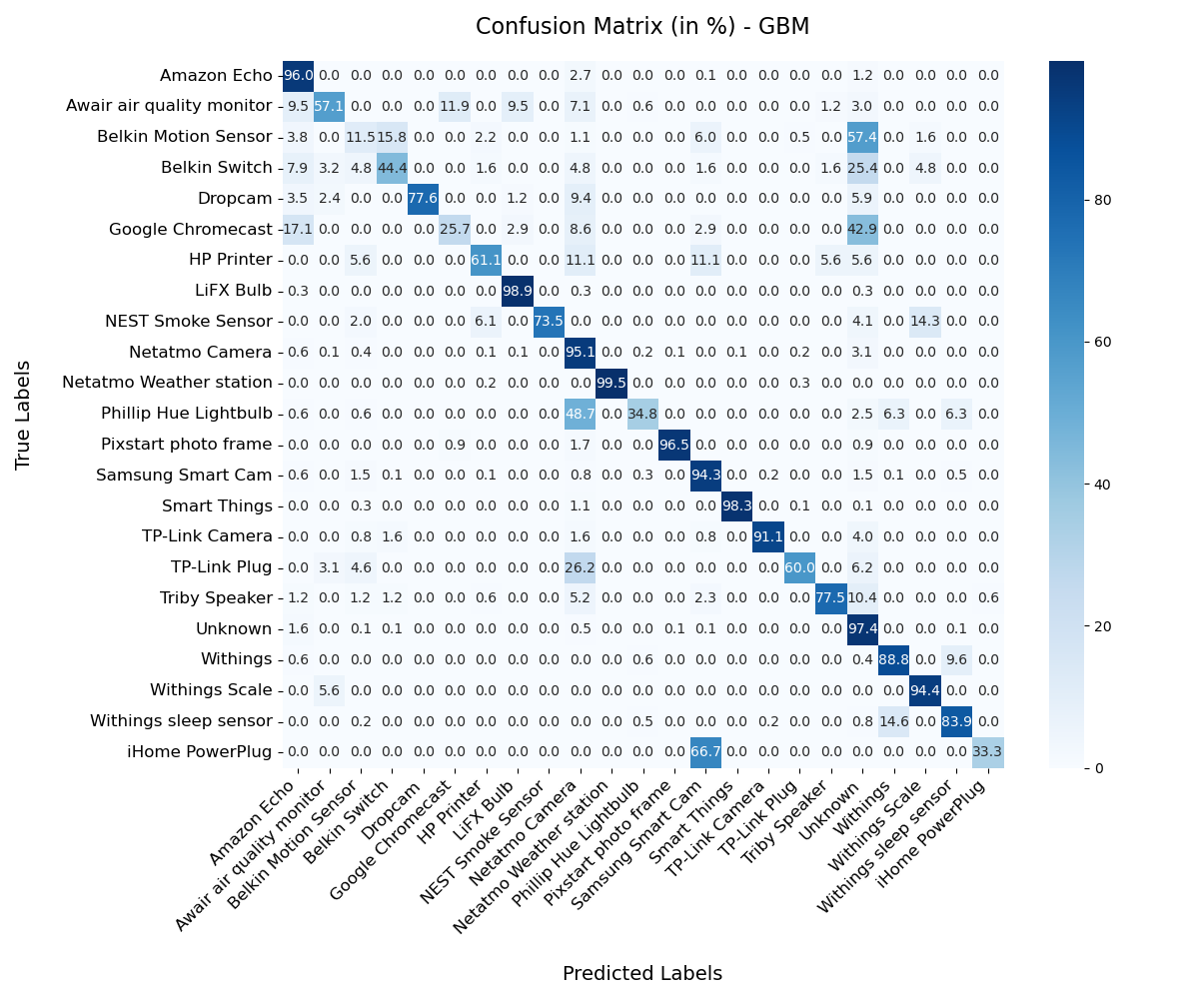
Gradient Boosting
High Accuracy: Excels in capturing complex patterns in data through sequential model building.
Error Correction: Each new model focuses on correcting errors from the previous ones, enhancing overall performance.
Flexibility: Can handle different types of data and is adaptable to various problem complexities.
Customization: Offers parameters for fine-tuning, allowing optimization for specific datasets and tasks.
Fig.3.2. Confusion matrix of IoT device classification using Gradient Boosting (accuracy: 95.020 percent, RRSE: 31.579 percent)

Slide 9
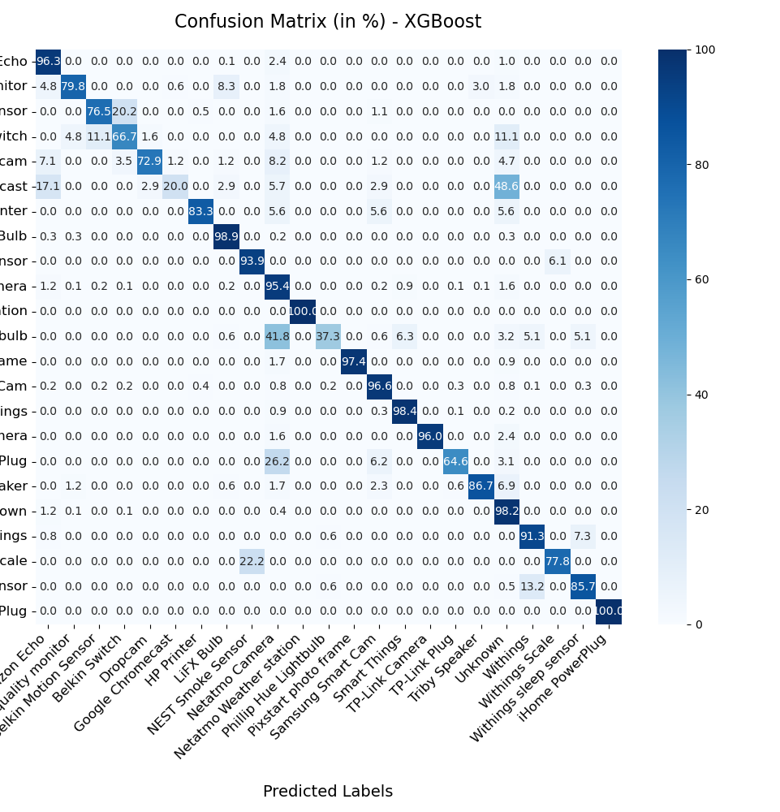
XGBoost
Performance Optimization: Designed for speed and efficiency, making it ideal for large-scale datasets.
Regularization: Incorporates L1 and L2 regularization to prevent overfitting, ensuring robust model performance.
Advanced Features: Supports parallel processing and tree pruning, enhancing computational efficiency and model accuracy.
Scalability: Handles large datasets and high-dimensional data effectively, which is essential for network traffic analysis.
Fig.3.3. Confusion matrix of IoT device classification using XGBoost (accuracy: 96.261 percent, RRSE: 25.765 percent)

Slide 10
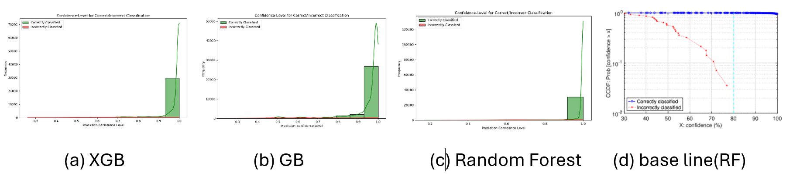
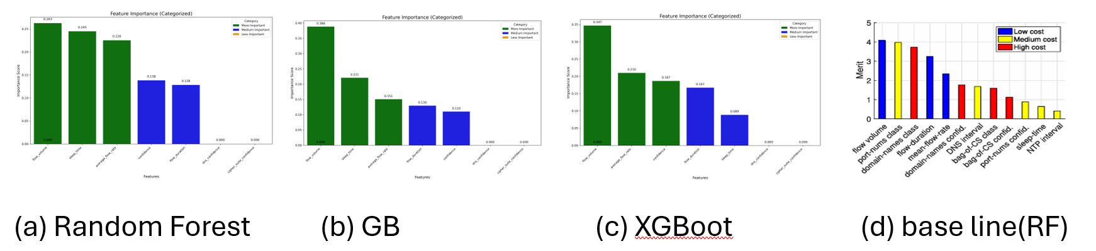
Results and Analysis
Fig.4. Confidence Level comparison between baseline paper and 3 different models implemented in this paper.
Fig.5. Attribute importance comparison between baseline paper and 3 different models implemented in this paper.

Slide 11
Model | Metric | Value
Random Forest | Accuracy | 95.86971
 | RRSE | 28.60379
Gradient Boosting | Accuracy | 95.02049
 | RRSE | 31.57934
XGBoost | Accuracy | 96.26165
 | RRSE | 25.76584
Base line (Random Forest) | Accuracy | 99.88
 | RRSE | 5.06
Model | Fold 1 | Fold 2 | Fold 3 | Fold 4 | Fold 5 | Mean
Random Forest | 0.84841736 | 0.95507453 | 0.94872023 | 0.95914247 | 0.9395748 | 0.930185
Gradient Boosting | 0.7472534 | 0.95005642 | 0.95480729 | 0.95347111 | 0.91739414 | 0.904596
XGBoost | 0.85355425 | 0.96561554 | 0.94681988 | 0.96499198 | 0.9416533 | 0.934526
Table.3. Cross-Validation Scores and Mean Performance Across Models
Table.2. Accuracy and RRSE(Root Relative Squared Error) values of baseline paper and 3 different models implemented in this paper.

Slide 12
Results observations
XGBoost outperformed others with highest accuracy.
Google Chromecast, Belkin Switch, and Philips Hue Lightbulb showed higher misclassification rates due to data bias.
Feature importance analysis:
Flow volume as the most critical factor.
DNS and cipher suite confidence scores less influential.
Need for advanced feature engineering to improve misclassified devices.

Slide 13
Conclusion
Achievements:
Successfully replicated and extended the baseline work.
Developed a scalable ML framework with promising results.
Limitations:
Dataset constraints (28 devices vs. 128 days in baseline).
In conclusion, this research successfully extended the work of Sivanathan et al. by applying a multi-stage machine learning approach to classify IoT devices based on network traffic characteristics. Among the models tested, XGBoost achieved the highest accuracy and efficiency.
Notes:
This work contributes to the field of IoT security by offering a robust and scalable method for identifying IoT devices, with potential improvements in feature engineering and data preprocessing for future studies.

Slide 14
References
A. Sivanathan et al., "Classifying IoT Devices in Smart Environments Using Network Traffic Characteristics," in IEEE Transactions on Mobile Computing, vol. 18, no. 8, pp. 1745-1759, 1 Aug. 2019, doi: 10.1109/TMC.2018.2866249.
A. Sivanathan et al., "Characterizing and classifying IoT traffic in smart cities and campuses," 2017 IEEE Conference on Computer Communications Workshops (INFOCOM WKSHPS), Atlanta, GA, USA, 2017, pp. 559-564, doi: 10.1109/INFCOMW.2017.8116438.
S. Alexander and R. Droms, “DHCP Options and BOOTP vendor extensions,” Internet Requests for Comments, RFC Editor, RFC 2132, Mar. 1997.
https://github.com/cisco/joy
https://github.com/kakumanuphanindra/Classifying_IoT_Devices_Based_on_Network_Patterns (source code link for this paper)

