Slide 1
PHP-TRAVELS
Flight Modules

Slide 2
Flight Module
1. Firstly Navigate to the (“https://phptravels.net/flights)
2. User will select the options like one way or roundtrip here he will select one way
3. Then the user want to select flying from and destination to
4. Then he will add the travellers and click on search
5. It will show the results accordingly
6. Then we have to filter the flights like selecting price range , flights according to the user needs
7.Then he will enter to the booking page once he will enter valid data the user can able to book flight
8 In case if he enter invalid it will show not found

Slide 3
Technologies used
Tools and Technologies​
Technologies Used:​
Test case design​
Java​
Selenium WebDriver​
Cucumber​
Pom design pattern​
Hybrid frame work​
TestNG​
Log4j and extend report​

Slide 4
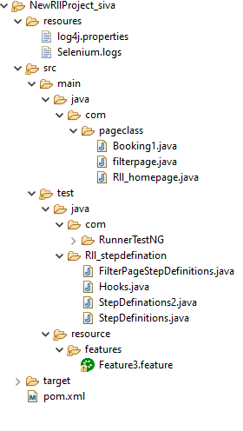
Framework overview​
Src/main/java : page classes ​
Src/test/java : stepsdefinitions and runner​
Src/test/resources: feature file

Slide 5
Test scenario​

Slide 6
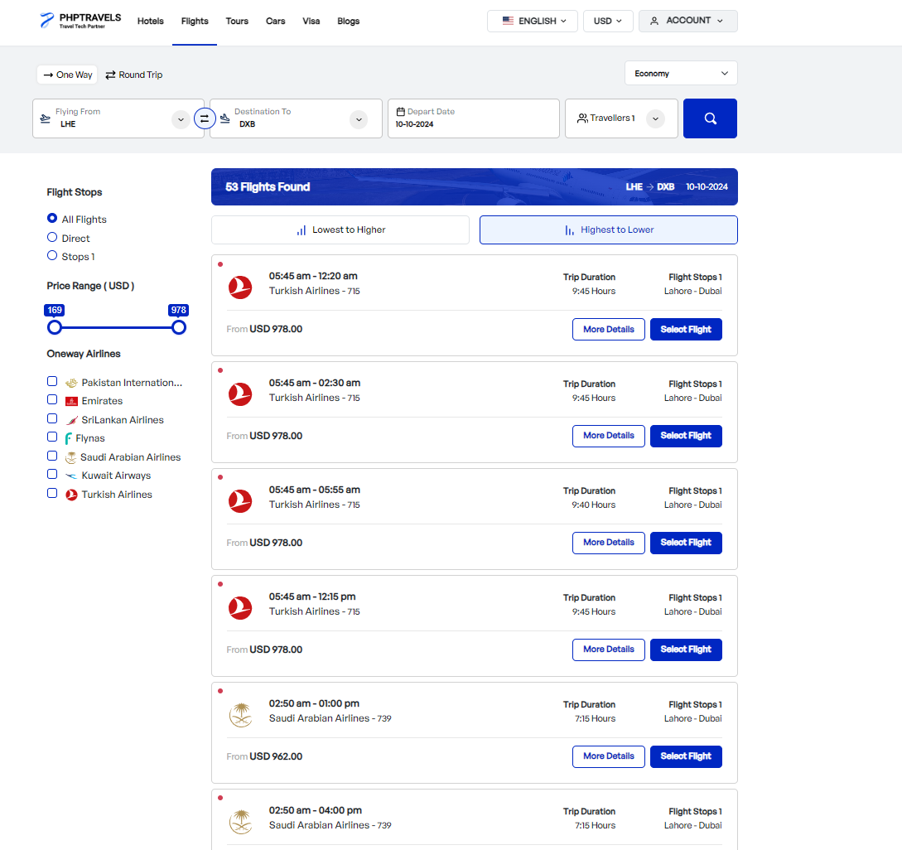
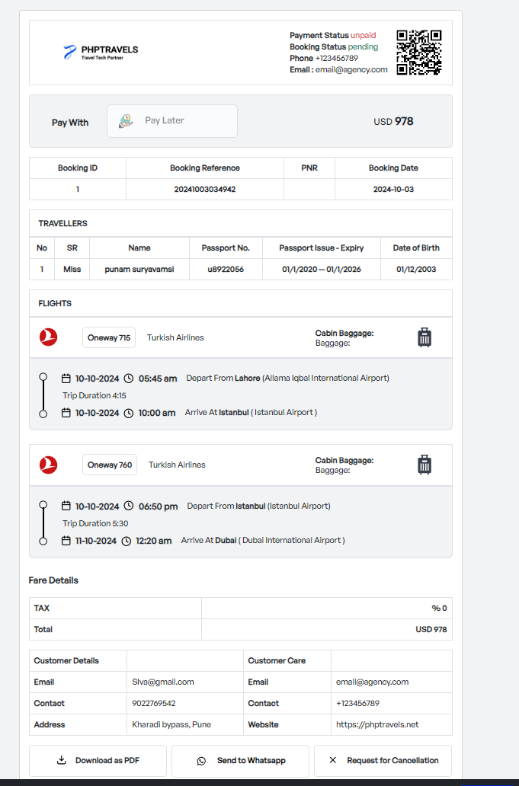

Slide 7
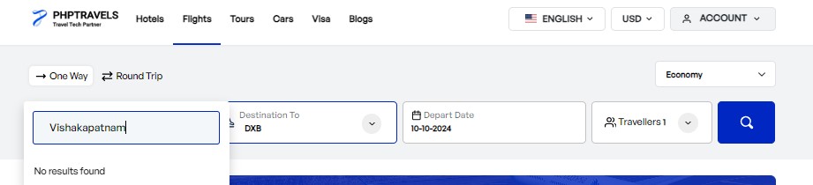
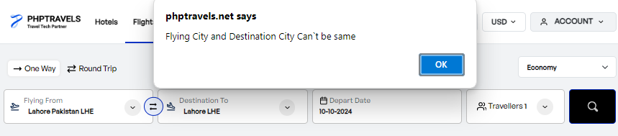

Slide 8
Framework
A test automation framework is a structured and organized set of rules, practices, and tools that guide how tests are created, executed, and managed.
Log4j
It allows developers to log messages during the execution of an application, which can help in monitoring, debugging, and troubleshooting.
Cucumber Reports
These reports give insights into how well the system meets the specified behaviors by showing which test scenarios passed, failed, or were skipped. The reports are generated in various formats such as HTML, JSON, or JUnit XML.
Extent Reports
It is a popular reporting library used in automation testing to generate highly detailed and customizable test reports. Extent Reports can be integrated with various automation frameworks, such as Selenium, TestNG, and Cucumber.

