Slide 1
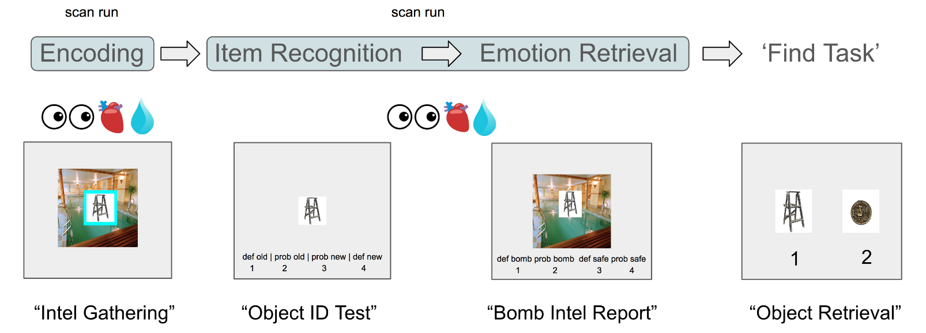
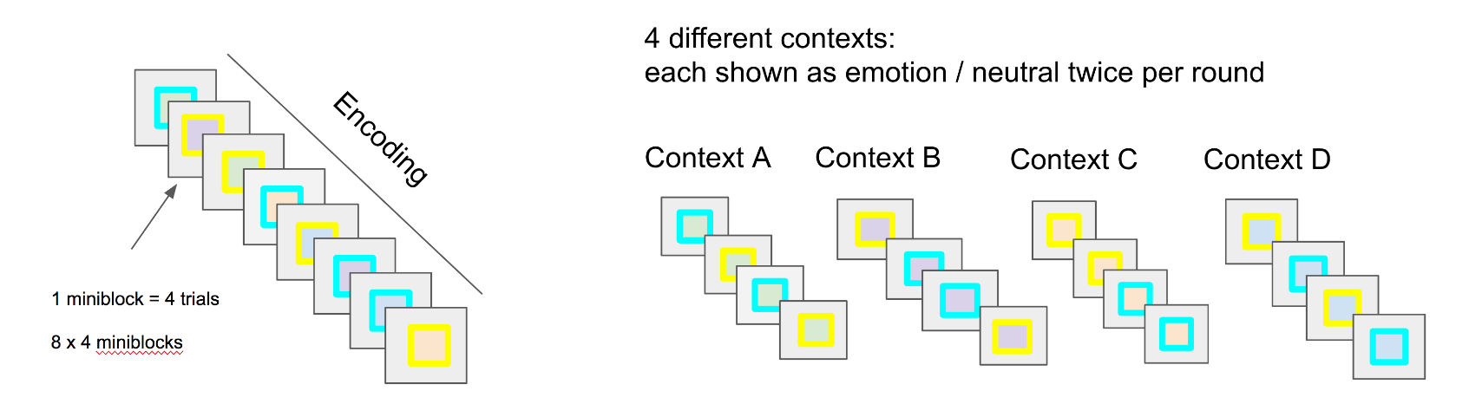
“Object Selection”
1 miniblock = 4 trials
8 x 4 miniblocks / round

Slide 3



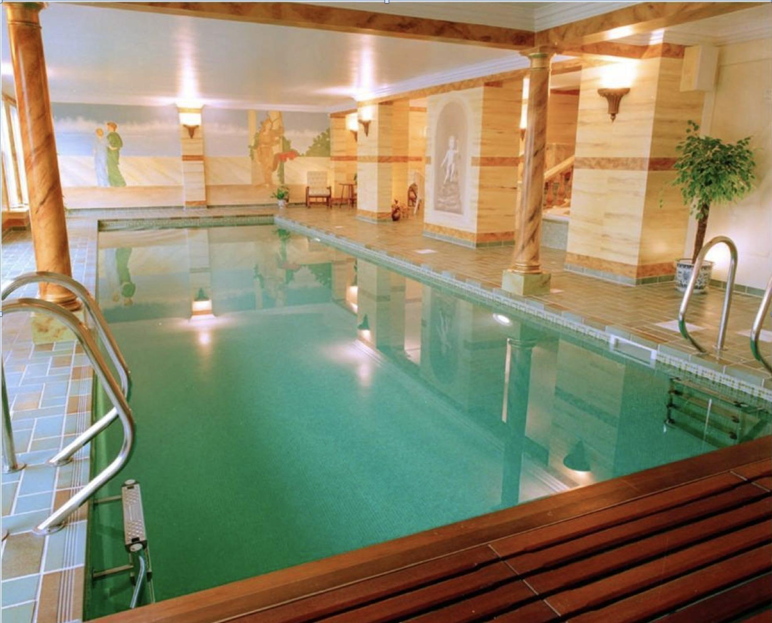
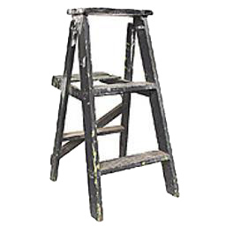

scan run
scan run
Encoding
Item Recognition Emotional Retrieval
Find Task
def old | prob old | prob new | def new
1 2 3 4
def startle prob startle def safe prob safe
1 2 3 4
“Intel Gathering”
“Object ID Test”
“Bomb Report”

Slide 4
scan run
scan run
Encoding
Item Recognition Emotional Retrieval
Find Task
def old | prob old | prob new | def new
1 2 3 4
def startle prob startle def safe prob safe
1 2 3 4
“Intel Gathering”
“Object ID Test”
“Bomb Report”

