Slide 1
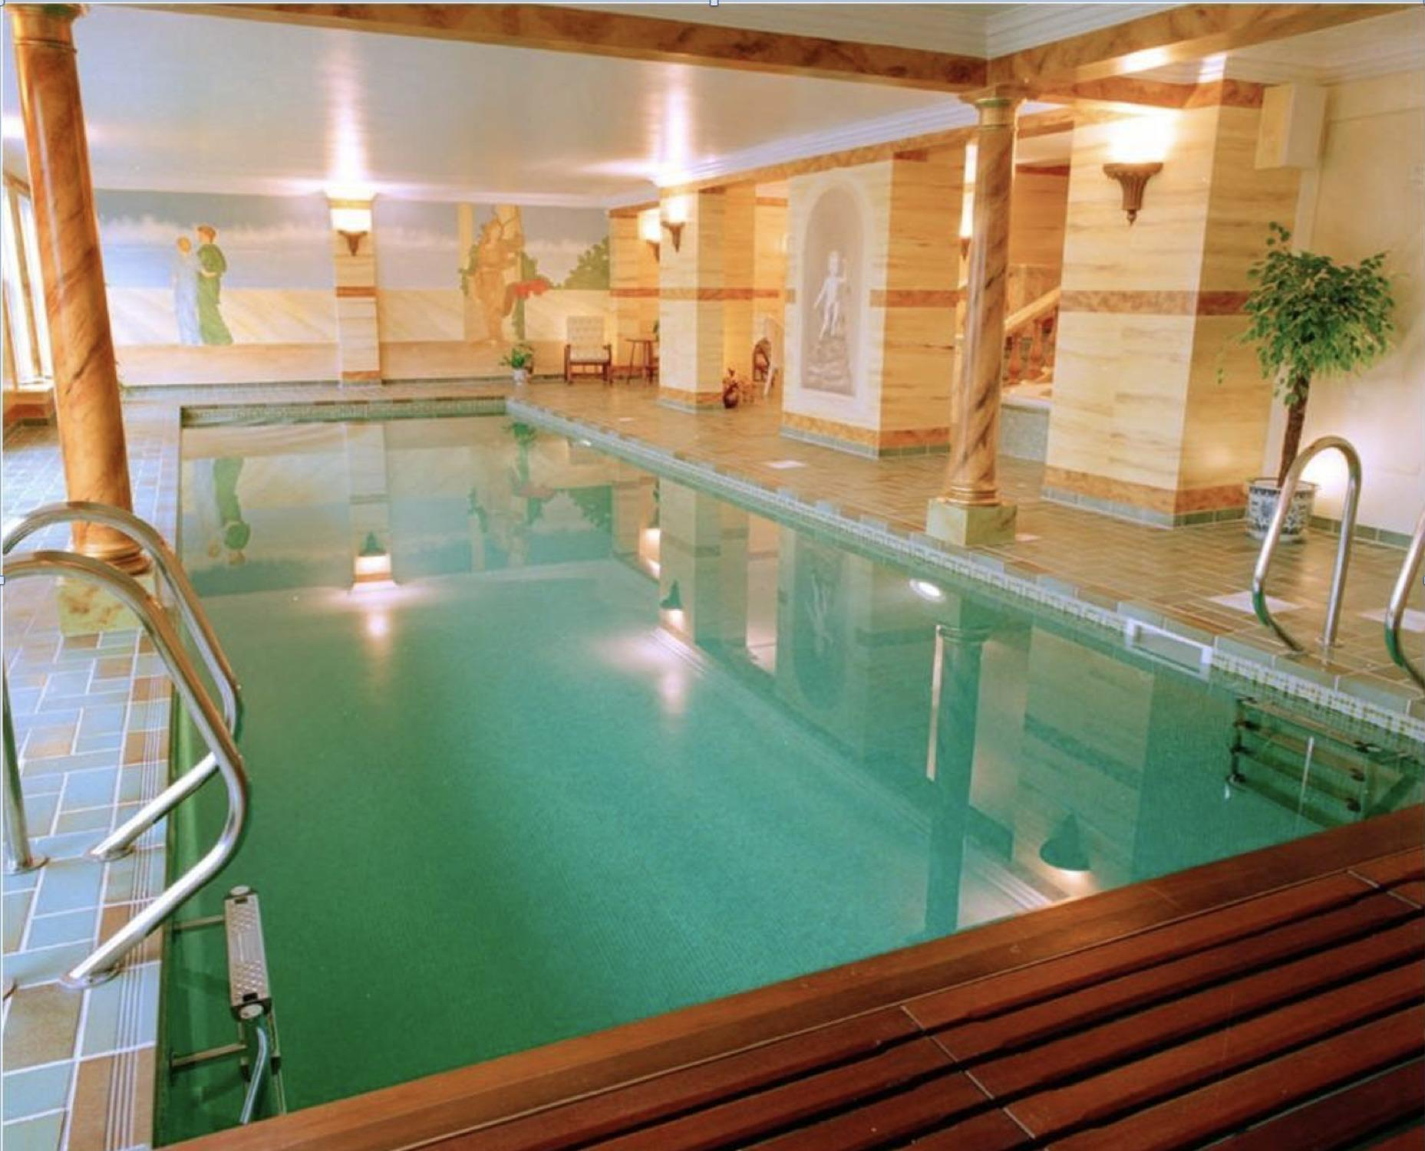

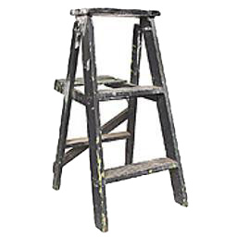
Would this object float?
1 = yes | 2 = no
1.5 sec
25%
[2, 4, 6, 8] sec
1 = yes | 2 = no
2 sec
…
1.5 sec

