Slide 1
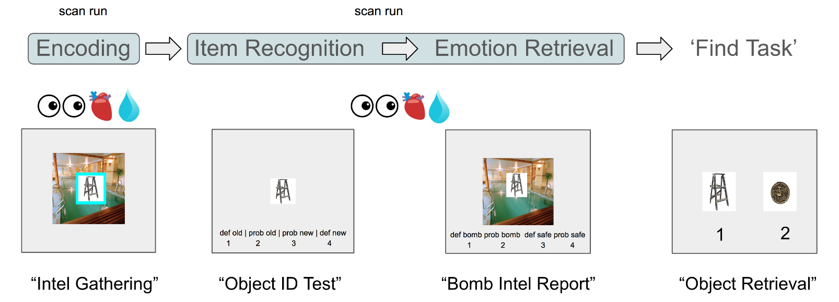
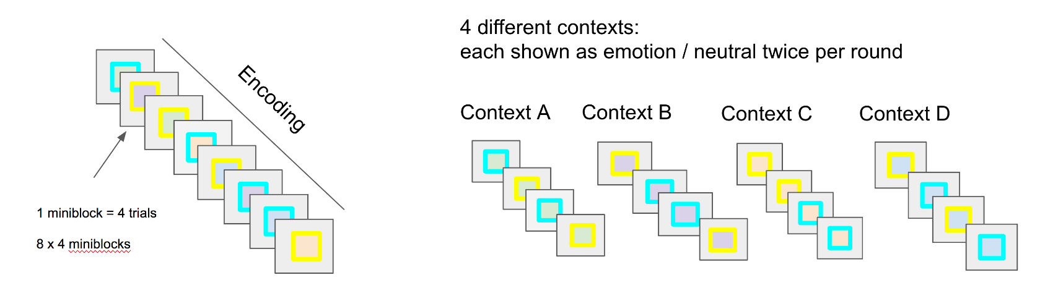
“Object Selection”
1 miniblock = 4 trials
8 x 4 miniblocks / round

