Slide 1


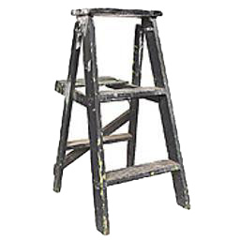
Reminder: These colors indicate BOMBS or SAFETY!
BOMBS
WARNING: BOMBS!
SAFETY
4 sec
25%
3 sec
[2, 4, 6, 8] sec
…
2 sec

