Slide 1
Chapter 1: Explore the Network
Introduction to Networks v6.0
Notes:
Cisco Networking Academy Program
Introduction to Networks v6.0
Chapter 1: Explore the Network

Slide 2


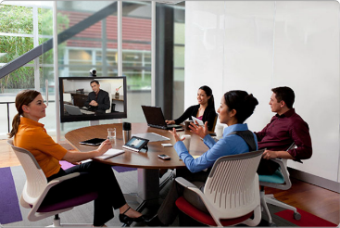
Globally Connected Networking Today
Network has no boundary and supports the way we:
Learn
Communicate
Work
Play
Notes:
1.1 – Globally Connected
1.1.1 – Network Today

Slide 3
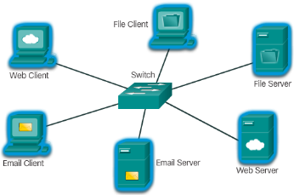
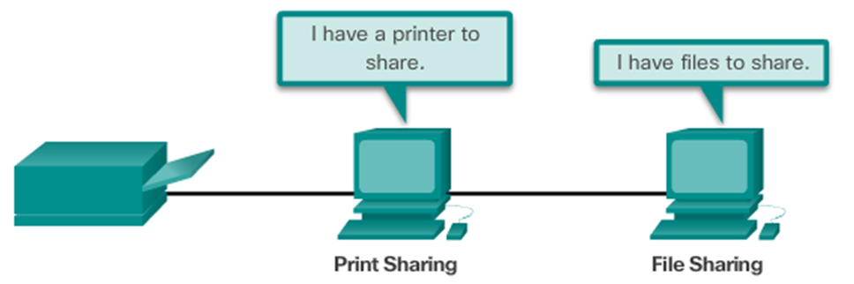
Globally Connected Providing Resources in a Network
Networks of Many Sizes
Small Home / Office Networks
Medium to Large Networks
World Wide Network
Clients and Servers
Clients request and display information
Servers provide information to other devices on the network
Peer-to-Peer
Computers can be both server and client at the same time.
What are the advantages?
What are the disadvantages?
Notes:
1.1 – Globally Connected
1.1.2 – Providing Resources in a Network

Slide 4
1.2 LANs, WANs, and the Internet
Notes:
Cisco Networking Academy Program
Introduction to Networks v6.0
Chapter 1: Explore the Network

Slide 5
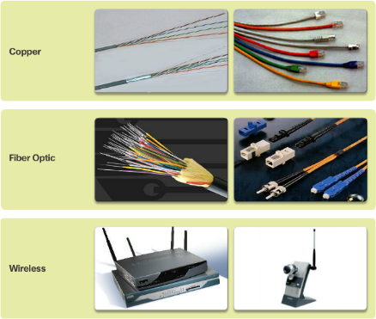
LANs, WANs, and the Internet Network Components
End Devices
Either the source or destination of a message
Name some end devices
Intermediary Network Devices
Connect multiple individual networks to form an internetwork
Connect the individual end devices to the network
Ensure data flows across the network
Provide connectivity
Network Media
Provide the pathway for data transmission
Interconnect devices
Name the three types of media
Notes:
1.2 – LANs, WANs, and the Internet
1.2.1 – Network Components

Slide 6






LANs, WANs, and the Internet Network Components
Network Representations
What do the symbols represent?
Topology Diagrams
Physical
Logical
Notes:
1.2 – LANs, WANs, and the Internet
1.2.1 – Network Components

Slide 7
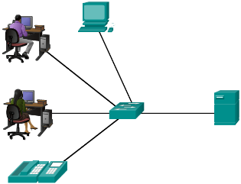
LANs, WANs, and the Internet LANs and WANs
Local Area Networks
Spans across small geographical area
Interconnects end devices
Administrated by a single organization
Provide high speed bandwidth to internal devices
WAN Area Networks
Interconnects LAN
Administrated by multiple service providers
Provide slower speed links between LANS
Can you name more network types?
Notes:
1.2 – LANs, WANs, and the Internet
1.2.2 – LANs and WANs

Slide 8
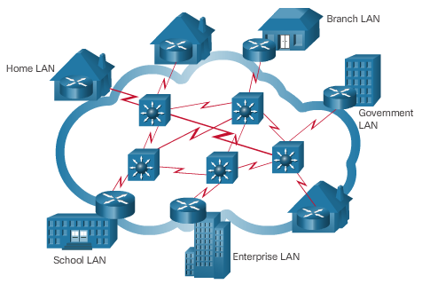
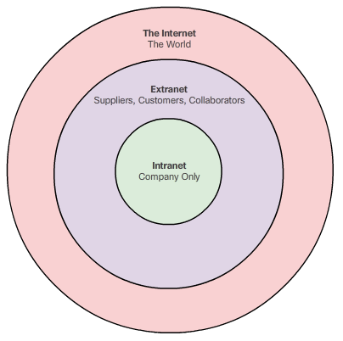
LANs, WANs, and the Internet The Internet, Intranets, and Extranets
The Internet
Worldwide collection of interconnected networks
Not owned by any individual or group
Intranets and Extranets
Notes:
1.2 – LANs, WANs, and the Internet
1.2.3 – The Internet, Intranets, and Extranets

Slide 9
LANs, WANs, and the Internet Internet Connections
Internet Access Technologies
Internet Service Provider (ISP)
Broadband cable
Broadband Digital Subscriber Line (DSL)
Wireless WANs
Mobile Services
Business DSL
Leased Lines
Metro Ethernet
Types of Internet Connections
Home and Small Office
Business
Notes:
1.2 – LANs, WANs, and the Internet
1.2.4 – Internet Connections

Slide 10
1.3 The Network as a Platform
Notes:
Cisco Networking Academy Program
Introduction to Networks v6.0
Chapter 1: Explore the Network

Slide 11
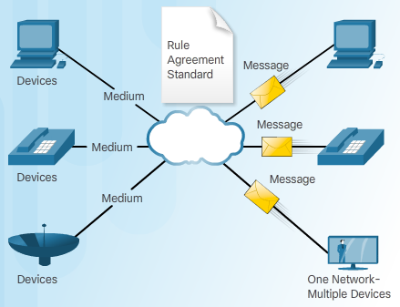
The Network as a Platform Converged Networks
Traditional Separate Networks
Each network with its own rules and
The Converging Network
Capable of delivering data, voice, and video over the same network infrastructure
Notes:
1.3 – The Network as a Platform
1.3.1 – Converged Networks

Slide 12
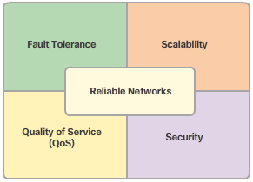
The Network as a Platform Reliable Network
Four Basic Characteristics of Network Architecture
Fault Tolerance
Scalability
Quality of Service (QoS)
Security
Notes:
1.3 – The Network as a Platform
1.3.2 – Reliable Network

Slide 13
1.4 The Changing Network Environment
Notes:
Cisco Networking Academy Program
Introduction to Networks v6.0
Chapter 1: Explore the Network

Slide 14

The Changing Network Environment Network Trends
Top trends include:
Bring Your Own Device (BYOB)
Online Collaboration
Video Communications
Cloud Computing
Notes:
1.4 – The Changing Network Environment
1.4.1 – Network Trends

Slide 15

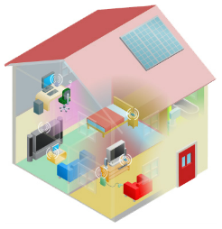
The Changing Network Environment Networking Technologies for the Home
Technology Trends in the Home
Smart home
Powerline Networking
Uses existing electrical wiring to connect devices
Wireless Broadband
Wireless Internet Service Provider (WISP)
Wireless Broadband Service using cellular technology
Notes:
1.4 – The Changing Network Environment
1.4.2 - Networking Technologies for the Home

Slide 16
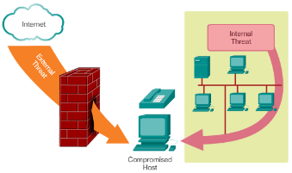
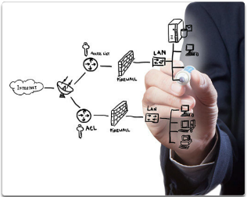
The Changing Network Environment Network Security
Security Threats
Viruses, worms, and Trojan horses
Spyware and adware
Zero-day attacks, also called zero-hour attacks
Hacker attacks
Denial of service attacks
Data interception and theft
Identity theft
Security Solutions
Antivirus and antispyware
Firewall filtering
Dedicated firewall systems
Access control lists (ACL)
Intrusion prevention systems (IPS)
Virtual Private Networks (VPNs)
Notes:
1.4 – The Changing Network Environment
1.4.3 – Network Security

Slide 17
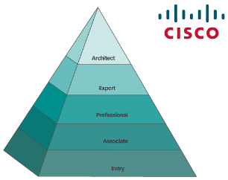
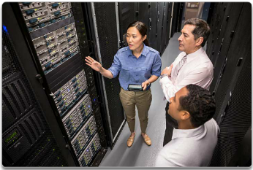
The Changing Network Environment Network Architecture
Cisco Network Architecture
Support technologies and applications
Ensure connectivity across any combination of networks
CCNA
A first step to a networking career
Notes:
1.4 – The Changing Network Environment
1.4.4 – Network Architecture

Slide 18
1.5 Chapter Summary
Notes:
Cisco Networking Academy Program
Introduction to Networks v6.0
Chapter 1: Explore the Network

Slide 19
Chapter Summary Summary
Explain how multiple networks are used in everyday life.
Describe the topologies and devices used in a small to medium-sized business network.
Explain the basic characteristics of a network that supports communication in a small to medium-sized business.
Explain trends in networking that will affect the use of networks in small to medium-sized businesses.
Notes:
1.5.1.3 - Summary

Slide 20


Slide 21


Slide 22
Section 1.1 New Terms and Commands
client
collaborative learning spaces
global communities
human network
network collaboration services
network of networks
peer-to-peer network
server
Notes:
New Terms and Commands

Slide 23
Section 1.2 New Terms and Commands
broadband cable
broadband DSL
business DSL
cable
cellular
dedicated leased line
dial-up telephone
DSL
end devices
extranet
hardware
intermediary devices
internetworking devices
Internet Service Provider (ISP)
Intranet
leased lines
Local Area Network (LAN)
logical topology diagrams
medium
Metropolitan Area Network (MAN)
metro Ethernet
network access devices
network interface card (NIC)
network media
physical port, interface
physical topology diagrams
satellite
security devices
service provider (SP)
software
Storage Area Network (SAN)
TelePresence endpoint
teleworkers
topology diagram
VoIP phones
Wide Area Network (WAN)
Wireless LAN (WLAN)
Notes:
New Terms and Commands

Slide 24
Section 1.3 New Terms and Commands
availability
circuit switched networks
content security
converged network
data confidentiality
data integrity
delay
Denial of Service (DoS)
encrypting data
fault tolerance
hierarchical layered structure
intelligent information network
network architecture
network bandwidth
network congestion
network infrastructure security
packet loss
packet switched networks
packets
Quality of Service (QoS)
queue
redundancy
routing function
scalability
user authentication
Notes:
New Terms and Commands

Slide 25
Section 1.4 New Terms and Commands
access control lists (ACL)
adware
Bring Your Own Deice (BYOD)
cloud computing
data centers
data interception and theft
hacker attacks
identity theft
intrusion prevention systems (IPS)
multiple layers of security
multitasking
online collaboration
person-to-person video calling
powerline networking
server clusters
server farms
smart home technology
spyware
Trojan horses
video conferencing
virtual private networks (VPNs)
virtualization
viruses
wireless broadband service
wireless internet service provider (WISP)
wireless local area networks (WLAN)
worms
zero-day attacks
Notes:
New Terms and Commands

