Slide 1
Logic

Slide 2
Logic
It relates to Knowledge Representation (KR) and inferencing in AI programs
Typically a reference to systematic method of reasoning
Example:
F1: If it is hot and humid, then it will rain.
F2: If it is humid, then it is hot.
F3: It is humid now.
F1, F2, F3 are facts.
The question is will it rain?
R: will it rain

Slide 3
It is hot, it is humid and it will rain are assertions which are
Simple in the sense that they can not be further decomposed.
Declarative with the characteristic that these may be true or false but never both,.i.e., excluded middle.

Slide 4
In symbolic logic, the method of reasoning which is followed is first to identify simple declarative facts called Atoms
An atom is a symbol representing a simple proposition which has the following characteristics:
- not decomposable
- has T or F values but not both.

Slide 5
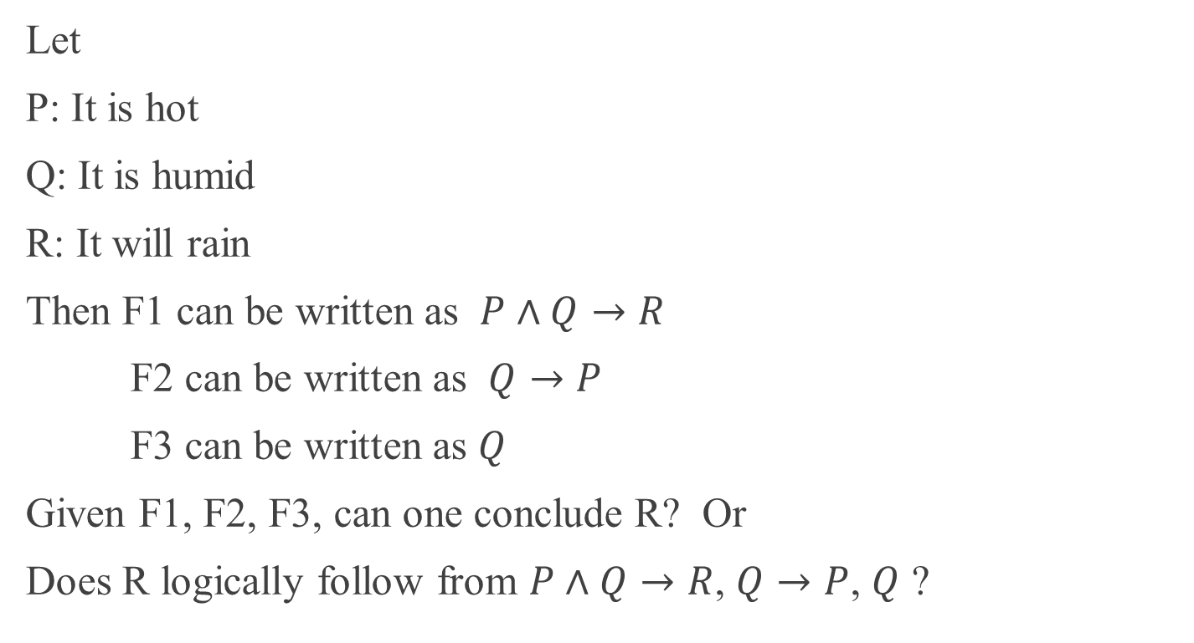
Let
P: It is hot
Q: It is humid
R: It will rain
Then F1 can be written as $P∧Q→R$
F2 can be written as $Q→P$
F3 can be written as $Q$
Given F1, F2, F3, can one conclude R? Or
Does R logically follow from $P∧Q→R$, $Q→P$, $Q$ ?

Slide 6
In propositional calculus, we have
Simple declarative statements identified as propositions (atoms).
Calculus – basically refers to a set of rules for calculating with symbols. So we shall have a set of rules to combine propositions and compound propositions often called formulas.
A set of theorems which when systematically employed will help us establish new propositions.

Slide 7
Given G and H as propositions (atoms), this table gives us truth values of formulas
G H ~G GɅH GVH G→H G↔H
----------------------------------------------------------------------------
T T F T T T T
T F F F T F F
F T T F T T F
F F T F F T T
Given this table and hierarchical description of operators, it is possible to evaluate any other formula.

Slide 8
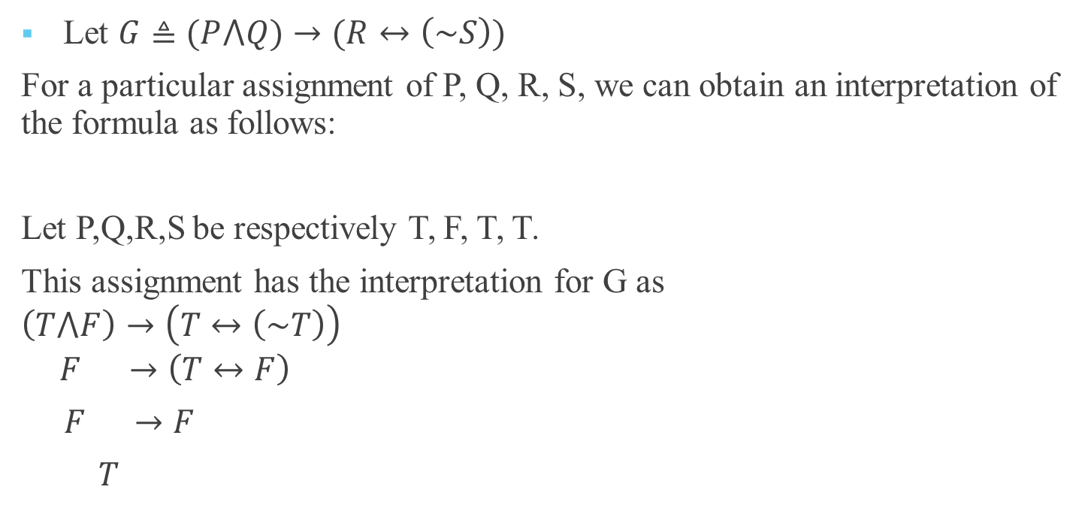
An Interpretation of a formula
Let $G≜(P⋀Q)→(R↔\left(\sim S\right))$
For a particular assignment of P, Q, R, S, we can obtain an interpretation of the formula as follows:
Let P,Q,R,S be respectively T, F, T, T.
This assignment has the interpretation for G as
$$\left(T⋀F\right)→\left(T↔\left(\sim T\right)\right)$$
$$F →\left(T↔F\right)$$
$F →F$
$T$

Slide 9
Interpretation of G
Definition: Given a propositional formula G, Let A₁, A₂,… , A_{n} be the atoms occurring in the formula G, then an interpretation of G is an assignment of truth values of A₁, A₂,… , A_{n} in which every A_{i} is assigned T or F but not both.
Definition: A formula G is said to be true under (or in) an interpretation if and only if G is evaluated to T in the interpretation, otherwise G is said to be false under the interpretation.
Clearly for n distinct propositions, there shall be 2^{n} interpretations.

Slide 10

Extreme cases are always interesting
$G≜((P→Q)⋀P)→Q$
$P$ $Q$ $P→Q$ $(P→Q)⋀P$ $((P→Q)⋀P)→Q$
----------------------------------------------------------------------------------
T T T T T
T F F F T
F T T F T
F F T F T

Slide 11

Extreme cases are always interesting
$G≜(P→Q)⋀(P⋀\sim Q)$
$P$ $Q$ $\sim Q$ $P→Q$ $P⋀\sim Q$ $(P→Q)⋀(P⋀\sim Q)$
----------------------------------------------------------------------------------
T T F T F F
T F T F T F
F T F T F F
F F T T F F

Slide 12
Definition: A formula is said to be valid if and only if it is true under all its interpretation.
A formula is said to be invalid if and only if it is not valid.
Definition: A formula is said to be inconsistent (unsatisfiable ) if and only if it is false under all its interpretations.
A formula is said to be consistent (satisfiable ) if and only if it is not inconsistent.

Slide 13
A formula is valid if and only if its negation is inconsistent.
A formula is inconsistent if and only if its negation is valid.
A formula is invalid if and only if there is at least one interpretation under which the formula is false.
A formula is consistent if and only if there is one interpretation under which the formula is true.
If a formula is valid then it is consistent but not vice versa.
If a formula is inconsistent then it is invalid but not vice versa.

Slide 14

Examples
$P⋀\sim P$ is inconsistent and therefore also invalid.
$P⋁\sim P$ is valid and therefore consistent.
$P→\sim P$ is invalid yet it is consistent.

Slide 15
Inference Rules in Propositional Logic
Given a set of propositions – regarded as premises, the attempt is to find the truth value of a new proposition from the premises.
This is also considered as – inferencing from premises.
There are two classic rules of inferencing
Modus ponen
Chain rule

Slide 16

Modus ponen
From $P$ and $P→Q$ infer $Q$
This is sometimes written as
$P$
$P→Q$
---------
$Q$
---------

Slide 17

Given P is true, the condition that Q is false is false, establishing Q is true.
$P$ $Q$ $P→Q$
-----------------------
T T T
T F F
F T T
F F T

Slide 18

Example
F1: If it is hot and humid then it will rain.
F2: If it is humid then it is hot.
F3: It is humid now.
Will it Rain?
Let
P: It is hot
Q: It is humid
R: It will rain
Then F1 can be written as $P∧Q→R$
F2 can be written as $Q→P$
F3 can be written as $Q$
Given F1, F2, F3, we have to establish R.

Slide 19
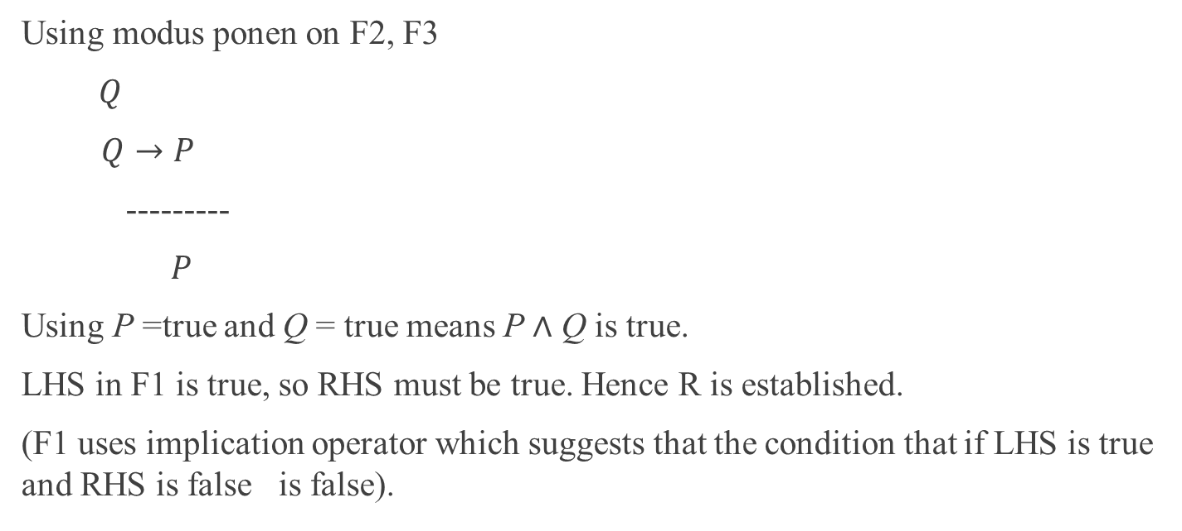
Using modus ponen on F2, F3
$Q$
$Q→P$
---------
$P$
Using P =true and Q = true means P $∧$ Q is true.
LHS in F1 is true, so RHS must be true. Hence R is established.
(F1 uses implication operator which suggests that the condition that if LHS is true and RHS is false is false).

Slide 20

Chain Rule
From $P→Q$ and $Q→R$, infer $P→R$
i.e. $P→Q$
$Q→R$
----------
$P→R$

Slide 21
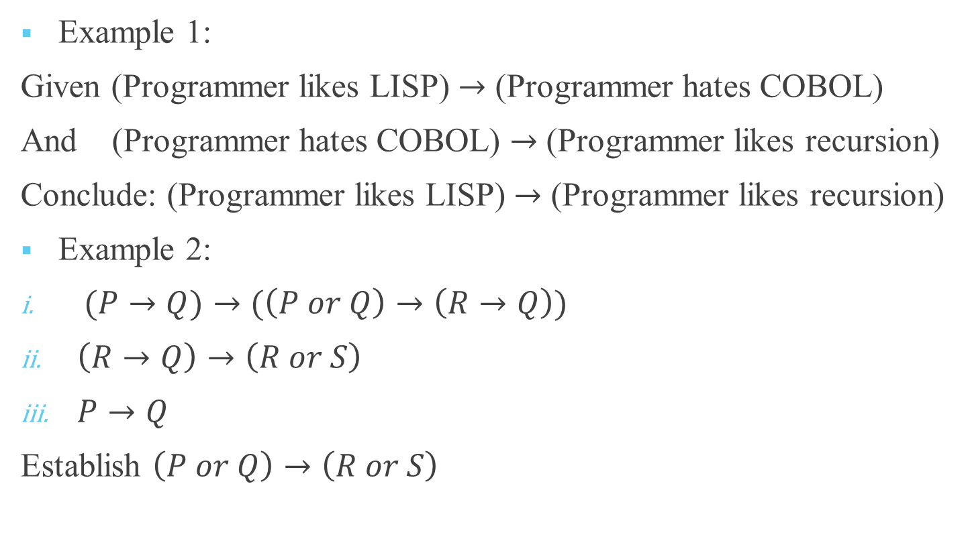
Examples
Example 1:
Given (Programmer likes LISP) $→$ (Programmer hates COBOL)
And (Programmer hates COBOL) $→$ (Programmer likes recursion)
Conclude: (Programmer likes LISP) $→$ (Programmer likes recursion)
Example 2:
$(P→Q)→(\left(P or Q\right)→\left(R→Q\right))$
$\left(R→Q\right)→\left(R or S\right)$
$P→Q$
Establish $\left(P or Q\right)→\left(R or S\right)$

Slide 22
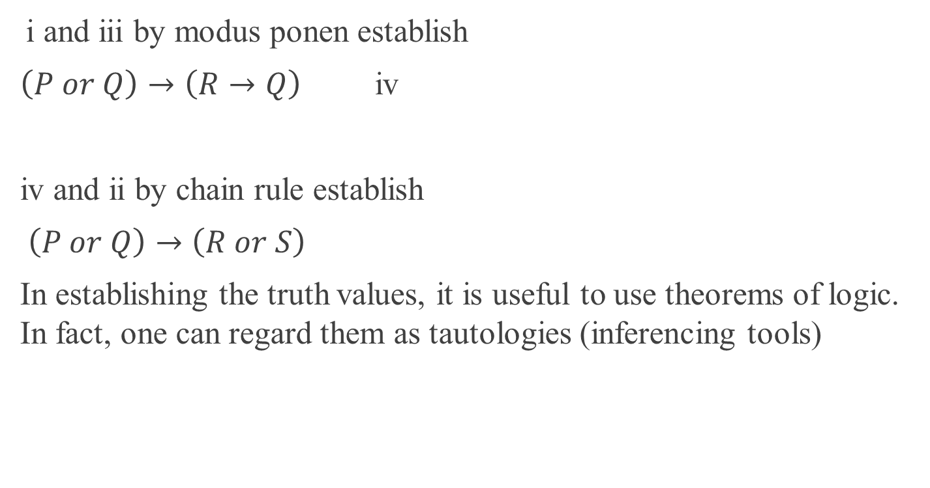
Examples
i and iii by modus ponen establish
$\left(P or Q\right)→\left(R→Q\right)$ iv
iv and ii by chain rule establish
$\left(P or Q\right)→\left(R or S\right)$
In establishing the truth values, it is useful to use theorems of logic. In fact, one can regard them as tautologies (inferencing tools)

Slide 23
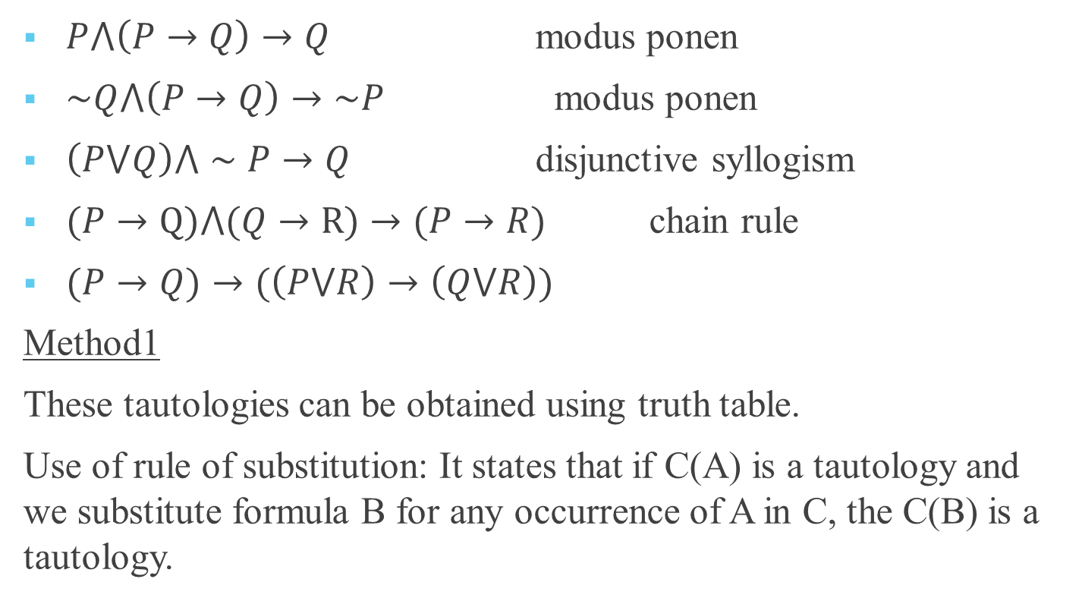
Some Useful Tautologies
$P⋀\left(P→Q\right)→Q$ modus ponen
$\sim Q⋀\left(P→Q\right)→\sim P$ modus ponen
$\left(P⋁Q\right)⋀∼P→Q$ disjunctive syllogism
$(P→Q)⋀(Q→R)→(P→R)$ chain rule
$(P→Q)→(\left(P⋁R\right)→\left(Q⋁R\right))$
Method1
These tautologies can be obtained using truth table.
Use of rule of substitution: It states that if C(A) is a tautology and we substitute formula B for any occurrence of A in C, the C(B) is a tautology.

Slide 24
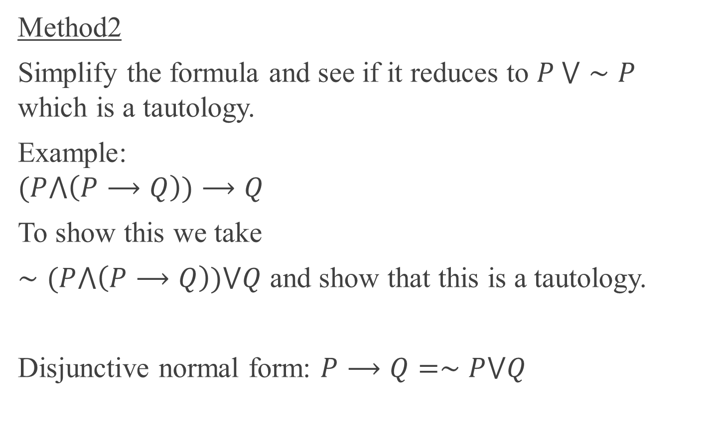
Method2
Simplify the formula and see if it reduces to $P ⋁∼P$ which is a tautology.
Example:
$$(P⋀\left(P⟶Q\right))⟶Q$$
To show this we take
$∼(P⋀\left(P⟶Q\right))⋁Q$ and show that this is a tautology.
Disjunctive normal form: $P⟶Q=∼P⋁Q$

Slide 25

Example contd
$∼(P⋀\left(P⟶Q\right))⋁Q$
$$=(∼P⋁∼\left(P⟶Q\right))⋁Q$$
$$=(∼P⋁∼\left(∼P⋁Q\right))⋁Q$$
$$=(∼P⋁\left(P⋀∼Q\right))⋁Q$$
$$=((∼P⋁P)⋀(∼P⋁∼Q))⋁Q$$
$$=(T⋀(∼P⋁∼Q))⋁Q$$
$$=(∼P⋁∼Q)⋁Q$$
$$=∼P⋁∼Q⋁Q$$
$$=∼P⋁T$$
$$=T$$

Slide 26

Example
F1: If it is summer time, it is warm.
F2: If it is winter time, it is cold.
F3: It is summer time or winter time.
Establish it is warm or cold.
Let
P: It is summer time
Q: It is warm
R: It is winter time
S: It is cold
Then F1 : $P⟶Q$
F2 : $R→S$
F3 : $P⋁R$
F4 : $Q⋁S$ (to establish)

Slide 27
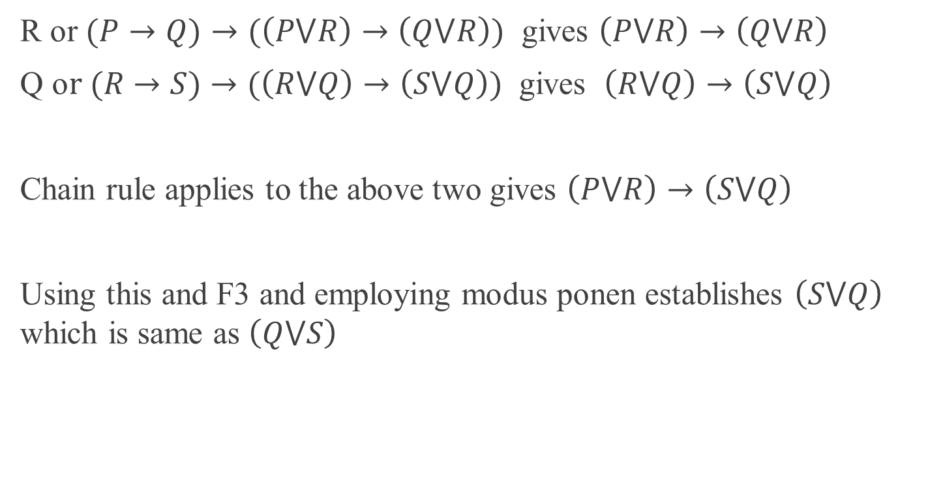
Example Contd…
R or $(P→Q)→(\left(P⋁R\right)→\left(Q⋁R\right))$ gives $\left(P⋁R\right)→\left(Q⋁R\right)$
Q o$r (R→S)→(\left(R⋁Q\right)→\left(S⋁Q\right))$ gives $\left(R⋁Q\right)→\left(S⋁Q\right)$
Chain rule applies to the above two gives $\left(P⋁R\right)→\left(S⋁Q\right)$
Using this and F3 and employing modus ponen establishes $\left(S⋁Q\right)$ which is same as $\left(Q⋁S\right)$

Slide 28
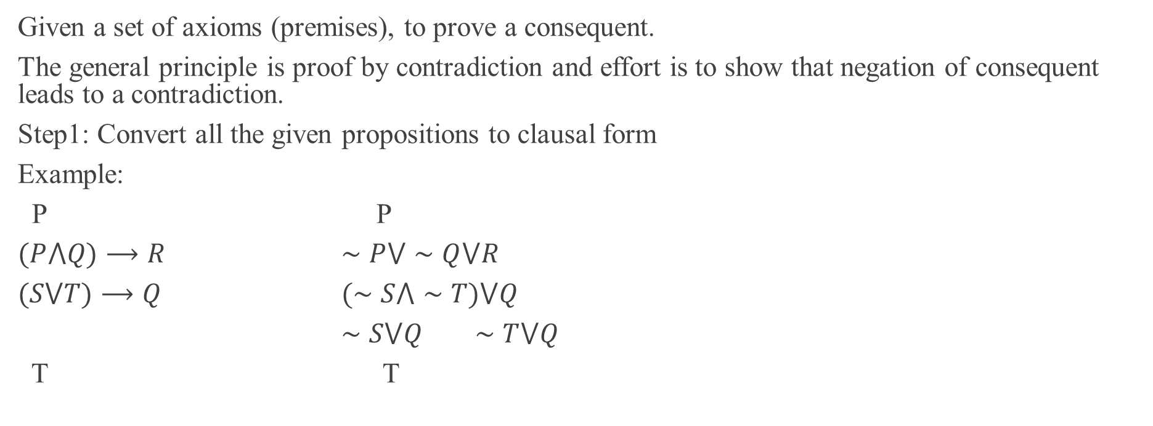
Proof by resolution principle in propositional logic
Given a set of axioms (premises), to prove a consequent.
The general principle is proof by contradiction and effort is to show that negation of consequent leads to a contradiction.
Step1: Convert all the given propositions to clausal form
Example:
P P
$(P⋀Q)⟶R$ $∼P⋁∼Q⋁R$
$(S⋁T)⟶Q$ $(∼S⋀∼T)⋁Q$
$∼S⋁Q ∼T⋁Q$
T T

Slide 29
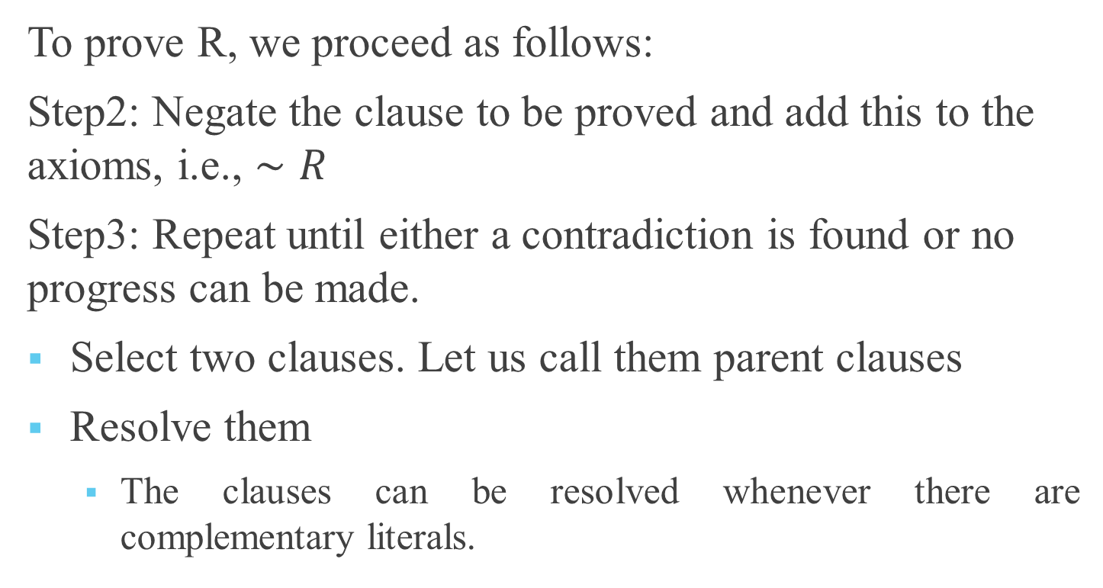
To prove R, we proceed as follows:
Step2: Negate the clause to be proved and add this to the axioms, i.e., $∼R$
Step3: Repeat until either a contradiction is found or no progress can be made.
Select two clauses. Let us call them parent clauses
Resolve them
The clauses can be resolved whenever there are complementary literals.

Slide 30

P $∼P⋁∼Q⋁R$ $∼S⋁Q$ $∼T⋁Q$ T $∼R$
$∼P⋁∼Q$
$∼Q$
$∼T$
Contradiction
Hence R is established

Slide 31

Example
F1: $P⟶Q$
F2: $R⟶S$
F3: $P⋁R$
Establish $Q⋁S$
Step1: negate consequent $∼(Q⋁S)$
Convert to Clausal form
$∼P⋁Q$ $∼R⋁S$ $P⋁R$
$∼Q$ $∼S$

Slide 32

Example
$∼P⋁Q$ $∼R⋁S$ $P⋁R$ $∼Q$ $∼S$
$∼P$ $∼R$
$P$
Contradiction
Hence $Q⋁S$ is established.(Note the way parallelism can be exercised)

