Slide 1
Predicate Logic

Slide 2
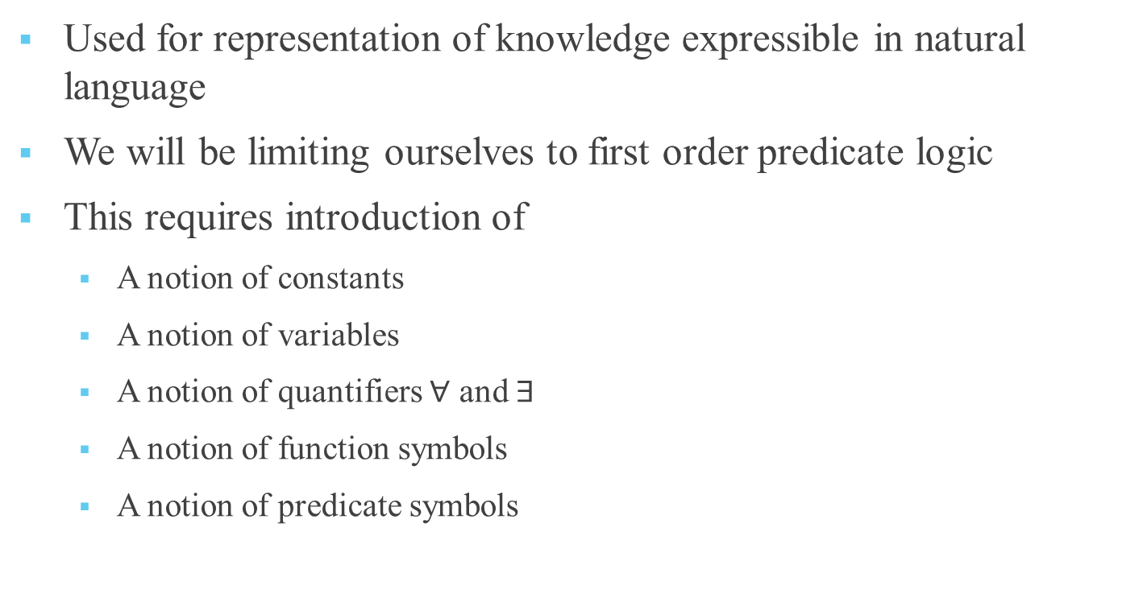
Predicate Logic
Used for representation of knowledge expressible in natural language
We will be limiting ourselves to first order predicate logic
This requires introduction of
A notion of constants
A notion of variables
A notion of quantifiers $∀$ and $∃$
A notion of function symbols
A notion of predicate symbols

Slide 3
Constants – basically identifiable individual symbols from a given domain, e.g., 3, Red
Variables – which take values from a given domain, e.g., x,y
Function symbols – which take variables/constants as parameters and evaluate to a value in a domain, e.g.,
father(kamal)
half-of(x)
dist(x,y,u,v) n parameters means n-place function
Predicate symbols – which takes a set of constants as parameters and evaluate/map to a value true or false. (n parameters means n-place predicate)

Slide 4
Definitions
Term
A constant is a term
A variable is a term
If f is a n-place function and t₁, t₂, …, t_{n} are terms, then f(t₁, t₂, …, t_{n} ) is a term
All terms are generated using the above rules
Example:
plus(plus-one(x),x) is a 2-place function with each parameter in it as term. Hence it is a term.

Slide 5
Definitions
Atom
Like in propositional logic where we had a notion of atom as a declarative statement
Which was not decomposable any further
Which has a value T or F but not both
We have a notion of atom in predicate logic also.
An atom is any n-place predicate symbol. If t₁, t₂, …, t_{n} are terms, then P(t₁, t₂, …, t_{n} ) is a atom

Slide 6
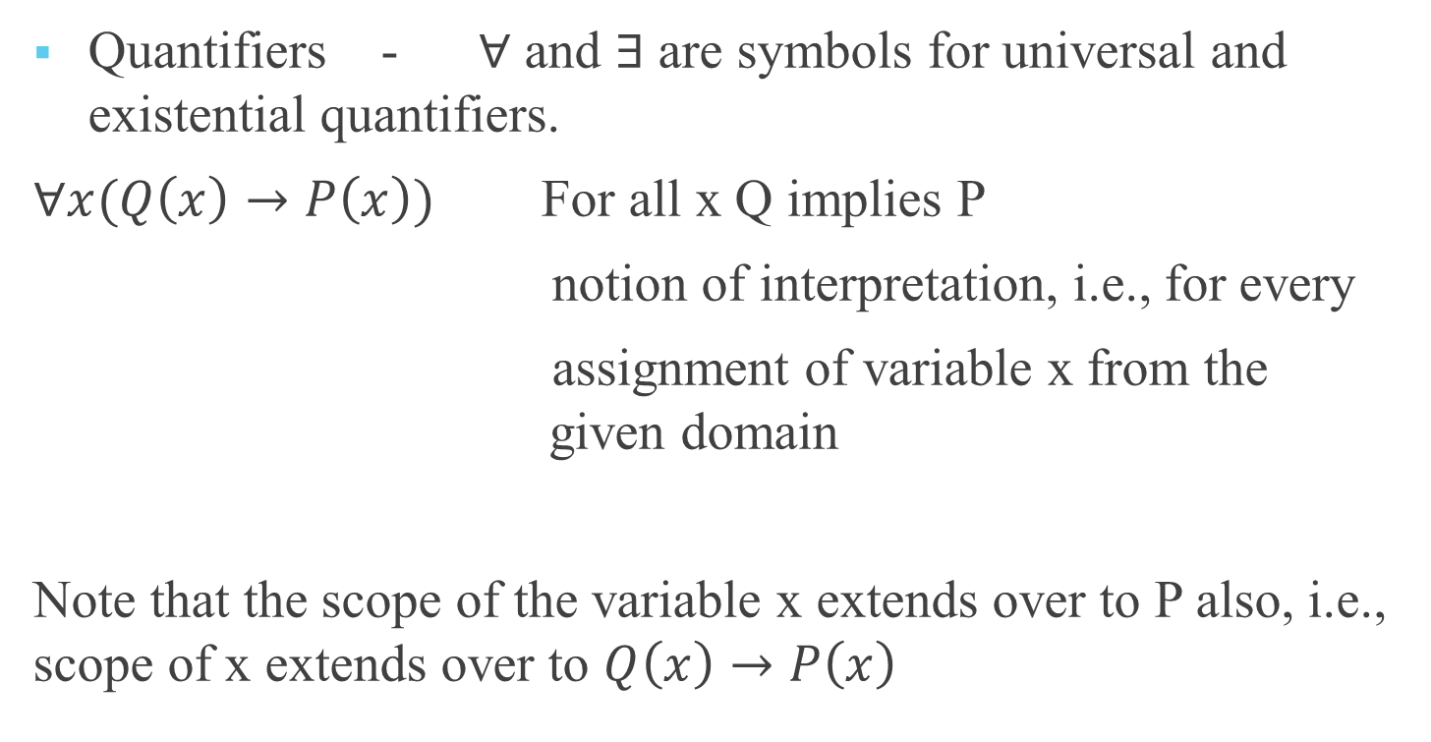
Definitions
Quantifiers - $∀$ and $∃$are symbols for universal and existential quantifiers.
$∀x(Q\left(x\right)→P\left(x\right))$ For all x Q implies P
notion of interpretation, i.e., for every
assignment of variable x from the given domain
Note that the scope of the variable x extends over to P also, i.e., scope of x extends over to $Q\left(x\right)→P\left(x\right)$

Slide 7
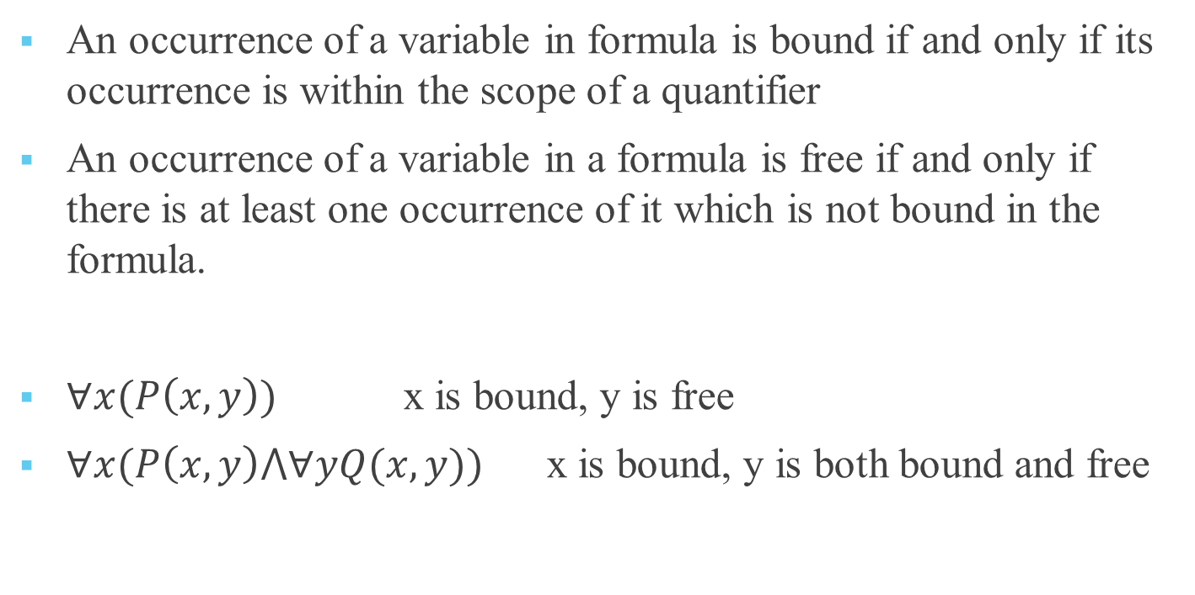
Bound and free variables
An occurrence of a variable in formula is bound if and only if its occurrence is within the scope of a quantifier
An occurrence of a variable in a formula is free if and only if there is at least one occurrence of it which is not bound in the formula.
$∀x(P\left(x,y\right))$ x is bound, y is free
$∀x(P\left(x,y\right)⋀∀yQ(x,y))$ x is bound, y is both bound and free

Slide 8
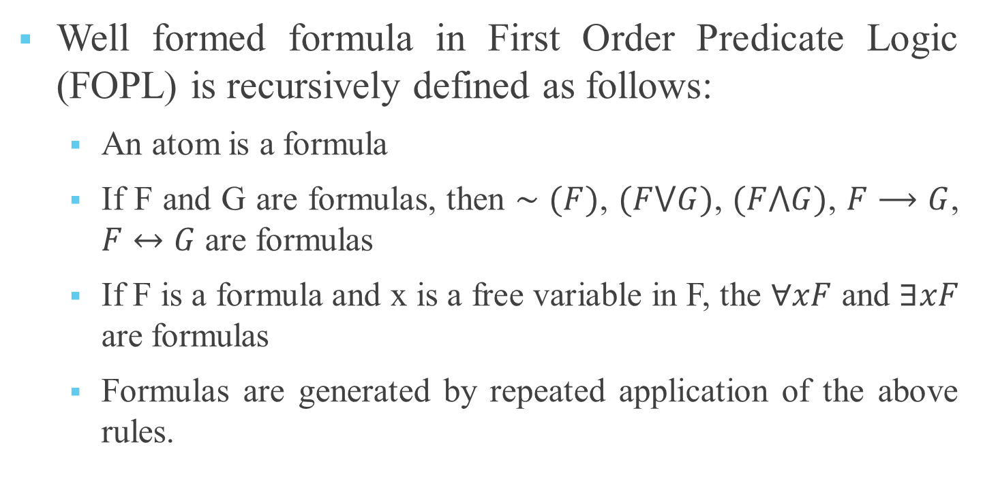
Well formed formula ( WFF)
Well formed formula in First Order Predicate Logic (FOPL) is recursively defined as follows:
An atom is a formula
If F and G are formulas, then $∼(F)$, $(F⋁G)$, $(F⋀G)$, $F⟶G$, $F↔G$ are formulas
If F is a formula and x is a free variable in F, the $∀xF$ and $∃xF$ are formulas
Formulas are generated by repeated application of the above rules.

Slide 9
Example: Axioms of natural numbers
A1: For every number, there is one and only one immediate successor.
A2: There is no number for which 0 is successor.
A3: For every number other than 0, there is one and only one immediate predecessor.
Let
f(x) represents successor of x
g(x) represents predecessor of x
e(x, y) represents equals predicate

Slide 10
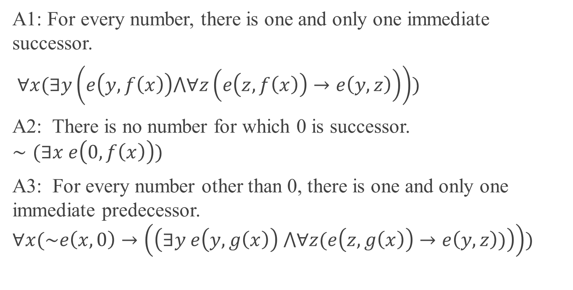
Axioms of natural numbers in FOPL
A1: For every number, there is one and only one immediate successor.
$∀x(∃y\left(e\left(y,f\left(x\right)\right)⋀∀z\left(e\left(z,f\left(x\right)\right)→e\left(y,z\right)\right)\right))$
A2: There is no number for which 0 is successor.
$$∼(∃x e\left(0,f\left(x\right)\right))$$
A3: For every number other than 0, there is one and only one immediate predecessor.
$$∀x(\sim e\left(x,0\right)→\left(\left(∃y e\left(y,g\left(x\right)\right) ⋀∀z(e\left(z,g\left(x\right)\right)→e\left(y,z\right))\right)\right))$$

Slide 11
Interpretation of a formula
An interpretation of a formula F in FOPL consists of a non-empty domain D, and an assignment of values to each variable, function symbol and predicate symbol occurring as follows:
To each variable, we assign an element in D.
To each n-place function symbol, we assign a mapping from D^{n} to D.
To each n-place predicate symbol, we assign a mapping from D^{n} to (T,F)
We say that the formula is interpreted over the domain D.

Slide 12
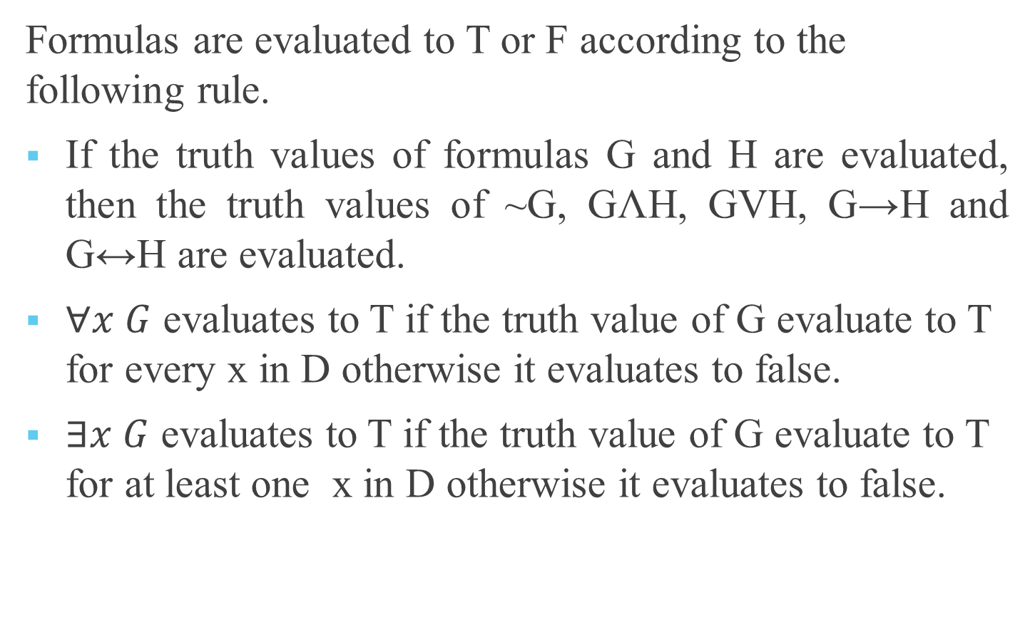
Formulas are evaluated to T or F according to the following rule.
If the truth values of formulas G and H are evaluated, then the truth values of ~G, GɅH, GVH, G→H and G↔H are evaluated.
$∀x G$ evaluates to T if the truth value of G evaluate to T for every x in D otherwise it evaluates to false.
$∃x G$ evaluates to T if the truth value of G evaluate to T for at least one x in D otherwise it evaluates to false.

Slide 13
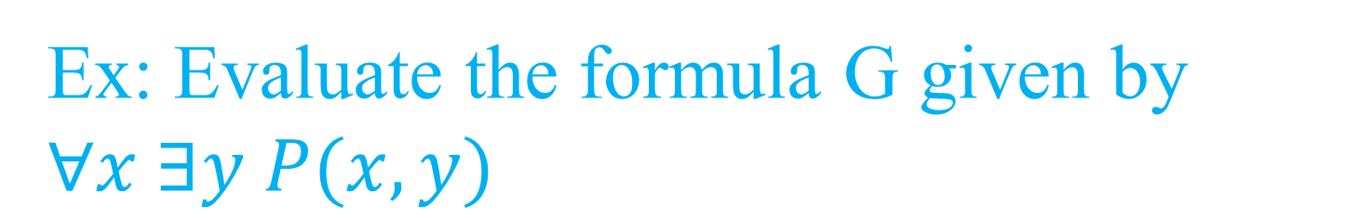
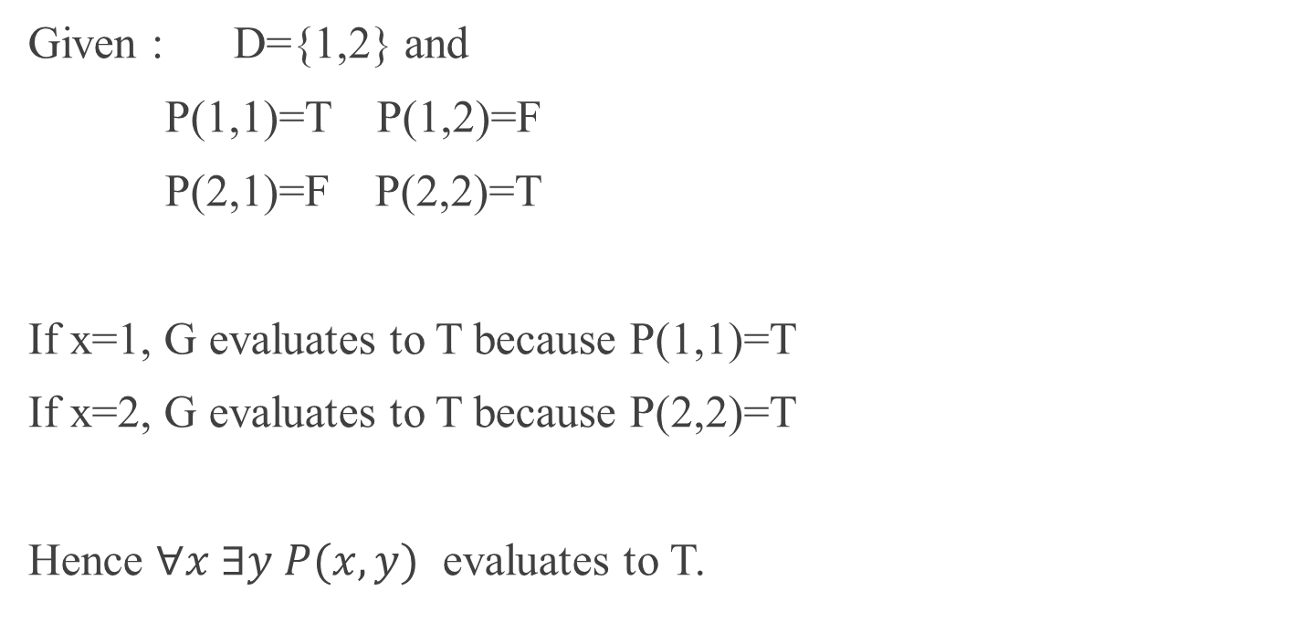
Ex: Evaluate the formula G given by $∀x ∃y P(x,y)$
Given : D={1,2} and
P(1,1)=T P(1,2)=F
P(2,1)=F P(2,2)=T
If x=1, G evaluates to T because P(1,1)=T
If x=2, G evaluates to T because P(2,2)=T
Hence $∀x ∃y P(x,y)$ evaluates to T.

Slide 14
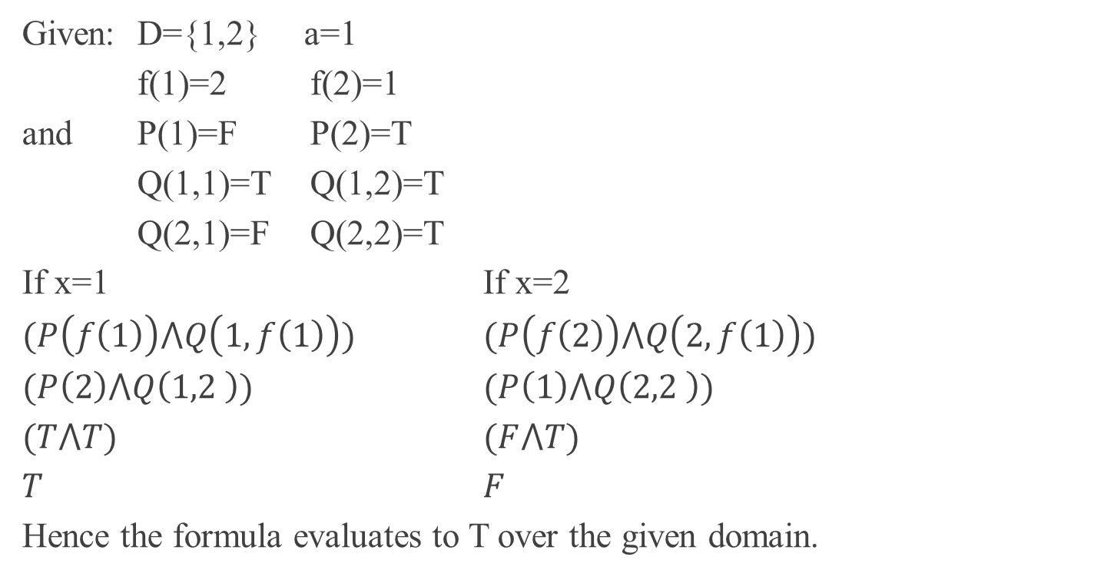
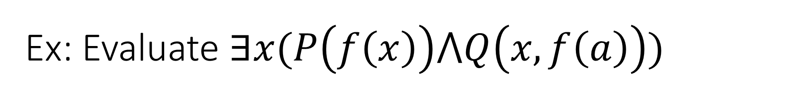
Ex: Evaluate $∃x(P\left(f\left(x\right)\right)⋀Q\left(x,f\left(a\right)\right))$
Given: D={1,2} a=1
f(1)=2 f(2)=1
and P(1)=F P(2)=T
Q(1,1)=T Q(1,2)=T
Q(2,1)=F Q(2,2)=T
If x=1 If x=2
$(P\left(f\left(1\right)\right)⋀Q\left(1,f\left(1\right)\right))$ $(P\left(f\left(2\right)\right)⋀Q\left(2,f\left(1\right)\right))$
$(P\left(2\right)⋀Q\left(1,2 \right))$ $(P\left(1\right)⋀Q\left(2,2 \right))$
$(T⋀T)$ $(F⋀T)$
$T$ $F$
Hence the formula evaluates to T over the given domain.

Slide 15
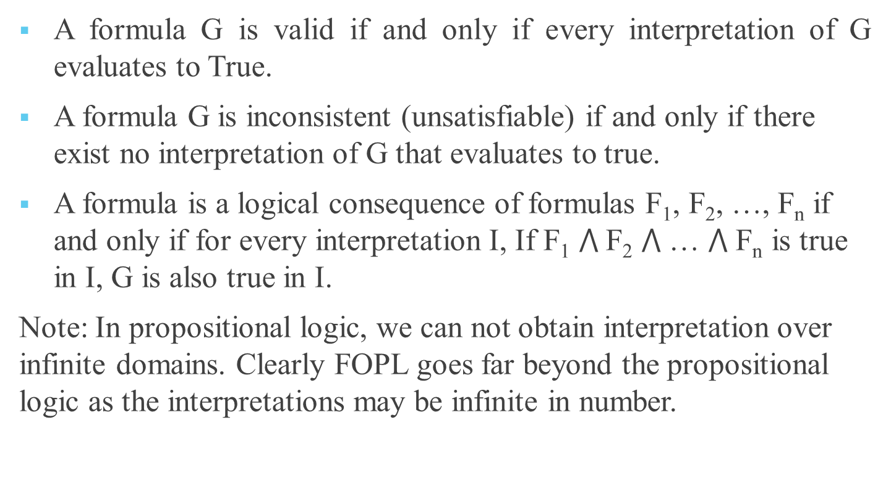
Definitions
A formula G is valid if and only if every interpretation of G evaluates to True.
A formula G is inconsistent (unsatisfiable) if and only if there exist no interpretation of G that evaluates to true.
A formula is a logical consequence of formulas F₁, F₂, …, F_{n} if and only if for every interpretation I, If F₁ $⋀$F₂ $⋀$ … $⋀$ F_{n} is true in I, G is also true in I.
Note: In propositional logic, we can not obtain interpretation over infinite domains. Clearly FOPL goes far beyond the propositional logic as the interpretations may be infinite in number.

Slide 16
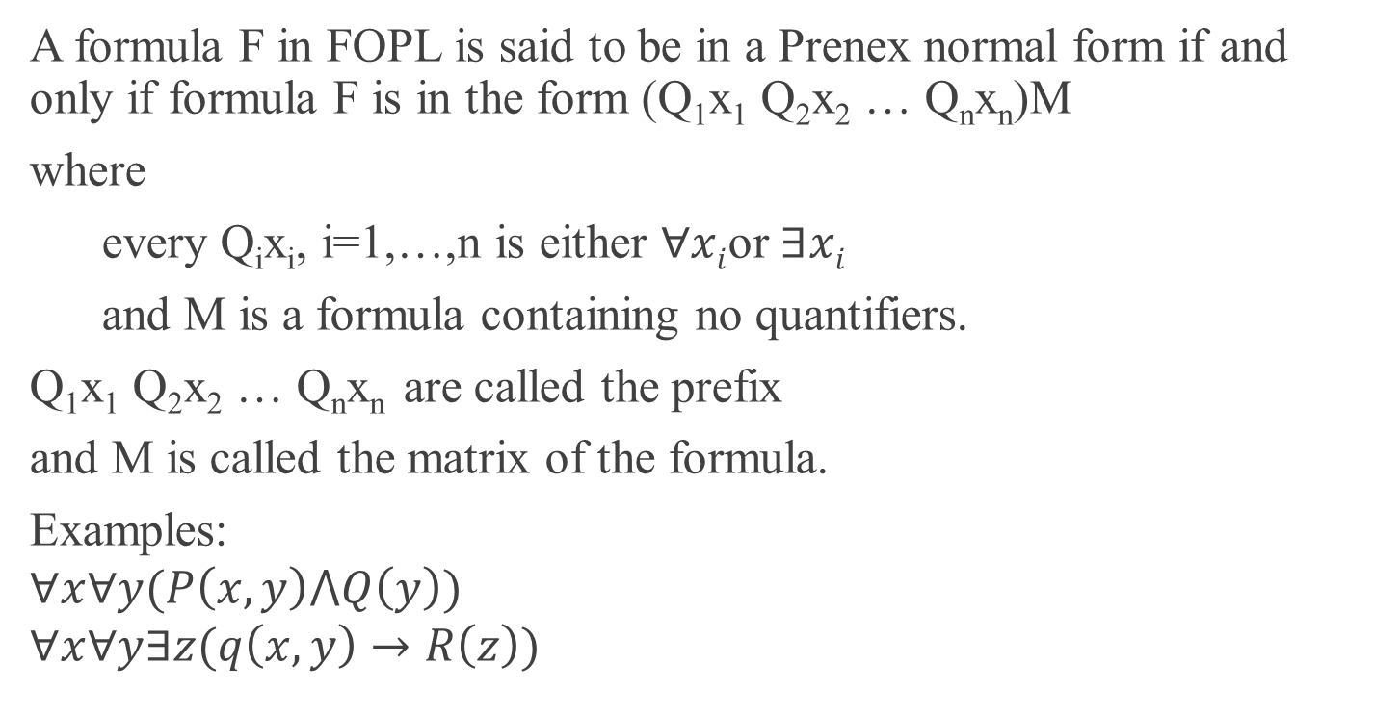
Prenex Normal Form
A formula F in FOPL is said to be in a Prenex normal form if and only if formula F is in the form (Q₁x₁ Q₂x₂ … Q_{n}x_{n})M
where
every Q_{i}x_{i}, i=1,…,n is either $∀xi$or $∃xi$
and M is a formula containing no quantifiers.
Q₁x₁ Q₂x₂ … Q_{n}x_{n} are called the prefix
and M is called the matrix of the formula.
Examples:
$$∀x∀y(P\left(x,y\right)⋀Q\left(y\right))$$
$$∀x∀y∃z(q\left(x,y\right)→R\left(z\right))$$

Slide 17
Now clearly one would like to explore if every formula in FOPL is expressible in prenex normal form.
To begin with, this requires establishing equivalence between formulas.
Definition:
Two formulas F and G are equivalent if and only if the truth value of F and G are same under every interpretation.

Slide 18
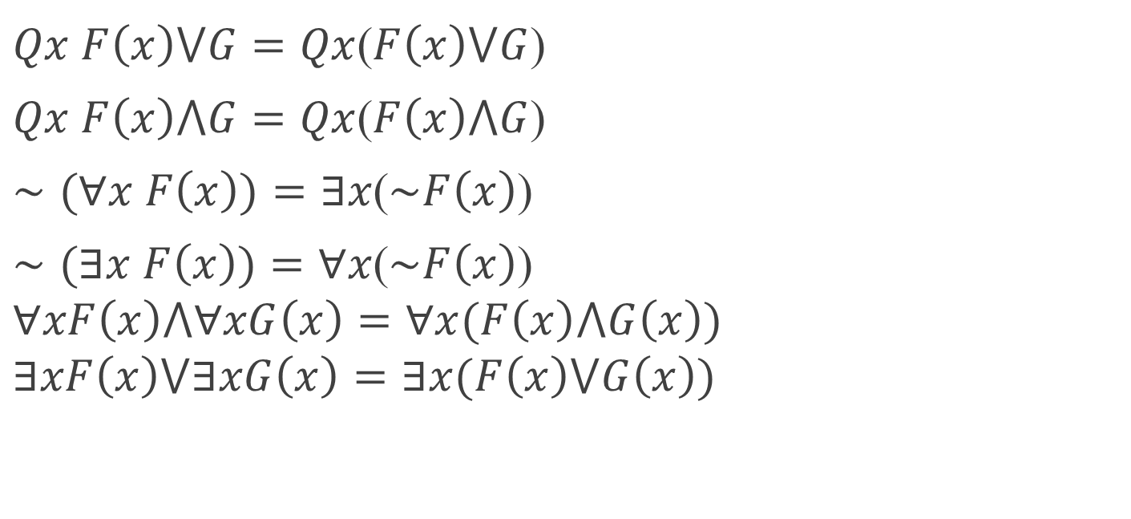
Some equivalent formulas which are also laws
$Qx F\left(x\right)⋁G=Qx$($F\left(x\right)⋁G$)
$Qx F\left(x\right)⋀G=Qx$($F\left(x\right)⋀G$)
$∼(∀x F\left(x\right))=∃x$($\sim F\left(x\right)$)
$∼(∃x F\left(x\right))=∀x$($\sim F\left(x\right)$)
$$∀xF\left(x\right)⋀∀xG\left(x\right)=∀x(F\left(x\right)⋀G\left(x\right))$$
$$∃xF\left(x\right)⋁∃xG\left(x\right)=∃x(F\left(x\right)⋁G\left(x\right))$$

Slide 19
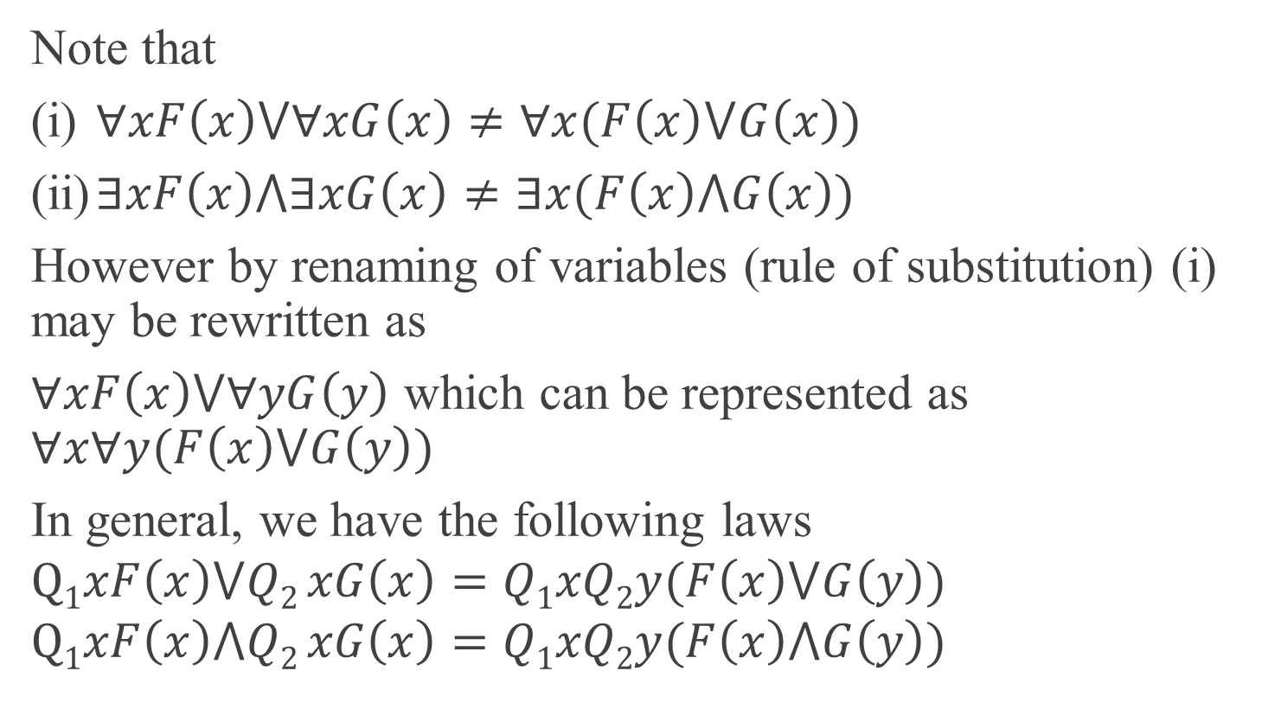
Note that
(i) $∀xF\left(x\right)⋁∀xG\left(x\right)≠∀x(F\left(x\right)⋁G\left(x\right))$
(ii) $∃xF\left(x\right)⋀∃xG\left(x\right)≠∃x(F\left(x\right)⋀G\left(x\right))$
However by renaming of variables (rule of substitution) (i) may be rewritten as
$∀xF\left(x\right)⋁∀yG\left(y\right)$ which can be represented as $∀x∀y(F\left(x\right)⋁G\left(y\right))$
In general, we have the following laws
$$Q1xF\left(x\right)⋁Q2 xG\left(x\right)=Q1xQ2y(F\left(x\right)⋁G\left(y\right))$$
$$Q1xF\left(x\right)⋀Q2 xG\left(x\right)=Q1xQ2y(F\left(x\right)⋀G\left(y\right))$$

Slide 20
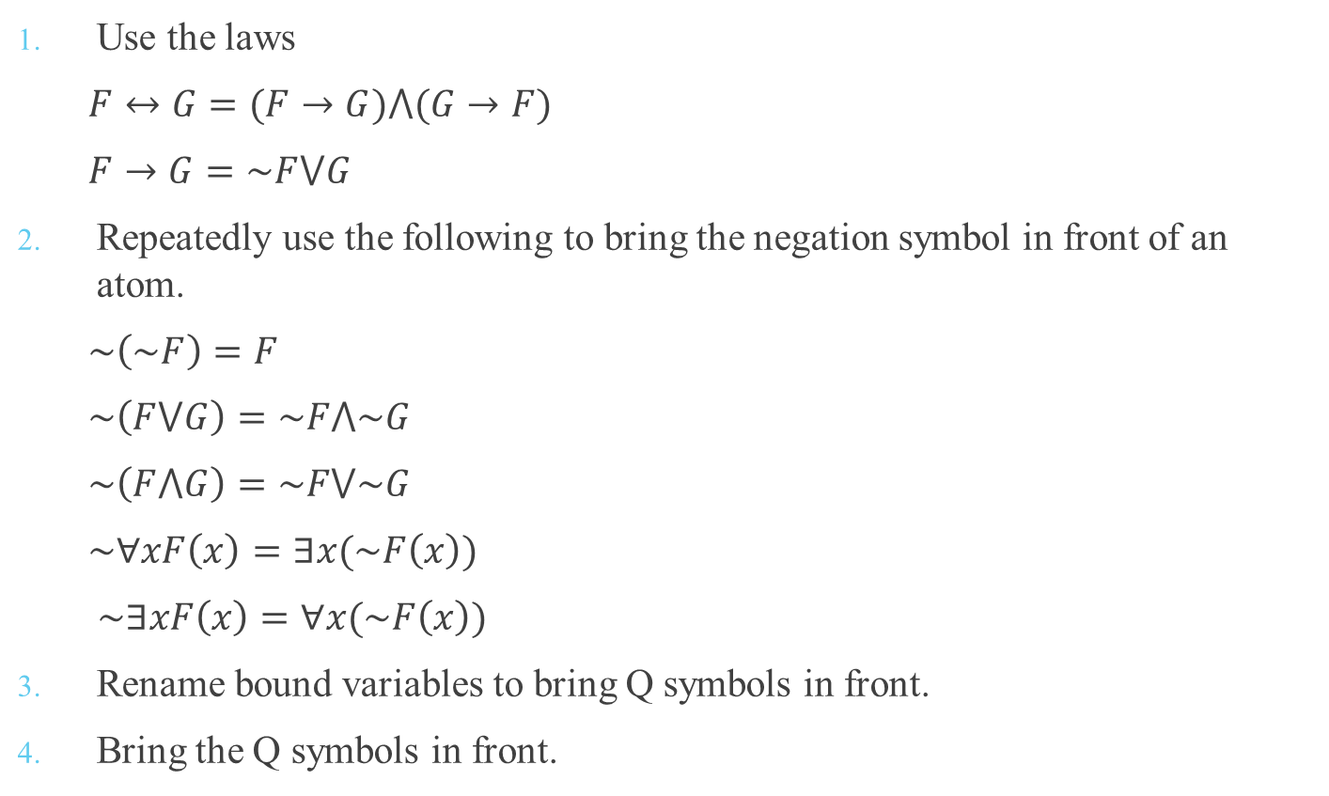
Transforming Formulas to Prenex Normal Form
Use the laws
$F↔G=(F→G)⋀(G→F)$
$F→G=\sim F⋁G$
Repeatedly use the following to bring the negation symbol in front of an atom.
$\sim \left(\sim F\right)=F$
$\sim \left(F⋁G\right)=\sim F⋀\sim G$
$\sim \left(F⋀G\right)=\sim F⋁\sim G$
$\sim ∀xF\left(x\right)=∃x(\sim F\left(x\right))$
$\sim ∃xF\left(x\right)=∀x(\sim F\left(x\right))$
Rename bound variables to bring Q symbols in front.
Bring the Q symbols in front.

Slide 21
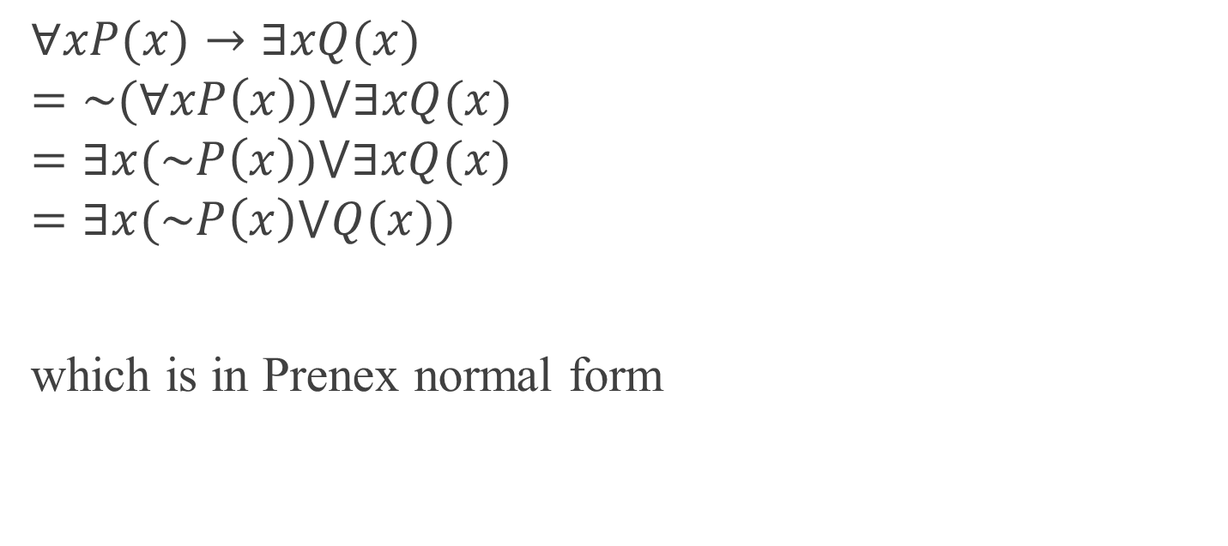
Example: Convert to Prenex normal form
$$∀xP(x)→∃xQ(x)$$
$$=\sim (∀xP\left(x\right))⋁∃xQ(x)$$
$$=∃x(\sim P\left(x\right))⋁∃xQ(x)$$
$$=∃x(\sim P\left(x\right)⋁Q(x))$$
which is in Prenex normal form

Slide 22
Inferencing in Predicate Logic
F1: Some patients like all doctors.
F2: No patient like any quack.
C: Therefore, no doctor is a quack.
These are statements in natural language.
The first two represent knowledge in the domain.
Third one is a conclusion to be inferred from the knowledge.

Slide 23
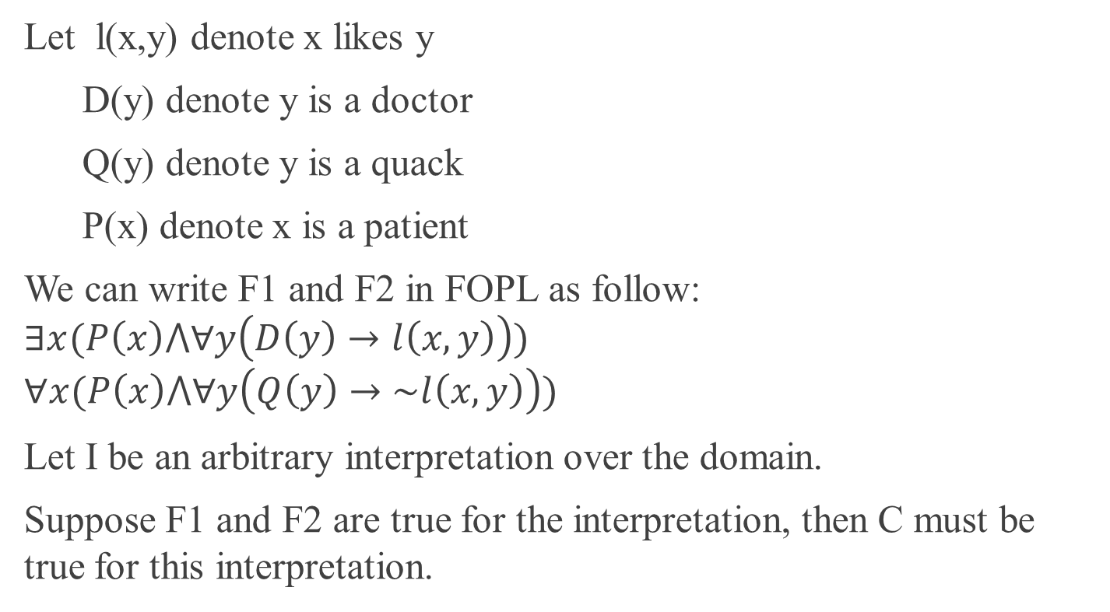
Inferencing in Predicate Logic
Let l(x,y) denote x likes y
D(y) denote y is a doctor
Q(y) denote y is a quack
P(x) denote x is a patient
We can write F1 and F2 in FOPL as follow:
$$∃x(P\left(x\right)⋀∀y\left(D\left(y\right)→l\left(x,y\right)\right))$$
$$∀x(P\left(x\right)⋀∀y\left(Q\left(y\right)→\sim l\left(x,y\right)\right))$$
Let I be an arbitrary interpretation over the domain.
Suppose F1 and F2 are true for the interpretation, then C must be true for this interpretation.

Slide 24
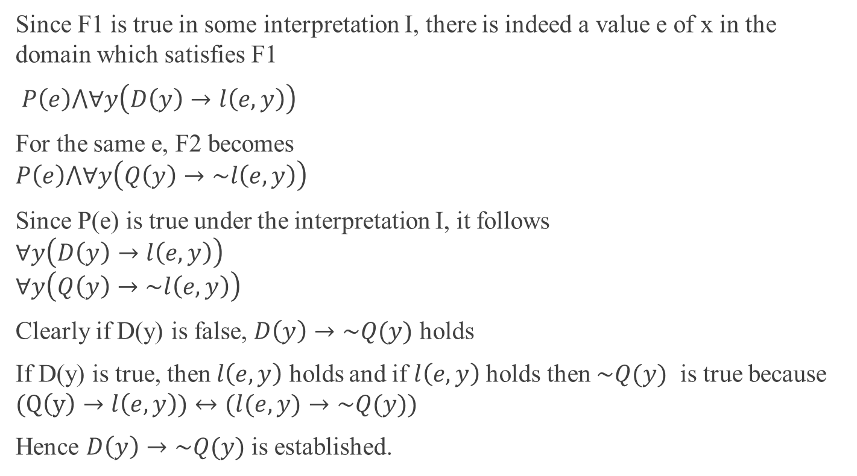
Inferencing in Predicate Logic
Since F1 is true in some interpretation I, there is indeed a value e of x in the domain which satisfies F1
$P\left(e\right)⋀∀y\left(D\left(y\right)→l\left(e,y\right)\right)$
For the same e, F2 becomes
$$P\left(e\right)⋀∀y\left(Q\left(y\right)→\sim l\left(e,y\right)\right)$$
Since P(e) is true under the interpretation I, it follows
$$∀y\left(D\left(y\right)→l\left(e,y\right)\right)$$
$$∀y\left(Q\left(y\right)→\sim l\left(e,y\right)\right)$$
Clearly if D(y) is false, $D\left(y\right)→\sim Q(y)$ holds
If D(y) is true, then $l\left(e,y\right)$ holds and if $l\left(e,y\right)$ holds then $\sim Q(y)$ is true because $(Q\left(y\right)→l\left(e,y\right))↔(l(e,y)→\sim Q(y))$
Hence $D\left(y\right)→\sim Q(y)$ is established.

Slide 25
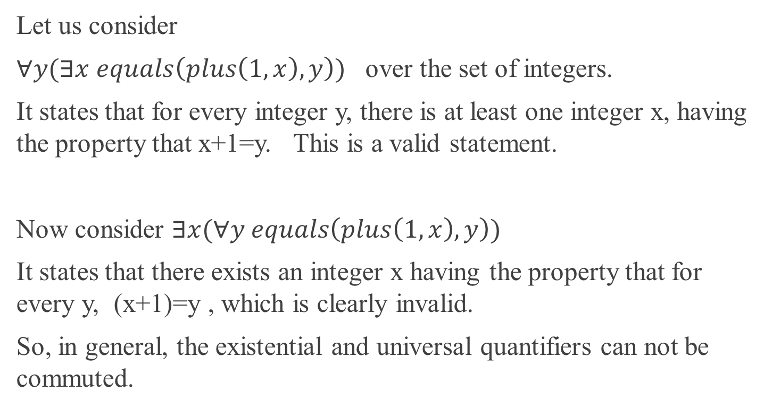
Mixing Universal and Existential Quantifiers
Let us consider
$∀y(∃x equals\left(plus\left(1,x\right),y\right))$ over the set of integers.
It states that for every integer y, there is at least one integer x, having the property that x+1=y. This is a valid statement.
Now consider $∃x(∀y equals\left(plus\left(1,x\right),y\right))$
It states that there exists an integer x having the property that for every y, (x+1)=y , which is clearly invalid.
So, in general, the existential and universal quantifiers can not be commuted.

Slide 26
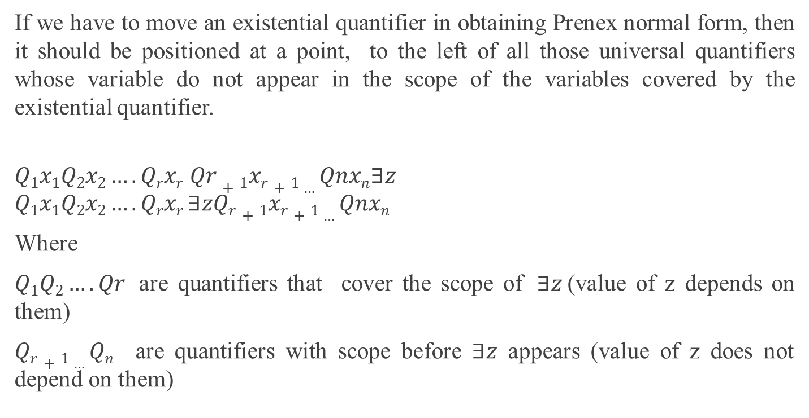
Mixing Universal and Existential Quantifiers
If we have to move an existential quantifier in obtaining Prenex normal form, then it should be positioned at a point, to the left of all those universal quantifiers whose variable do not appear in the scope of the variables covered by the existential quantifier.
$$Q1x1Q2x2….Qrxr Qr+1xr+1…Qnxn∃z$$
$$Q1x1Q2x2….Qrxr ∃zQr+1xr+1…Qnxn$$
Where
$Q1Q2….Qr$ are quantifiers that cover the scope of $∃z$ (value of z depends on them)
$Qr+1…Qn$ are quantifiers with scope before $∃z$ appears (value of z does not depend on them)

Slide 27
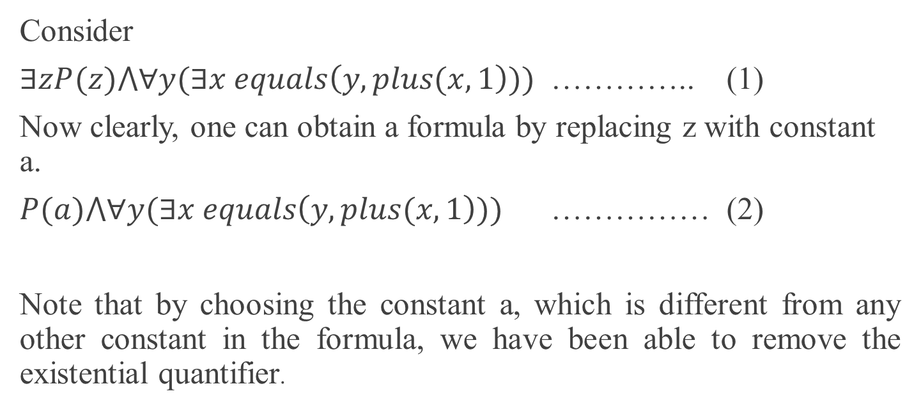
Skolmisation
Consider
$∃zP(z)⋀∀y(∃x equals\left(y,plus(x,1\right)))$ ………….. (1)
Now clearly, one can obtain a formula by replacing z with constant a.
$P(a)⋀∀y(∃x equals\left(y,plus(x,1\right)))$ …………… (2)
Note that by choosing the constant a, which is different from any other constant in the formula, we have been able to remove the existential quantifier.

Slide 28
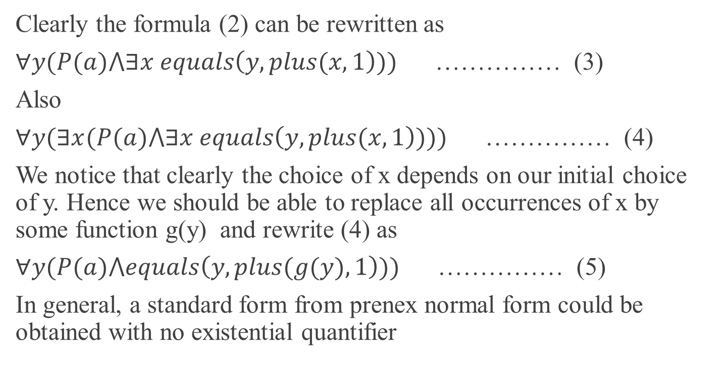
Skolmisation
Clearly the formula (2) can be rewritten as
$∀y(P(a)⋀∃x equals\left(y,plus(x,1\right)))$ …………… (3)
Also
$∀y(∃x(P(a)⋀∃x equals\left(y,plus(x,1\right))))$ …………… (4)
We notice that clearly the choice of x depends on our initial choice of y. Hence we should be able to replace all occurrences of x by some function g(y) and rewrite (4) as
$∀y(P(a)⋀equals\left(y,plus(g(y),1\right)))$ …………… (5)
In general, a standard form from prenex normal form could be obtained with no existential quantifier

Slide 29
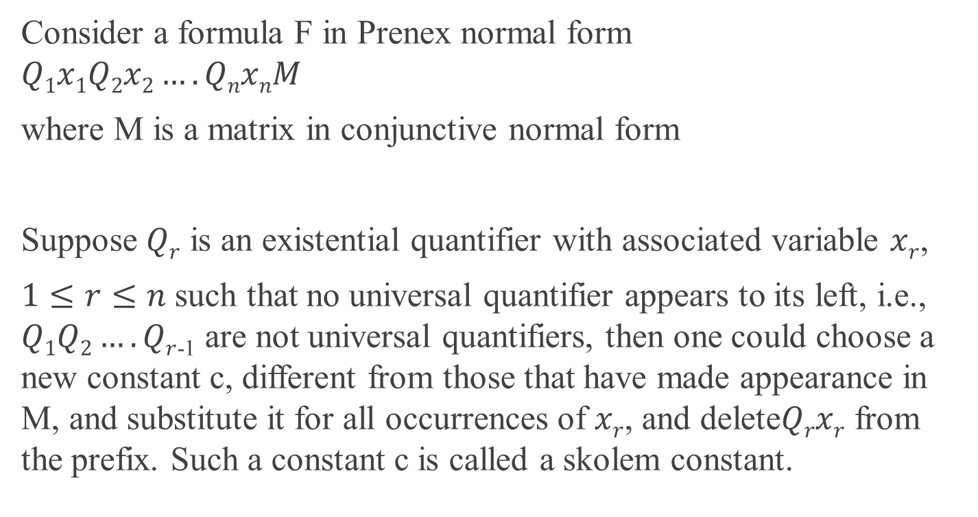
Skolem Standard Form
Consider a formula F in Prenex normal form
$$Q1x1Q2x2….QnxnM$$
where M is a matrix in conjunctive normal form
Suppose $Qr$ is an existential quantifier with associated variable $xr$,
$1≤r≤n$ such that no universal quantifier appears to its left, i.e., $Q1Q2….Qr$₋₁ are not universal quantifiers, then one could choose a new constant c, different from those that have made appearance in M, and substitute it for all occurrences of $xr$, and delete$Qrxr$ from the prefix. Such a constant c is called a skolem constant.

Slide 30
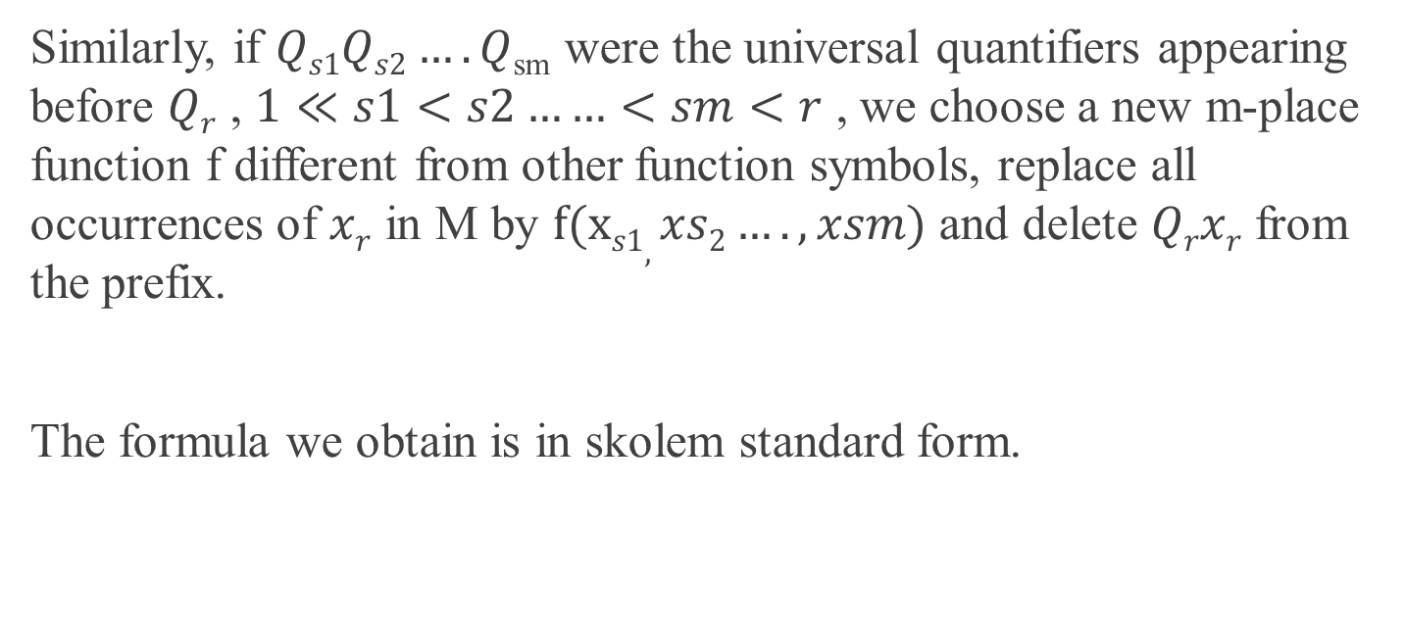
Skolem Standard Form
Similarly, if $Qs1Qs2….Q$_{sm} were the universal quantifiers appearing before $Qr$ , $1≪s1<s2……<sm<r$ , we choose a new m-place function f different from other function symbols, replace all occurrences of $xr$ in M by $f(xs1,xs2….,xsm)$ and delete $Qrxr$ from the prefix.
The formula we obtain is in skolem standard form.

Slide 31
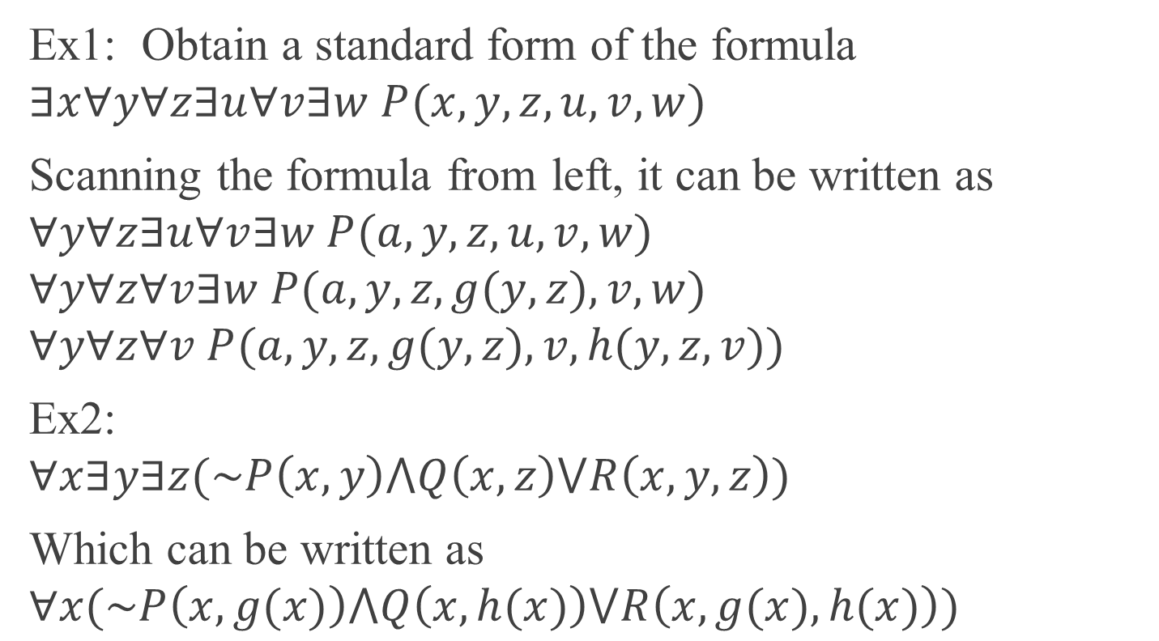
Examples
Ex1: Obtain a standard form of the formula
$$∃x∀y∀z∃u∀v∃w P(x,y,z,u,v,w)$$
Scanning the formula from left, it can be written as
$$∀y∀z∃u∀v∃w P(a,y,z,u,v,w)$$
$$∀y∀z∀v∃w P(a,y,z,g(y,z),v,w)$$
$$∀y∀z∀v P(a,y,z,g(y,z),v,h(y,z,v))$$
Ex2:
$$∀x∃y∃z(\sim P\left(x,y\right)⋀Q\left(x,z\right)⋁R\left(x,y,z\right))$$
Which can be written as
$$∀x(\sim P\left(x,g(x)\right)⋀Q\left(x,h(x)\right)⋁R\left(x,g(x),h(x)\right))$$

