Slide 1
Inference in Predicate Logic

Slide 2
Using Resolution Principle for Predicate logic
To be able to use the resolution principle for predicate logic, it is important that given a formula,
Transform it to Prenex normal form
Skolmise the formula
Remove the universal quantifiers
Express the formula as a set of clauses
Use resolution principle

Slide 3
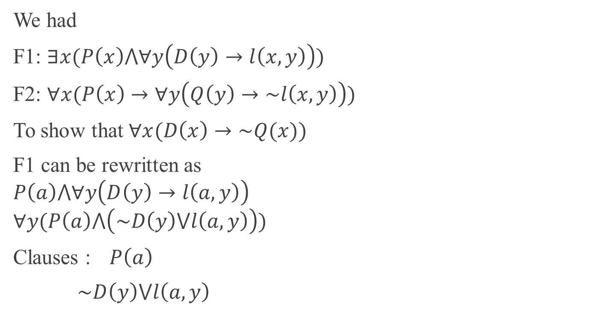
Doctor/Quack Example
We had
F1: $∃x(P\left(x\right)⋀∀y\left(D\left(y\right)→l\left(x,y\right)\right))$
F2: $∀x(P\left(x\right)→∀y\left(Q\left(y\right)→\sim l\left(x,y\right)\right))$
To show that $∀x(D\left(x\right)→\sim Q(x))$
F1 can be rewritten as
$$P\left(a\right)⋀∀y\left(D\left(y\right)→l\left(a,y\right)\right)$$
$$∀y(P\left(a\right)⋀\left(\sim D\left(y\right)⋁l\left(a,y\right)\right))$$
Clauses : $P\left(a\right)$
$\sim D\left(y\right)⋁l\left(a,y\right)$

Slide 4
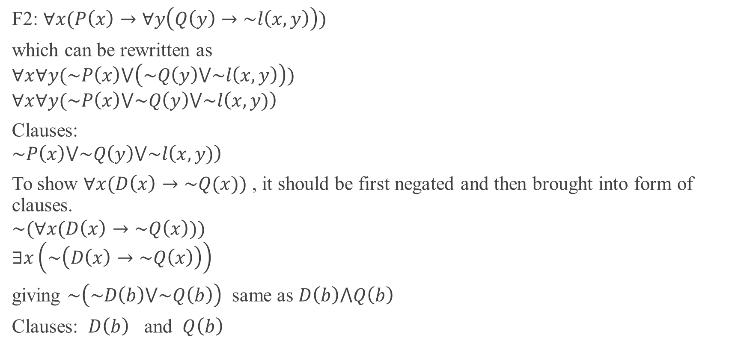
Doctor/Quack Example
F2: $∀x(P\left(x\right)→∀y\left(Q\left(y\right)→\sim l\left(x,y\right)\right))$
which can be rewritten as
$$∀x∀y(\sim P\left(x\right)⋁\left(\sim Q\left(y\right)⋁\sim l\left(x,y\right)\right))$$
$$∀x∀y(\sim P\left(x\right)⋁\sim Q\left(y\right)⋁\sim l\left(x,y)\right)$$
Clauses:
$$\sim P\left(x\right)⋁\sim Q\left(y\right)⋁\sim l\left(x,y)\right)$$
To show $∀x(D\left(x\right)→\sim Q(x))$ , it should be first negated and then brought into form of clauses.
$$\sim (∀x(D\left(x\right)→\sim Q\left(x\right)))$$
$$∃x\left(\sim \left(D\left(x\right)→\sim Q\left(x\right)\right)\right)$$
giving $\sim \left(\sim D\left(b\right)⋁\sim Q\left(b\right)\right)$ same as $D\left(b\right)⋀Q\left(b\right)$
Clauses: $D\left(b\right)$ and $Q\left(b\right)$

Slide 5


Doctor/Quack Example
$P\left(a\right)$ $\sim D\left(y\right)⋁l\left(a,y\right)$ $\sim P\left(x\right)⋁\sim Q\left(y\right)⋁\sim l\left(x,y)\right)$ $D\left(b\right)$ $Q\left(b\right)$
$l\left(a,b\right)$
$\sim l\left(a,b)\right)$
Nil
Hence Contradiction
Therefore $D\left(x\right)→\sim Q(x)$ is established
The order in which clauses are combined also matter in some cases and may lead to circularity as exemplified in the next example.
$$\sim P\left(x\right)⋁\sim l\left(x,b)\right)$$

Slide 6
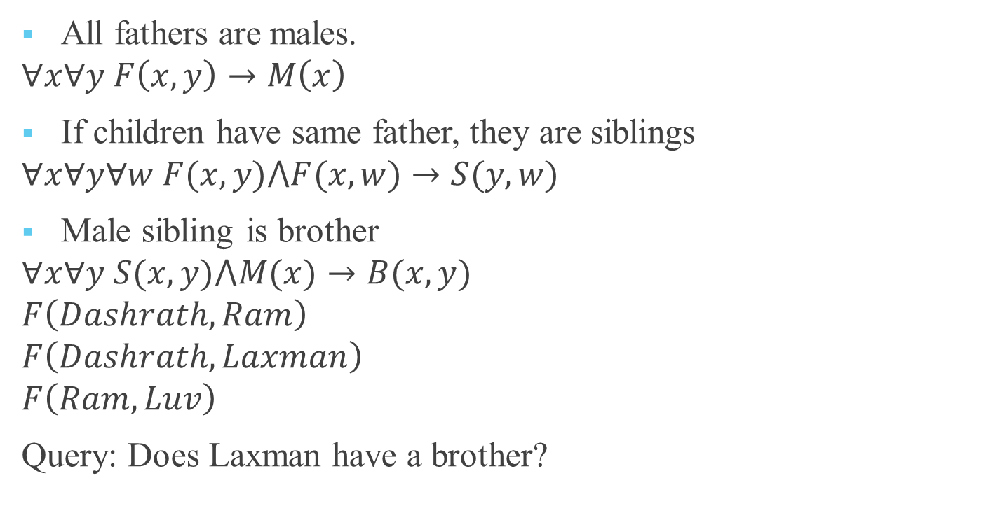
Family Relationship Example
All fathers are males.
$$∀x∀y F\left(x,y\right)→M\left(x\right)$$
If children have same father, they are siblings
$$∀x∀y∀w F(x,y)⋀F(x,w)→S(y,w)$$
Male sibling is brother
$$∀x∀y S(x,y)⋀M(x)→B(x,y)$$
$$F\left(Dashrath, Ram\right)$$
$$F\left(Dashrath, Laxman\right)$$
$$F\left(Ram,Luv\right)$$
Query: Does Laxman have a brother?

Slide 7
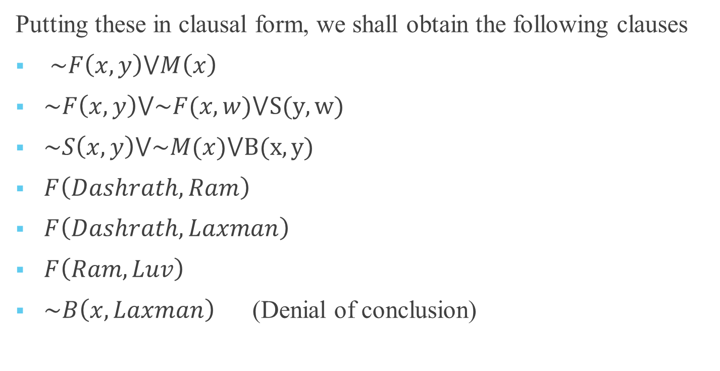
Family Relationship Example
Putting these in clausal form, we shall obtain the following clauses
$\sim F\left(x,y\right)⋁M\left(x\right)$
$\sim F\left(x,y\right)⋁\sim F(x,w)⋁S(y,w)$
$\sim S\left(x,y\right)⋁\sim M(x)⋁B(x,y)$
$F\left(Dashrath, Ram\right)$
$F\left(Dashrath, Laxman\right)$
$F\left(Ram,Luv\right)$
$\sim B\left(x,Laxman\right)$ (Denial of conclusion)

Slide 8

$\sim F\left(x,y\right)⋁M\left(x\right)$ $\sim F\left(x,y\right)⋁\sim F(x,w)⋁S(y,w)$ $\sim S\left(x,y\right)⋁\sim M(x)⋁B(x,y)$
$F\left(Dashrath, Ram\right)$ $F\left(Dashrath, Laxman\right)$ $F\left(Ram,Luv\right)$ $\sim B\left(x,Laxman\right)$
$\sim F\left(Dashrath,Ram\right)⋁\sim F(Dashrath,w)⋁S(Ram,w)$
$$\sim F(Dashrath,w)⋁S(Ram,w)$$
$S(Ram,Laxman)$ $M\left(Ram\right)$
$\sim S\left(Ram,y\right)⋁B(Ram,y)$
$B(Ram,Laxman)$
Nil
Hence Laxman has a brother.

Slide 9
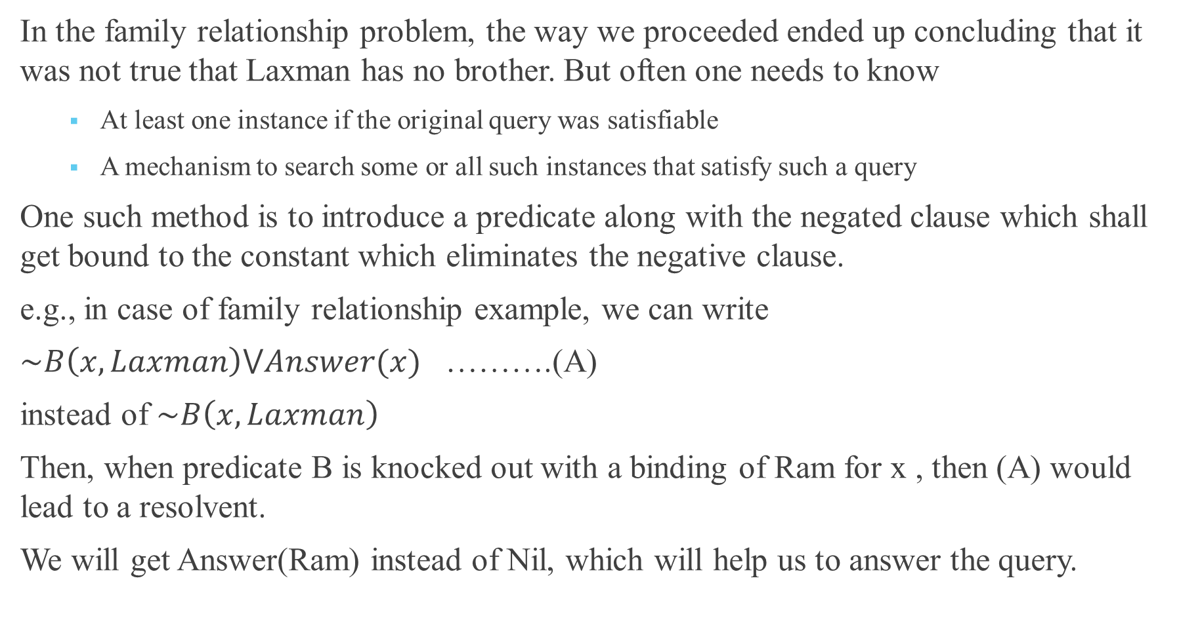
In the family relationship problem, the way we proceeded ended up concluding that it was not true that Laxman has no brother. But often one needs to know
At least one instance if the original query was satisfiable
A mechanism to search some or all such instances that satisfy such a query
One such method is to introduce a predicate along with the negated clause which shall get bound to the constant which eliminates the negative clause.
e.g., in case of family relationship example, we can write
$\sim B\left(x,Laxman\right)⋁Answer(x)$ ……….(A)
instead of $\sim B\left(x,Laxman\right)$
Then, when predicate B is knocked out with a binding of Ram for x , then (A) would lead to a resolvent.
We will get Answer(Ram) instead of Nil, which will help us to answer the query.

Slide 10
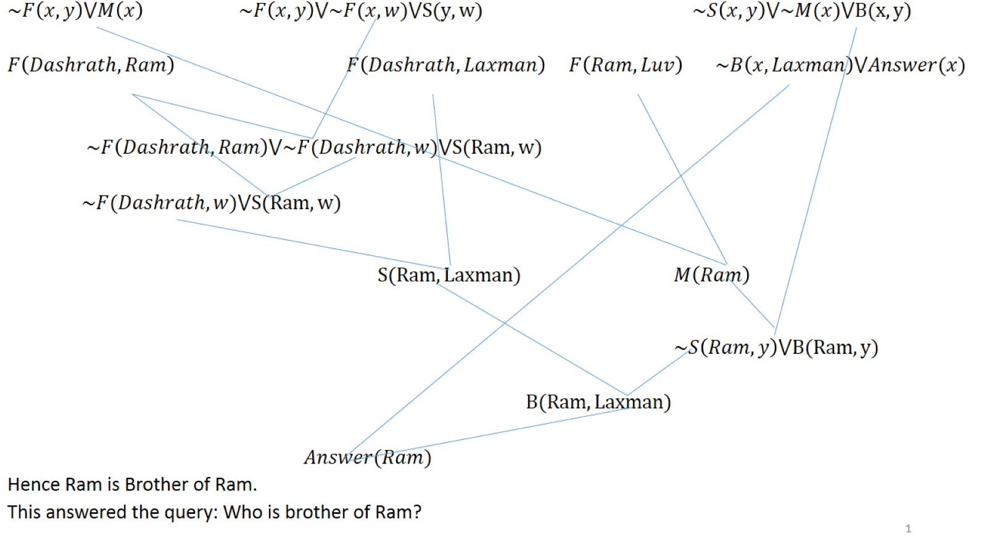

Slide 11
Typical Heuristics for generating Proofs
Unit Preference
A clause with a single literal is called a unit clause. It is suggested that one may prefix to use unit clauses first. The reason is simple. Unit clauses lead to elimination of at least one literal thereby reducing the number of literals in the non-unit clause with which it has been resolved. Also note that two clauses with (m) and (n) (m>1, n>1) may lead to clause length upto (m+n-2).
Note: Prolog uses basically depth first strategy. Beginning with the first clause, one attempts the resolution of negated clauses.

Slide 12
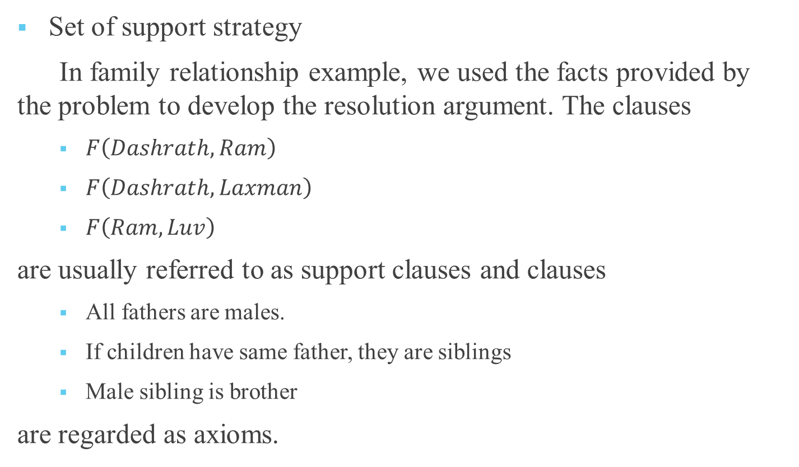
Typical Heuristics for generating Proofs
Set of support strategy
In family relationship example, we used the facts provided by the problem to develop the resolution argument. The clauses
$F\left(Dashrath, Ram\right)$
$F\left(Dashrath, Laxman\right)$
$F\left(Ram,Luv\right)$
are usually referred to as support clauses and clauses
All fathers are males.
If children have same father, they are siblings
Male sibling is brother
are regarded as axioms.

Slide 13
Typical Heuristics for generating Proofs
Choose unique literals
Choice of unique literal is advantageous in more than one way
Reducing the length of clauses and faster resolution
Less likely to lead to circularity. Clauses having multiple appearance offer no clear way to decide how to expedite resolution.

Slide 14
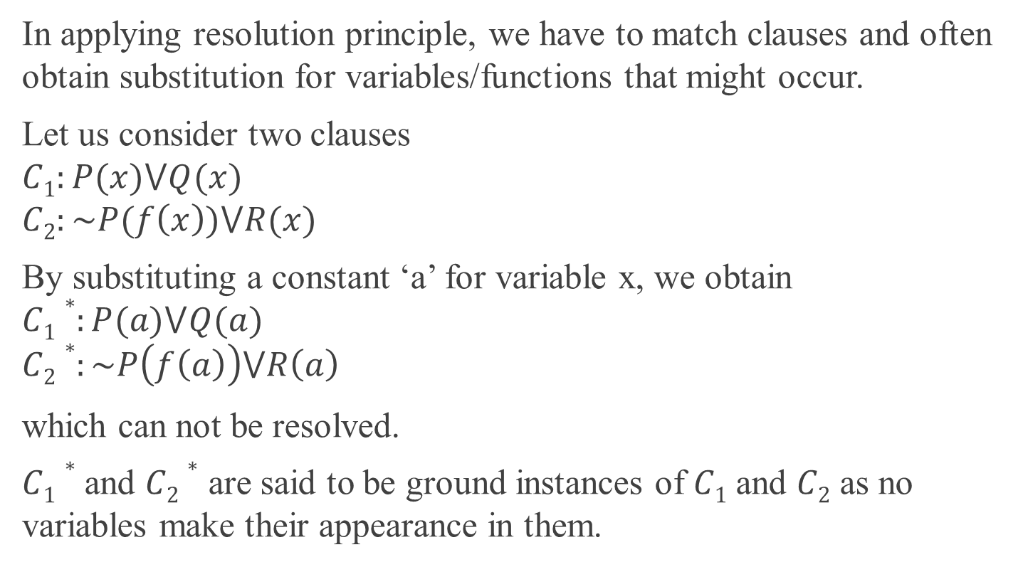
Substitution and Unification
In applying resolution principle, we have to match clauses and often obtain substitution for variables/functions that might occur.
Let us consider two clauses
$$C1:P(x)⋁Q(x)$$
$$C2:\sim P(f\left(x\right))⋁R(x)$$
By substituting a constant ‘a’ for variable x, we obtain
$$C1∗:P(a)⋁Q(a)$$
$$C2∗:\sim P\left(f\left(a\right)\right)⋁R\left(a\right)$$
which can not be resolved.
$C1∗$ and $C2∗$ are said to be ground instances of $C1$ and $C2$ as no variables make their appearance in them.

Slide 15
Substitution and Unification
While attempting matching for resolution, we may have several situations arising where depending on what substitution has been attempted on which variable, we may obtain different instances of the same formula.

Slide 16
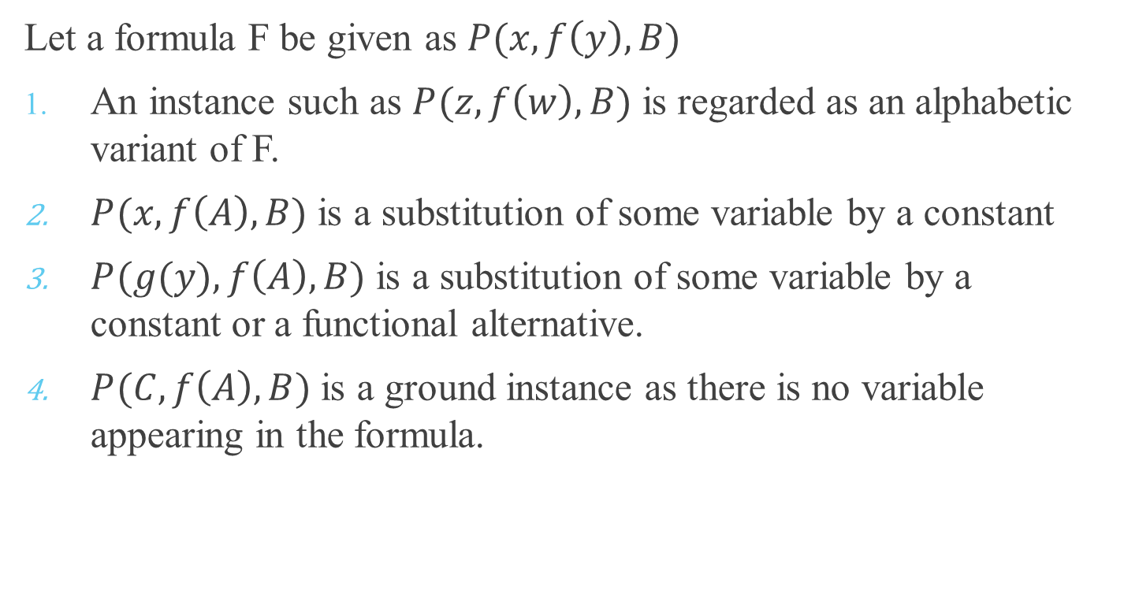
Substitution
Let a formula F be given as $P(x,f\left(y\right),B)$
An instance such as $P(z,f\left(w\right),B)$ is regarded as an alphabetic variant of F.
$P(x,f\left(A\right),B)$ is a substitution of some variable by a constant
$P(g(y),f\left(A\right),B)$ is a substitution of some variable by a constant or a functional alternative.
$P(C,f\left(A\right),B)$ is a ground instance as there is no variable appearing in the formula.

Slide 17
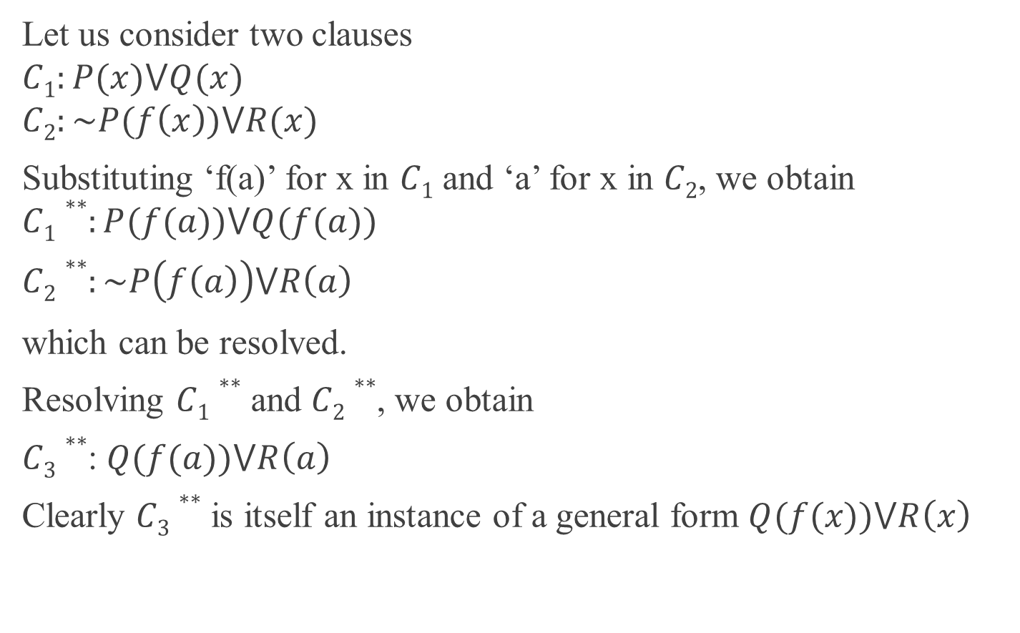
Let us consider two clauses
$$C1:P(x)⋁Q(x)$$
$$C2:\sim P(f\left(x\right))⋁R(x)$$
Substituting ‘f(a)’ for x in $C1$ and ‘a’ for x in $C2$, we obtain
$$C1∗∗:P(f(a))⋁Q(f(a))$$
$C2∗∗:\sim P\left(f\left(a\right)\right)⋁R\left(a\right)$
which can be resolved.
Resolving $C1∗∗$ and $C2∗∗$, we obtain
$C3∗∗$: $Q(f(a))⋁R\left(a\right)$
Clearly $C3∗∗$ is itself an instance of a general form $Q(f(x))⋁R\left(x\right)$

Slide 18
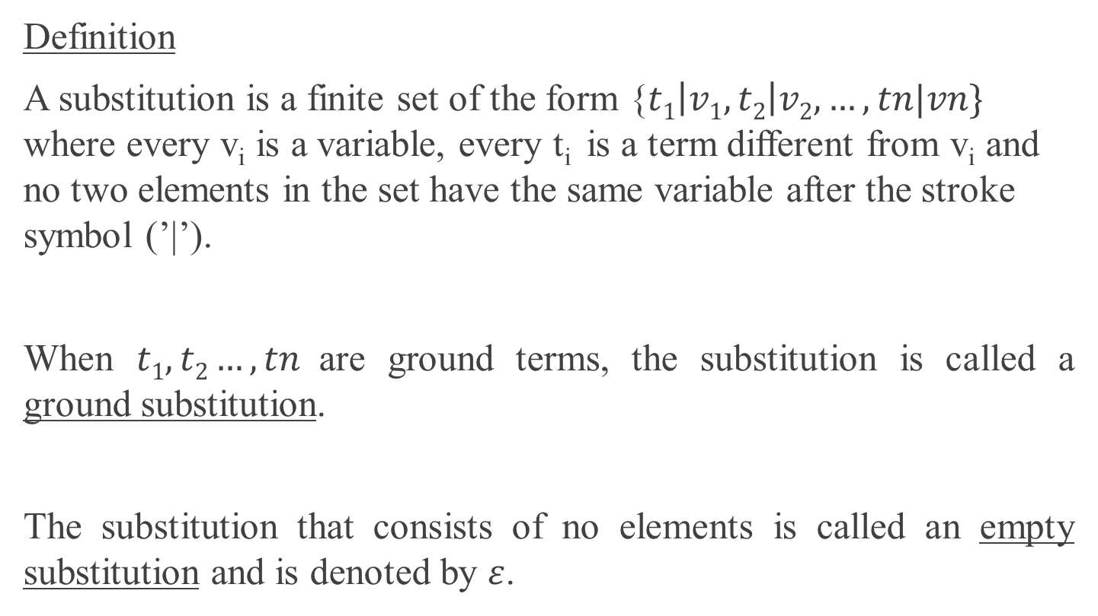
Substitution
Definition
A substitution is a finite set of the form {$t1\left|v1,t2\right|v2,…,tn|vn\}$ where every v_{i} is a variable, every t_{i} is a term different from v_{i} and no two elements in the set have the same variable after the stroke symbol (’|’).
When $t1,t2…,tn$ are ground terms, the substitution is called a ground substitution.
The substitution that consists of no elements is called an empty substitution and is denoted by $ε$.

Slide 19
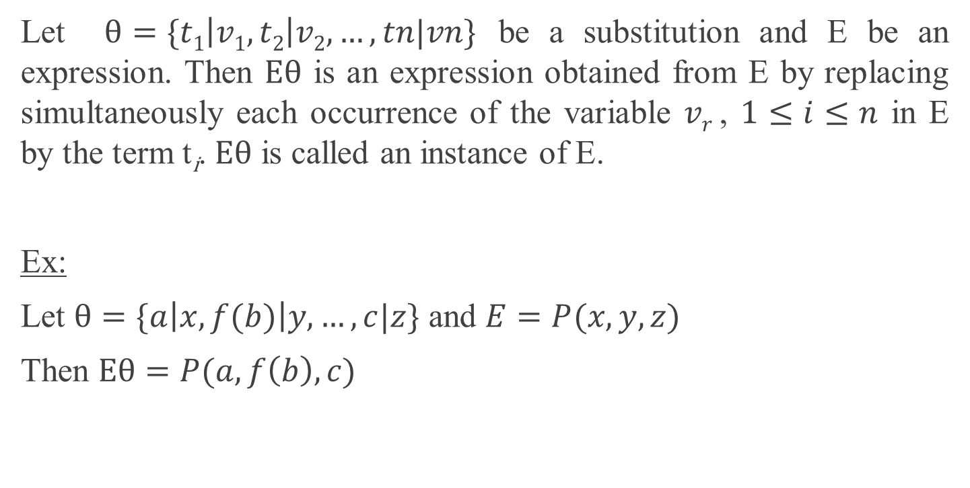
Substitution
Let $θ=\{t1\left|v1,t2\right|v2,…,tn|vn\}$ be a substitution and E be an expression. Then $Eθ$ is an expression obtained from E by replacing simultaneously each occurrence of the variable $vr$ , $1≤i≤n$ in E by the term t_{i}. $Eθ$ is called an instance of E.
Ex:
Let $θ=\{a\left|x,f(b)\right|y,…,c|z\}$ and $E=P(x,y,z)$
Then $Eθ=P(a,f\left(b\right),c)$

Slide 20
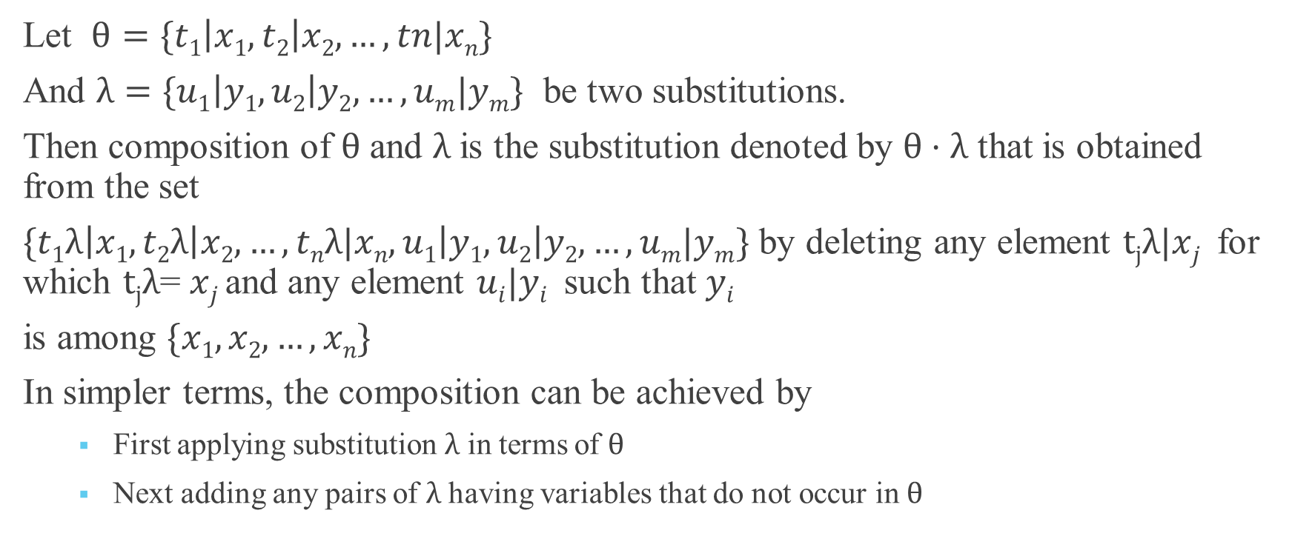
Substitution
Let $θ=\{t1\left|x1,t2\right|x2,…,tn|xn\}$
And $λ=\{u1\left|y1,u2\right|y2,…,um|ym\}$ be two substitutions.
Then composition of $θ$ and $λ$ is the substitution denoted by $θ⋅λ$ that is obtained from the set
$\{t1λ\left|x1,t2λ\right|x2,…,tnλ|xn,u1\left|y1,u2\right|y2,…,um|ym\}$ by deleting any element $tjλ|xj$ for which $tjλ$= $xj$ and any element $ui|yi$ such that $yi$
is among $\{x1,x2,…,xn\}$
In simpler terms, the composition can be achieved by
First applying substitution $λ$ in terms of $θ$
Next adding any pairs of $λ$ having variables that do not occur in $θ$

Slide 21
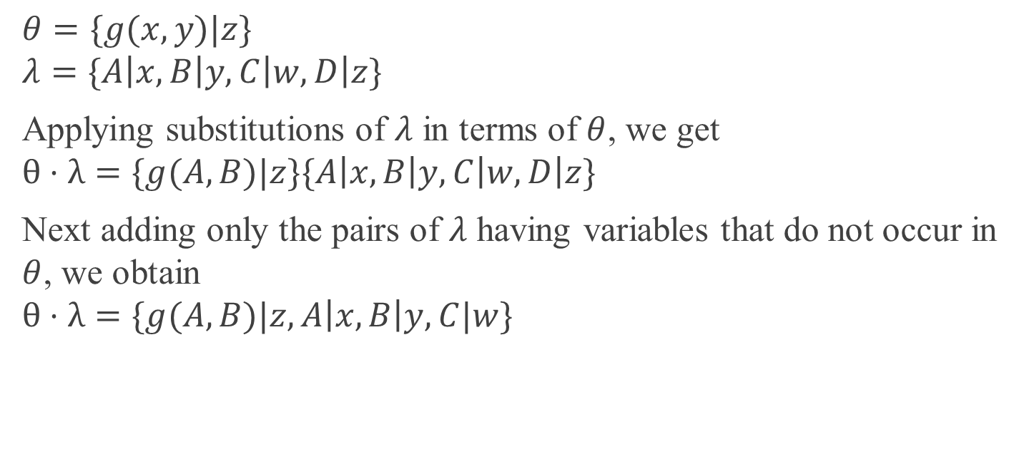
Example
$$θ=\{g(x,y)|z\}$$
$$λ=\{A\left|x,B\right|y,C\left|w,D\right|z\}$$
Applying substitutions of $λ$ in terms of $θ$, we get
$$θ⋅λ=\{g(A,B)|z\}\{A\left|x,B\right|y,C\left|w,D\right|z\}$$
Next adding only the pairs of $λ$ having variables that do not occur in $θ$, we obtain
$$θ⋅λ=\{g(A,B)|z,A\left|x,B\right|y,C|w\}$$

Slide 22
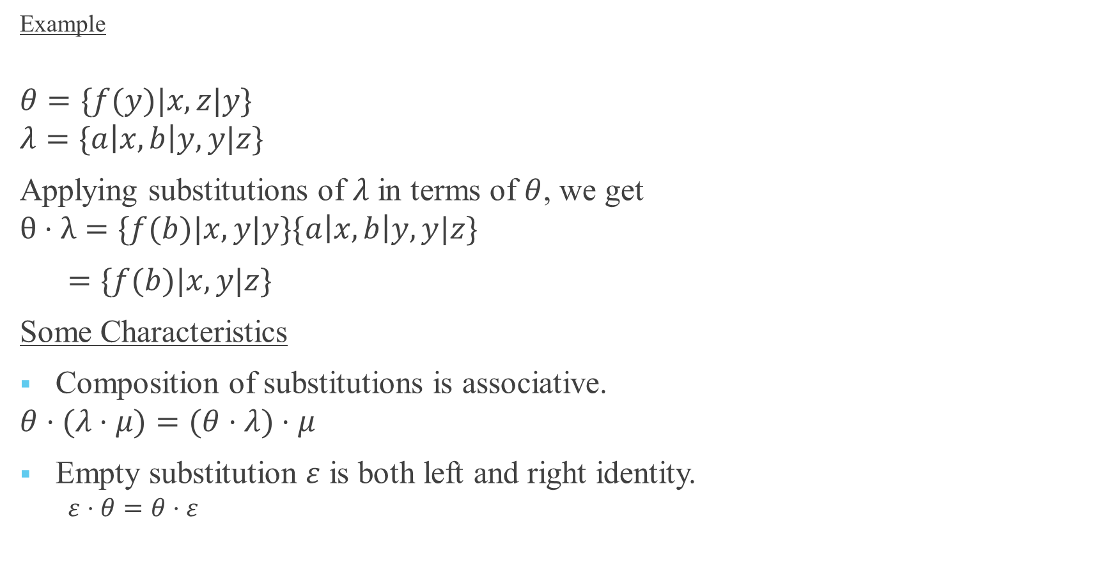
Example
$$θ=\{f(y)|x,z|y\}$$
$$λ=\{a\left|x,b\right|y, y|z\}$$
Applying substitutions of $λ$ in terms of $θ$, we get
$$θ⋅λ=\{f(b)|x,y|y\}\{a\left|x,b\right|y,y|z\}$$
$=\{f(b)|x,y|z\}$
Some Characteristics
Composition of substitutions is associative.
$$θ⋅(λ⋅μ)=(θ⋅λ)⋅μ$$
Empty substitution $ε$ is both left and right identity.
$$ε⋅θ=θ⋅ε$$

Slide 23
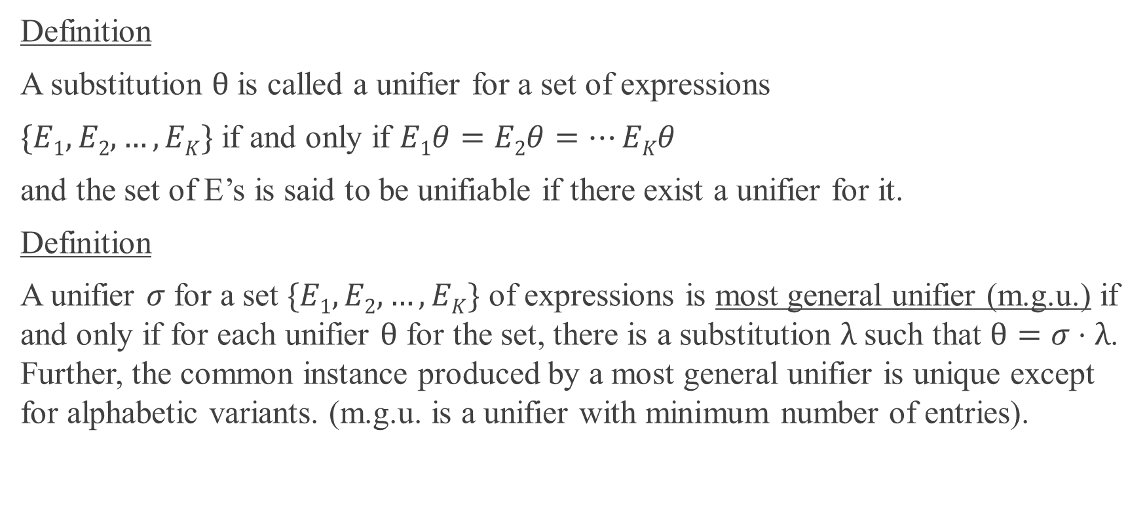
Definition
A substitution $θ$ is called a unifier for a set of expressions
$\{E1,E2,…,EK\}$ if and only if $E1θ=E2θ=…EKθ$
and the set of E’s is said to be unifiable if there exist a unifier for it.
Definition
A unifier $σ$ for a set $\{E1,E2,…,EK\}$ of expressions is most general unifier (m.g.u.) if and only if for each unifier $θ$ for the set, there is a substitution $λ$ such that $θ=σ⋅λ$. Further, the common instance produced by a most general unifier is unique except for alphabetic variants. (m.g.u. is a unifier with minimum number of entries).

Slide 24
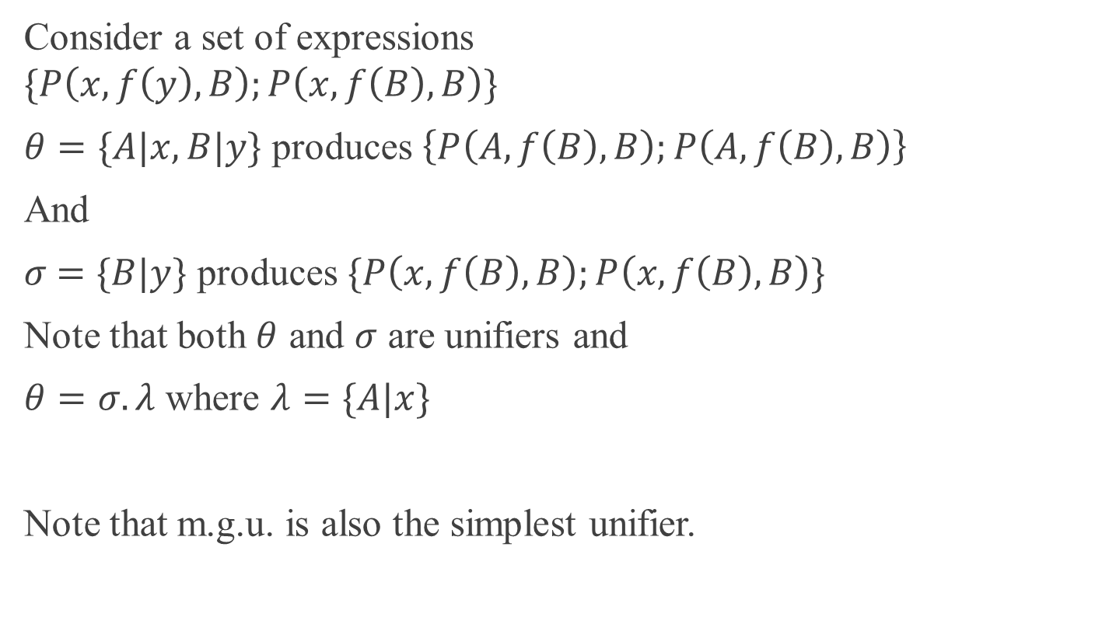
Example
Consider a set of expressions
$$\{P\left(x,f\left(y\right),B\right);P\left(x,f\left(B\right),B\right)\}$$
$θ=\{A|x,B|y\}$ produces $\left\{P\left(A,f\left(B\right),B\right);P\left(A,f\left(B\right),B\right)\right\}$
And
$σ$ $=\{B|y\}$ produces $\{P\left(x,f\left(B\right),B\right);P\left(x,f\left(B\right),B\right)\}$
Note that both $θ$ and $σ$ are unifiers and
$θ=σ.λ$ where $λ=\{A|x\}$
Note that m.g.u. is also the simplest unifier.

Slide 25
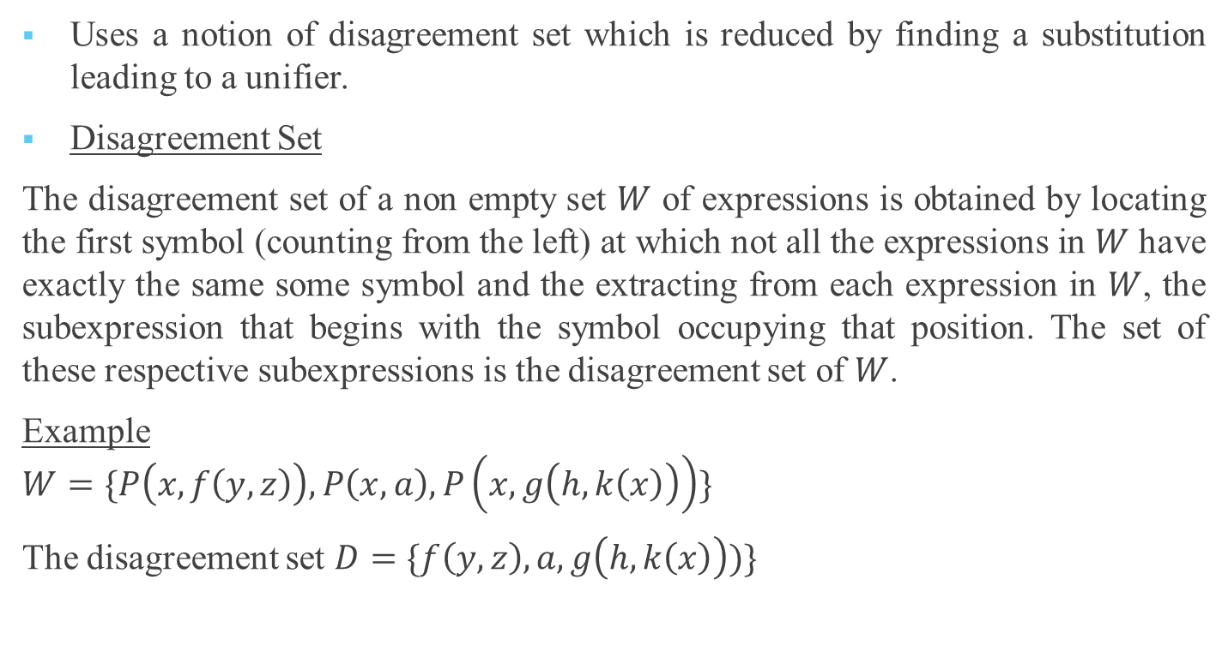
Unification Algorithm
Uses a notion of disagreement set which is reduced by finding a substitution leading to a unifier.
Disagreement Set
The disagreement set of a non empty set $W$ of expressions is obtained by locating the first symbol (counting from the left) at which not all the expressions in $W$ have exactly the same some symbol and the extracting from each expression in $W$, the subexpression that begins with the symbol occupying that position. The set of these respective subexpressions is the disagreement set of $W$.
Example
$$W=\{P\left(x,f\left(y,z\right)\right),P\left(x,a\right),P\left(x,g\left(h,k\left(x\right)\right)\right)\}$$
The disagreement set $D=\{f\left(y,z\right),a,g\left(h,k\left(x\right)\right))\}$

Slide 26
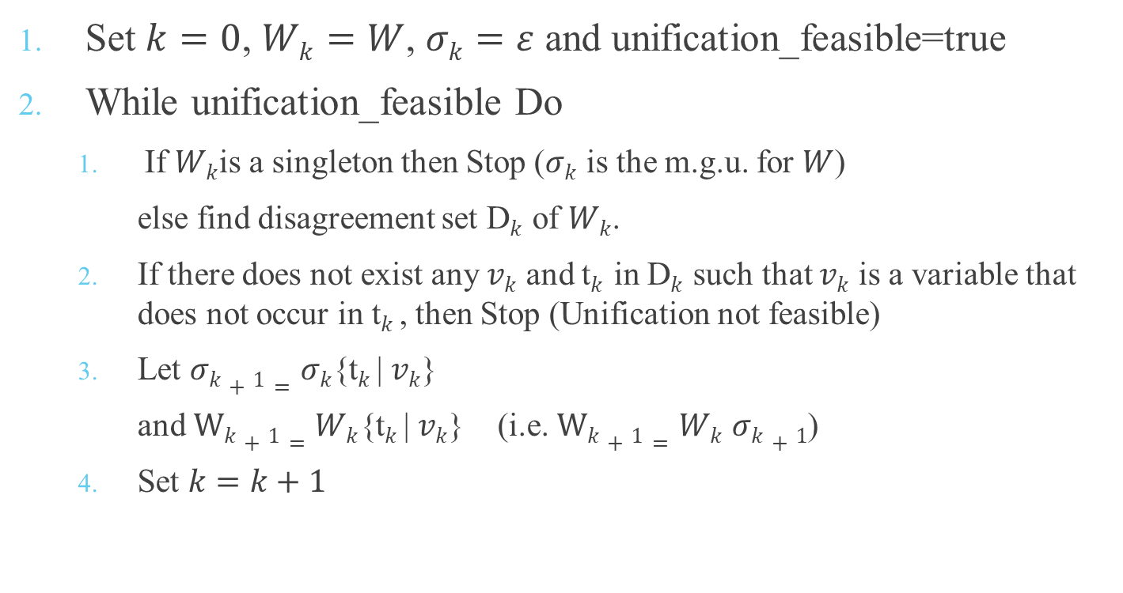
Unification Algorithm
Set $k=0$, $Wk=W$, $σk=ε$ and unification_feasible=true
While unification_feasible Do
If $Wk$is a singleton then Stop ($σk$ is the m.g.u. for $W$)
else find disagreement set D$k$ of $Wk$.
If there does not exist any $vk$ and t$k$in D$k$ such that $vk$ is a variable that does not occur in t$k$, then Stop (Unification not feasible)
Let $σk+1=σk${t$k$| $vk$}
and $Wk+1=Wk${t$k$| $vk$} (i.e. $Wk+1=Wk$ $σk+1$)
Set $k=k+1$

Slide 27

Unification Algorithm
Set $k=0$, $Wk=W$, $σk=ε$ and unification_feasible=true
while unification_feasible
Do
begin
If $Wk$is a singleton
then
begin
output($σk$ )
Stop
end
else

Slide 28

Unification Algorithm
begin
find disagreement set D$k$ of $Wk$
Find a pair $vk$ and t$k$in D$k$ such that $vk$ is a variable not occurring in t$k$
If such a t$k$| $vk$ pair exists
then
begin
Set $σk+1=σk${t$k$| $vk$}
$Wk+1=Wk$ $σk+1$
$k=k+1$
end
else
begin
Output(“Unification not possible”)
Stop
end
end
end

Slide 29
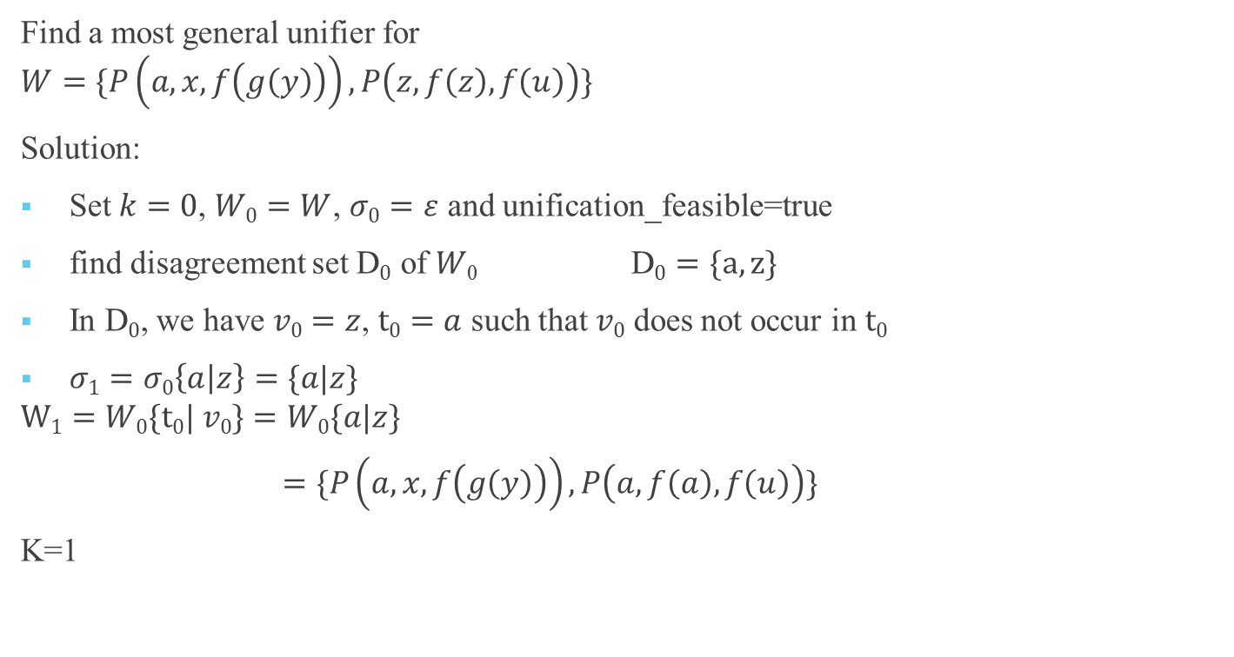
Example
Find a most general unifier for
$$W=\{P\left(a,x,f\left(g\left(y\right)\right)\right),P\left(z,f\left(z\right),f\left(u\right)\right)\}$$
Solution:
Set $k=0$, $W0=W$, $σ0=ε$ and unification_feasible=true
find disagreement set D$0$ of $W$₀ D$0=\{a,z\}$
In D$0$, we have $v0=z$, $t0=a$ such that $v0$ does not occur in $t0$
$σ1=σ0\left\{a | z\right\}=\{a|z\}$
$$W1=W0\{t0| v0\}=W0\{a|z\}$$
$=\{P\left(a,x,f\left(g\left(y\right)\right)\right),P\left(a,f\left(a\right),f\left(u\right)\right)\}$
K=1

Slide 30

Example
$W1$ is not a singleton
find disagreement set D$1$ $D1=\{x,f(a)\}$
$σ2=σ1\left\{f(a) | x\right\}=\{a|z,f\left(a\right)|x\}$
$$W2=W1\left\{f(a) | x\right\}$$
$=\{P\left(a,f(a),f\left(g\left(y\right)\right)\right),P\left(a,f\left(a\right),f\left(u\right)\right)\}$
K=2

Slide 31
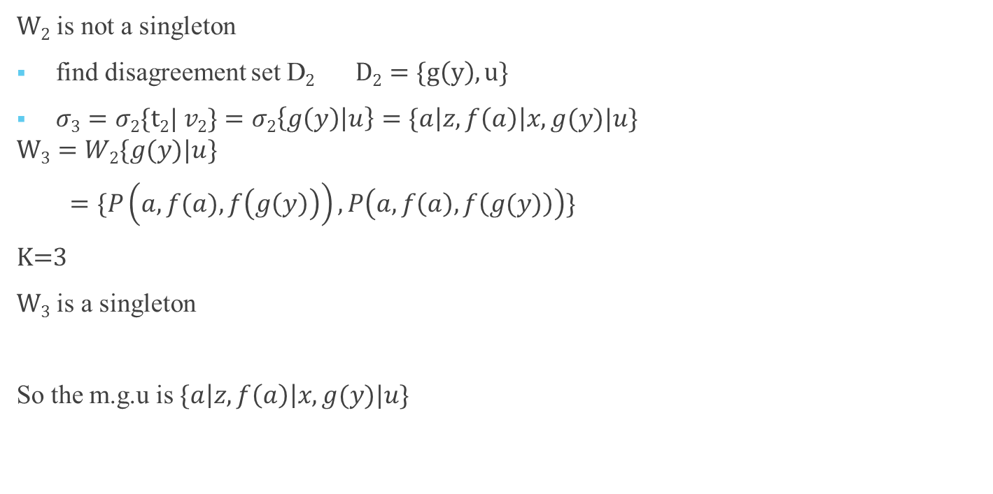
Example
$W2$ is not a singleton
find disagreement set D$2$ $D2=\{g\left(y\right),u\}$
$σ3=σ2\{t2| v2\}=σ2\left\{g\left(y\right) | u\right\}=\{a\left|z,f\left(a\right)\right|x, g(y)|u\}$
$$W3=W2\{g(y)|u\}$$
$=\{P\left(a,f(a),f\left(g\left(y\right)\right)\right),P\left(a,f\left(a\right),f\left(g(y)\right)\right)\}$
K=3
$W3$ is a singleton
So the m.g.u is $\{a\left|z,f\left(a\right)\right|x, g(y)|u\}$

Slide 32
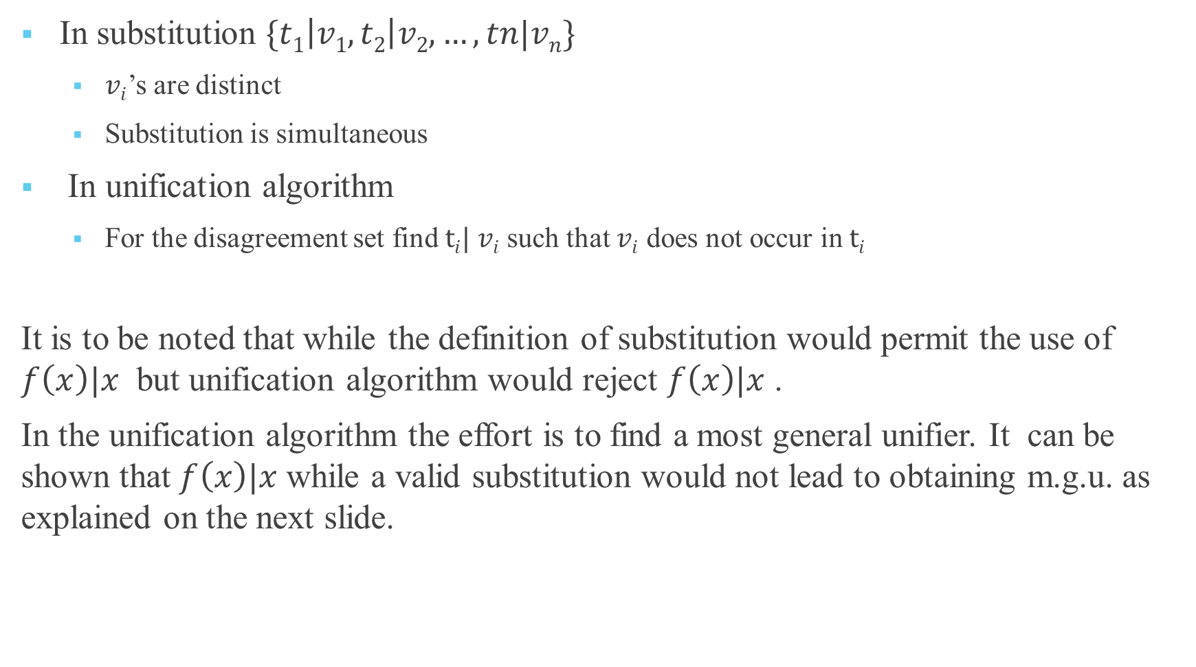
In substitution $\{t1\left|v1,t2\right|v2,…,tn|vn\}$
$vi$’s are distinct
Substitution is simultaneous
In unification algorithm
For the disagreement set find $ti| vi$ such that $vi$ does not occur in $ti$
It is to be noted that while the definition of substitution would permit the use of $f\left(x\right)|x$ but unification algorithm would reject $f\left(x\right)|x$ .
In the unification algorithm the effort is to find a most general unifier. It can be shown that $f\left(x\right)|x$ while a valid substitution would not lead to obtaining m.g.u. as explained on the next slide.

Slide 33
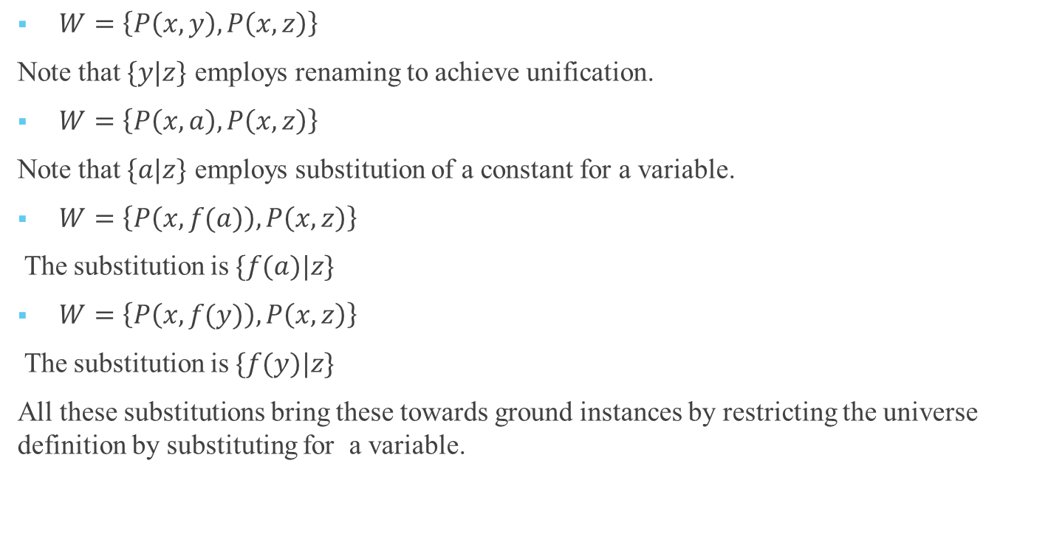
An explanation
$W=\left\{P\left(x,y\right),P\left(x,z\right)\right\}$
Note that $\{y|z\}$ employs renaming to achieve unification.
$W=\left\{P\left(x,a\right),P\left(x,z\right)\right\}$
Note that $\{a|z\}$ employs substitution of a constant for a variable.
$W=\left\{P\left(x,f(a)\right),P\left(x,z\right)\right\}$
The substitution is $\{f(a)|z\}$
$W=\left\{P\left(x,f(y)\right),P\left(x,z\right)\right\}$
The substitution is $\{f(y)|z\}$
All these substitutions bring these towards ground instances by restricting the universe definition by substituting for a variable.

Slide 34
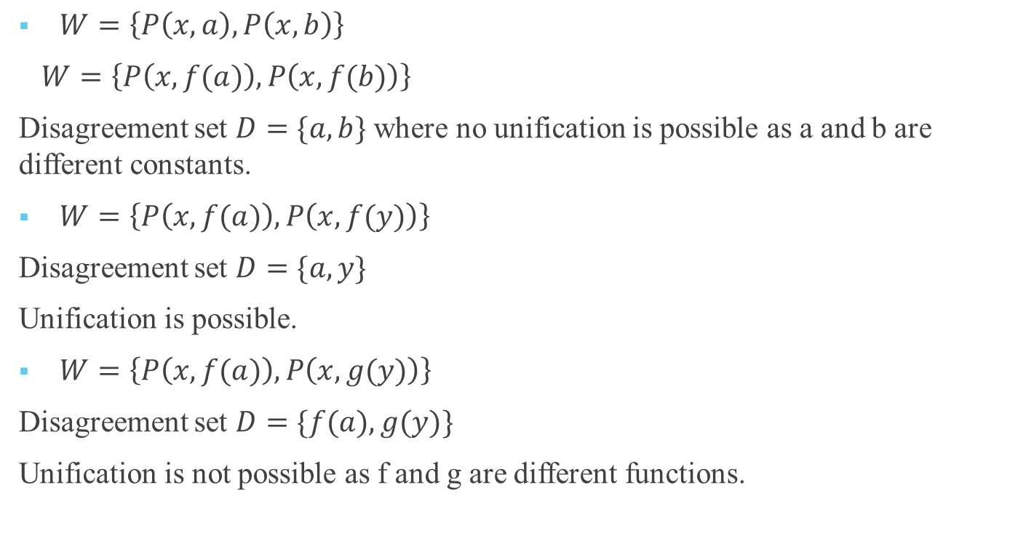
Examples
$W=\left\{P\left(x,a\right),P\left(x,b\right)\right\}$
$W=\left\{P\left(x,f(a)\right),P\left(x,f(b)\right)\right\}$
Disagreement set $D=\{a,b\}$ where no unification is possible as a and b are different constants.
$W=\left\{P\left(x,f(a)\right),P\left(x,f(y)\right)\right\}$
Disagreement set $D=\{a,y\}$
Unification is possible.
$W=\left\{P\left(x,f(a)\right),P\left(x,g(y)\right)\right\}$
Disagreement set $D=\{f(a),g(y)\}$
Unification is not possible as f and g are different functions.

Slide 35
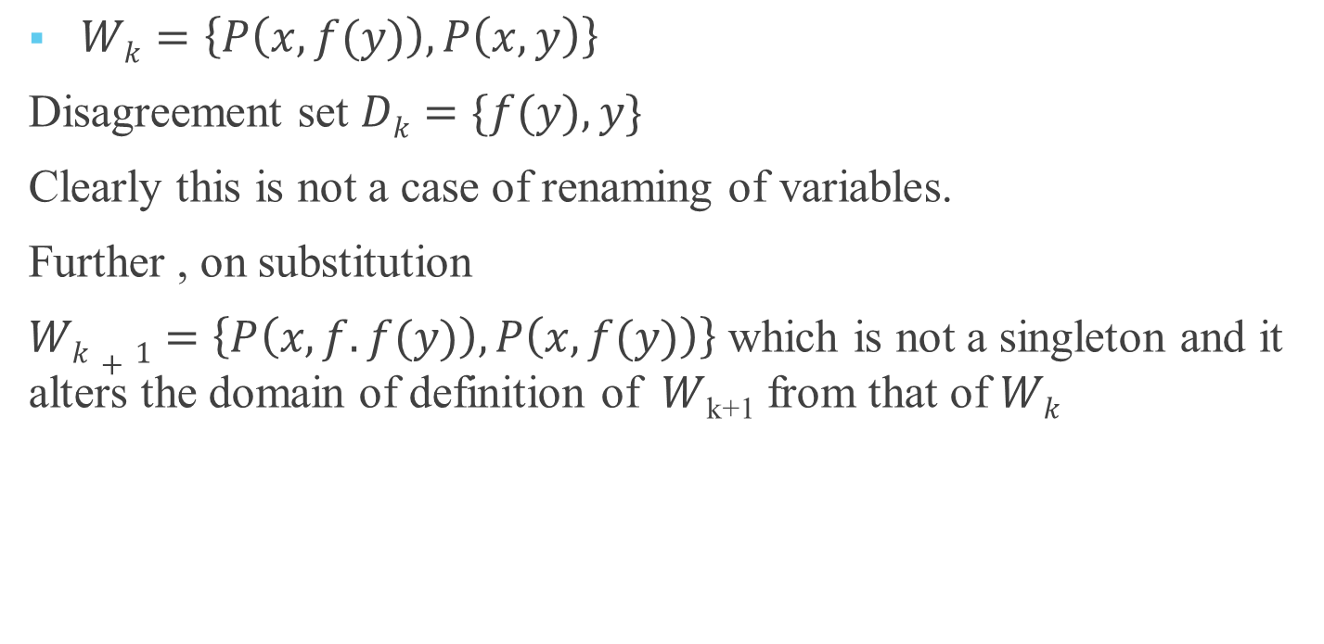
Examples
$Wk=\left\{P\left(x,f(y)\right),P\left(x,y\right)\right\}$
Disagreement set $Dk=\{f(y),y\}$
Clearly this is not a case of renaming of variables.
Further , on substitution
$Wk+1=\left\{P\left(x,f.f(y)\right),P\left(x,f(y)\right)\right\}$ which is not a singleton and it alters the domain of definition of $W$_{k+1} from that of $Wk$

