Slide 1
Bixby’s Virtual Pet Sim - A Tamagotchi Inspired Game
Team Bixby - Arshnoor Amin, Khoi Lam, Neal Sklar, Shrawak Lama

Slide 2

Problem Statement
Our Team was inspired by the Tamagotchi pet simulator
We decided to make our own pet simulator
We were interested in learning more about Scrum and how that would fit into a team based project
We were also looking forward to applying all the concepts we’d learned throughout the semester into one final project to show the extent of what we’d learned

Slide 3
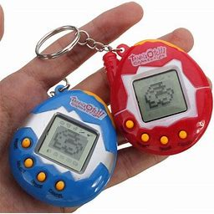
Background
The original 1997 Tamagotchi pet simulator
Hunger meter, Happy meter, Bracelet meter, and Discipline meter to determine how healthy and well behaved the pet is.
Pet lifecycle: Baby, Child, Teenager, then Adult.
Our program seeks to implement this design using Java and JavaFX

Slide 4

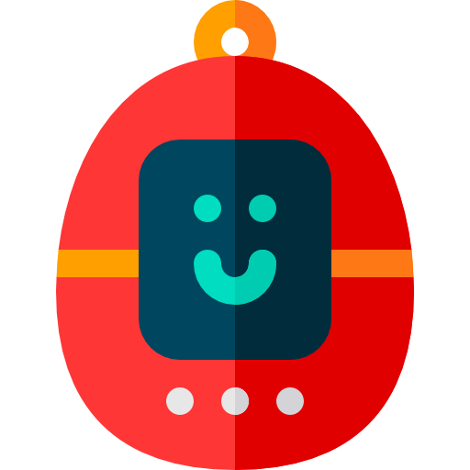
Motivation
Tamagotchi is a fan-favorite game that has sold 82 million copies as of 2010
Unique for its user interactions and visuals, we thought Tamagotchi was a perfect fit for the design aspects and material we’ve been learning in class
Goal: to make a functional pet simulator using everything we learned from the class and labs
Implementation of Java design principles and JavaFX visuals

Slide 5
DESIGN STAGES

Slide 6
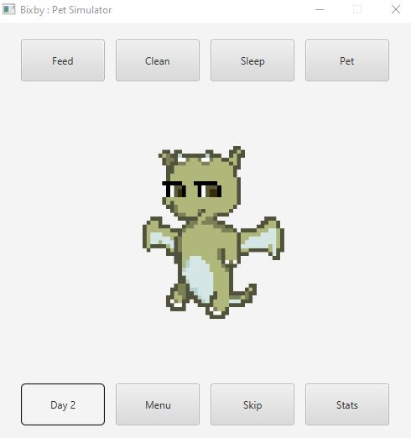
GUI Interface

Slide 7
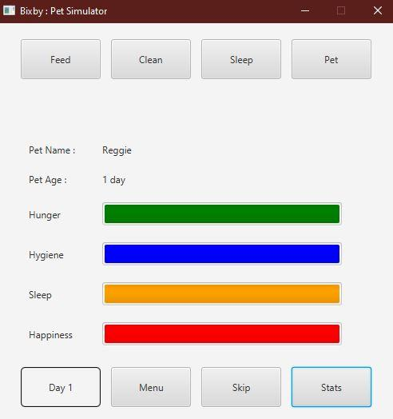
Implementing Stats & Menu

Slide 8
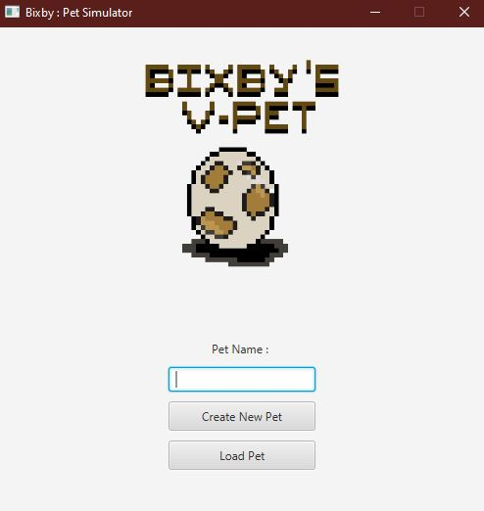
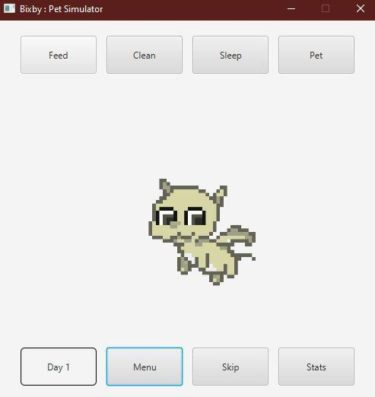
Final Product

