Slide 1
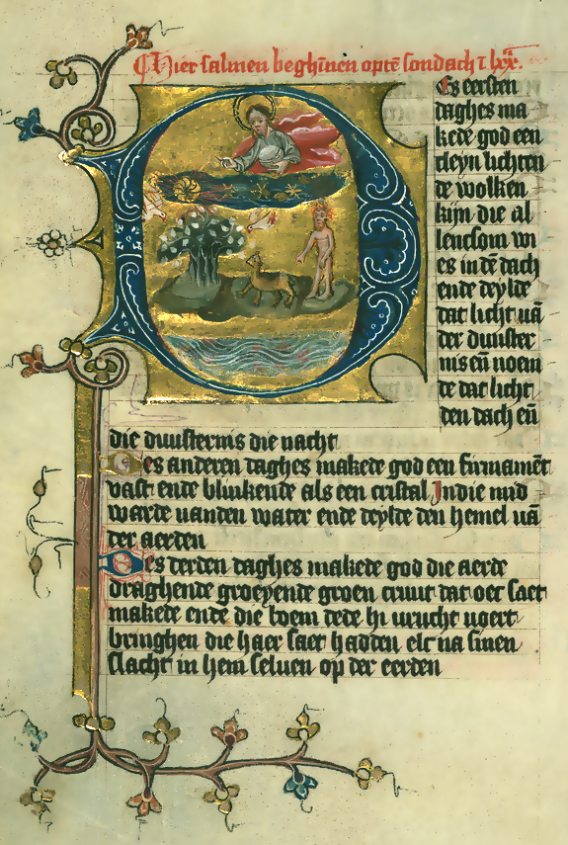
HTML
The Web Document

Slide 2
Background
HTTP is a 2-phase protocol used by most web applications and all web browsers
REQUEST: a client/browser asks a server for a resource
RESPONSE: the server responds with the resource
The response is usually an HTML document
An HTML document is ‘plain text’
An HTML document may use other resources
Images
Scripts
Fonts
Video
Stylesheets

Slide 3
Introduction
When a user types a URL
The browser creates an HTTP request for the document
The server responds with the document. The document has
content : the data of the document.
structure : relationships between content
style : how the content is displayed / rendered
The browser generates requests for any resources that the document requires
images
fonts
…
The browser renders the document
For each data element determines the size, location, color, etc.. of the element
The document is then turned into pixels and shown on the screen.

Slide 4
Document Content
Essays in the art of writing.
Title
By Robert Louis Stevenson
Attribution
On Some Technical Elements of Style in Literature
Chapter
There is nothing more disenchanting to man than to be shown the springs and mechanism of any art. All our arts and occupations lie wholly on the surface; it is on the surface that we perceive their beauty, fitness, and significance; and to pry below is to be appalled by their emptiness and shocked by the coarseness of the strings and pulleys. In a similar way, psychology itself, when pushed to any nicety, discovers an abhorrent baldness, but rather from the fault of our analysis than from any poverty native to the mind. And perhaps in aesthetics the reason is the same: those disclosures which seem fatal to the dignity of art seem so perhaps only in the proportion of our ignorance; and those conscious and unconscious artifices which it seems unworthy of the serious artist to employ were yet, if we had the power to trace them to their springs, indications of a delicacy of the sense finer than we conceive, and hints of ancient harmonies in nature. This ignorance at least is largely irremediable. We shall never learn the affinities of beauty, for they lie too deep in nature and too far back in the mysterious history of man. The amateur, in consequence, will always grudgingly receive details of method, which can be stated but never can wholly be explained; nay, on the principle laid down in Hudibras, that
Paragraph
‘Still the less they understand, The more they admire the sleight-of-hand,’
Quotation

Slide 5
Document Structure
Essays in the art of writing.
The document elements are related to each other in specific ways.
The document contains a title followed by a chapter.
The title contains an author.
The chapter contains a paragraph and a quotation.
By Robert Louis Stevenson
On Some Technical Elements of Style in Literature
There is nothing more disenchanting to man than to be shown the springs and mechanism of any art. All our arts and occupations lie wholly on the surface; it is on the surface that we perceive their beauty, fitness, and significance; and to pry below is to be appalled by their emptiness and shocked by the coarseness of the strings and pulleys. In a similar way, psychology itself, when pushed to any nicety, discovers an abhorrent baldness, but rather from the fault of our analysis than from any poverty native to the mind. And perhaps in aesthetics the reason is the same: those disclosures which seem fatal to the dignity of art seem so perhaps only in the proportion of our ignorance; and those conscious and unconscious artifices which it seems unworthy of the serious artist to employ were yet, if we had the power to trace them to their springs, indications of a delicacy of the sense finer than we conceive, and hints of ancient harmonies in nature. This ignorance at least is largely irremediable. We shall never learn the affinities of beauty, for they lie too deep in nature and too far back in the mysterious history of man. The amateur, in consequence, will always grudgingly receive details of method, which can be stated but never can wholly be explained; nay, on the principle laid down in Hudibras, that
‘Still the less they understand, The more they admire the sleight-of-hand,’

Slide 6
Document Style
Essays in the art of writing.
Large bold underlined
By Robert Louis Stevenson
Small all-caps gray
On Some Technical Elements of Style in Literature
Medium bold blue
There is nothing more disenchanting to man than to be shown the springs and mechanism of any art. All our arts and occupations lie wholly on the surface; it is on the surface that we perceive their beauty, fitness, and significance; and to pry below is to be appalled by their emptiness and shocked by the coarseness of the strings and pulleys. In a similar way, psychology itself, when pushed to any nicety, discovers an abhorrent baldness, but rather from the fault of our analysis than from any poverty native to the mind. And perhaps in aesthetics the reason is the same: those disclosures which seem fatal to the dignity of art seem so perhaps only in the proportion of our ignorance; and those conscious and unconscious artifices which it seems unworthy of the serious artist to employ were yet, if we had the power to trace them to their springs, indications of a delicacy of the sense finer than we conceive, and hints of ancient harmonies in nature. This ignorance at least is largely irremediable. We shall never learn the affinities of beauty, for they lie too deep in nature and too far back in the mysterious history of man. The amateur, in consequence, will always grudgingly receive details of method, which can be stated but never can wholly be explained; nay, on the principle laid down in Hudibras, that
Small black
‘Still the less they understand, The more they admire the sleight-of-hand,’
Small italic indented

Slide 7
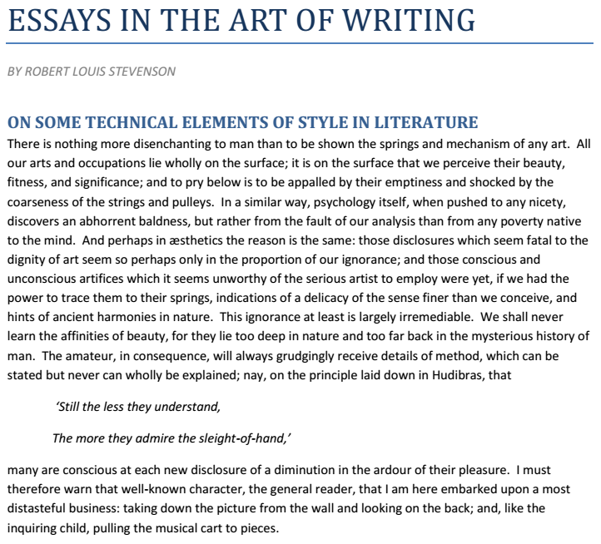
Rendered Document
The browser takes the content, structure, and style information and 'renders' the document. This is the result.

Slide 8
HTML Documents
HTML documents: Hypertext markup language
hypertext : links
markup language : the content is ‘marked up’ with tags that describe the documents structure
The structure is hierarchical
HTML documents are
Plain text documents
Content is typed in with a plain-text word processor
Content is tagged
tags are typed in with a plain-text word processor
HTML documents are all about ‘semantics’
Not concerned with ‘looks’
All about ‘meaning’
CSS is all about ‘style’

Slide 9
HTML Syntax
HTML documents are composed of elements
Also known as tags
Content is ‘tagged’ to describe it’s meaning within the document.
You might tag the content as an ‘article’
TAG_START
TAGGED_CONTENT
TAG_END
<article>
this is the article
</article>

Slide 10
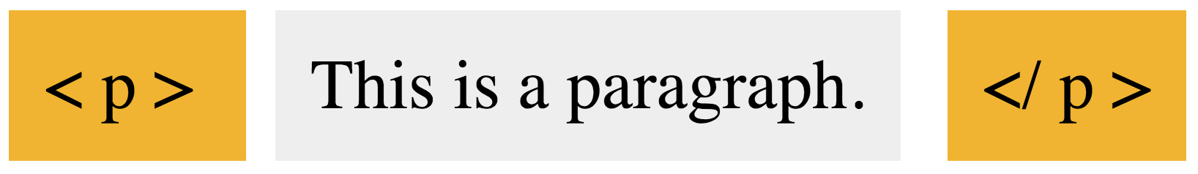
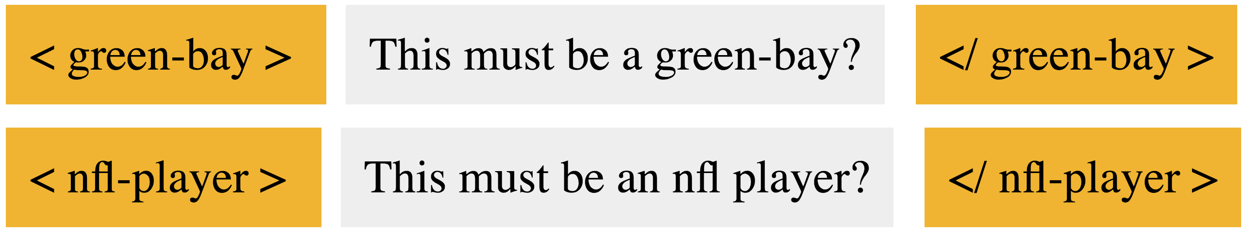

HTML Syntax
A tag is always written like:
Notes on tags
Tags contain an element name. The tag above is the ‘p’ or ‘paragraph’ element.
A tag has both a start and a close. The closing tag is denoted by the two-character sequence </.
Some tags (just a few) don’t need to be closed.
There is a well-defined set of element names in HTML. You cannot invent your own.

Slide 11
HTML Syntax
Tags define the structure of the content
Tags declare the semantic meaning of the content
Tags describe how content is related to other content via nesting
Tags are not case sensitive. Each of the following are semantically equal.
<BODY>
<Body>
<body>
<bODY>
We should always use lower-case anyway.
<body>
NOT <BODY>
NOT <BoDy>

Slide 12
Document Structure
Tags define the structure of a document by nesting.
Each tag must be fully contained within a ‘parent’ tag.
Tags are related to each other as
parent : If A contains B without another tag between them, A is the parent of B.
child : If B is contained by A without another tag between them, B is the child of A.
sibling : If A and B have the same parent, A and B are siblings.

Slide 13
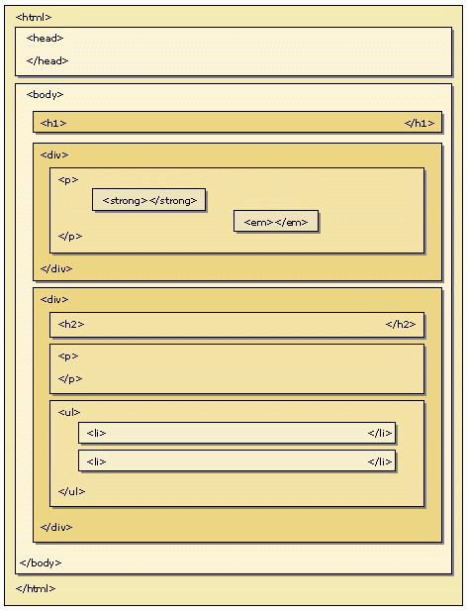
Example of Document Structure

Slide 14

HTML Syntax : Attributes
Tags may have attributes
<tagname att1="val1" att2="val2" …>
An attribute is always written as an attribute-name followed by an equal symbol (=) followed by text in double-quotes (this is the value).
name=“value”
Each element has a well-defined set of attribute names. You can’t invent your own.

Slide 15
Document Structure
<div>Essays in the art of writing.
</div>
Starting with just the words of the document, the structure and style are indicated with "markup" (also known as "tags").
<h6>By Robert Louis Stevenson</h6>
<div class="chapter">On Some Technical Elements of Style in Literature
</div>
<p>There is nothing more disenchanting to man than to be shown the springs and mechanism of any art. All our arts and occupations lie wholly on the surface; it is on the surface that we perceive their beauty, fitness, and significance; and to pry below is to be appalled by their emptiness and shocked by the coarseness of the strings and pulleys. In a similar way, psychology itself, when pushed to any nicety, discovers an abhorrent baldness, but rather from the fault of our analysis than from any poverty native to the mind. And perhaps in aesthetics the reason is the same: those disclosures which seem fatal to the dignity of art seem so perhaps only in the proportion of our ignorance; and those conscious and unconscious artifices which it seems unworthy of the serious artist to employ were yet, if we had the power to trace them to their springs, indications of a delicacy of the sense finer than we conceive, and hints of ancient harmonies in nature. This ignorance at least is largely irremediable. We shall never learn the affinities of beauty, for they lie too deep in nature and too far back in the mysterious history of man. The amateur, in consequence, will always grudgingly receive details of method, which can be stated but never can wholly be explained; nay, on the principle laid down in Hudibras, that</p>
<q>‘Still the less they understand, The more they admire the sleight-of-hand,’</q>

Slide 16
Spaces, Tabs, Newlines
<div>Essays in the art of writing.<h6>By Robert Louis Stevenson</h6></div><div class="chapter">On Some Technical Elements of Style in Literature<p>There is nothing more disenchanting to man than to be shown the springs and mechanism of any art. All our arts and occupations lie wholly on the surface; it is on the surface that we perceive their beauty, fitness, and significance; and to pry below is to be appalled by their emptiness and shocked by the coarseness of the strings and pulleys. In a similar way, psychology itself, when pushed to any nicety, discovers an abhorrent baldness, but rather from the fault of our analysis than from any poverty native to the mind. And perhaps in aesthetics the reason is the same: those disclosures which seem fatal to the dignity of art seem so perhaps only in the proportion of our ignorance; and those conscious and unconscious artifices which it seems unworthy of the serious artist to employ were yet, if we had the power to trace them to their springs, indications of a delicacy of the sense finer than we conceive, and hints of ancient harmonies in nature. This ignorance at least is largely irremediable. We shall never learn the affinities of beauty, for they lie too deep in nature and too far back in the mysterious history of man. The amateur, in consequence, will always grudgingly receive details of method, which can be stated but never can wholly be explained; nay, on the principle laid down in Hudibras, that</p><q>‘Still the less they understand, The more they admire the sleight-of-hand,’</q></div>
Note that spaces and new-lines don't often make a difference.
Typing this into a file will be rendered exactly the same as the previous example; it's just harder to read the HTML directly (which doesn’t really matter anyway).

Slide 17
Syntax and Tags
HTML5 has rules about how to mark-up data.
It has a well-defined set of element names. You must use only those elements defined by the standard.
Each element has a semantic specification that defines when it should be used.
Some elements have constraints on what they may contain. You must follow the specification as it relates to the hierarchical document structure.
Each element has a well defined set of attribute names. You must use only those attribute names.
Each element attribute has a well-defined set of values. You must use only those attribute values.
HTML Syntax describes the rules for writing correct HTML. The rest of this presentation describes HTML 5 Syntax.

Slide 18
HTML Tags
There are over 100 tags in HTML5. They can be grouped as follows
Structure: html, head, body, div, span
Text: p, h1-h6, strong, em, abbr, acronym, address, bdi, bdo, blockquote, cite, q, code, ins, del, dfn, kbd, pre, samp, var, br, sub, sup, b, i, big, small, hr, pre
Links: a, base
Images and Objects: img, area, map, object, param
Lists: uo, ol, li, dl, dt, dd
Tables: table, tr, td, th, tbody, thead, tfoot, col, colgroup, caption
Forms: form, input, textarea, select, option, optgroup, button, label, fieldset, legend

Slide 19
Starting Template
Every document must have the following at minimum
DOCTYPE. Specifies an "HTML 5" document.
<html> Is the root element. There must only be one html element in the document. The html element Must have exactly two children in the following order
<head>
<body>
<head> There must be only one head element. The head must have a title. The title must not be empty. Other elements are allowed and may occur in any order.
<body> There must be only one body in the entire document. The body is always the second child of the html element.
<!DOCTYPE html>
<html>
<head>
<title>Title</title>
</head>
<body>
</body>
</html>

Slide 20
Notes about Appearance
HTML typically ignores spaces and new-lines that you type. The following two tags appear the same in the browser.
<span>This has a lot of spaces.</span>
<span>This has a lot of spaces.</span>
HTML also has default style rules for each element. We will discuss style later; but for now notice that tags are either:
BLOCK: the tag is separated from surrounding elements by empty space (like a blank line has been inserted)
INLINE: the tag is not separated from surrounding elements. No visible indication that there is a separate "thing" in the document.

Slide 21
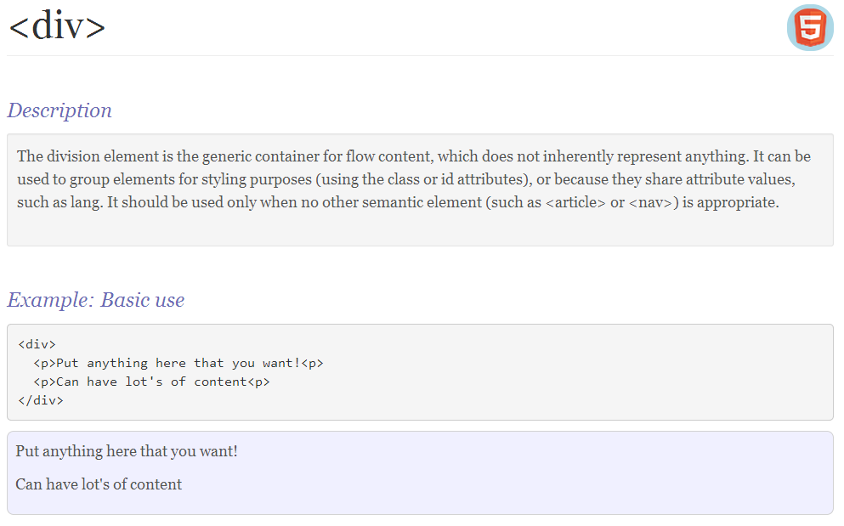
Generic Structural Elements

Slide 22
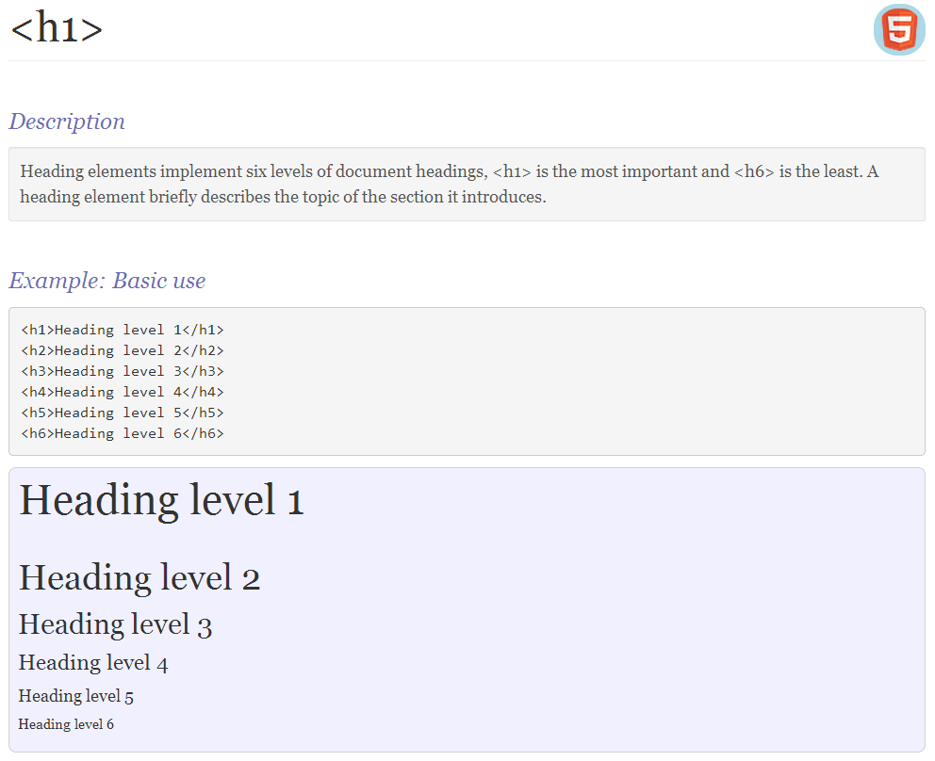
Headings

Slide 23
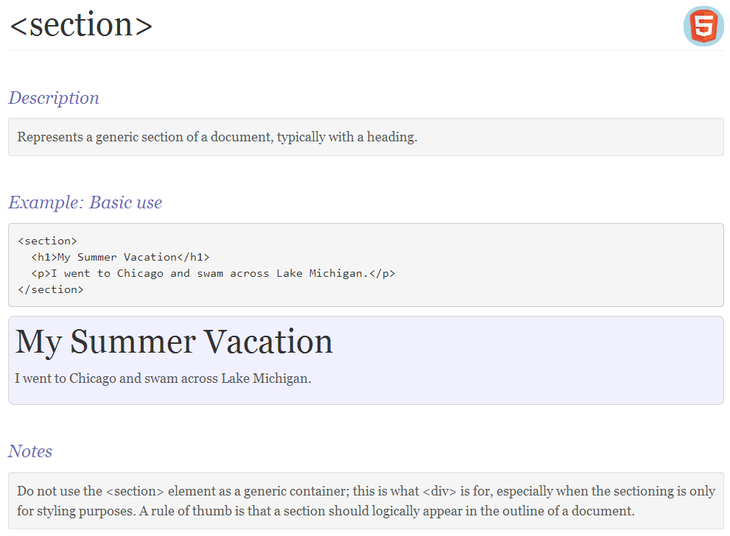
Section

Slide 24
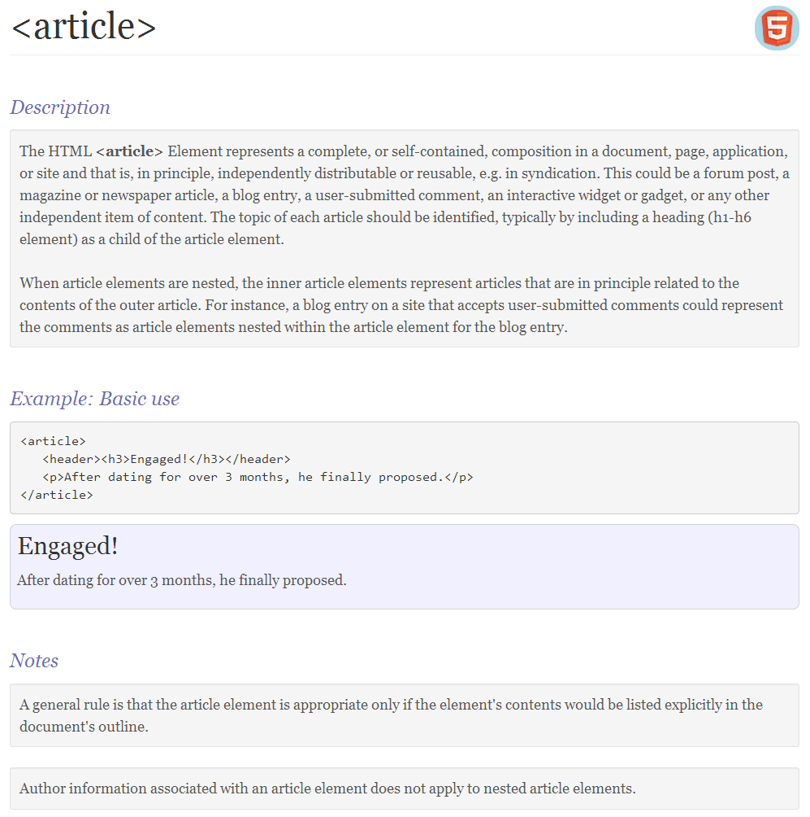
Article

Slide 25
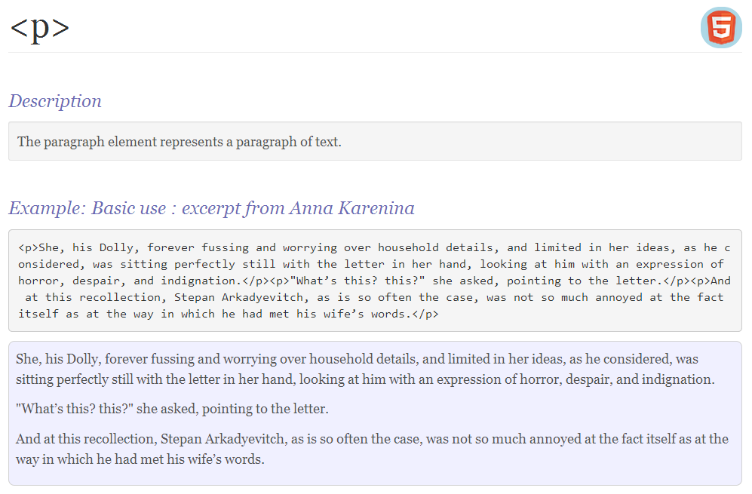
Paragraph

Slide 26
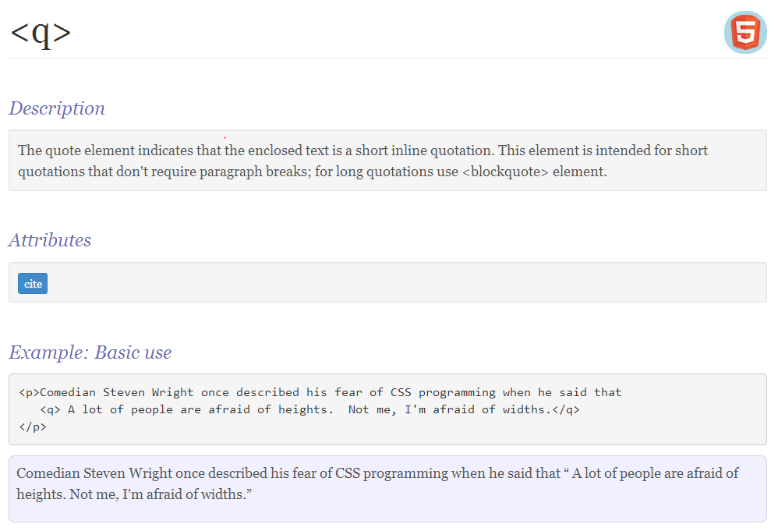
Quotation

Slide 27
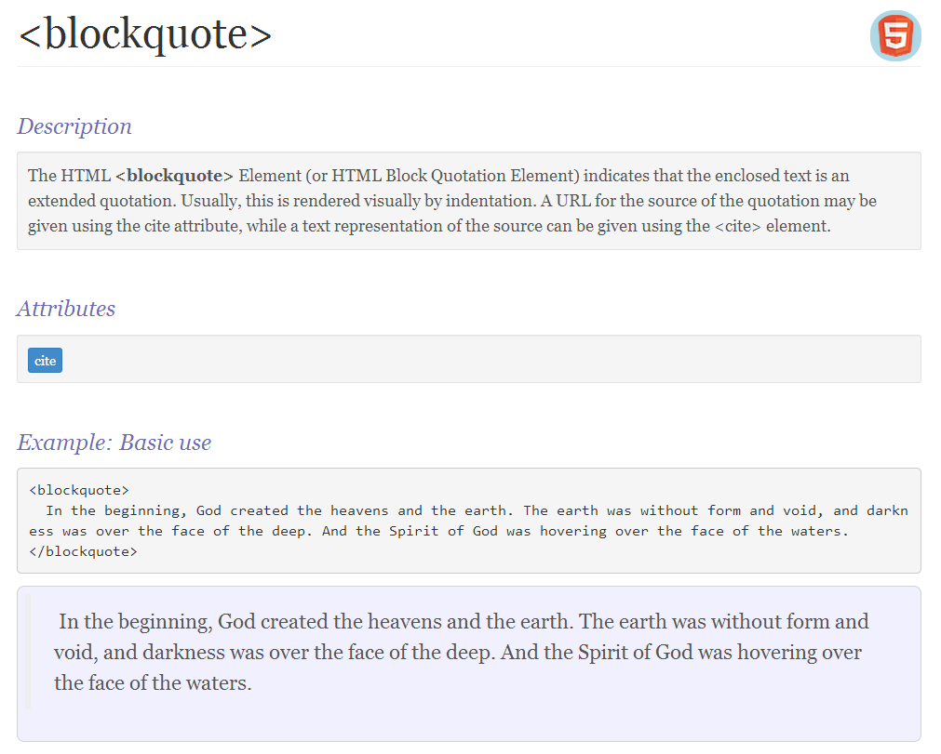
Blockquote

Slide 28
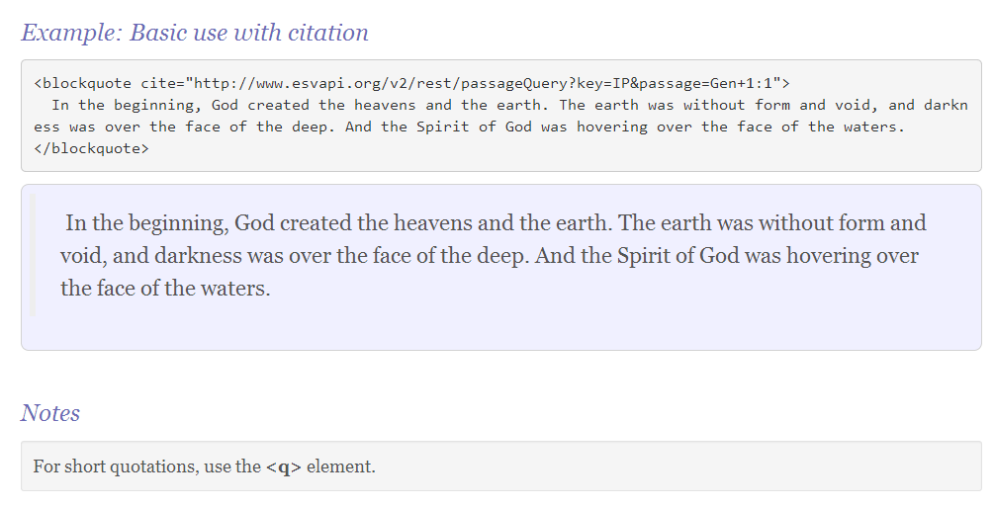
Blockquote

Slide 29
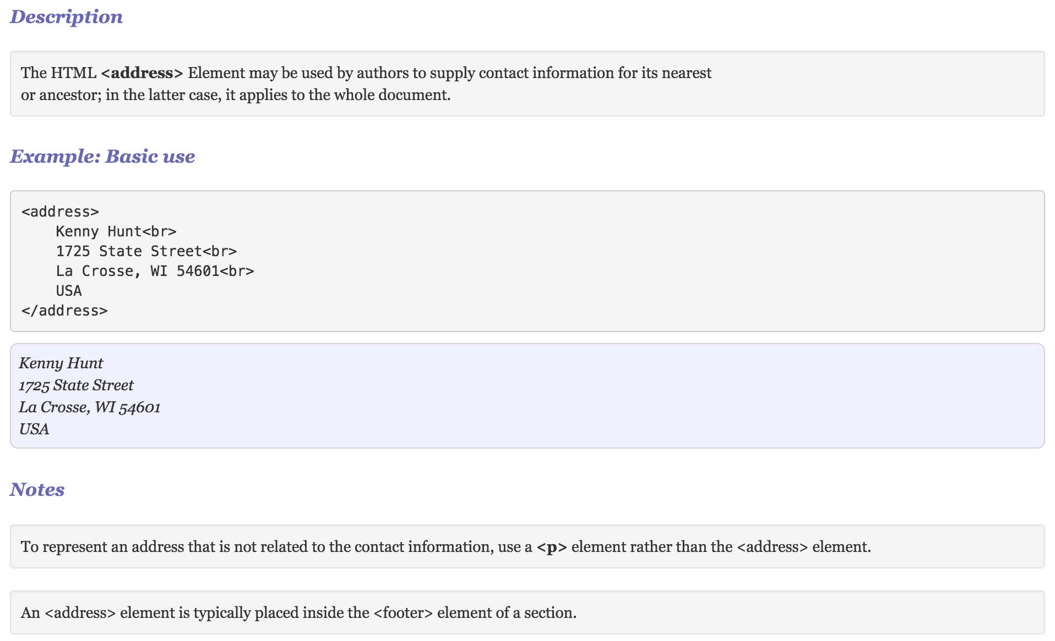
Address

Slide 30
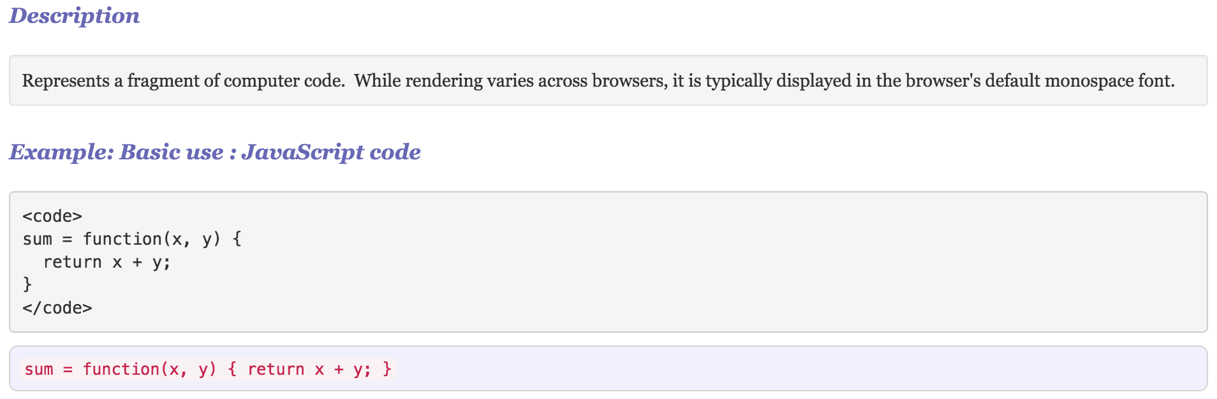
Code

Slide 31
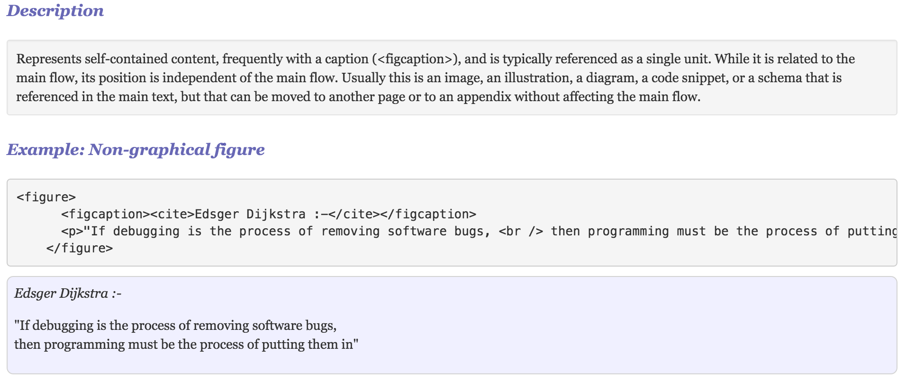
Figure

Slide 32
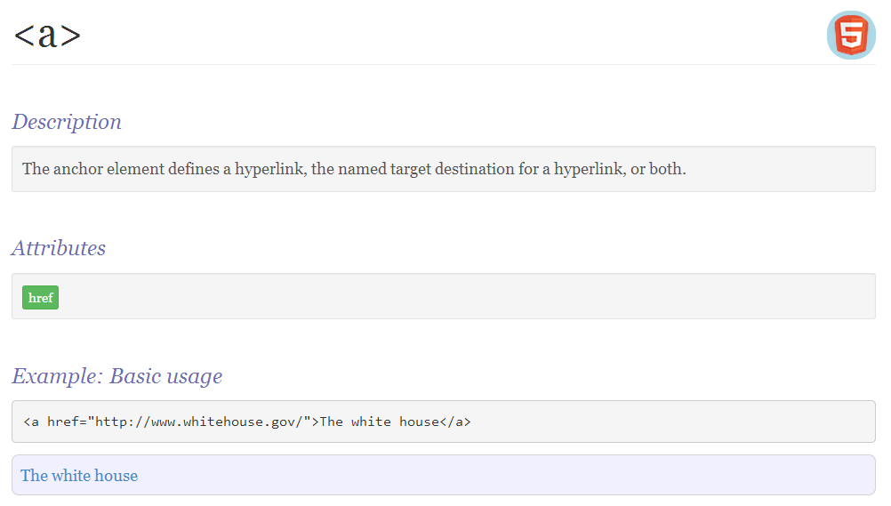
Anchors

Slide 33
Images
Web browsers have support for images in many formats. The most common are:
GIF
8 bit color (usually lossy)
Small file size
Use for logos/icons
JPEG
24 bit color (usually lossy)
Good compression
Use for photos
PNG
24 bit color with better transparency support than JPEG
Good compression
Use for photos

Slide 34
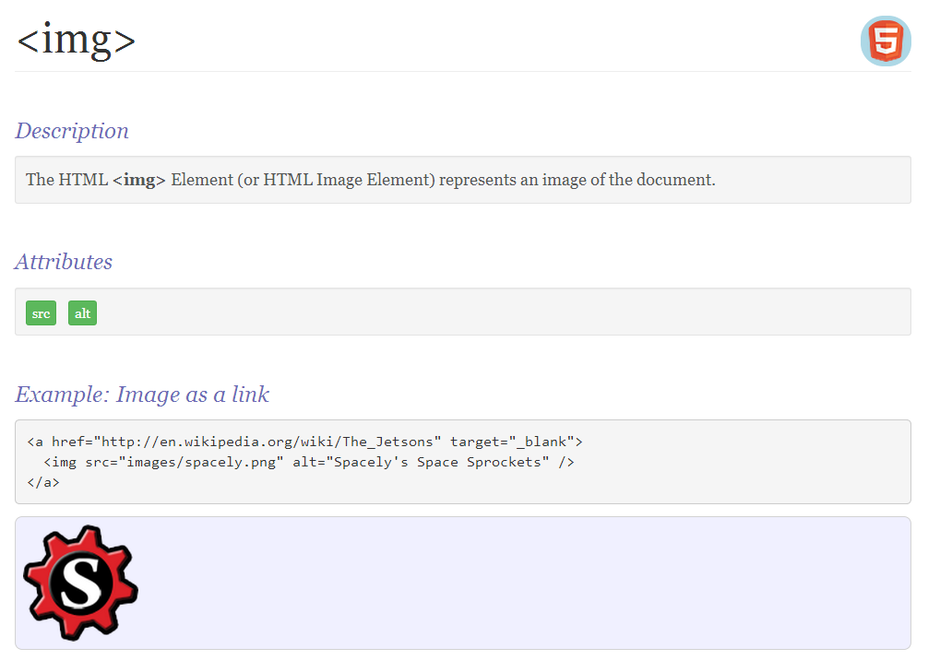
Images

Slide 35
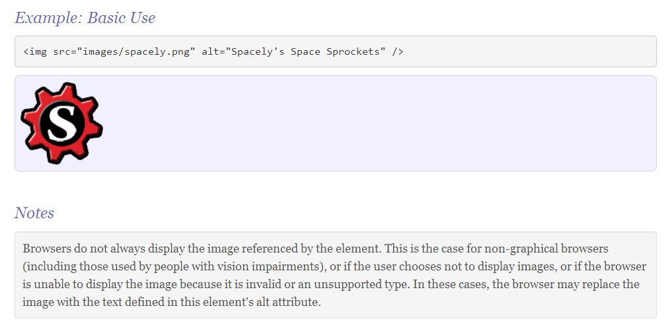
Images

Slide 36
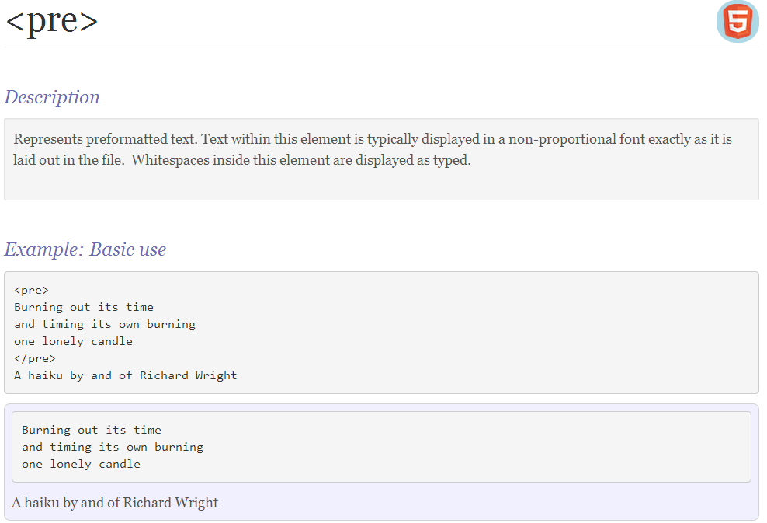
Preformatted

Slide 37
A sidenote
Let's write an HTML page that describes HTML tags.
<body>
<p>
The <div> tag represents the generic block-level structuring
element in HTML 5. You should only use <div> when
no specific alternative is available.
</p>
</body>

Slide 38
Entities
Some characters have a special meaning
"<" indicates the start of an element (or tag)
How to put a ‘<‘ in a paragraph of text?
Create a page that contains the text "x < y".
Result | Description | Entity Name | Entity Number
 | non-breaking space | &nbsp; | &#160;
< | less than | &lt; | &#60;
> | greater than | &gt; | &#62;
& | ampersand | &amp; | &#38;
¢ | cent | &cent; | &#162;
£ | pound | &pound; | &#163;
¥ | yen | &yen; | &#165;
€ | euro | &euro; | &#8364;
§ | section | &sect; | &#167;
© | copyright | &copy; | &#169;
® | registered trademark | &reg; | &#174;

Slide 39
Lists
There are three kinds of HTML lists
UL : an unordered list of items
order of the items is not meaningful
rendered with bullets
items are tagged with <LI>
OL : an ordered list of items
order of the items is meaningful
rendered with numbers
items are tagged with <LI>
DL : a description list
a list of terms and their descriptions/definitions
Contains only dt and dd elements

Slide 40
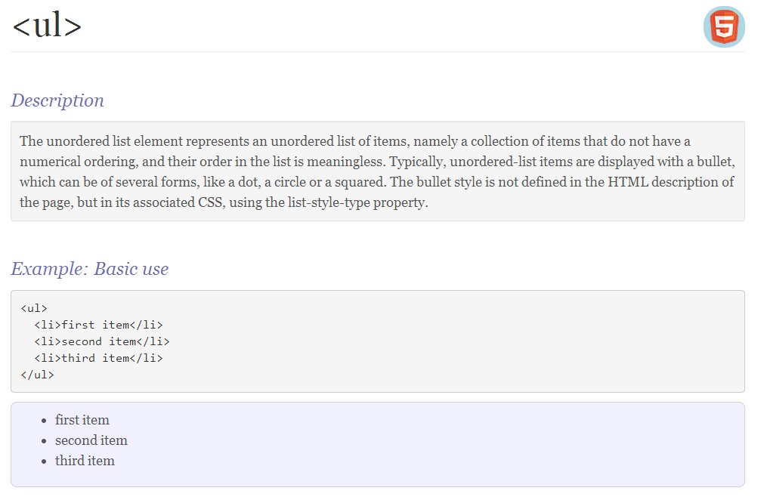
Lists

Slide 41
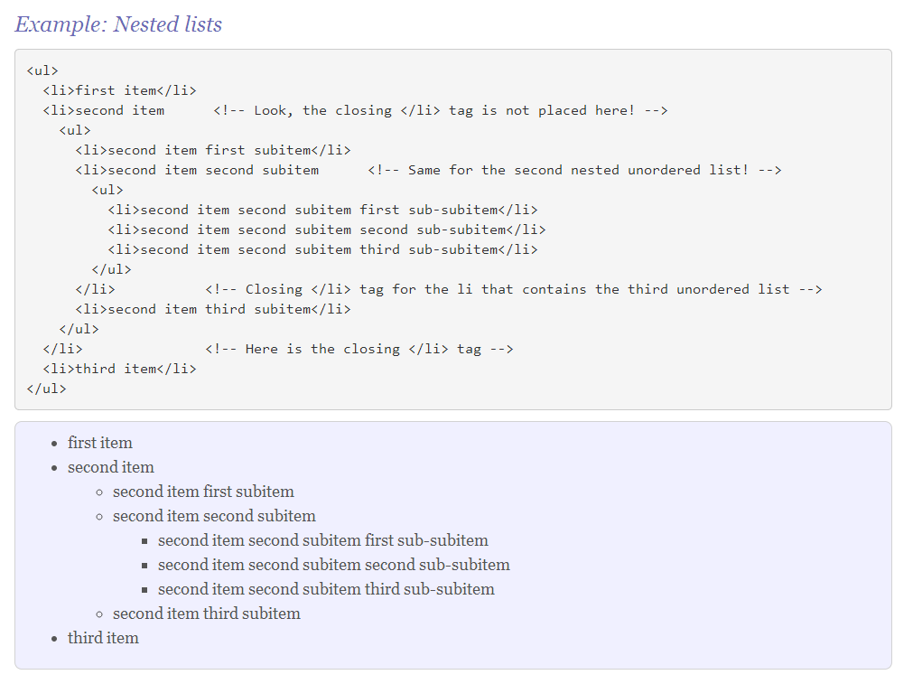
Lists

Slide 42
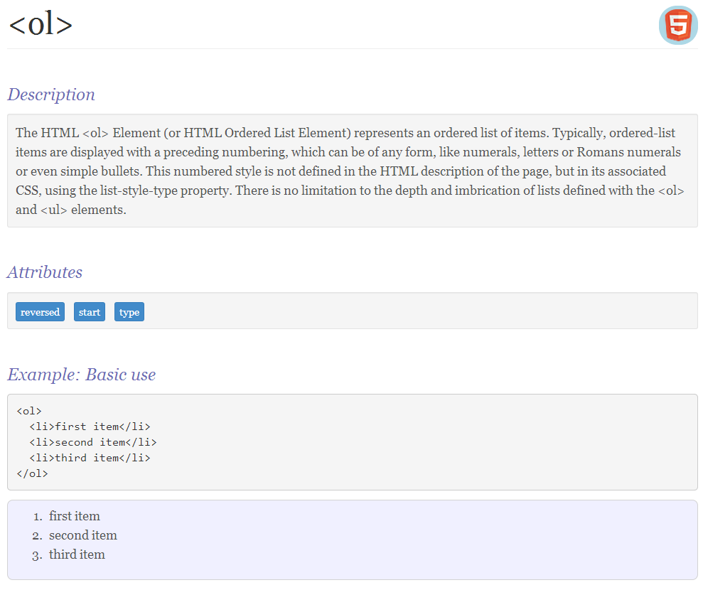
Lists

Slide 43
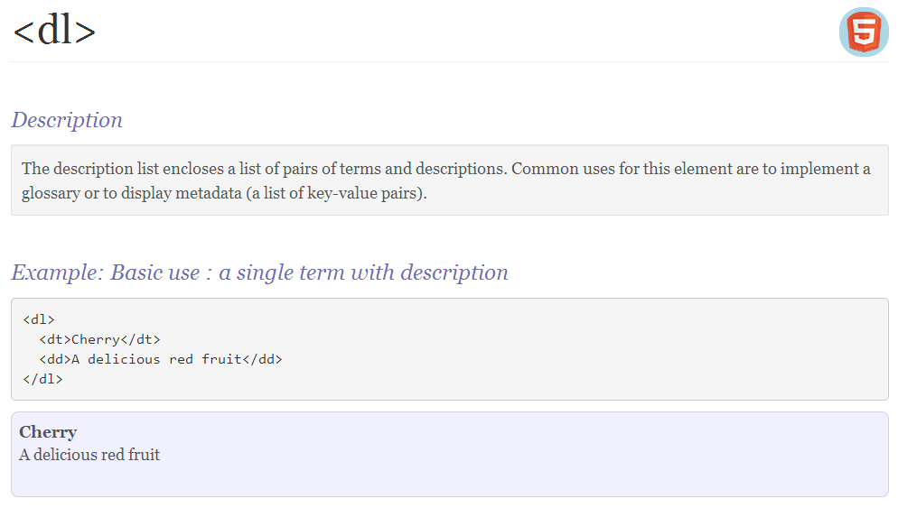
Lists

Slide 44
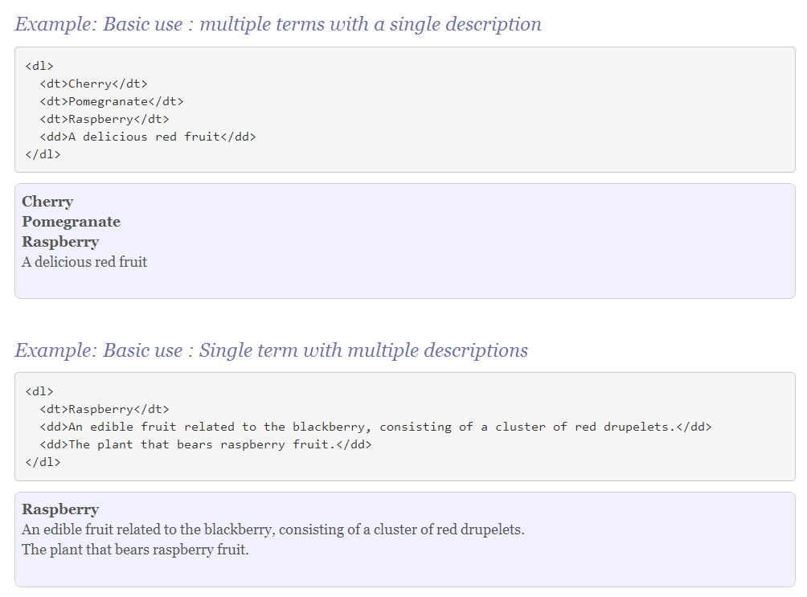
Lists

Slide 45
Forms
An HTML form contains elements that obtain data from users.
Different types of input : text, numbers, dates, others
Need to know where to submit the data
Need to know when to submit the data
Need to know how to submit the data
A form defines
the specific inputs
where to submit the data
when to submit the data
how to submit the data

Slide 46
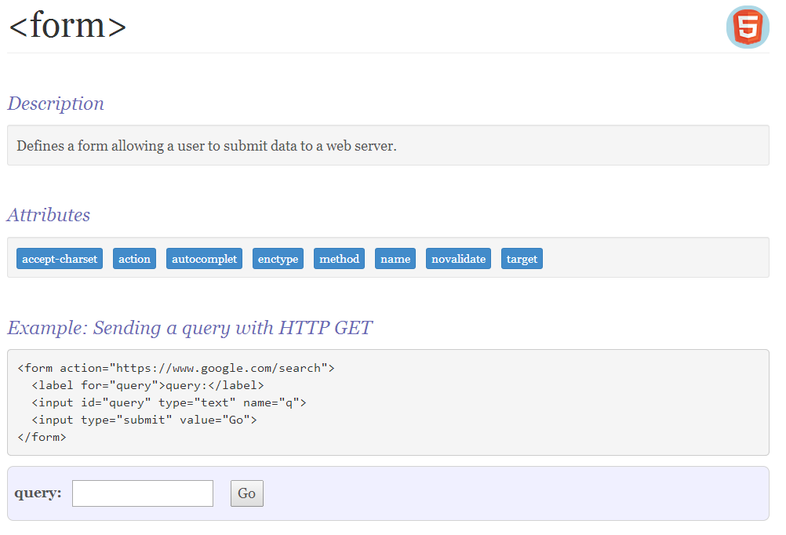
Forms

Slide 47
Form attributes
A single page may contain numerous forms
A form may contain any valid html
tables, articles, sections, lists, …
With respect to the function of the form
input elements : gather the user data
action attribute : where to submit the data
submit button : when to submit the data
method attribute : how to submit the data

Slide 48
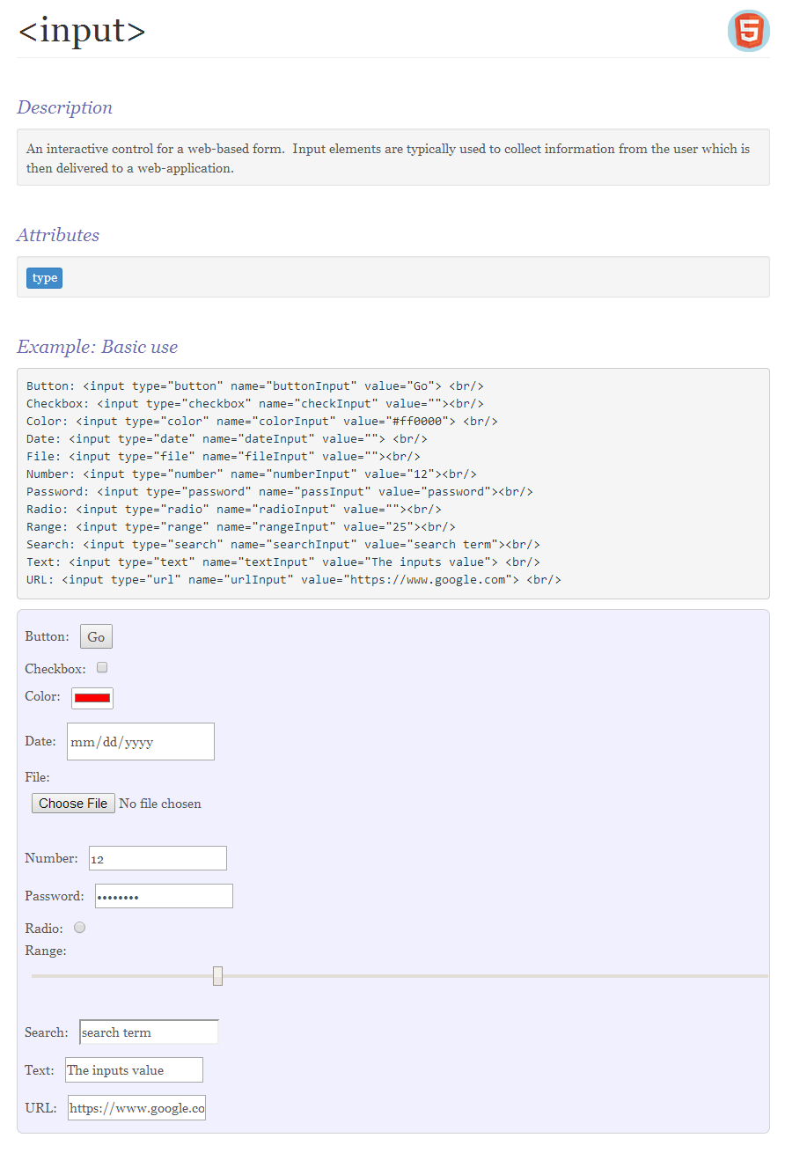
Input

Slide 49
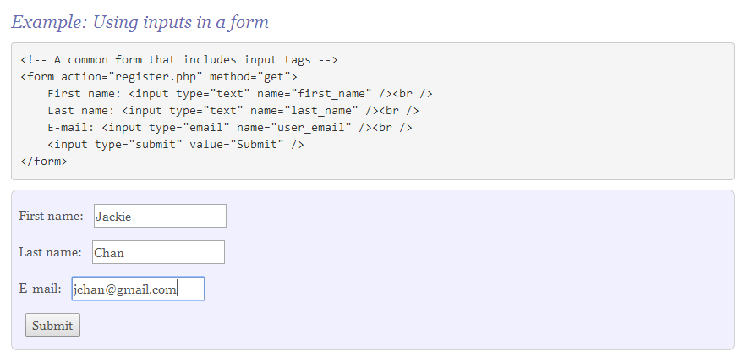
Inputs
Form data is sent to the server as name-value pairs. The input elements control the name-value pairs.
name attribute : names the datum
value :
data entered by the user
value attribute : provides initial value
When the above form is submitted, the web server would receive the following information
first_name="Jackie"
last_name="Chan"
email="jchan@gmail.com"

Slide 50
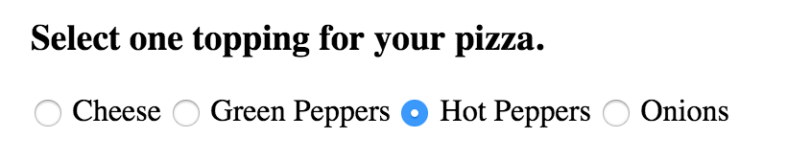
Radio Inputs
Consider the following form fragment. How to enforce the ‘single selection’ constraint?
Write an HTML fragment that generates the above.
Modify the HTML fragment so that the user is allowed to choose as many toppings as desired.

Slide 51
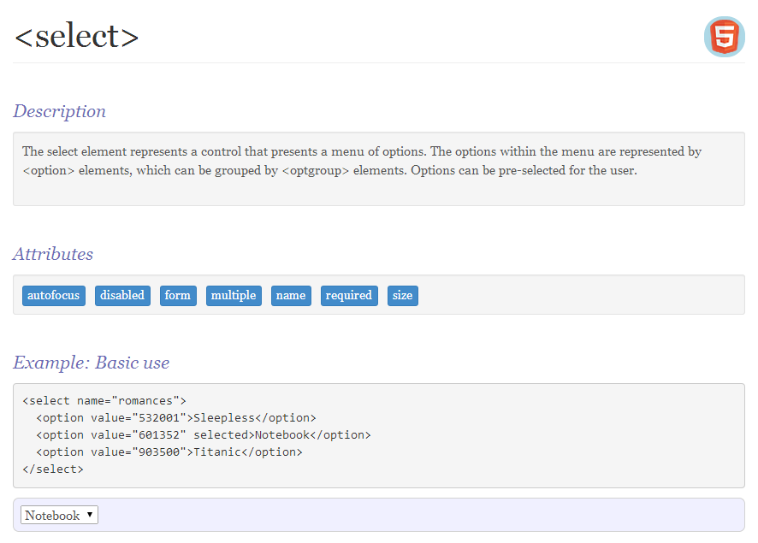
Select : A non-input input

Slide 52
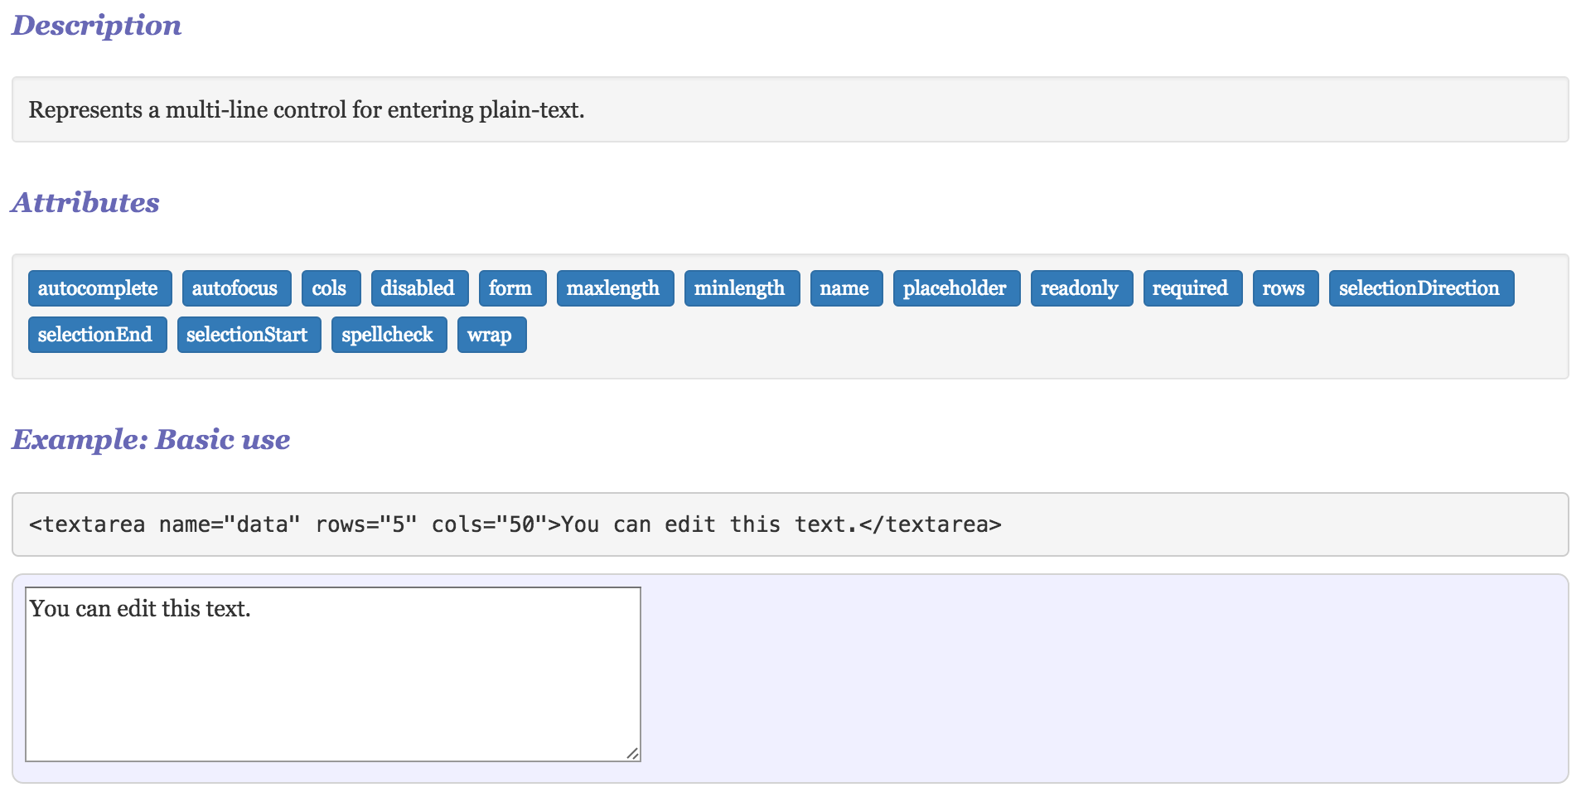
textarea : A non-input input

Slide 53
Table Overview
A table is a grid of data. A table can only contain
A <caption> (optional)
Any valid html
A <colgroup> (optional)
contains only <col> children
<col> supports a span attribute
A <thead> (optional)
contains only <tr> children
A <tfoot> (optional)
contains only <tr> children
A <tbody> (mandatory but supplied if not provided)
Contains only <tr> children
Contains only <th> and <td> children
These can contain any valid html

Slide 54
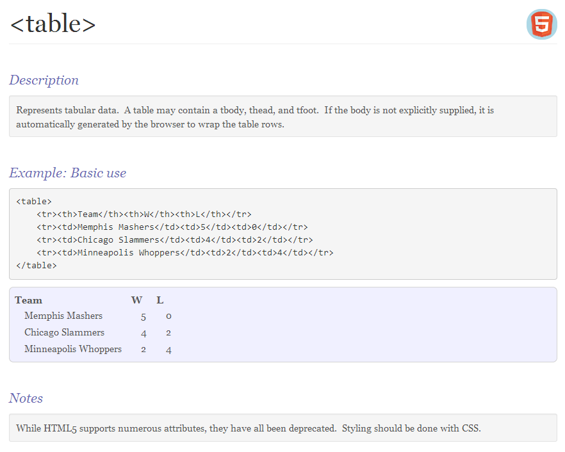
Table

Slide 55
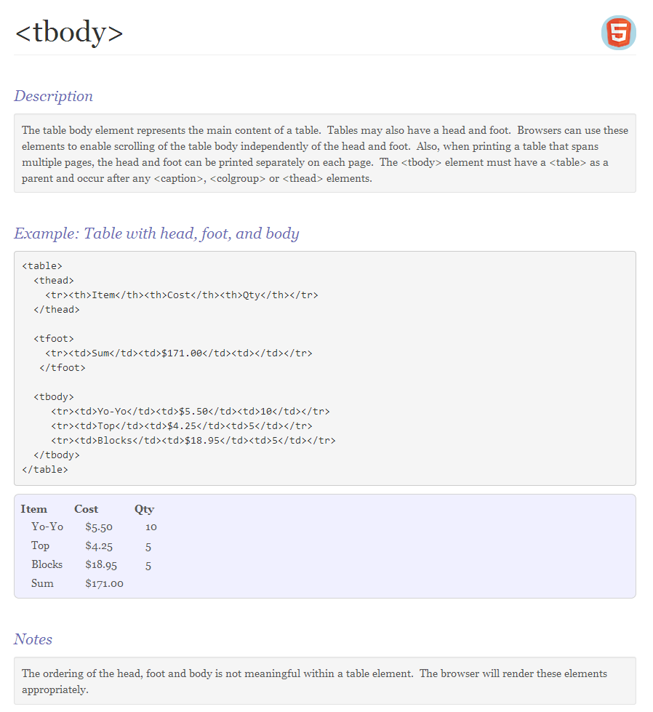
Table

Slide 56
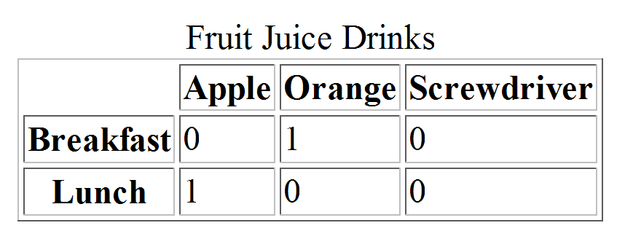
Table example
<table border = "border">
<caption> Fruit Juice Drinks </caption>
<tr>
<th> </th>
<th> Apple </th>
<th> Orange </th>
<th> Screwdriver </th>
</tr>
<tr>
<th> Breakfast </th>
<td> 0 </td>
<td> 1 </td>
<td> 0 </td>
</tr>
<tr>
<th> Lunch </th>
<td> 1 </td>
<td> 0 </td>
<td> 0 </td>
</tr>
</table>

Slide 57
Spanning rows/columns
Table cells (td/th) can span multiple columns and/or rows. This is controlled by the following attributes
colspan : the number of columns that the cell spans
rowspan : the number of rows that the cell spans
Example
<td colspan="2" rowspan="2">Some data</td>

Slide 58
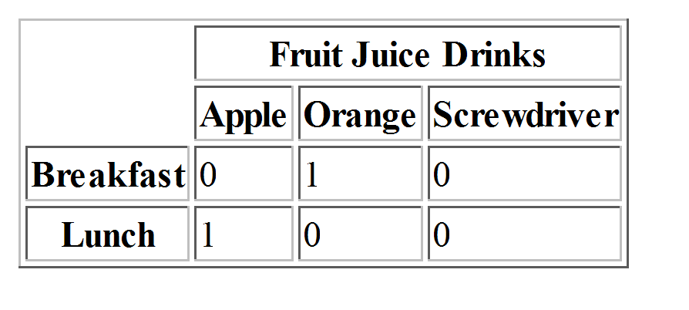
Table example
<table border = "border">
<tr>
<th></th>
<th colspan=“3”>Fruit Juice Drinks</th>
</tr>
<tr>
<th> </th>
<th> Apple </th>
<th> Orange </th>
<th> Screwdriver </th>
</tr>
<tr>
<th> Breakfast </th>
<td> 0 </td>
<td> 1 </td>
<td> 0 </td>
</tr>
<tr>
<th> Lunch </th>
<td> 1 </td>
<td> 0 </td>
<td> 0 </td>
</tr>
</table>

Slide 59
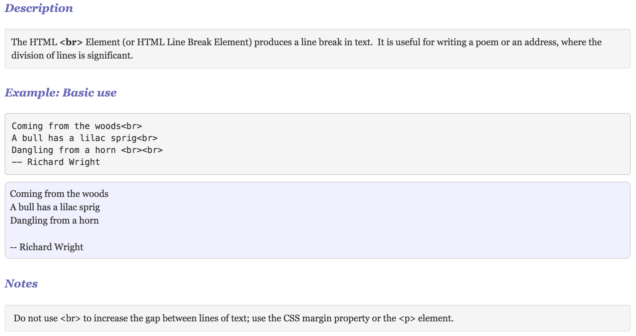
Break

Slide 60
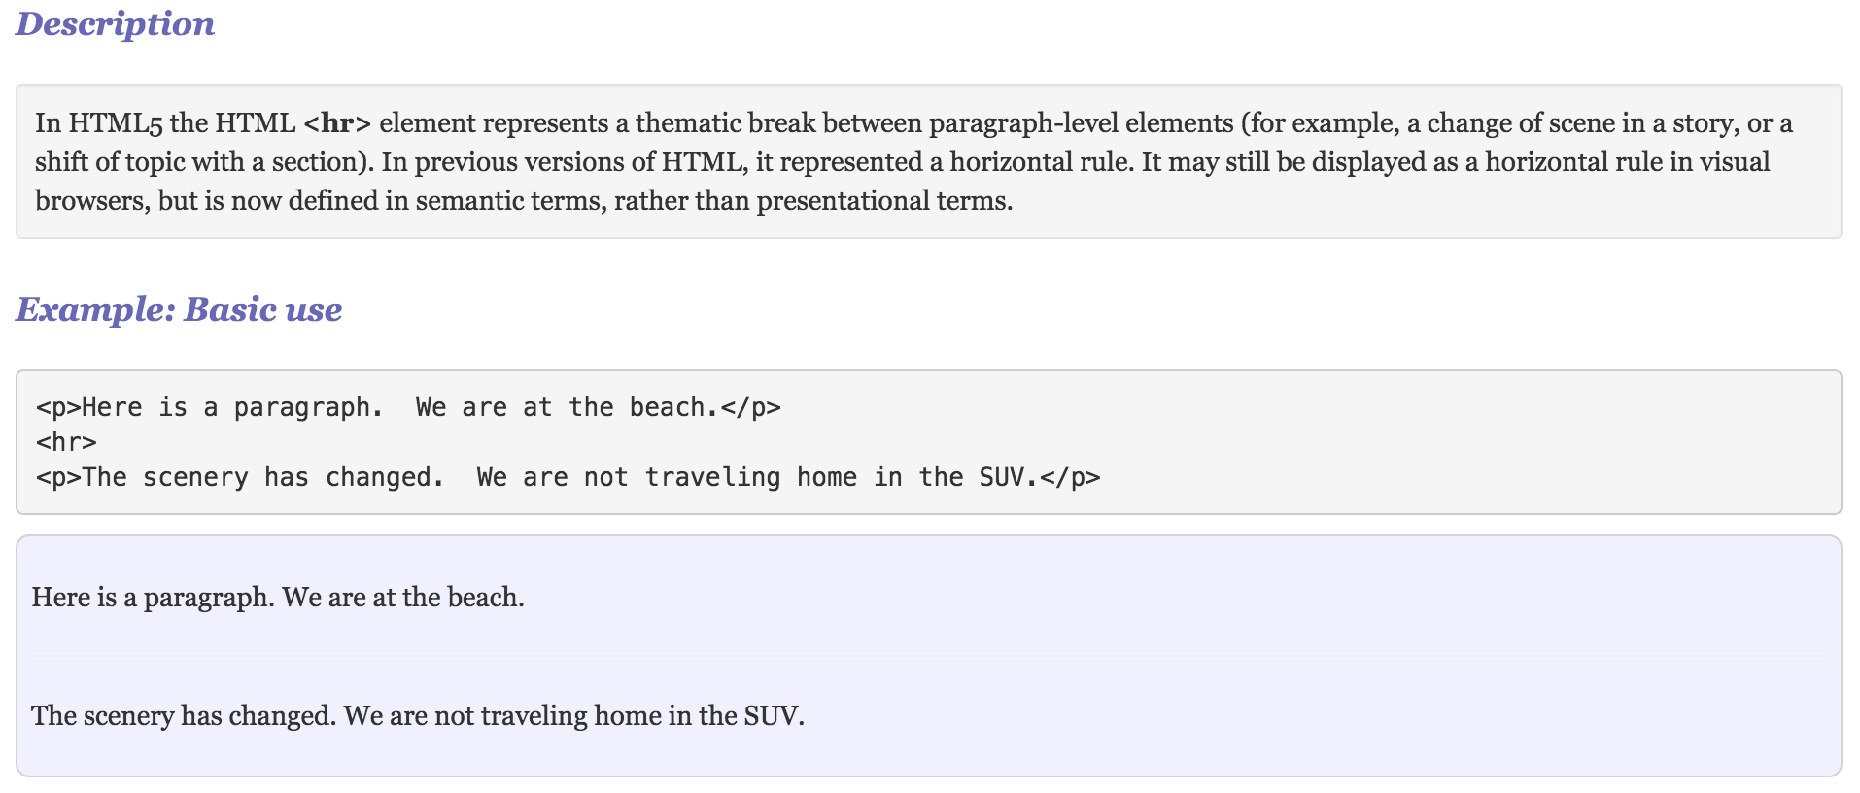
HR

Slide 61
Text-level
<b>
Indicates text that is stylistically distinct from normal text.
Does not mean “bold” but usually does
<em>
Emphasized text. Nesting level indicates increased importance.
<i>
Indicates text in an ‘alternate voice’ such as technical terms, foreign transliterations, or italicized text.
<strong>
Indicates string importance.
<mark>
highlighted text. Often used for search results.

Slide 62
Text-level
<s>
Represents text that is no longer accurate or relevant
Usually rendered as ‘strike-through’
<u>
Represents an unarticulated, non-textual annotation. Use for mis-spellings, proper names in Chinese prose, etc..
i.e. underlined :
<small>
Represents side comments (inline). Should be used for short text fragments.
<aside>
A section of a page that is tangentially related to the surrounding content. Often used of side-bars or side-navigation.

Slide 63
Text-level
<dfn>
Represents the defining instance of a term. In other words, it is the term that is later defined.
<p>The <dfn>WWW</dfn> is a global computer network.</p>
<sup> & <sub>
Represents superscripts (sup) and subscripts (sub)
<time>
Represents either a date or a time in the Gregorian calendar
<var>
A variable
<var>E</var> = <var>M</var><var>C<var><sup>2</sup>
<samp>
Sample output from a computer program.
<span>
The generic inline element. Only use if no other inline element is appropriate

