Slide 1

Ajax
The Asynchronous JavaScript and XML(ish stuff)

Slide 2
Out with the Old
Old:
The user enters a URL and a web page is loaded.
A user clicks a link and a web page is loaded.
A user clicks a link and a web page is loaded…
New:
The user enters a URL and a web page is loaded.
A user clicks a link and a script gets some data and updates the page.
A user clicks a link and a script gets some data and updates the page.

Slide 3
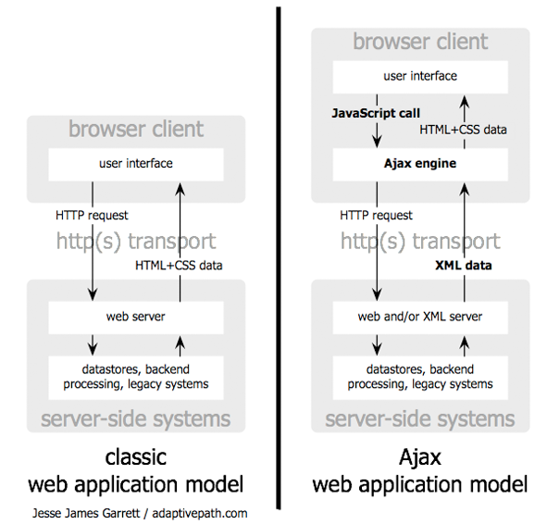

Slide 4
Jquery and Ajax
JQuery
JavaScript library used by ~80% of the largest web sites.
contains an "ajax" function that executes ajax calls.
Enable jQuery by
Use a CDN: <script src="https://code.jquery.com/jquery-3.1.1.js" integrity="sha256-16cdPddA6VdVInumRGo6IbivbERE8p7CQR3HzTBuELA=" crossorigin="anonymous"></script>
Download : download a version into your folder and use the appropriate script tag.
JQuery exposes one function as an entry point
$

Slide 5
AJAX
JQuery supports an 'ajax' method.
The method accepts a single configuration object.
The method executes asynchronously. It returns immediately after initiating an HTTP request.
The following configuration properties are commonly used
url : the url of the AJAX request
data : an object that is either
passed in the query parameter for GET/DELETE
passed as a url-encoded string in the body for PUT/POST
headers : an object containing headers
success : a function callback
a function that accepts (result, status, xhr)
error : a function callback
a function that accepts ( xhr, status, error )
complete : a function callback
a function that accepts ( xhr, status )
method : the HTTP method to invoke

Slide 6
Ajax Example
var globalTask;
$.ajax({
url: "http://138.49.184.143:3000/tasker/api/abc/def",
data: { key : '123' },
type: 'GET',
success: function( task) {
globalTask = task;
$( "<h1>" ).text( task.description ).appendTo( "body" );
$( "<div class=\"content\">").html( task.dueDate ).appendTo( "body" );
},
error: function( xhr, status, errorThrown ) {
alert( "Sorry, there was a problem!" + errorThrown );
},
complete: function( xhr, status ) {
alert( "The request is complete!" );
}
});
console.log( globalTask ); // what prints out?

Slide 7
Some Details
In general, you can only load data from the same web site that your html document came from. This is called the "same origin policy"
Data is always sent textually in an HTTP request.
How to send/receive an object such as { a : [1, false, []] }?
JSON specifies a textual format for representing JavaScript objects. JSON is also a globally defined object in JavaScript
JSON.parse( txt ) => produces a JavaScript object
JSON.stringify( obj ) => produces JSON text
To convert between Objects and JSON strings
var txt = '{ "make" : "ford", "year" : 2012 }';
var obj = JSON.parse(txt);
var asString = JSON.stringify(obj);

