Slide 1

Responsive Web Design

Slide 2
Agenda
There is no agenda

Slide 3
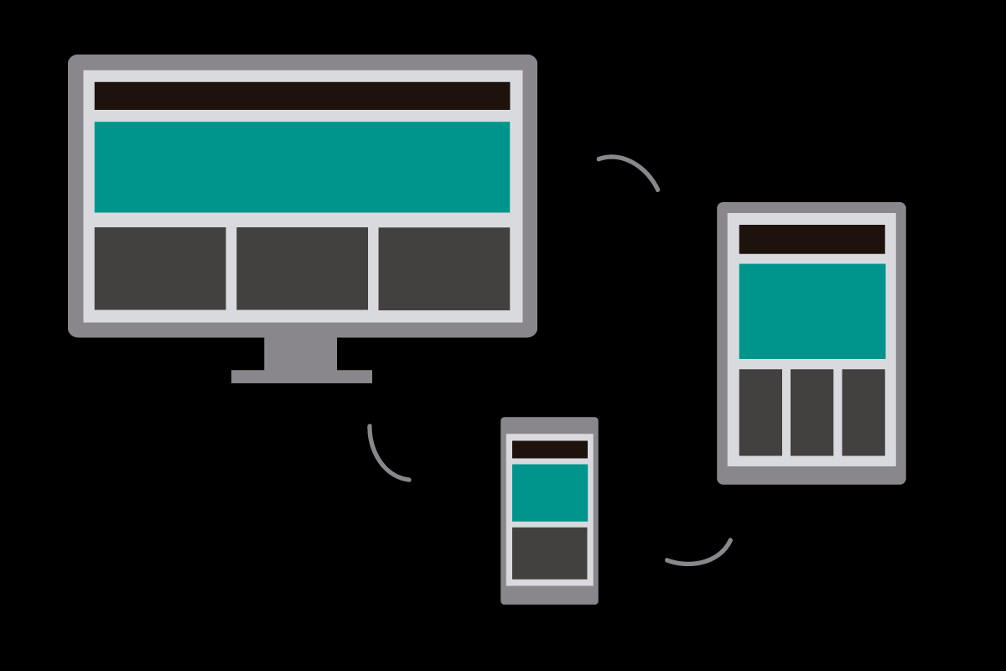
What the heck is RWD anyway?

Slide 4
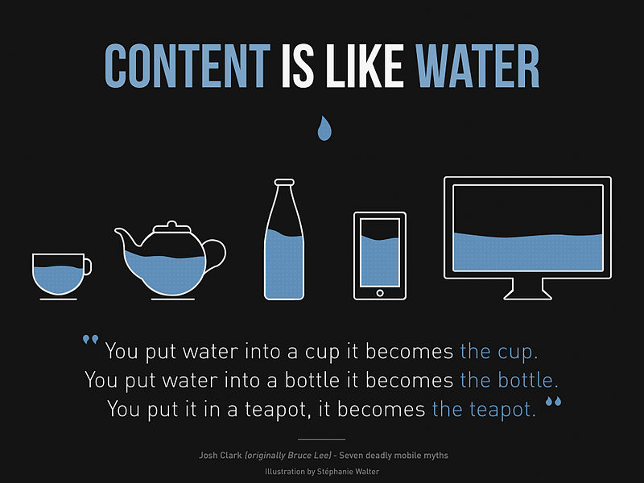

Slide 5
Okay, Why should I care?
Supporting your multi-device user base
One site to rule them all
Bulletproof design – future-proof, device-agnostic
You don’t have a choice

Slide 6
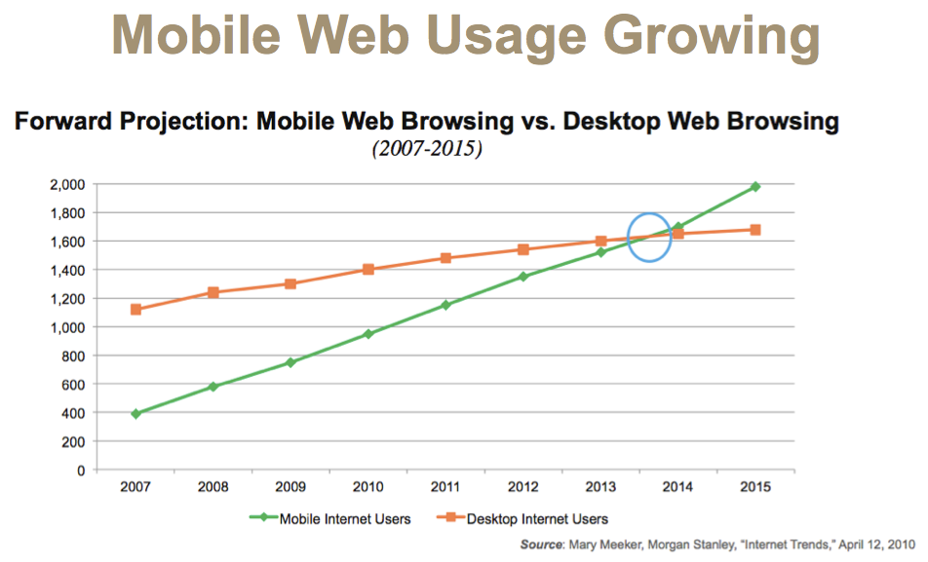

Slide 7
A Brief History
“Those who do not study the history are condemned to repeat it”
- George Santayana
One site to rule them all vs separate mobile site
Ethan Morcotte – coined the term in 2010
Cleverly combined the existing tools – media queries, flexible grids, and flexible images.

Slide 8
Media Queries
MVP of responsive web design
Allow you to group styles and target them to devices based on some criteria
Target styles for specific conditions – width, orientation, media type
Syntax: @media (media feature) { // styles }
Media features can be combined using logical operators

Slide 9
“Talk is cheap. Show me the code.”
- Linus Torvalds

Slide 10
Flexible Grid
Fluid, proportion based grids
Relative size units, not pixels or points (the root of all evil)

Slide 11
Responsive Images
Set max-width to 100%. Boom! Done. Majaa maadi.

Slide 12
Summary
What is RWD and why we should care
Fundamental ideas of responsive web design
Media queries
Fluid proportion based grid
Responsive images

Slide 13
Bootstrap

Slide 14
Intro
Bootstrap is the most popular HTML, CSS, and JS framework for developing responsive, mobile first projects on the web
No magic, it’s all plain old CSS
Ships with vanilla CSS, but source code written in less and sass
Supports all major browsers (Even IE 8-11 *slow clap*)
The wall of browser bugs

Slide 15
Getting started
Download the source, compile, and include
Less or sass or plain old CSS – your choice!
Compiled and minified files
Bootstrap CDN – don’t use it on production site
Through package managers – npm, bower

Slide 16
CSS
Bootstrap has a lot (add a lot of lots here) of CSS classes
All Bootstrap magic boils down to carefully designed CSS classes

Slide 17
Bootstrap Grid System
12 column grid, each column 8.33% wide
Predefined CSS grid classes – col-SIZE-SPAN
Device Breakpoints:
Device Class | Break-points | CSS Class
Mobile | < 768px | col-xs-*
Tablet | >=768px | col-sm-*
Desktop | >=992px | col-md-*
Larger devices | >=1200px | col-lg-*

Slide 18
Components
Reusable components built to provide iconography, dropdowns, input groups, navigation, alerts, and much more.
So many components, so little space to list them all. Go back to browser!

Slide 19
JavaScript
Brings Bootstrap’s components to life
Depends on jquery

Slide 20
Customizing Bootstrap
Major complaint – Bootstrap is too bloated
Contains many classes that you probably will never use
Using config file

Slide 21
Bootstrap 4
Still in beta
Moved from less to sass
Dropped support for IE8, IE9, iOS6
Added flexbox support
Switched from pixels to root ems

Slide 22
Questions?

Slide 23
Thank you!

