Slide 1
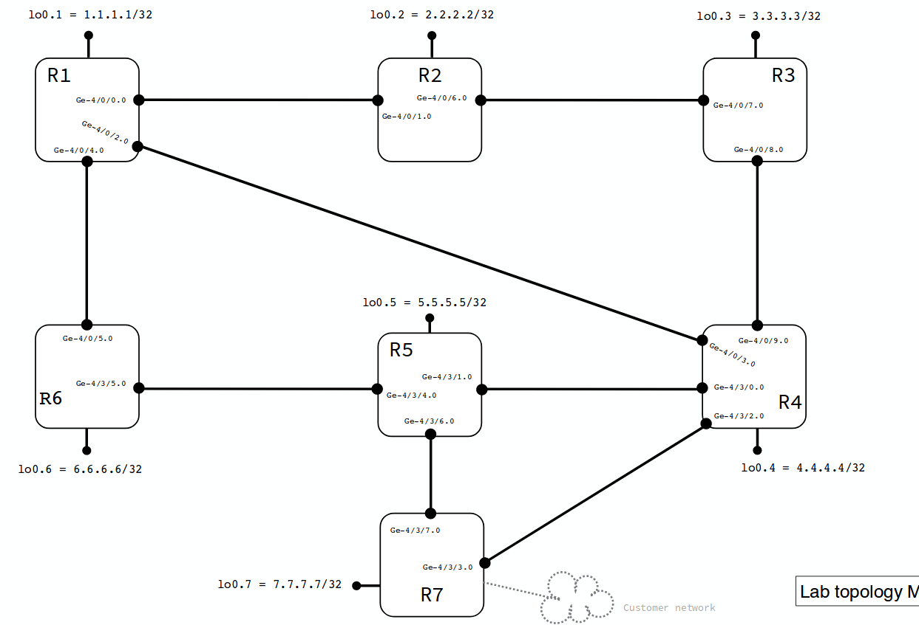
ISO: 49.0001.0010.0100.1001.00
ISO: 49.0001.0020.0200.2002.00
ISO: 49.0001.0030.0300.3003.00
ldp
ldp
ldp
ID: 1.1.1.1
ldp
ldp
ldp
ldp
192.168.2.1
192.168.2.2
192.168.4.1
192.168.4.2
192.168.3.1
ID: 2.2.2.2
Configured on all interfaces:
- ISIS (iso)
- MPLS with BGP-IGP
ID: 3.3.3.3
192.168.5.1
192.168.6.1
Enabled on all routers:
- RSVP
- ICMP-Tunneling
ISO: 49.0001.0050.0500.5005.00
192.168.5.2
192.168.3.2
192.168.6.2
ldp
ID: 5.5.5.5
ldp
ldp
ldp
ldp
192.168.10.1
192.168.10.2
192.168.8.1
192.168.8.2
ID: 6.6.6.6
ldp
ID: 4.4.4.4
192.168.7.2
ldp
192.168.9.1
ldp
ldp
ISO: 49.0001.0060.0600.6006.00
ISO: 49.0001.0040.0400.4004.00
192.168.9.2
Loose path
ID: 7.7.7.7
192.168.7.1
Strict path
ISO: 49.0001.0070.0700.7007.00

