Slide 1



CSA0811-Python Programming-Slot D
Remove Watermark from the Video
Guided by:
T. Vincent Gnanaraj
(Course Faculty)
Python Programming
Saveetha School of Engineering
Work done by:
S. Kaladhar Reddy
192211412
Computer Science Engineering
Saveetha School of Engineering

Slide 2
Abstract
With the rapid development of the Internet, watermarks are widely used in images to protect copyright. This implies that the robustness of watermark is very important. In recent years, there have been some studies to evaluate watermark performance by removing the watermark. Among them, some methods need to mark the watermark position in advance, and some require multiple images with the same watermark. Moreover, when the colour of the watermark is similar to that of the background, the existing methods can hardly remove the watermark from the watermarked image. In the proposed work, the authors presented a watermark removal structure consisting of watermark extraction and image inpainting to address the aforementioned issues. In particular, the extraction network is used to extract the watermark in the watermarked image, and the inpainting network is used to inpainting image for a better watermark removal image, respectively.

Slide 3
Introduction
With the rapid development of the Internet, image copyright has become an increasingly prominent problem. However, the watermarks are often attacked and destroyed, such that the image copyright is stolen. In order to evaluate and improve the robustness of visible watermarks, in recent years, more attention has been paid to the research of visible watermark removals. For visible watermark removal, there are two main problems with traditional methods. The first is the demand of manually marking the watermarked areas and non-watermarked areas in the watermarked image before performing watermark removal . Second, in order to efficiently remove the watermark in the watermarked image, multiple warter mark images that have the same watermark are needed for watermark removal. In recent years, some deep learning-based visible watermark removal methods are proposed to solve the aforementioned two problems.

Slide 4
Hardware and software requirements
SOFTWARE :
OS : Windows 10/11
Python: 3.12.6
Integrated development environment: Visual Studio Code
Storage: SSD for faster data access
HARDWARE REQUIREMENTS:
Processor: Pentium
RAM: 12GB
Storage space:1.2 to1.4GB

Slide 5
Existing System
A powersoft Online Watermark Remover : Available for windows, mac, and as an online tool, it efficiently removes logos and watermarks without degrading video quality.
Hit Paw Watermark Remover: This software allows users to remove watermarks from videos and photos seamlessly. Pricing varies, but it does offer a free version.
Video Eraser : Found on the App Store, this free video editor is perfect for iPhone and iPad users.
Remove & Add Watermark : Available on Google Play, it’s designed to both add and remove watermarks, making it a versatile video editing tool.
Video Eraser: Found on the App Store, this free video editor is perfect for iPhone and iPad users.
Video Watermark Remover Online: A browser-based solution that removes watermarks without needing any downloads.
Adobe Photoshop: While primarily a photo editor, with the right skills, it can be used to erase watermarks frame by frame, especially for GIFs.

Slide 6
Proposed System
o
Watermarks can ruin your photo: You have spent tons of time, money, and effort on capturing the perfect photo to record your precious moments & memories, only to find that somebody has watermarked the photo on social media.
It can be a really frustrating experience for the individual as the watermarks ruin the composition of the photo, draw viewers' attention away from the picture itself and prevent them from enjoying its beauty. Even a subtle watermark can reduce the positive impact a photo can create. It can drastically change it from a personal image so close to your heart to a professional photo with distractions in the form of watermarks that is difficult to remove Instantly.
Watermarks can be distracting: If you want your images to attract a larger audience, you should show them completely. However, watermarks get in the way, ruin the image, and prevent the viewers from seeing some crucial details, like important numbers, words, contact information, or even product features.
Besides, they can take away the feel of a good photograph and distract viewers from the composition and this is something you don’t want when you’ve worked hard on capturing or creating the photo.

Slide 7
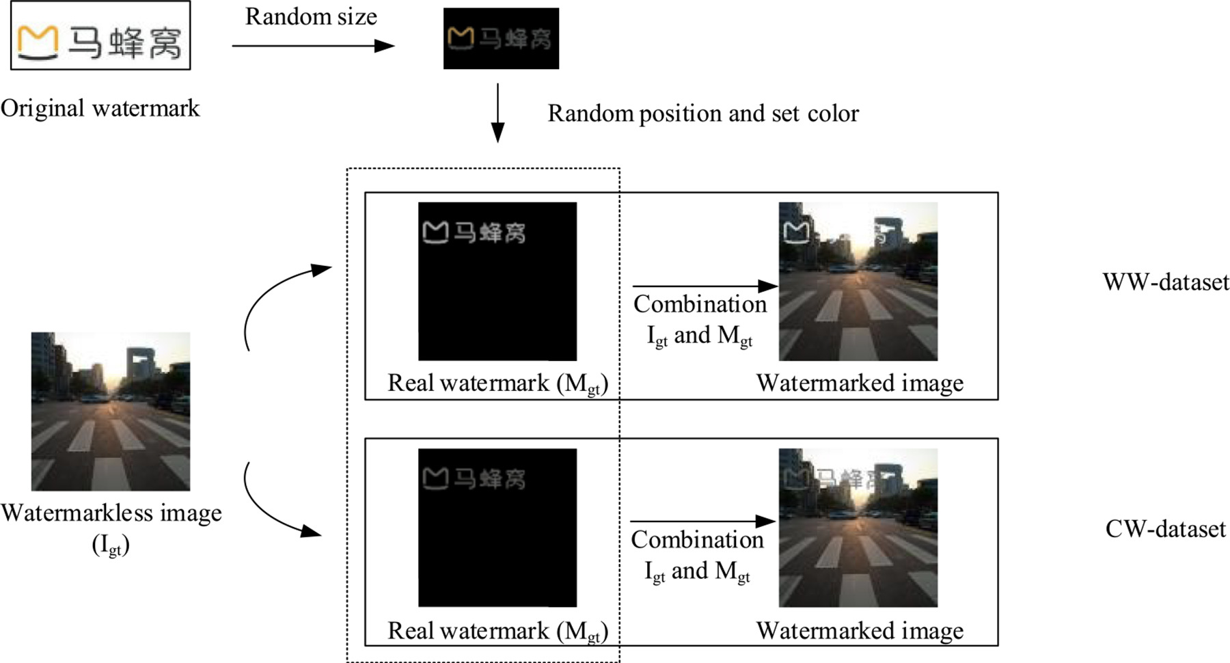
Architecture

Slide 8
Implementation
1. Enhance Visual Appeal:
Watermarks can be distracting and take away from the overall aesthetics of an image. By removing the watermark, you can improve the image's visual appeal and create a more polished and professional look.:
There may be instances where you come across a watermarked image you want to use for personal purposes, such as creating collages, printing photos for personal albums, or sharing them with friends and family. Removing the watermark allows you to use the image freely for personal use.
If you're working on a creative project, such as designing a website, creating digital artwork, or producing promotional materials, you may need to use images without watermarks. incorporate them seamlessly into your projects.

Slide 9
Design
In this section, we first introduce two watermarked image data sets. One is WW-data set in which each image added a white watermark, and the other is CW-data set which is a CW-data set. Specifically, each watermarked image is obtained by adding a watermark to an original image.
For the CW-data set, the colour of watermarks in the watermarked image is determined by the average pixel value of the region to be watermarked in the original image.
Second, we narrate network architecture based on conditional LSGAN(CGAN and LSGAN), which is mainly composed of two coordinated networks.

Slide 10

Code

Slide 11

Output

Slide 12
Future scope
The term “artificial intelligence” (AI) has been making waves in many different industries recently, and one sphere in which its influence is being felt profoundly is the industry of “watermark removal.” The future of AI watermark removal holds the promise of significant breakthroughs as well as possible applications, and this trend is expected to continue in the foreseeable future.
To locate and remove watermarks from photos or videos, AI watermark removal programs make use of complex algorithms. They have been really helpful in preserving the aesthetic integrity of the images while also ensuring that the underlying content has remained unaltered.
In recent years, we’ve witnessed considerable increases in the accuracy and efficiency of AI remove watermark tools, thanks to advancements in machine learning and image processing technology. These developments have allowed these programs to remove watermarks more effectively. But where do you see these technologies going from here in the future?

Slide 13
Conclusion
Conclusion
A watermark remover can be a valuable tool for enhancing your images, enabling personal use, supporting creative projects, and facilitating content creation. By removing watermarks, you can improve the visual appeal of your images, incorporate them seamlessly into your projects, and use them legally and ethically.
Whether you're a photographer, content creator, or simply want to utilize watermarked images for personal purposes, a watermark remover provides the flexibility and convenience to work with images without the limitations of watermarks. Choose a reliable and reputable watermark remover to unlock the full potential of your images and unleash your creativity.

Slide 14
Reference
F. Hartung et al.Watermarking of uncompressed and compressed video
Signal Processing
(1998)
R.G. van Schyndel et al.A digital watermark
Proceedings of the 1994 IEEE International Conference on Image Processing
(1994)
I.J. Cox et al.Secure spread spectrum watermarking for images, audio, and video
Proceedings of the 1997 IEEE International Conference on Image Processing
(1996)
S. Craver et al.On the invertibility of invisible watermarking techniques
Proceedings of the 1997 IEEE International Conference on Image Processing
(1997)
W. Zeng et al.On resolving rightful ownerships of digital images by invisible watermarks
Proceedings of the 1997 IEEE International Conference on Image Processing
(1997)
Wolfgang, R. B. and Delp, E. J., A watermarking technique for digital imagery: Further studies. Proceedings of the...
Qiao, L. and Nahrstedt, K., Watermarking schemes and protocols for protecting rightful ownership and customer's right....

Slide 15


