Slide 1

Scientific Python for Engineers
Dilip Kalagotla and Elijah LaLonde
Postdoctoral Scholars, FSU-FCAAP
Feb 6, 2026
https://github.com/kalagotla/dc-qc-sci-python

Slide 2

Table of Contents
Download and Installation
Integrated Development Environments (IDEs)
Scientific Python Cheat Sheet

Slide 3

Credit: Gemini Nano Banana “Pro”. Thanks to Python for making this possible.

Slide 4

Download and installation
Download anaconda here
Run setup and install
Advantages
Gives you all the required packages
No extra setup
Integrated Development Envs (IDE)
IDLE (L for learning)
Jupyter Notebook (web-based)
Jupyter Lab (Based on Notebook more of an IDE-experience)
Spyder (Only python IDE)
And many more
Environment management
Tutorials
Community

Slide 5

Integrated Development Learning Environment (IDLE)
Good for initial learning
You are doing most of the work
It has been packaged with python since ver. 1
Integrated Debugger
Aged badly!
Basis for all the new IDEs
It’s slow as it is written in Pyhton
Hello world! (It’s a time-honored tradition)

Slide 6

Jupyter Qt Console
Qt-based (graphics) console
Features some enhancements over IDLE
Inline figures, multi-line editing with syntax highlighting
Multiple kernels can be easily opened for multi-tasking
Can connect to Jupyter notebook to work parallel
Hello world!

Slide 7

Jupyter Notebook and Lab
Web based interface
Multiple language environment with support for more languages using add-ons
Rich text formatting
Creates .ipynb files
Can be exported to .pdf, .py, html, LaTeX formats and the list is not exhaustive
Lab – is based on Notebook but provides more IDE-like functionality
Hello world!

Slide 8

Spyder
Only python-based IDE
A highly recommended tool for scientific computing
Features
Syntax highlighting, introspection, code completion
Ipdb debugger is linked
Good for building projects
Matlab users recognize this interface easily
Hello world!

Slide 9
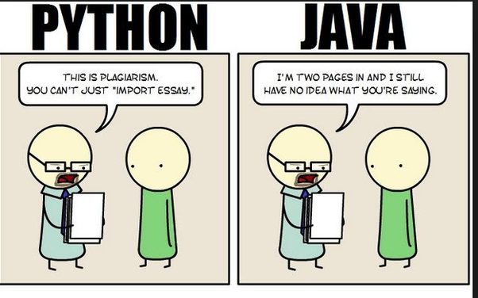
Scientific Python Cheat Sheet
Python is fast
for writing, testing, and developing
because it is easily interpreted, dynamically typed, and high-level
Python is slow
for repeated execution of low-level tasks
Python Cheat Sheet Notebook

Slide 10

Workshop Structure
Hour 1: Python Cheat sheet and Basics
Break
Hour 2: Scientific Python and Visualization
Break
Hour 3: Working with Deep Neural Networks (DNNs)

Slide 11
Thank you!

Slide 12

An informal, hands-on ML training series where we hang out, learn core machine-learning concepts, and explore architectures that can directly support your research. We’ll also work toward the AIAA Fluids ML Challenge, a unique opportunity to gain exposure within the AIAA ML community.
Machine Learning for Fluids Research A hands-on training series & AIAA Fluids ML Challenge
Google Form: https://forms.gle/tmWzTRKfyRjtV2xv5
Organizer
Dilip Kalagotla
Postdoctoral Scholar

