Slide 1

AI POWERED NUTRITION SCANNER
Team Members:
1. JAYASRI S (2117230020079)
2. KALAIVANI J(2117230020090)
3. KAMALI V(2117230020093)
BE.CSE/3rdyear/B
Department of Computer Science and Engineering
Mentor
Mr. Akash
Associate Professor
Department of Computer Science and Engineering
Rajalakshmi Institute of Technology.

Slide 2
METHODOLOGY
ALGORITHMS USED
1. Image Classification – Convolutional Neural Networks (CNN):
Used to detect and classify food items from images.
Can be trained or use pretrained models (like ResNet, Inception, etc.).
2. OCR (Optical Character Recognition):
Tools: Tesseract OCR, EasyOCR, Google Cloud Vision API
Used for reading nutrition labels and extracting textual information from food packages.
3. Natural Language Processing (NLP):
Libraries/Models: SpaCy, BERT
Used for analyzing ingredients from text (labels) and detecting harmful additives or allergens.
4. Calorie & Nutrient Estimation Algorithm:
Maps identified food items to standard portion-based nutritional values from databases like USDA, Nutritionix, etc.
5. User Profiling System:
Custom rule-based or lightweight ML model to personalize recommendations based on:
Age
Weight
Diet goal
Allergies
6. Health Rating Engine:
A scoring algorithm that rates food from 0 to 5 based on its nutritional content and user-specific health goals.
7. Learning Feedback Loop:
Optional supervised learning component to improve recognition accuracy using user feedback.
.
AI POWERED NUTRITION SCANNER

Slide 3
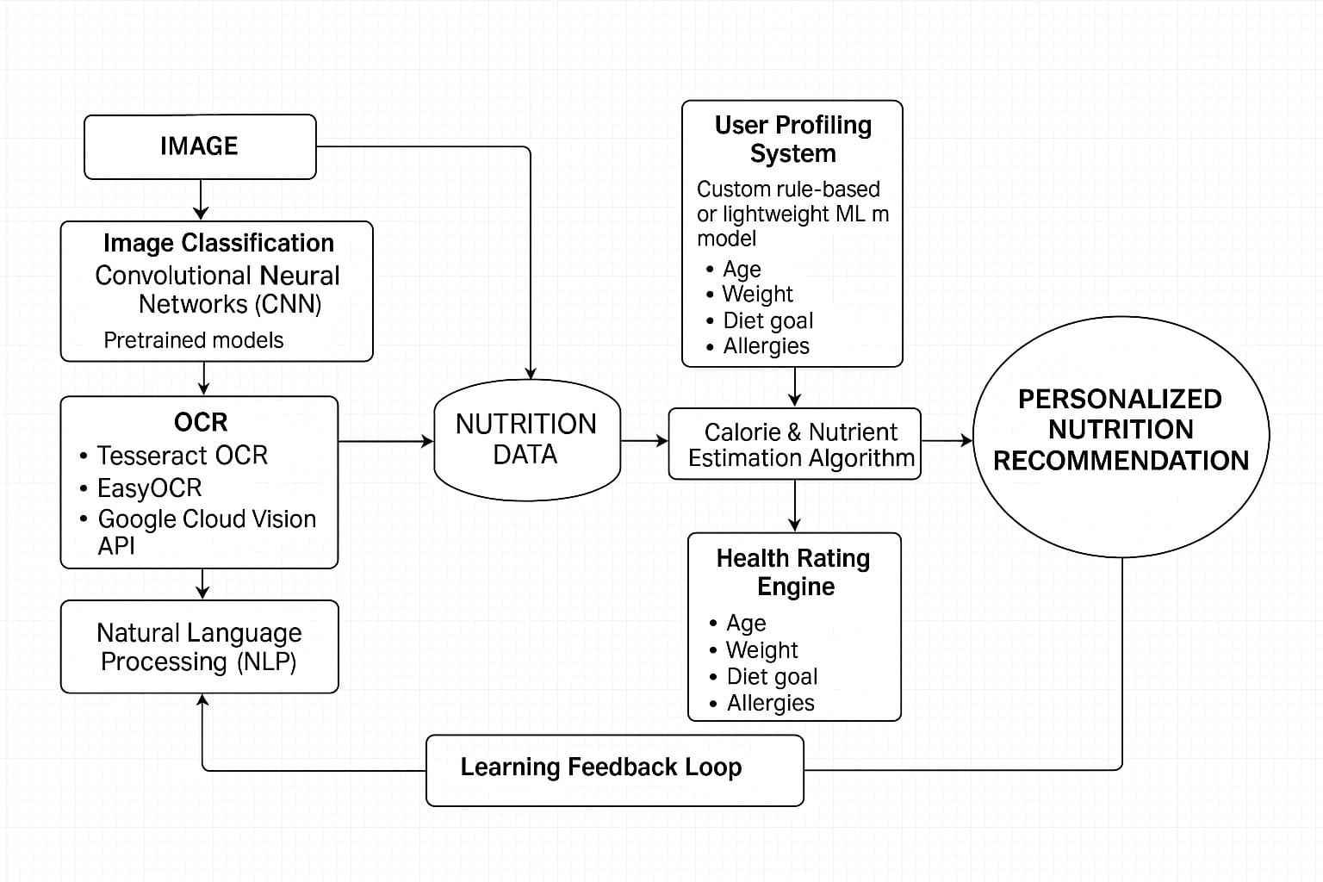
ARCHITECTURE DIAGRAM
AI POWERED NUTRITION SCANNER

Slide 4
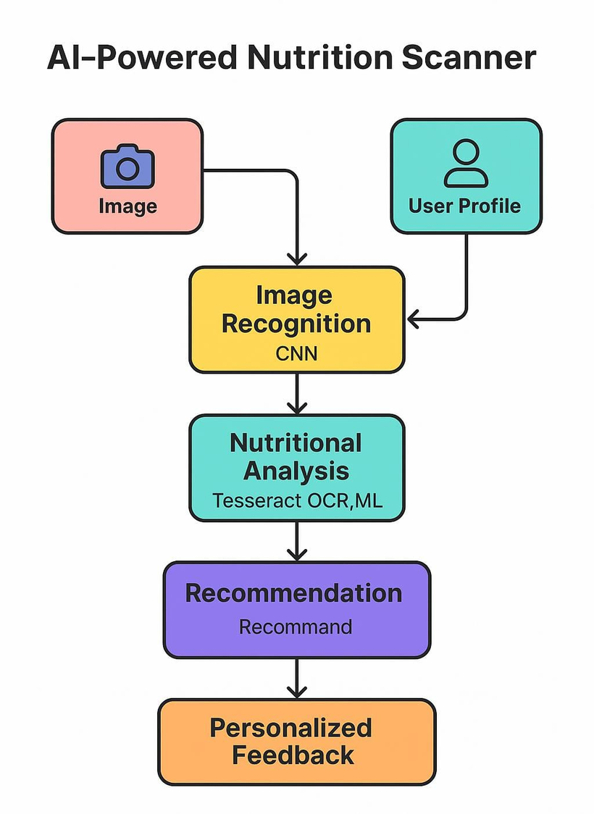
DATA FLOW DIAGRAM
AI POWERED NUTRITION SCANNER

Slide 5
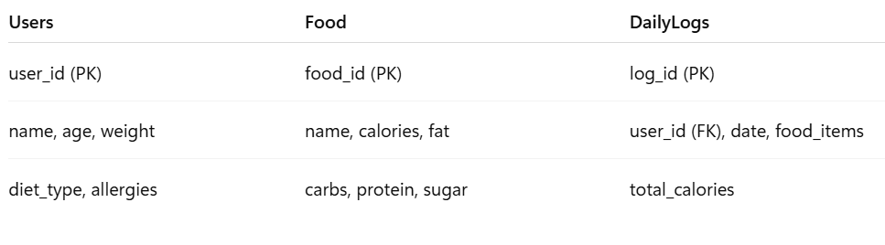
SYSTEM DESIGN
DATABASE SCHEMA DESIGN
User Profile Collection
{
"user_id": String,
"name": String,
"age": Number,
"weight": Number,
"diet_type": String,
"allergies": [String],
"goals": String,
"daily_logs": [ { date, foods, total_calories } ]
}
Food Nutrition
{
"food": String,
"calories": Number,
"fat": Number,
"carbs": Number,
"protein": Number,
"sugar": Number
}
AI POWERED NUTRITION SCANNER

Slide 6
UI INTERFACE / MOCKUPS
1. User Registration
Input Fields:
Name
Age
Weight
Height
Diet Preference (Dropdown)
Allergies (Multi-select)
2. Food Scanner Interface
Upload or capture food image OR scan nutrition label
Buttons:
[ Capture Image ]
[ Upload Image ]
[ Scan Label ]
Optional: Input portion size
Loading spinner during prediction
3. Nutrition Analysis Result
Displays prediction from ML model + estimated nutrition
Output:
Food Name: Burger
Calories: 295 kcal
Fat, Protein, Carbs, Sugar
Health Score: ★★★☆☆
Suggestion: “Try grilled sandwich instead”
4. Meal Log & Daily Intake Tracker
Visualizes daily intake + logs history
Charts: Calories, Protein, Fat (Matplotlib)
Table/List of previous food entries
Date selector for logs
AI POWERED NUTRITION SCANNER

Slide 7
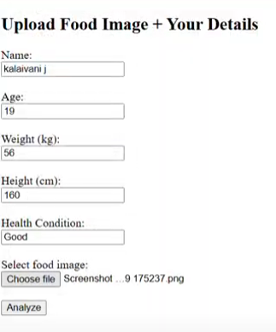
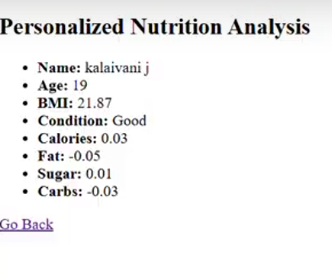
DEVELOPMENT PROGRESS
MODULES COMPLETED WITH OUTPUT
Food image upload
Flask API with predict endpoint
Basic AI model integration
JSON-based nutrition lookup
AI POWERED NUTRITION SCANNER

Slide 8
CODE SNIPPET
app.py – Core Backend Logic (Flask)
@app.route("/", methods=["GET", "POST"])
def analyze():
if request.method == "POST":
image = request.files["image"]
image.save(os.path.join("uploads", image.filename))
# Get user data
name = request.form["name"]
weight = float(request.form["weight"])
height = float(request.form["height"])
condition = request.form["condition"]
# Predict nutrition
nutrients = analyze_food_image(image.filename)
# BMI check for personalization
bmi = weight / ((height / 100) ** 2)
if bmi > 25 or "diabet" in condition.lower():
nutrients["sugar"] *= 0.5
return render_template("result.html", result=nutrients)
return render_template("index.html")
index.html – User Input UI
<form method="POST" enctype="multipart/form-data">
<input type="text" name="name" required>
<input type="number" name="age" required>
<input type="number" name="weight" required>
<input type="number" name="height" required>
<input type="text" name="condition">
<input type="file" name="image" required>
<input type="submit" value="Analyze">
</form>
utils.py – Image Processing + Prediction
def analyze_food_image(image_path):
model = load_model()
image = Image.open(image_path).convert('RGB')
image = transform(image).unsqueeze(0)
with torch.no_grad():
output = model(image)
return calories, fat, suger, carbohydrate
MELODY MART
AI POWERED NUTRITION SCANNER

Slide 9
INTEGRATION STATUS
AI Model integrated with Flask backend → PyTorch-based CNN model predicts nutrition from food image.
Frontend connected to Flask API → HTML form captures user input + image and sends it via POST request.
Nutrition data successfully fetched post-prediction → Prediction results (calories, fat, sugar, carbs) processed and displayed.
User account system (login/signup) – Not Implemented → Currently, user data is processed session-wise only.
Personalization module(advanced goals/allergy-based suggestions) – Partially Done → Basic BMI and condition-based sugar adjustment is implemented.
AI POWERED NUTRITION SCANNER

Slide 10
TESTING
Early Tests Done
Tested with sample images (burger, apple, pizza)
Accuracy: ~85% for known classes
Observed some mismatches for blurry or dark images
MELODY MART
AI POWERED NUTRITION SCANNER

Slide 11
Work Plan
UPDATED WORK PLAN
Remaining Tasks :
Add more food classes to AI model (retrain)
Integrate nutrition database/API
Improve frontend UI (show graph/feedback)
Add user profile + health condition options
TIMELINE :
TASK | DEADLINE
Final Model + Dataset | Aug 15
Frontend Polishing | Aug 17
Testing & Debugging | Aug 20
Final Report + Deployment | Aug 25
AI POWERED NUTRITION SCANNER

Slide 12

AI POWERED NUTRITION SCANNER

