Slide 1
Impact of Generative AI Usage Among Working Professionals in the Service Industry
File created on: 2/1/2026 2:02:54 PM

Slide 2
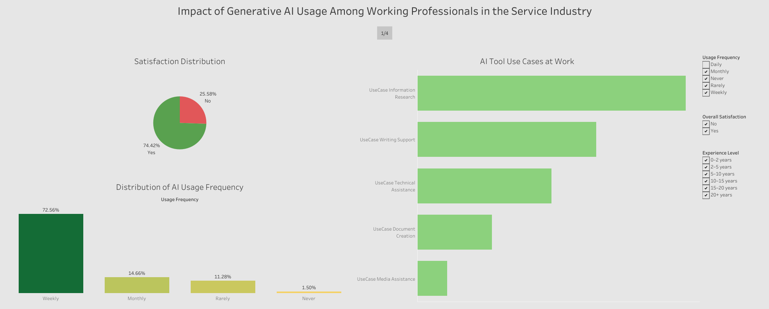

Slide 3
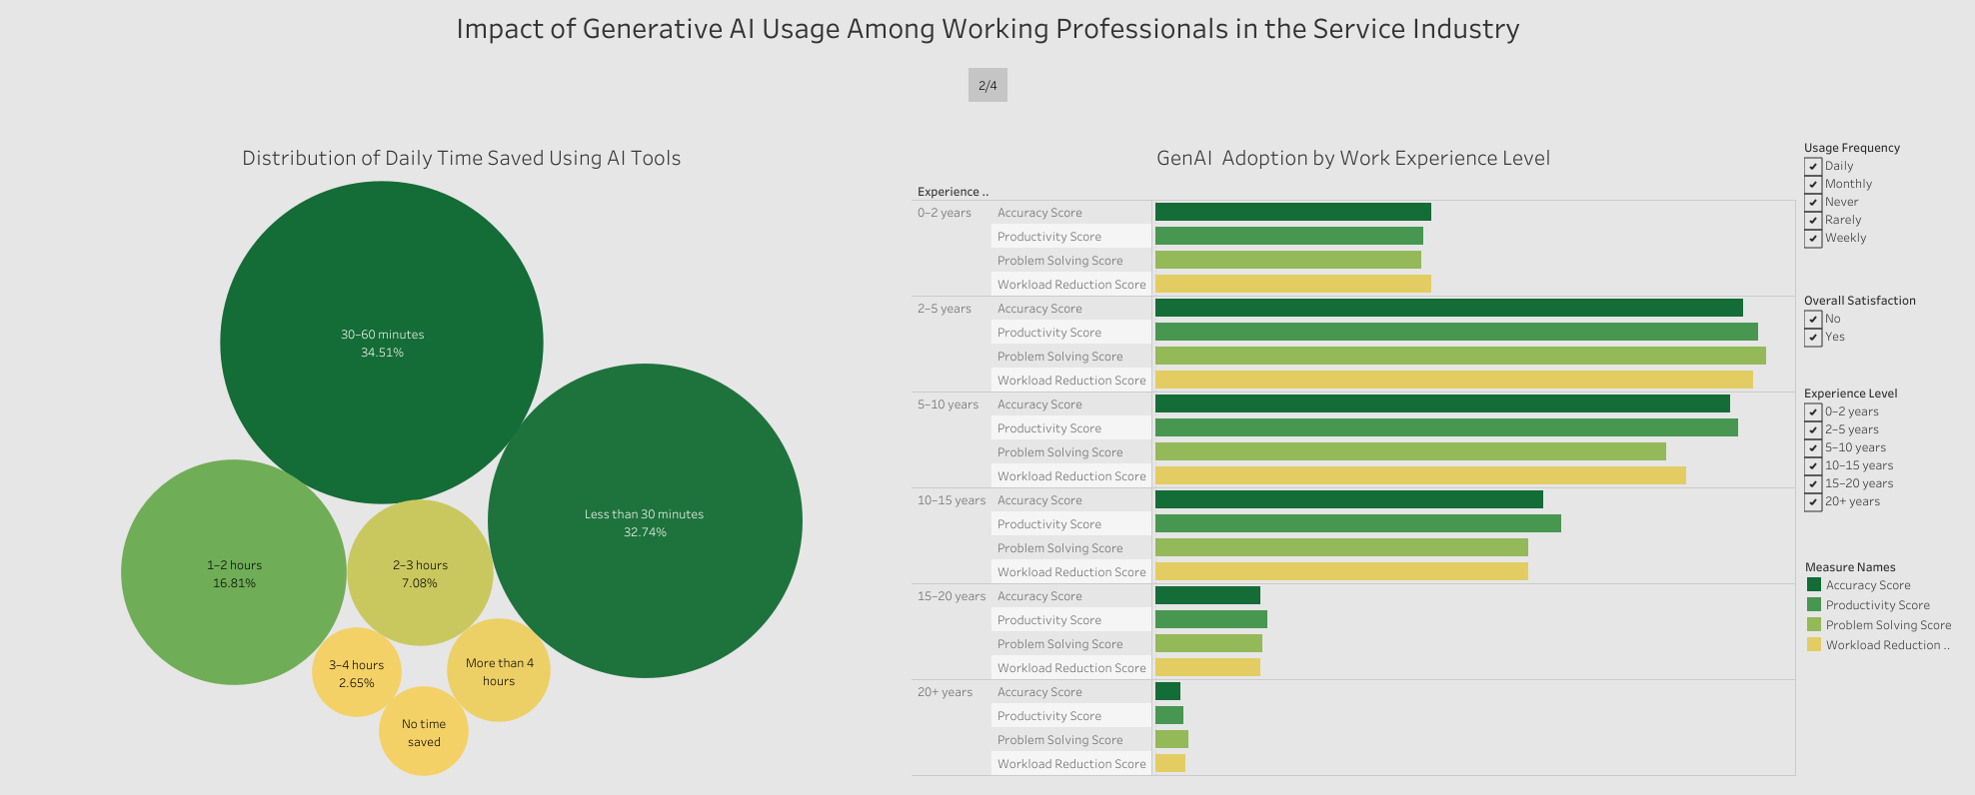

Slide 4
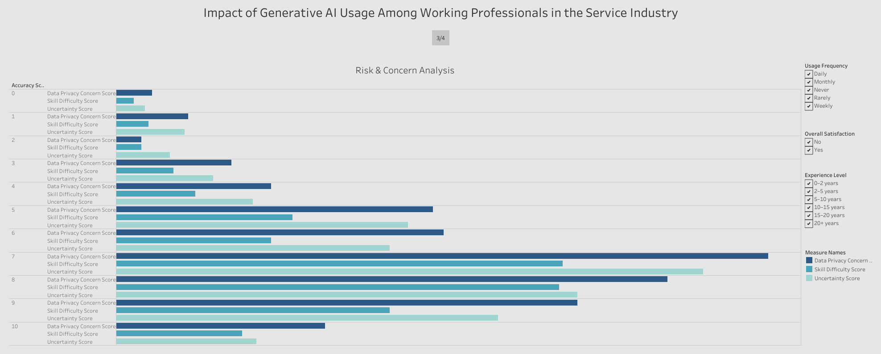

Slide 5
