Slide 1
603 - Final Project
Analysis on NYC Civil Service List Certification
By:-
Kalaiarasi Kaliappan

Slide 2
New York Civil Service exam
A written test for specific positions.
It is one of the most challenging examinations that require a lot of practice and preparation
Civil Service eligible lists are valid for at least one year, and up to four years, in accordance with state law.

Slide 3


Slide 4
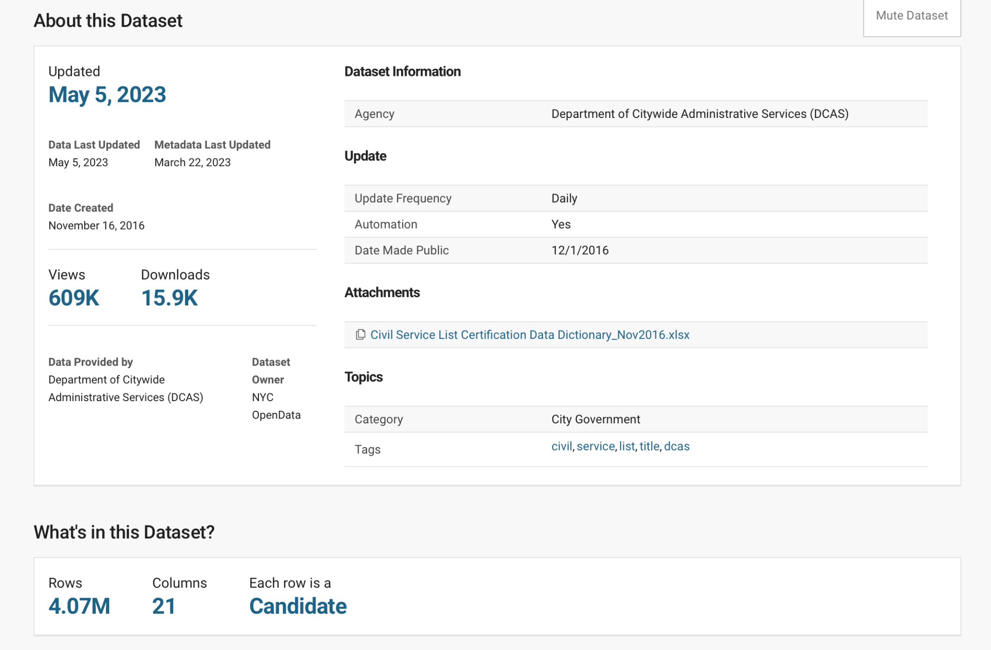

Slide 5
Key Attributes:
List No (Candidates rank)
List Agency Desc (Hiring Agency name)
List Title Desc (Job title)
Salary
Cert Date
Cert Expiration Date
No Certified
Provisional Replacement
No Vacancies

Slide 6
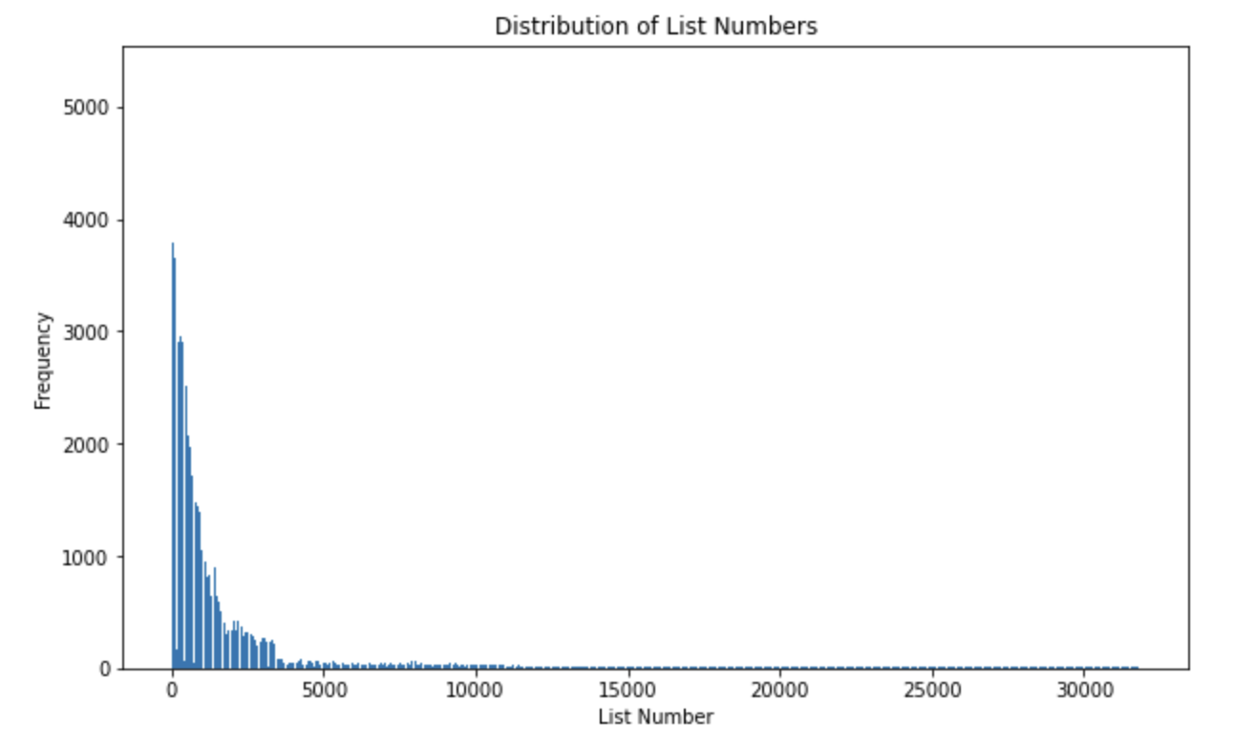
Distribution of List Numbers:
It’s observed that individuals with higher ranks have a larger spread in the dataset. This indicates that candidates with higher list numbers tend to have a wider range of positions and job titles available to them. It suggests that individuals with higher ranks have more opportunities and options for employment within the civil service.

Slide 7
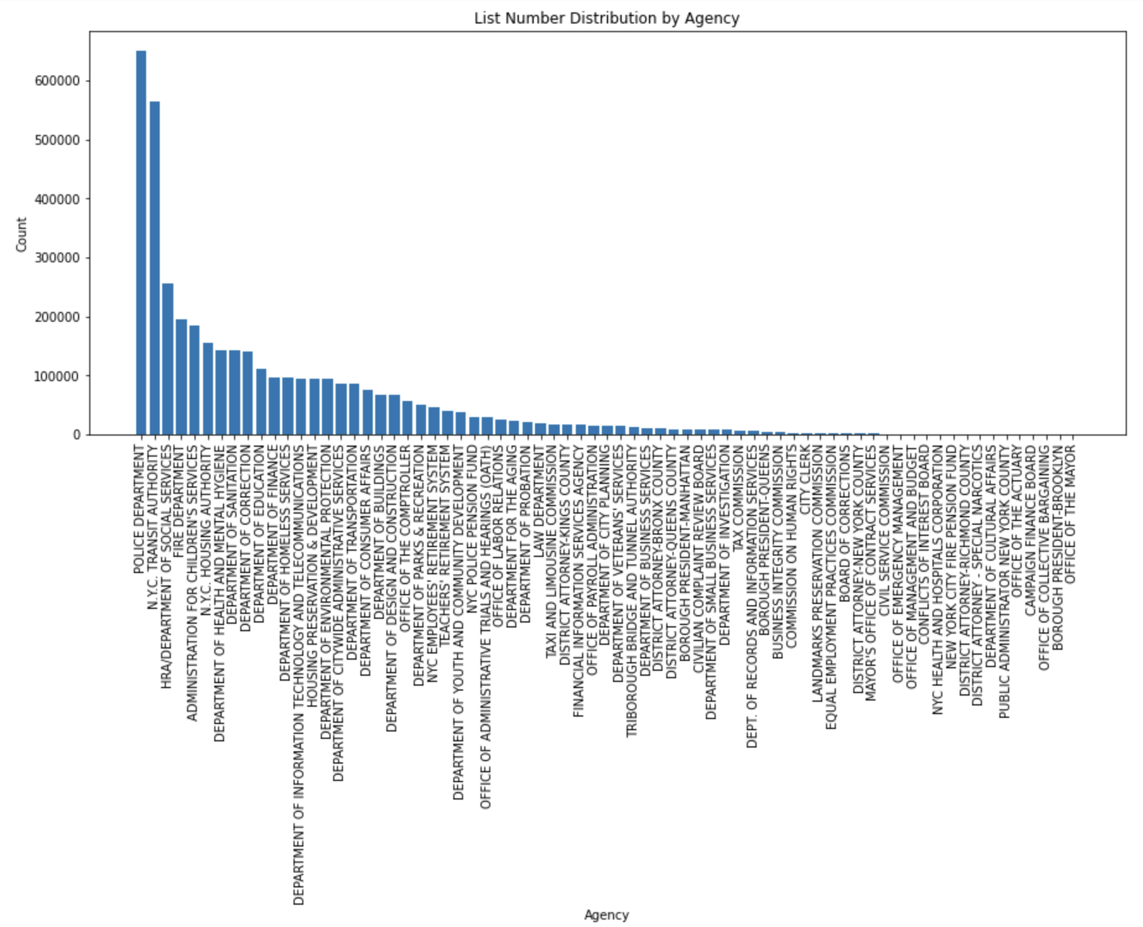

Slide 8
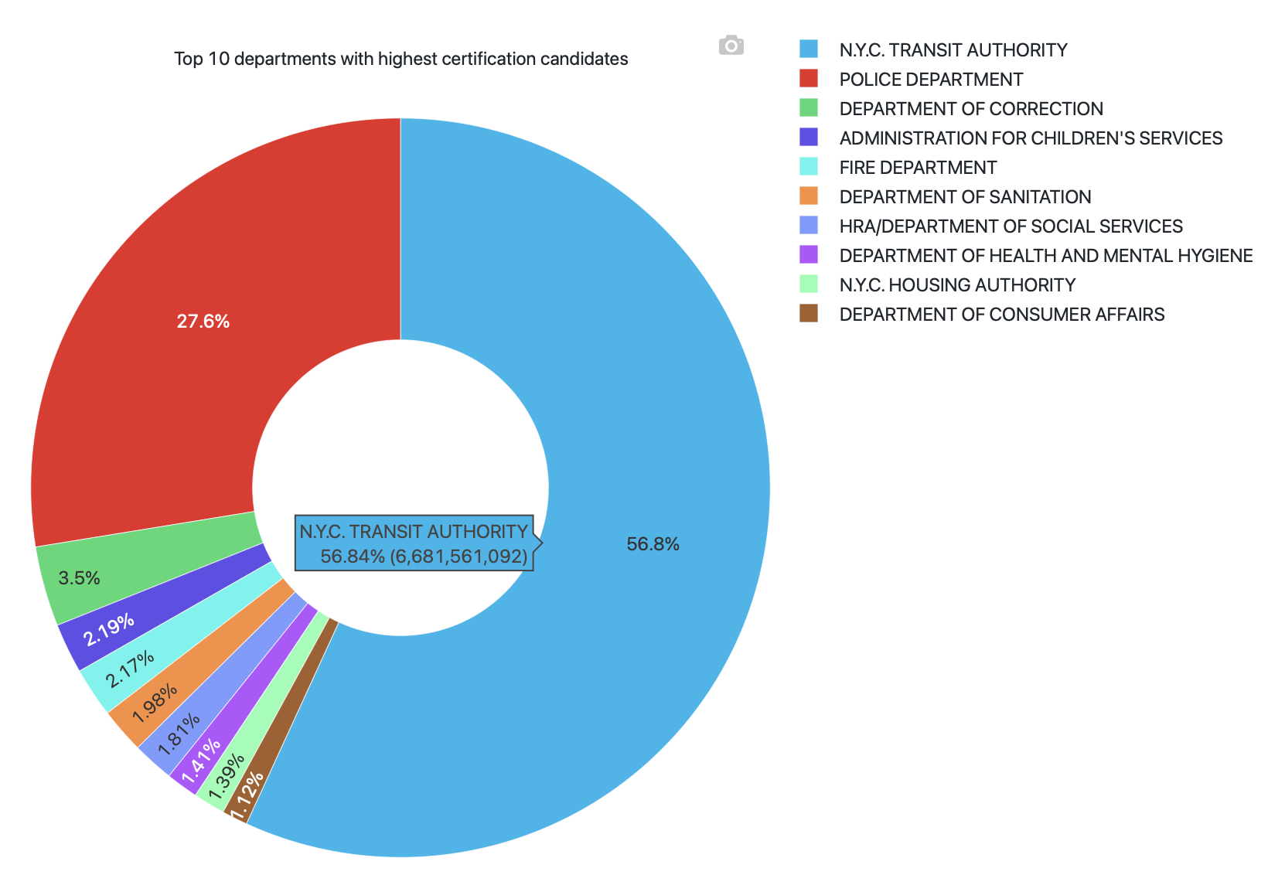
Top 10 agency which received most no.of certifications.

Slide 9
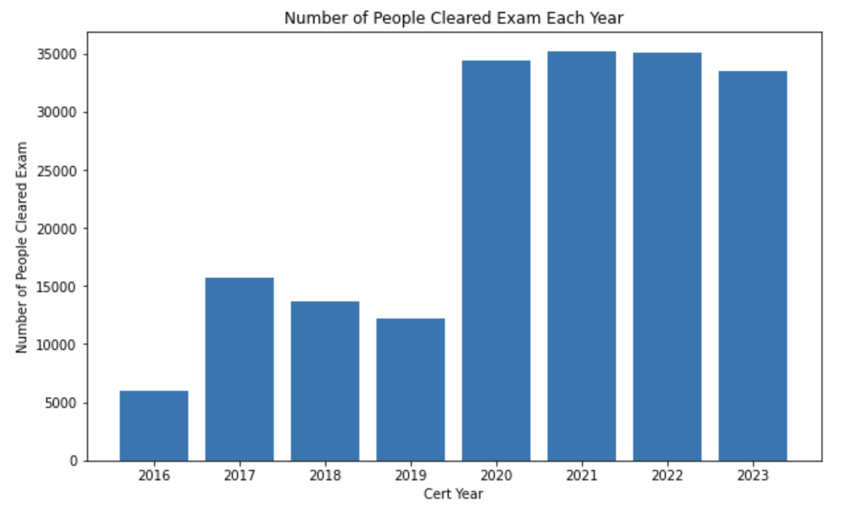

Slide 10
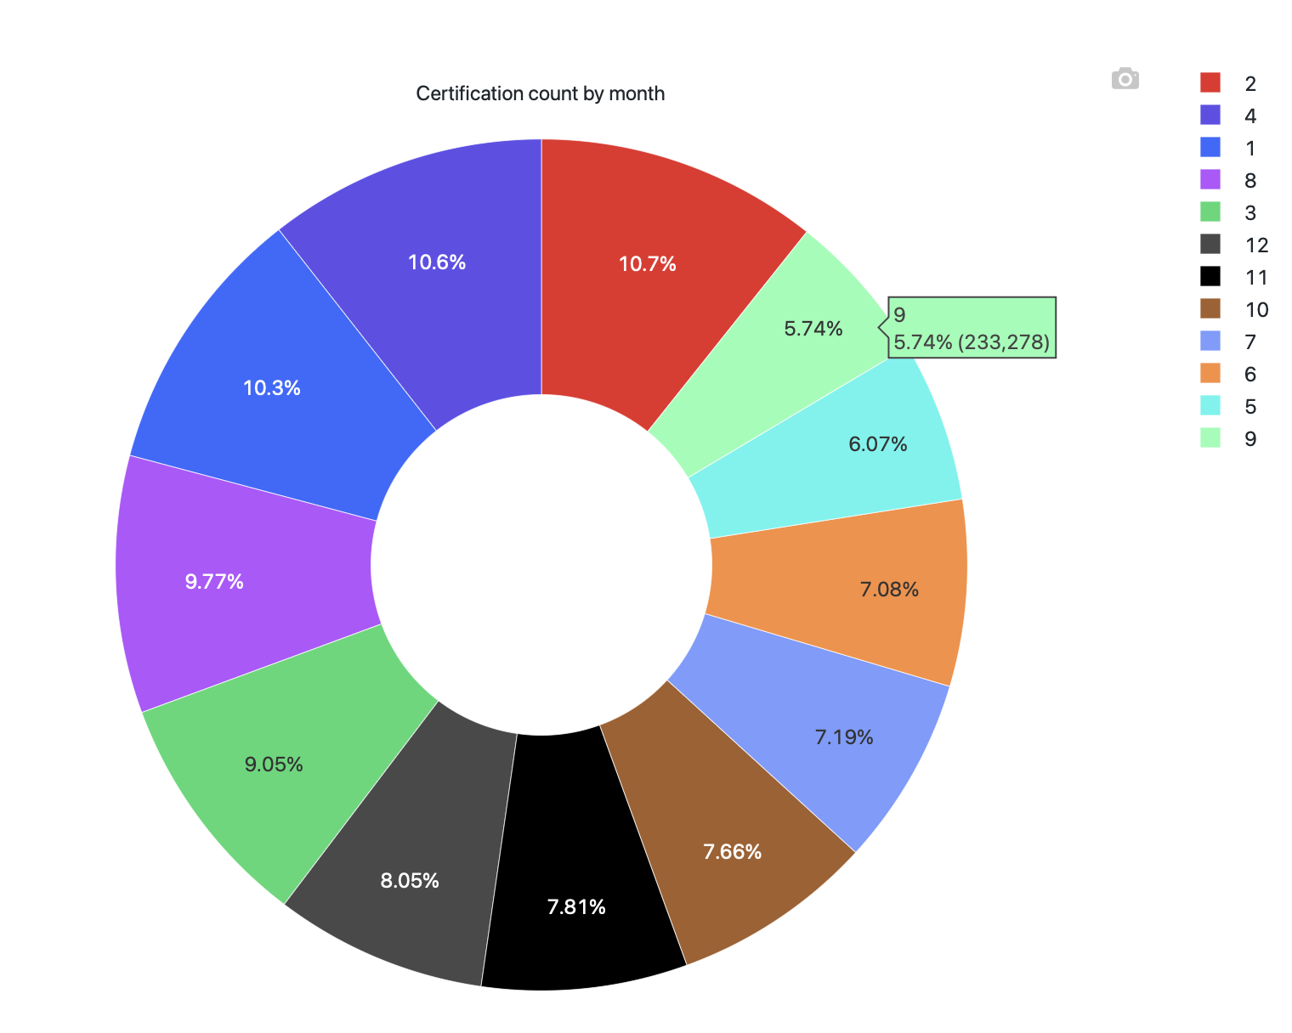
No. of people cleared exam based on month wise

Slide 11
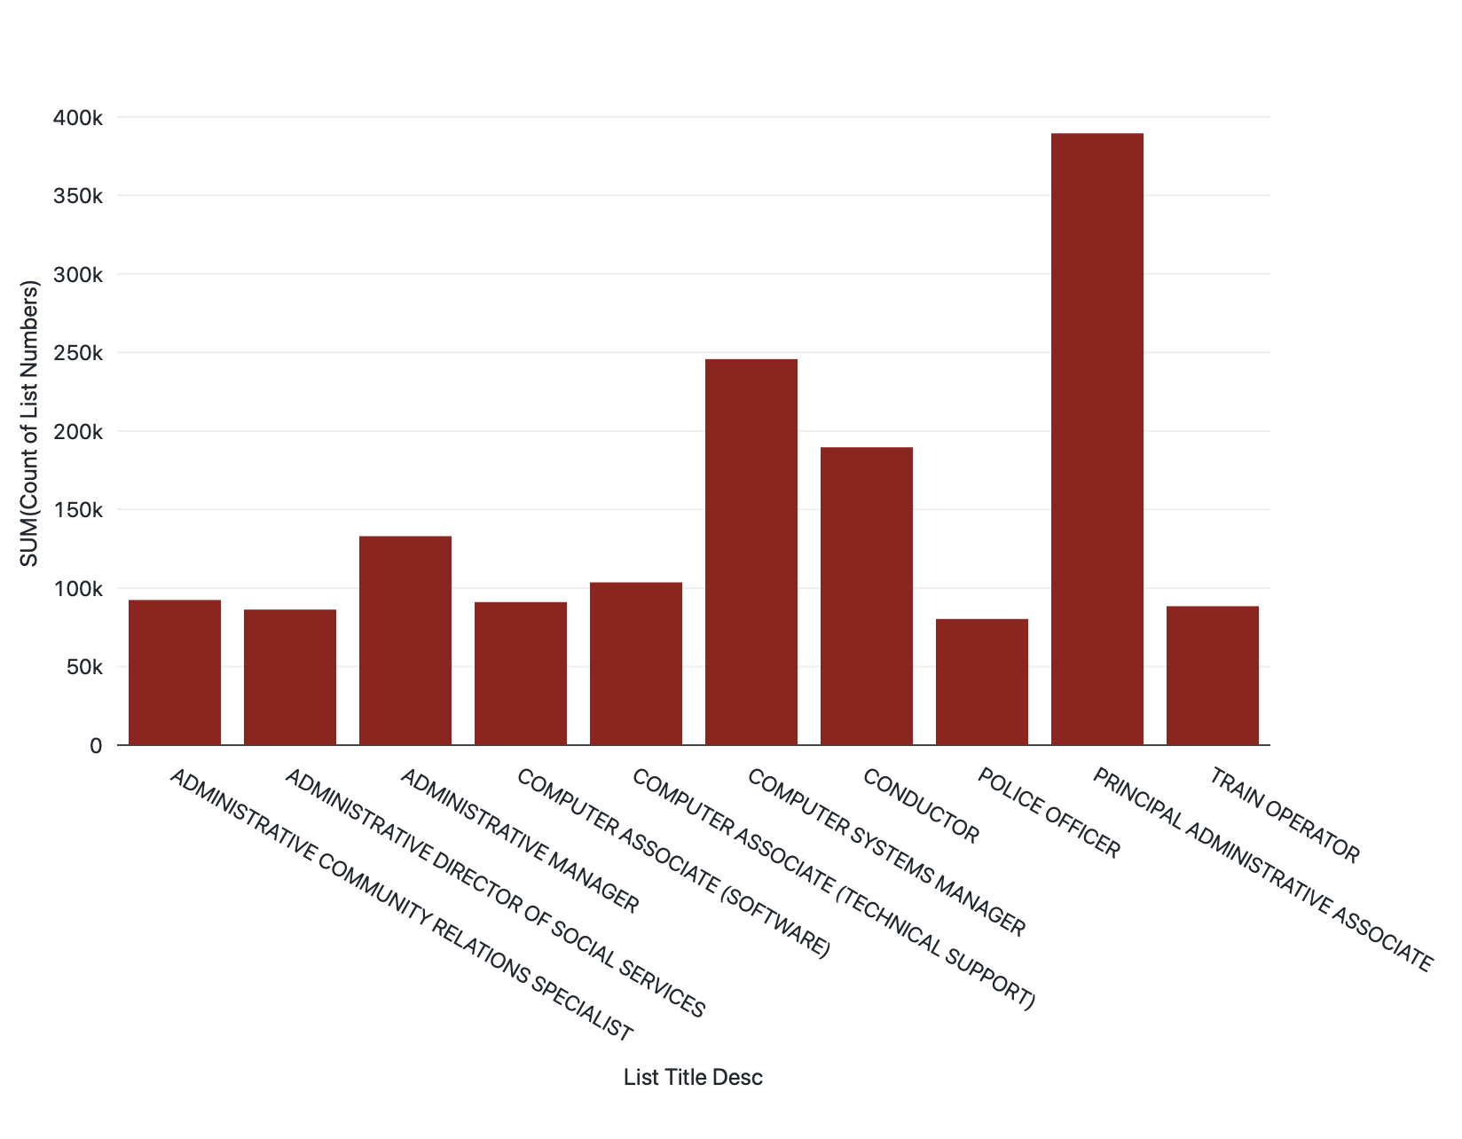
Top 10 departments prefered by most no. of candidates
PRINCIPAL ADMINISTRATIVE ASSOCIATE is the most sought-after certification, with over 300,000 candidates obtaining it, highlighting its popularity and potential career prospects.

Slide 12
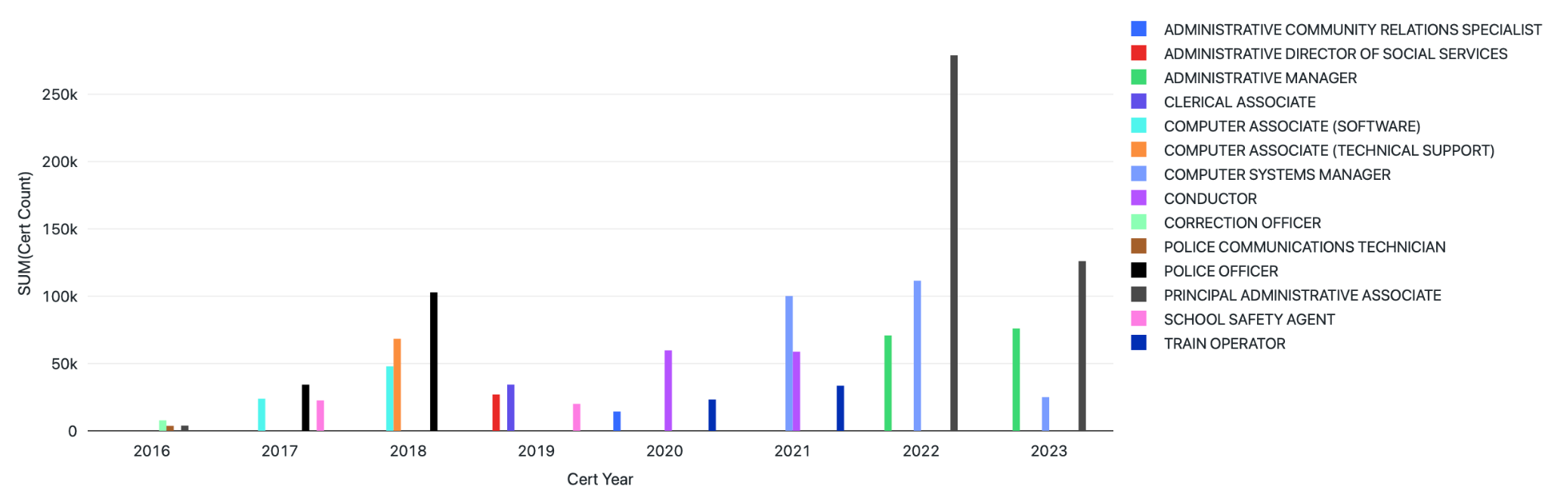
Top 3 certificates Preferred each year
Popular Certifications: PRINCIPAL ADMINISTRATIVE ASSOCIATE, ADMINISTRATIVE MANAGER, and COMPUTER SYSTEMS MANAGER are the top three preferred certifications by candidates in recent years, indicating their relevance and demand in the job market.

Slide 13
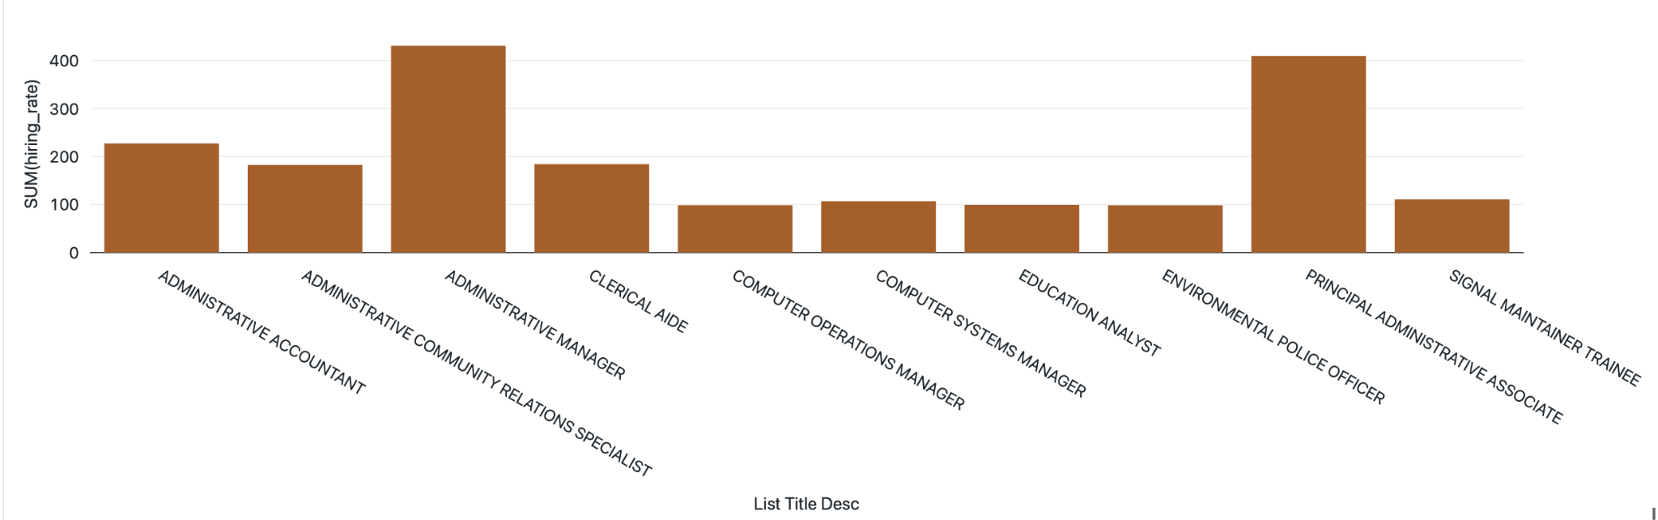
Top 10 positions which has more hiring rate
High Demand Titles: The positions of ADMINISTRATIVE MANAGER and PRINCIPAL ADMINISTRATIVE ASSOCIATE show high hiring rates, suggesting a consistent need for professionals in these roles.

Slide 14
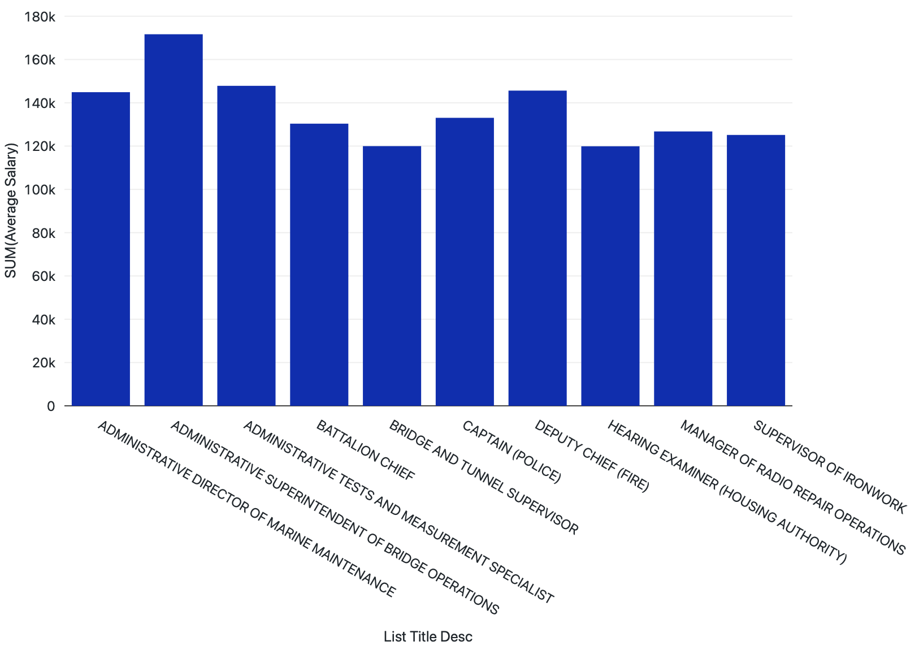
Maximum Salary received by top 10 job titles

Slide 15
The two job titles which has max and min average salary
Salary Disparity: The ADMINISTRATIVE SUPERINTENDENT OF BRIDGE OPERATIONS earns the highest salary, while the YOUTH DEVELOPMENT SPECIALIST earns the lowest, indicating a significant salary discrepancy across job titles.

Slide 16
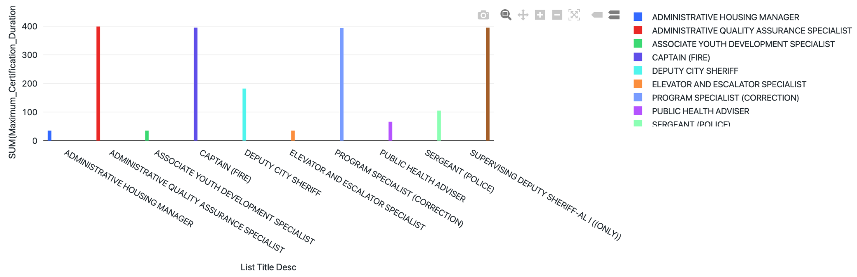
Top 10 certificates which has more Expiration days
Certifications like SUPERVISING DEPUTY SHERIFF-AL I ((ONLY)) and CAPTAIN (FIRE) have relatively longer certificate expiry dates, potentially requiring longer periods of recertification or renewal.

Slide 17
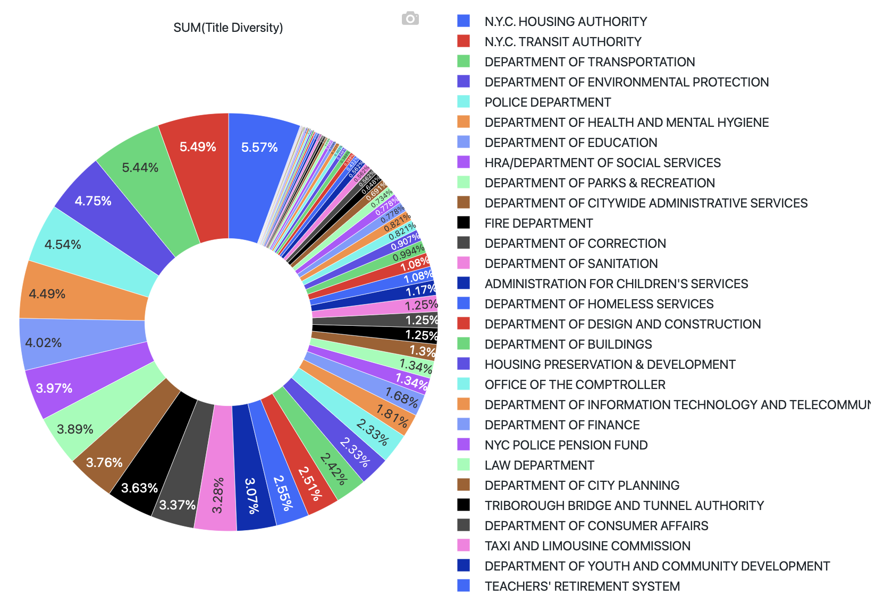
No. of Positions handled by each agencies

Slide 18
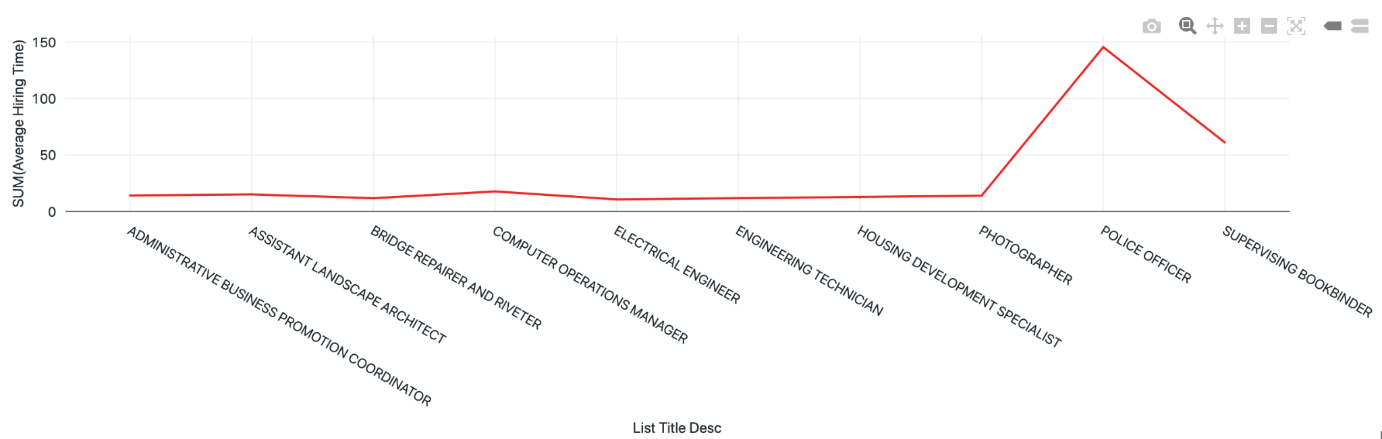
Job Titles which take more hiring time
Lengthy Hiring Process: Hiring a Police officer appears to have a longer duration compared to other positions, indicating a potentially rigorous selection and vetting process.

Slide 19
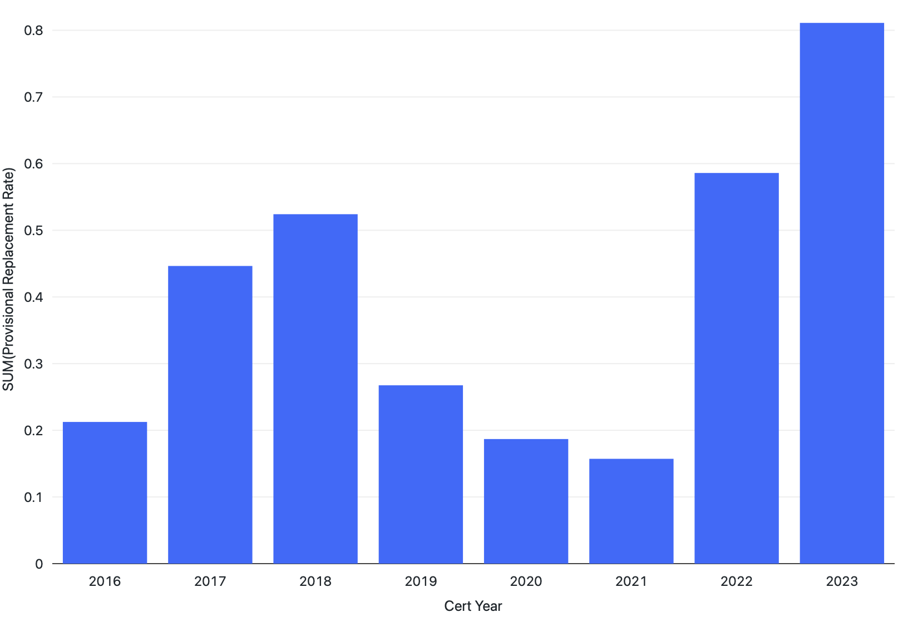
Provisional Replacement Rate over the years
Provisional Replacement Rate: Over time, there has been an increase in the rate at which provisional employees are being replaced with permanent employees, indicating a shift towards a more stable and permanent workforce.

Slide 20
Conclusion
Increase in Exam Clearing: The number of individuals clearing the exam has shown significant growth, exceeding 35,000 compared to the previous year, indicating a strong pool of qualified candidates.
Job Titles Distribution: Agencies such as N.Y.C. Transit, Housing, Police Department, and Environment have a diverse range of job titles, suggesting a wide variety of career opportunities within these sectors.
Salary Disparity: The ADMINISTRATIVE SUPERINTENDENT OF BRIDGE OPERATIONS earns the highest salary, while the YOUTH DEVELOPMENT SPECIALIST earns the lowest, indicating a significant salary discrepancy across job titles.
High Demand Titles: The positions of ADMINISTRATIVE MANAGER and PRINCIPAL ADMINISTRATIVE ASSOCIATE show high hiring rates, suggesting a consistent need for professionals in these roles.
Popular Certifications: PRINCIPAL ADMINISTRATIVE ASSOCIATE, ADMINISTRATIVE MANAGER, and COMPUTER SYSTEMS MANAGER are the top three preferred certifications by candidates in recent years, indicating their relevance and demand in the job market.
PRINCIPAL ADMINISTRATIVE ASSOCIATE is the most sought-after certification, with over 300,000 candidates obtaining it, highlighting its popularity and potential career prospects.
Lengthy Hiring Process: Hiring a Police officer appears to have a longer duration compared to other positions, indicating a potentially rigorous selection and vetting process.
Provisional Replacement Rate: Over time, there has been an increase in the rate at which provisional employees are being replaced with permanent employees, indicating a shift towards a more stable and permanent workforce.
Agency Analysis: The N.Y.C. Transit Authority and Police Department have the highest number of certified individuals, suggesting these agencies attract a significant number of candidates. However, the Police Department is the most preferred choice among all agencies.

Slide 21
Thank You!!!

