Slide 1
IST LIBRARY MANAGEMENT
PROJECT GUIDE: P.S.APIRAJITHA NAME: KALAISELVAN.J
ROLLNO: 2019202022 - R
BATCH: 2

Slide 2
MOTIVATION & OBJECTIVE
IST Library management system is an infrastructure that allows users/faculty to search books and book content and borrow books from the library. It helps the Librarian to manage books and retrieval of books from the users.

Slide 3
INTRODUCTION
In IST, this project will be useful for managing books in the Department Library. The Library Management System is an application for assisting a librarian in managing a book library in a university. The system would provide basic set of features to add/update members, add/update books, and manage check in specifications for the systems based on the client’s statement of need.
Library management system is a typical management Information system (MIS), its Development include the establishment and maintenance of back-end database and front-end application development aspects. For the former require the establishment of data consistency and integrity of the strong data security and good libraries. As for the latter requires the application fully functional, easy to use and so on.

Slide 4
IMPLEMENTATION PLATFORM / FRAMEWORK
Frontend: Flutter
Backend: Django REST Framework
Database: MySQL

Slide 5
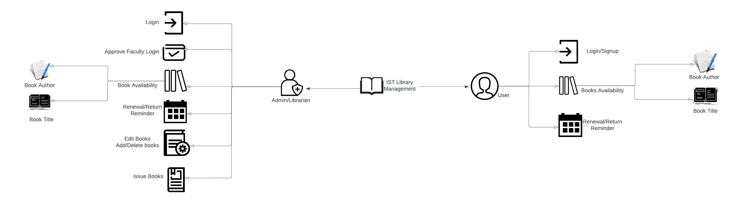
OVERALL ARCHITECTURE

Slide 6
LIST OF MODULES
2. USER/FACULTY
• Login
• Signup
• Book Information
• Search Tool
• Checkout/History/Renew Book
1. ADMIN/LIBRARIAN
• Login
• Book Information
• Add/Delete Book
• Renewal/Return/Issue Books
• Search Tool

Slide 7
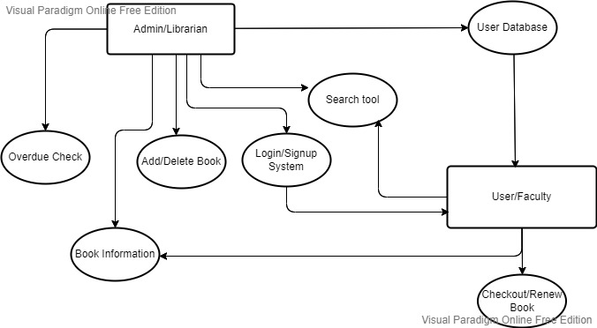
Detailed design of each module with block diagram

Slide 8
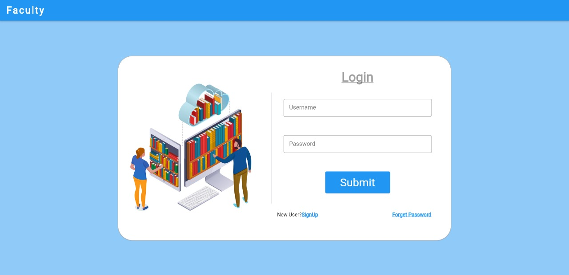
MODULE BASED OUTPUT SCREENSHOTS
1.FACULTY LOGIN

Slide 9
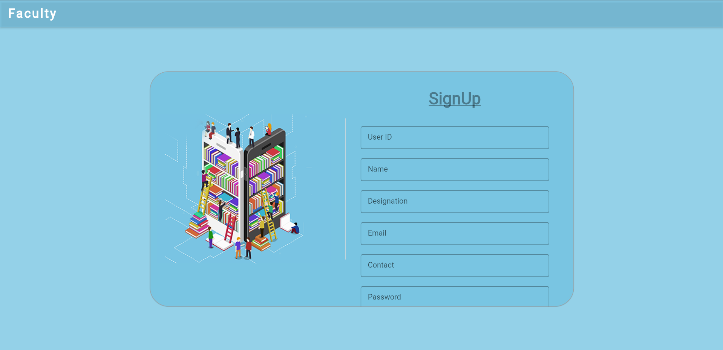
2.FACULTY SIGNUP

Slide 10
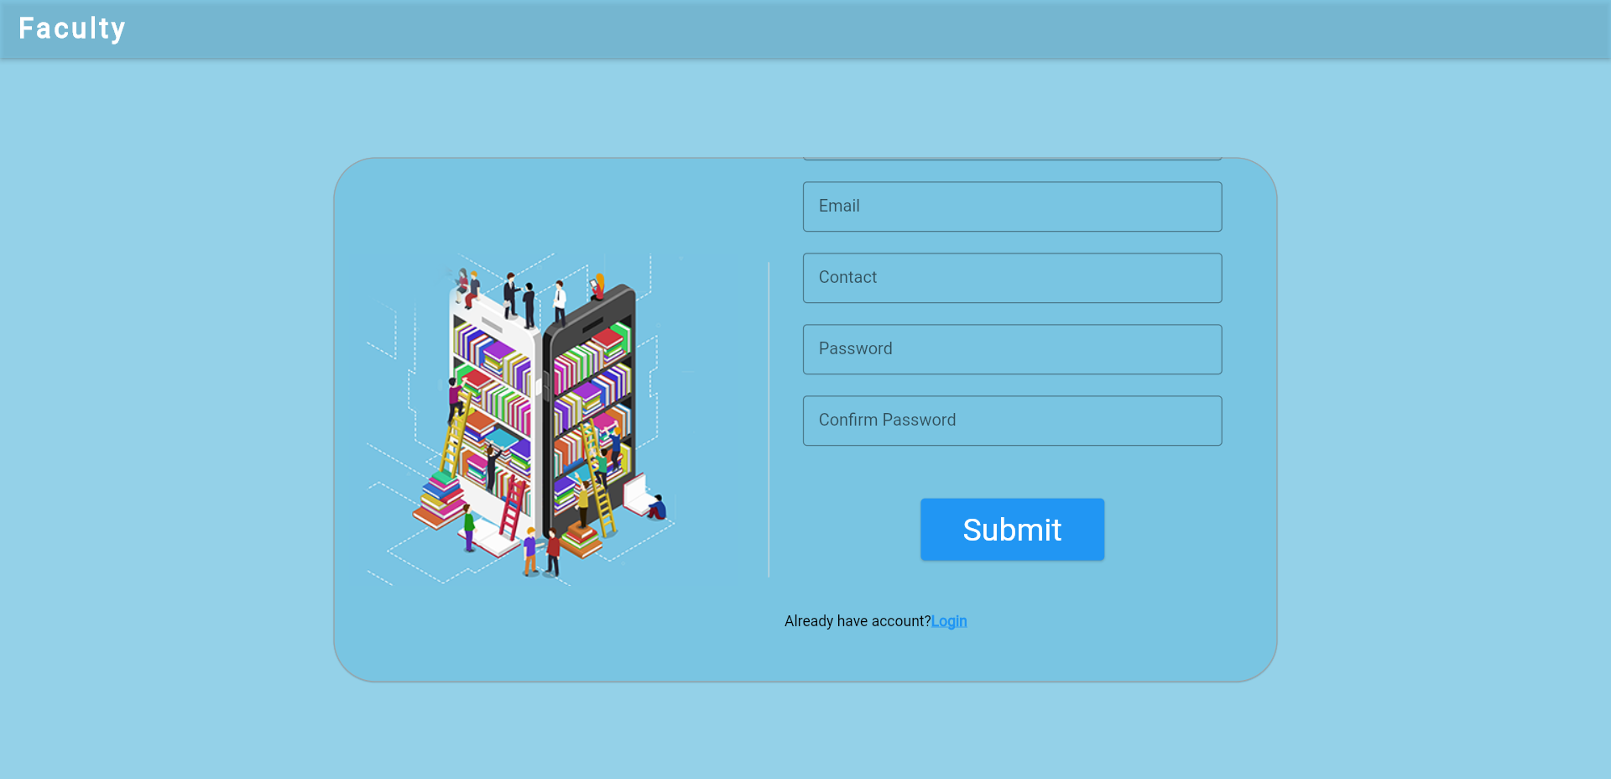

Slide 11
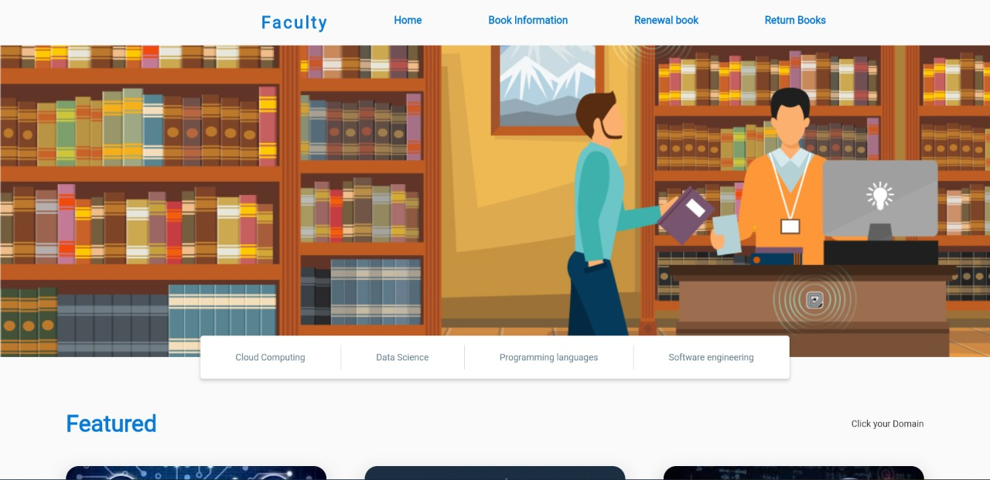
3.FACULTY HOMEPAGE

Slide 12
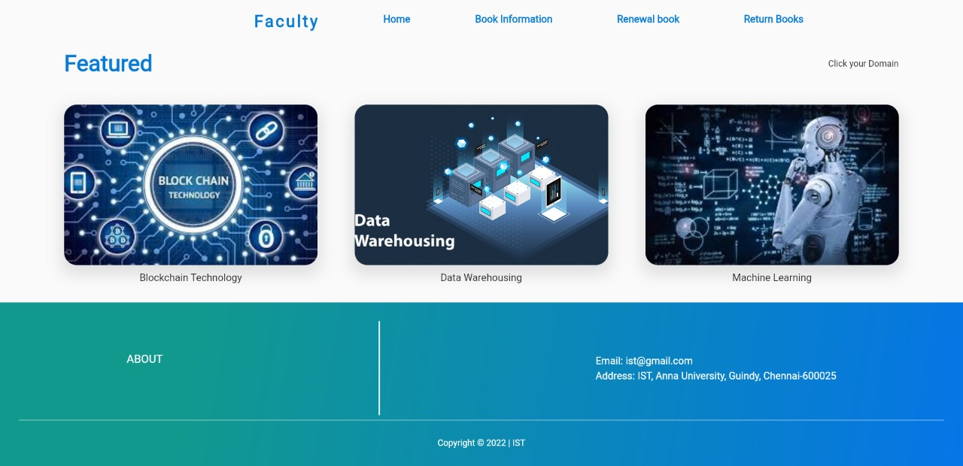

Slide 13
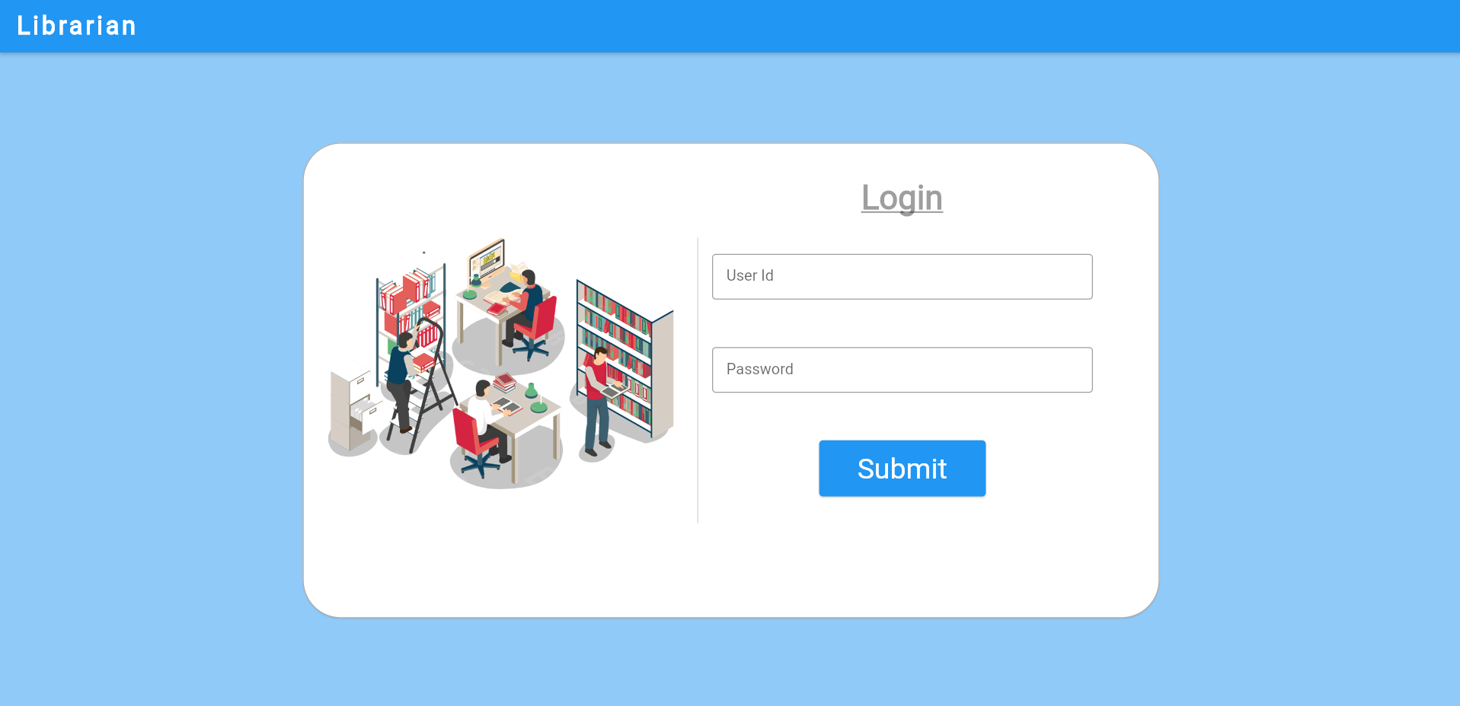
4.LIBRARIAN LOGIN

Slide 14
THANK YOU

