Slide 1

Team members:
Madhumathi.V
Kalaivani.P
Jothiprabha.K
Harshavarthini.A
Kanishka.S
Keerthidha.C.B
Team Flash

Slide 2
LOGIN PAGE OF A OTT PLATFORM
USING FIGMA

Slide 3
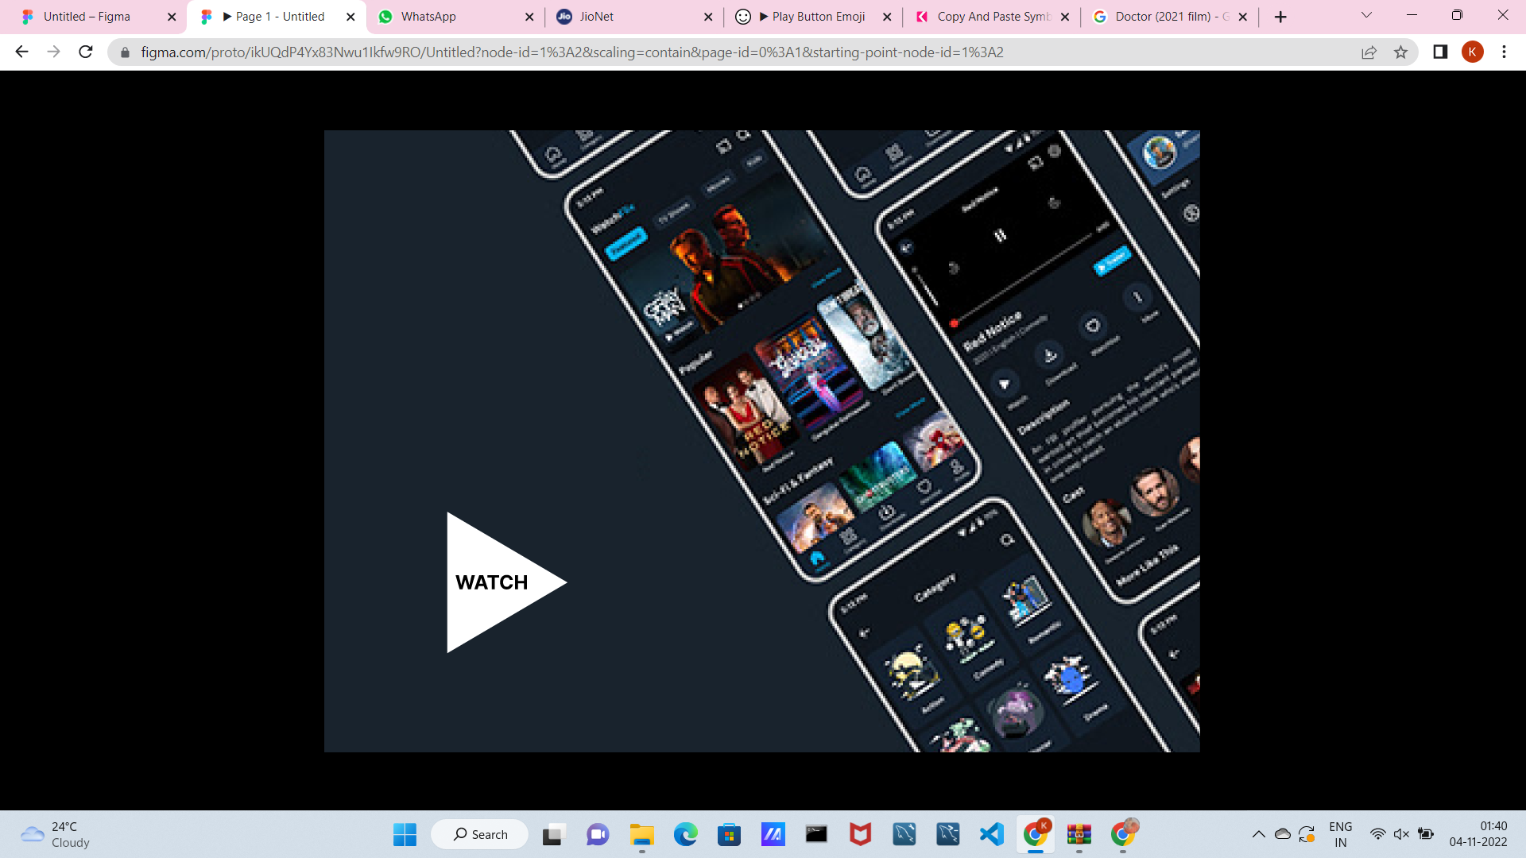

Slide 4
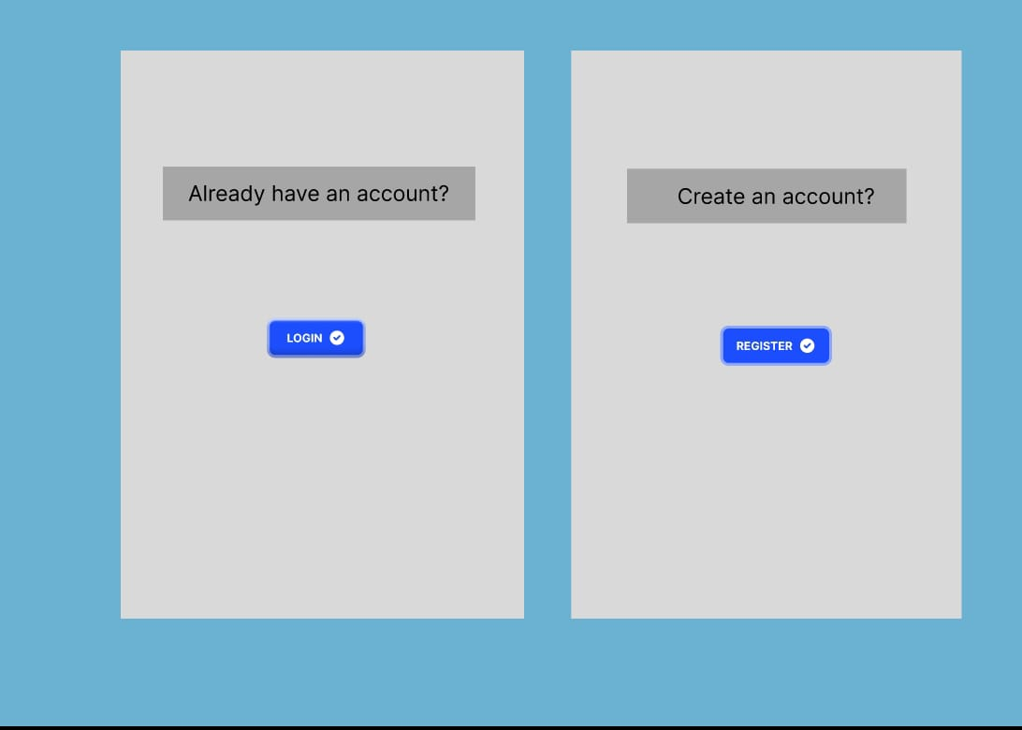

Slide 5
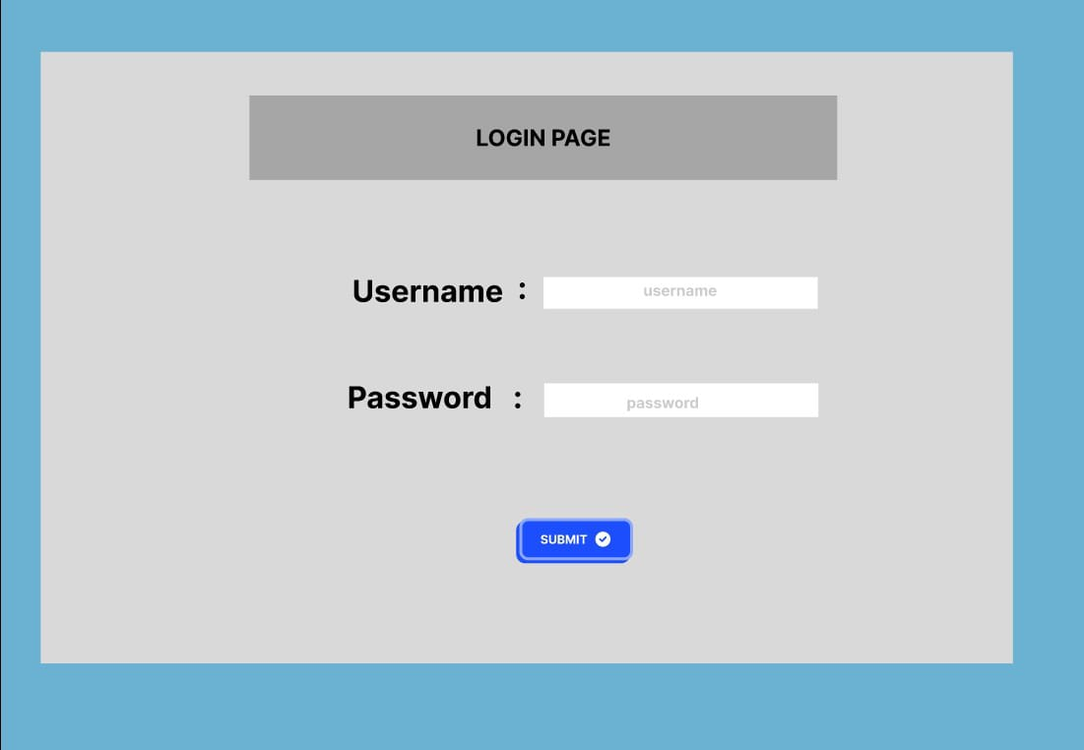

Slide 6
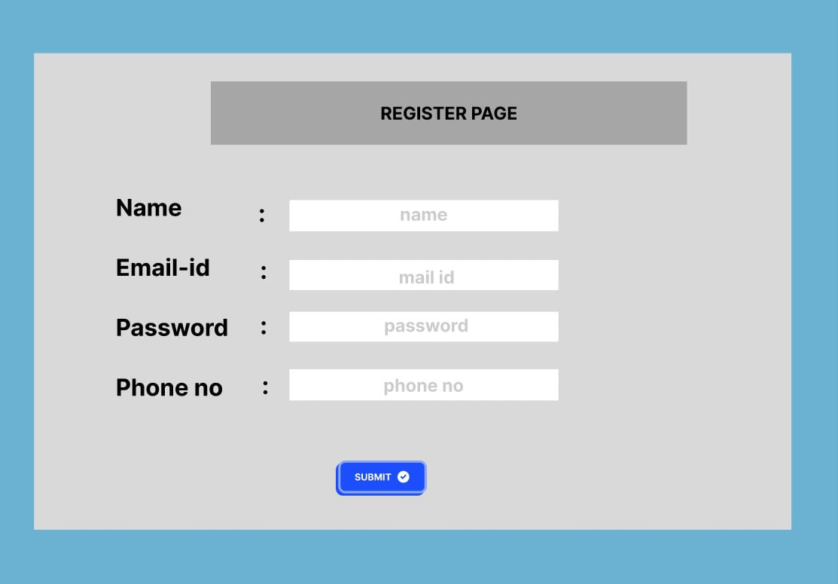

Slide 7
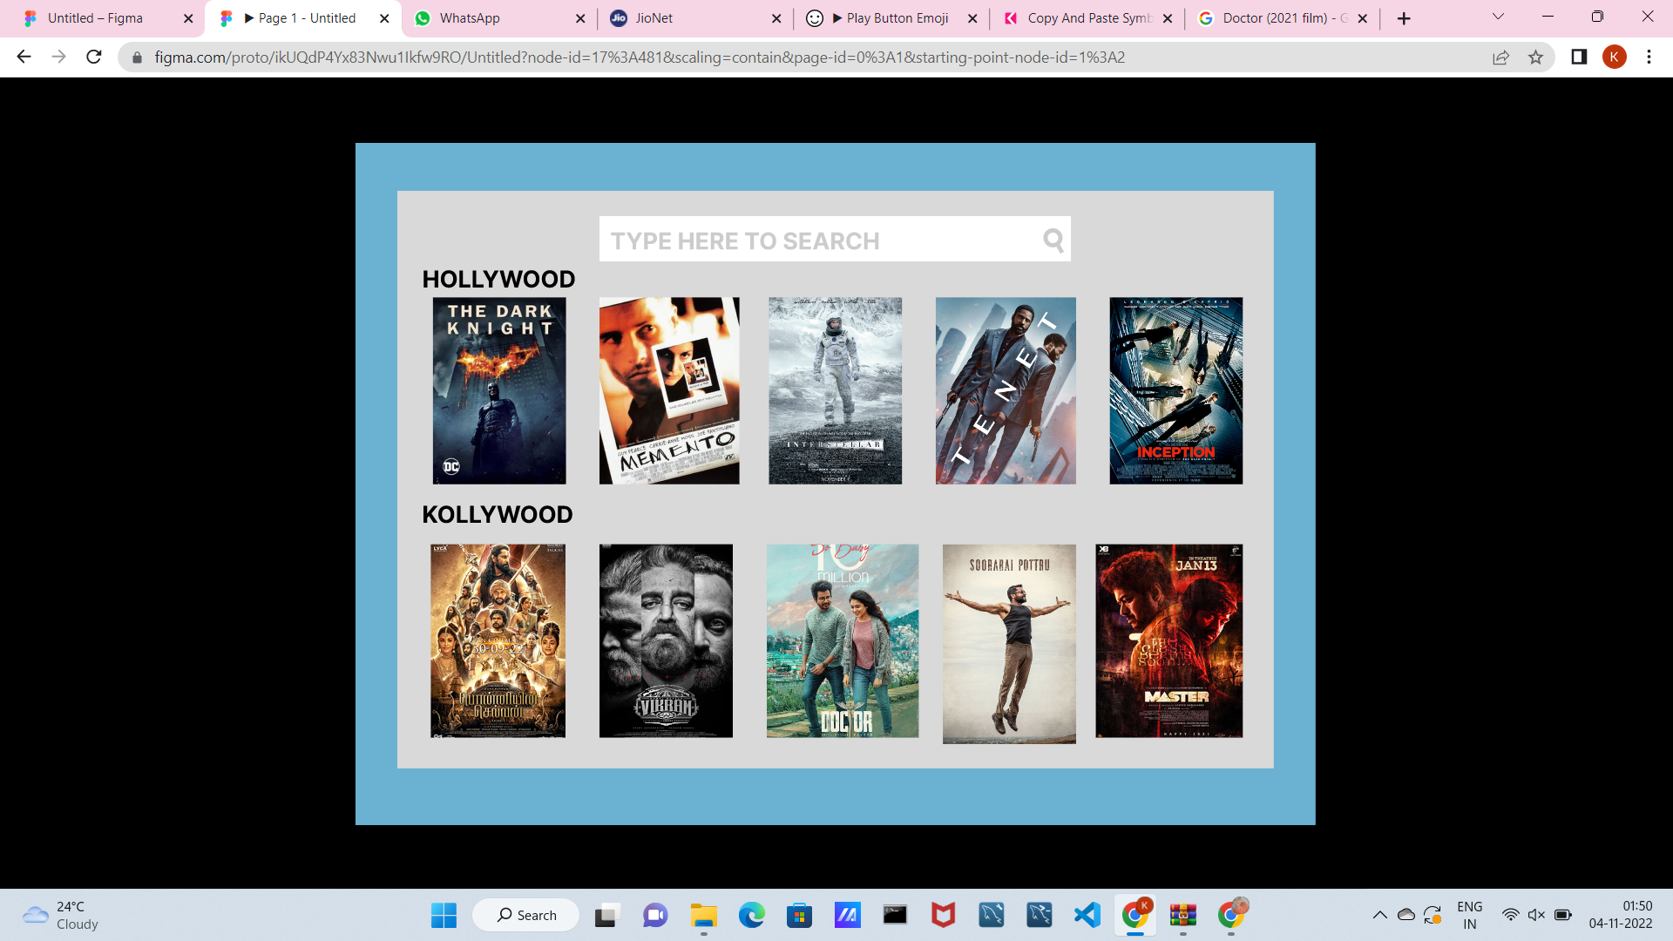

Slide 8
THANKYOU

