Slide 1
HTML
What is HTML ?
HTML stands for Hyper Text Markup Language
HTML describes the structure of a Web page
HTML consists of a series of elements
HTML is Not Case Sensitive
HTML tags are not case sensitive: <P> means the same as <p>.
Tag Description
<html> Defines the root of an HTML document
<body> Defines the document's body
<h1> to <h6> Defines HTML headings
HTML attributes provide additional information about HTML elements.
Attribute
<img src="img_girl.jpg"> where src is the attribute.

Slide 2
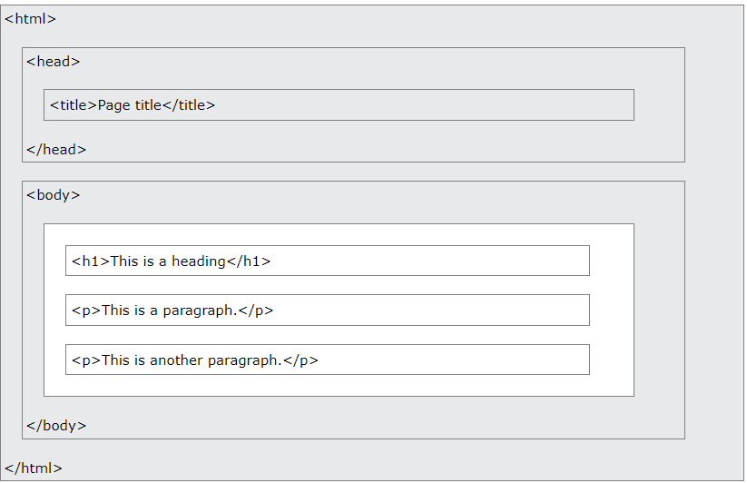
HTML Element
The HTML element is everything from the start tag to the end tag:
Eg : <h1>My First Heading</h1>

Slide 3
HTML Element
<br> - These elements are called empty elements. Empty elements do not have an end tag!
HTML Links:
HTML links are defined with the <a> tag:
Eg:<a href="https://www.w3schools.com">This is a link</a>
<a href="https://www.w3schools.com" target =“_self”>This is a link</a>
URL :
Absolute URL – Linkds to an external image
Relative URL - Links to an image within the same web page

Slide 4
HTML Formatting Elements
<b> - Bold text
<strong> - Important text
<i> - Italic text
<em> - Emphasized text
<mark> - Marked text
<small> - Smaller text
<del> - Deleted text
<ins> - Inserted text
<sub> - Subscript text
<sup> - Superscript text
Comment :
<!-- <p>This is another paragraph </p> -->

Slide 5
HTML Formatting Elements
<button onclick="document.location='default.asp'">HTML Tutorial</button>
The <div> element is often used as a container for other HTML elements.
Bold: <b>This text is bold</b>
List :
<ul >Looking for help?
<li> Use our help center</li>
<li> Check our FAQ</li>
</ul>
Meta Data – Data about data

Slide 6
HTML Formatting Elements
List :
<ol type =“a/i/1/circle/square” >Looking for help?
<li> Use our help center</li>
<li> Check our FAQ</li>
</ol>
Meta Data – Data about data

