Slide 1
Web design
STUDENTS NAME:s.KALAIYARASI
REGISTER AND NIMD:
24131131802522008/asanm113241311802522008
DEPARTMENT:BSc COMPUTER SCIENCE
COLLEGE:113-VALLALAR ARTS AND SCIENCE COLLEGE,ANNAMALAI UNIVERSITY

Slide 2
Project title
WEB DESIGN

Slide 3
AGENDA
Introduction
Principle Of Good Web design
Types of website
Web design process
Key Elements in web design
Latest Trends(2025)
Tools and technologies
Advantage Of Good Web design
Conclusion

Slide 4
Introduction
Web design = creating & arranging content for websites Focus: User Interface (UI): The look of the site (layout, fonts, colors, images). User Experience (UX): How easy & smooth it is to use (navigation, speed, accessibility). Together, UI + UX decide whether users stay on a website or leave.

Slide 5
Principle of Good Web design
Simplicity: Avoid clutter → clean design = better understanding. Consistency: Uniform style in fonts, colors, and layout builds professionalism. Responsive: Works on mobiles, tablets, and desktops. Fast loading: Users leave if a site is slow. Optimize images & code. Accessibility: Everyone, including people with disabilities, should be able to use the site.

Slide 6
Types of website
Static: Fixed pages (HTML, CSS) – simple & fast, but not interactive. Dynamic: Content changes automatically (PHP, JS, CMS like WordPress). Responsive: Adjusts layout according to screen size (Bootstrap, CSS media queries). E-commerce: Online shopping sites (Amazon, Flipkart).

Slide 7
Web Design
Planning: Create a sitemap & wireframe (blueprint of website). Designing: Select layout, colors, UI/UX elements. Development: Code using HTML, CSS, JS (and frameworks). Testing: Check speed, errors, and device compatibility. Launch & Maintenance: Publish site and update regularly.

Slide 8
Tools and technologies
Languages: HTML (structure), CSS (style), JS (interactivity). Frameworks: Bootstrap (responsive), React & Angular (dynamic apps). Design Tools: Figma, Adobe XD, Canva for mockups & UI design. CMS: WordPress, Wix – build websites without coding.

Slide 9
Key elements In web design
Header & Footer: Basic info, navigation, contact details. Navigation Bar: Menu to move across pages. Content Area: Main text, images, videos. Multimedia: Visuals to make it engaging. Forms & Buttons: For user interaction (login, contact, buy now).

Slide 10
Latest Trends (2025)
Dark Mode: Saves energy & looks modern. Minimalism: Simple, clean design with fewer distractions. AI & Chatbots: Auto-reply, personalization, better support. Voice Search Optimization: For smart devices (Alexa, Google). 3D Visuals & Animations: Make websites more engaging.

Slide 11
Advantage of Good web Design
Better User Experience: Easy to use, users stay longer. Builds Brand Identity: Professional look increases trust. Higher SEO Ranking: Google ranks user-friendly sites higher. Increases Traffic & Sales: More visitors = more business.

Slide 12
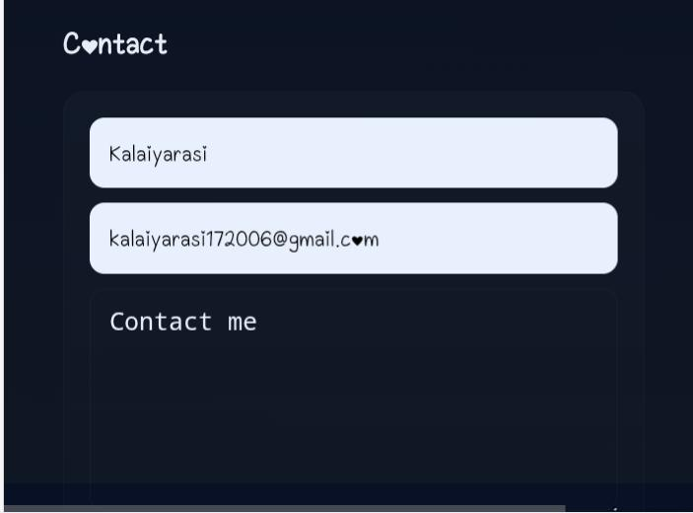

Slide 13
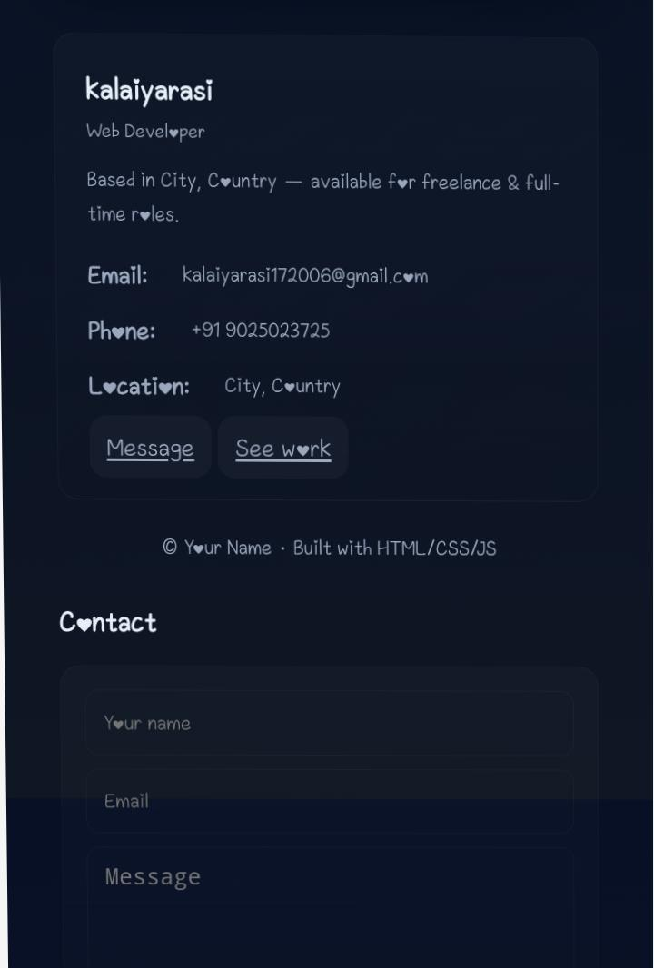

Slide 14
Conclusion
Web design = blend of creativity + technology A designer must combine aesthetic (design) with functionality (tech). Future: AI-powered websites, responsive layouts, and user-centered design will dominate.

