Slide 1
Opencampus
Course: From LLMs to AI Agent
Submitted By: Khushi Kala

Slide 2

Project Topic
An AI Game Agent
“Guesser D. Bot”

Slide 3
Main Idea
A “One Piece-themed” guessing game.
Think of a Character and the LLM will guess it.
LLM will ask you questions related to a One Piece’s character and you have to answer it according to your character.

Slide 4
Tech Stack
LangChain Framework
Facebook AI Similarity Search (FAISS) Vector Store
Gemini LLM: gemini-2.5-flash, gemini-2.5-pro, Ollama (Llama2-latest)
Google Embedding Model: gemini-embedding-001
Streamlit Interface
Beautiful Soup for Web Scraping
Website for data: https://onepiece.fandom.com/wiki

Slide 5
Demo
Think of a character…

Slide 6
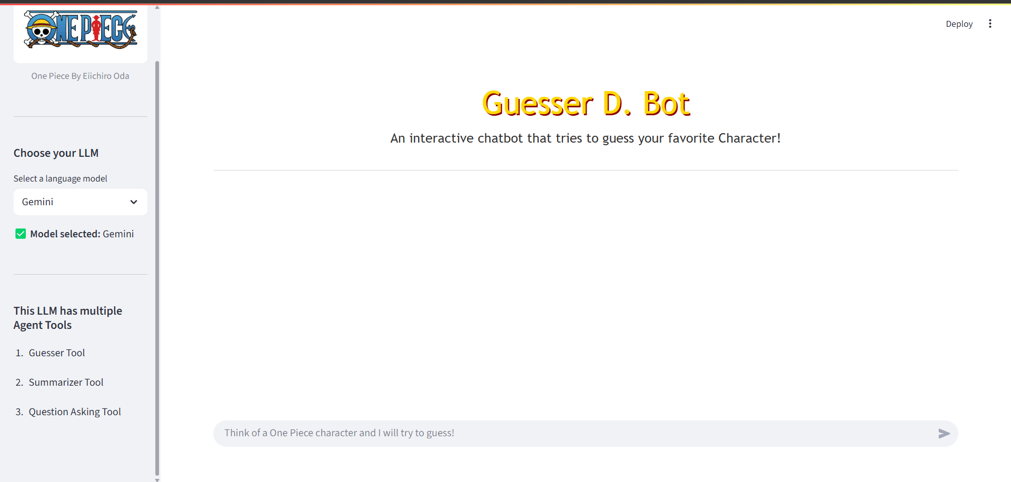
User Interface

Slide 7
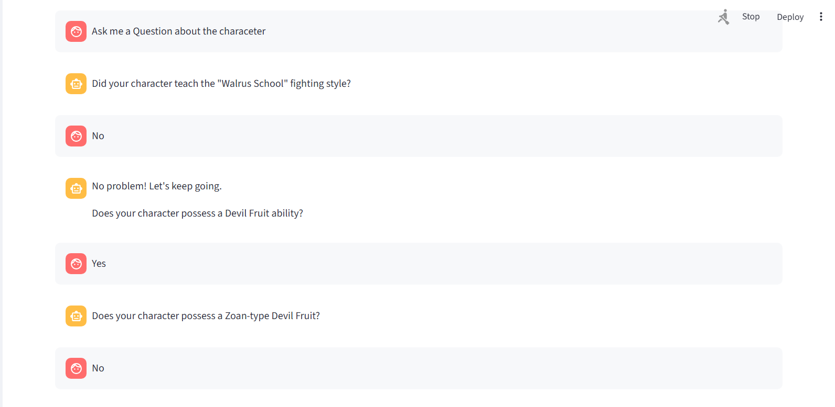
Trial : Guesser and Question Tool

Slide 8
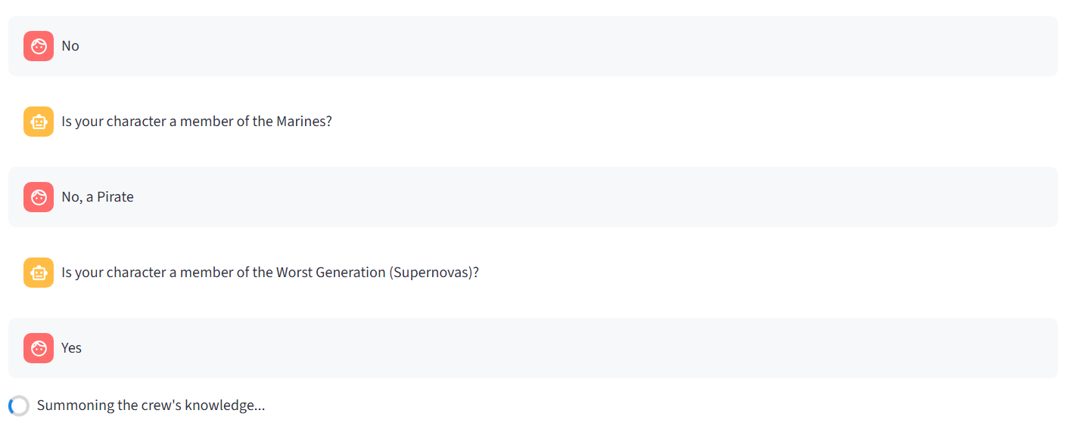
Continued

Slide 9
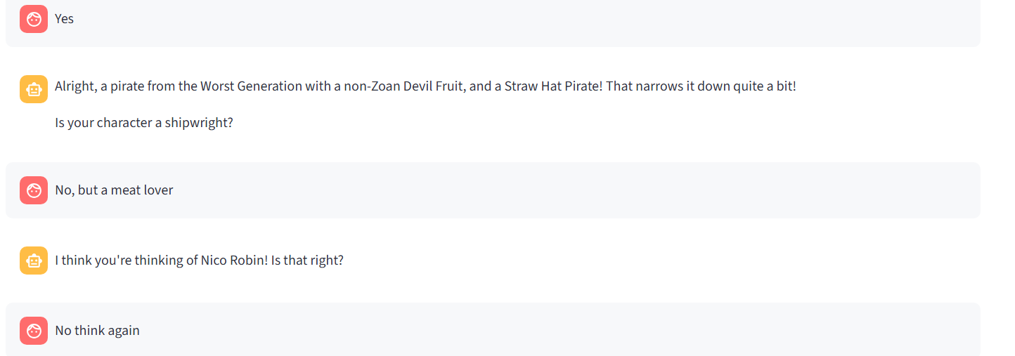
Continued

Slide 10
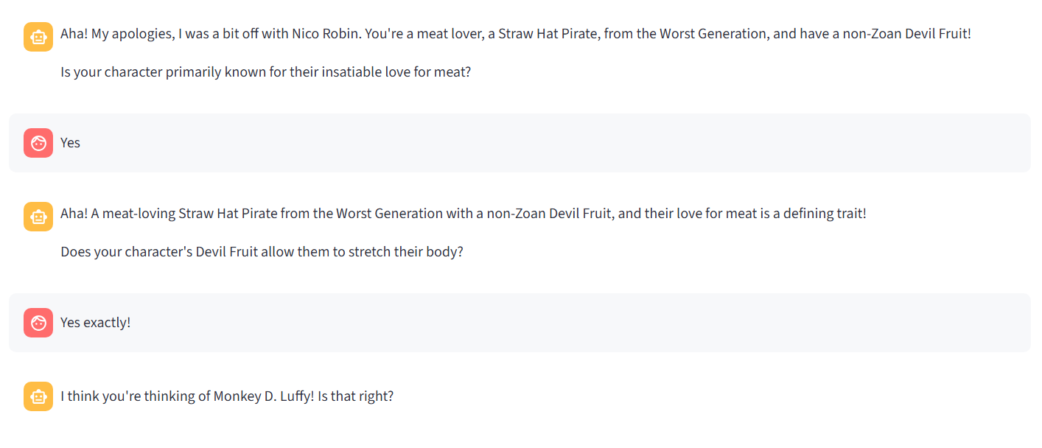
Continued

Slide 11
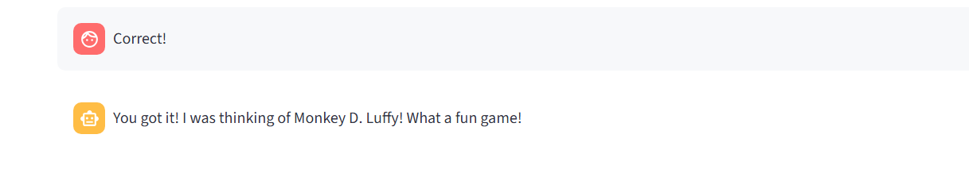
End of First Guess

Slide 12
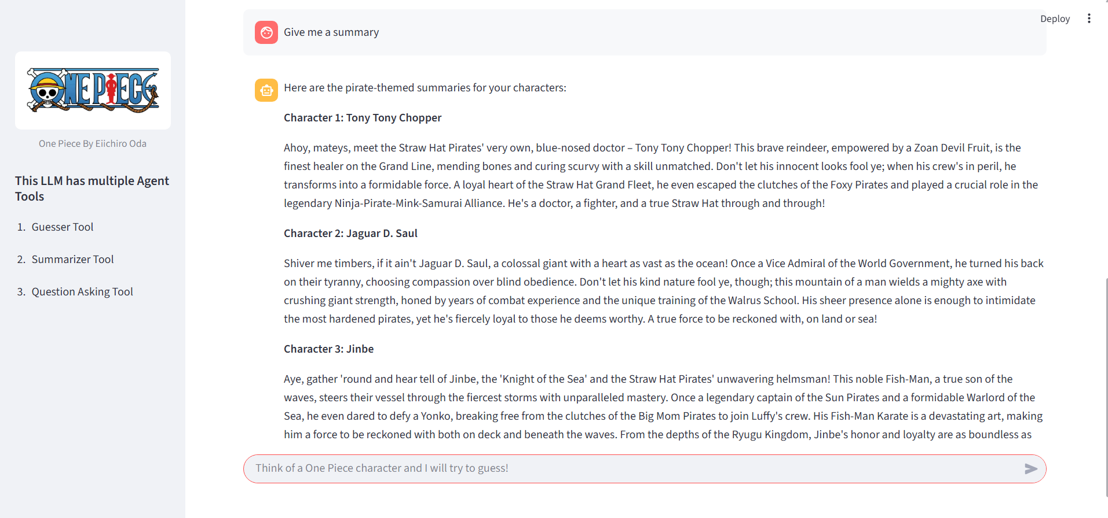
Summarizer Tool in a Pirate Way

Slide 13
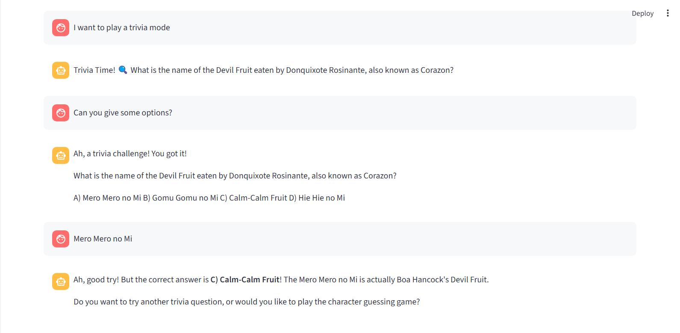
Trivia Tool

Slide 14
Challenges
LangGraph has also resulted in good results, but have to hold every case.
When data is increased then fetching the question is becoming difficulty due to history.
Json data has to be more clear and curated
Gemini Request Per day limit exceeded

Slide 15
Future Work
Including other anime universes and more creative questioning strategy handling.
Logically handling the questions asked in past (memory retention in LLM)

