Slide 1


Università degli Studi di Padova
Department of Information Engineering
Masters Degree in ICT for Internet and Multimedia
Master Degree in Computer Science Engineering
TREAT-IT
A Physician's complete directory ..

Slide 2
Università degli Studi di Padova
Department of Information Engineering
Masters Degree in ICT for Internet and Multimedia
Master Degree in Computer Science Engineering
Today’s Agenda
Introduction
Requirements analysis
Conceptual Design
Logical Design
Physical Design
JDBC
Demo

Slide 3
Università degli Studi di Padova
Department of Information Engineering
Masters Degree in ICT for Internet and Multimedia
Master Degree in Computer Science Engineering
Introduction
Physicians have a lot of clients who visit regularly and to maintain their results is a tiresome process.
One alternative way is to provide them an automated system,that takes care of complete automation of this tedious process.
This automation should make the data reliable to be shared with different divisions.
To make everything possible for every doctor, We present you TREAT IT.

Slide 4
Università degli Studi di Padova
Department of Information Engineering
Masters Degree in ICT for Internet and Multimedia
Master Degree in Computer Science Engineering
GOAL OF OUR PROJECT:
Doctors should be able to,
Manage prescriptions of medicines.
Patient history and personal data.
Received treatments and undertaken exams.
Every doctor should be able to freely access his/her own patients’ information and to share them with colleagues.

Slide 5
Università degli Studi di Padova
Department of Information Engineering
Masters Degree in ICT for Internet and Multimedia
Master Degree in Computer Science Engineering
Requirements of Doctors
● Allow doctors to insert, modify, query and delete data about patients
● Guarantee access to doctors just after they log in the system upon insertion of a personal password
● Patient records should contain: name, surname, fiscal Code, birth date and place of birth, telephone number, emails, ULSS, date of taking under care, vaccinations, allergies, diseases, hospitalizations, received prescriptions, prescription history, medical history, exemptions, certificates
● Manage submissions from different doctors on the same patient

Slide 6
Università degli Studi di Padova
Department of Information Engineering
Masters Degree in ICT for Internet and Multimedia
Master Degree in Computer Science Engineering
System Limitations
Be accessible from 1 up to 50 doctors
Easy to understand and to use
“RUN” on windows platform

Slide 7
Università degli Studi di Padova
Department of Information Engineering
Masters Degree in ICT for Internet and Multimedia
Master Degree in Computer Science Engineering
The protagonists of TREATIT
Doctor
Someone Providing medical care
Physician /Medic
Prescription, Certificate, Exemption etc..
Patient
Someone under medical care
Person
Doctor, Disease, Allergy, Medical history etc.
Medical History
Collection of data regarding past diseases and treatments
-
Patient

Slide 8
Università degli Studi di Padova
Department of Information Engineering
Masters Degree in ICT for Internet and Multimedia
Master Degree in Computer Science Engineering
Conceptual Design
ER schema construction and Functional Requirements check

Slide 9
Università degli Studi di Padova
Department of Information Engineering
Masters Degree in ICT for Internet and Multimedia
Master Degree in Computer Science Engineering
Transitioning to ER schema: requirements variation
Vaccination calls
Medical History details specification
Kinship information needed
Exam Results Date
Further external constraints specification

Slide 10
Università degli Studi di Padova
Department of Information Engineering
Masters Degree in ICT for Internet and Multimedia
Master Degree in Computer Science Engineering
The ER schema

Slide 11
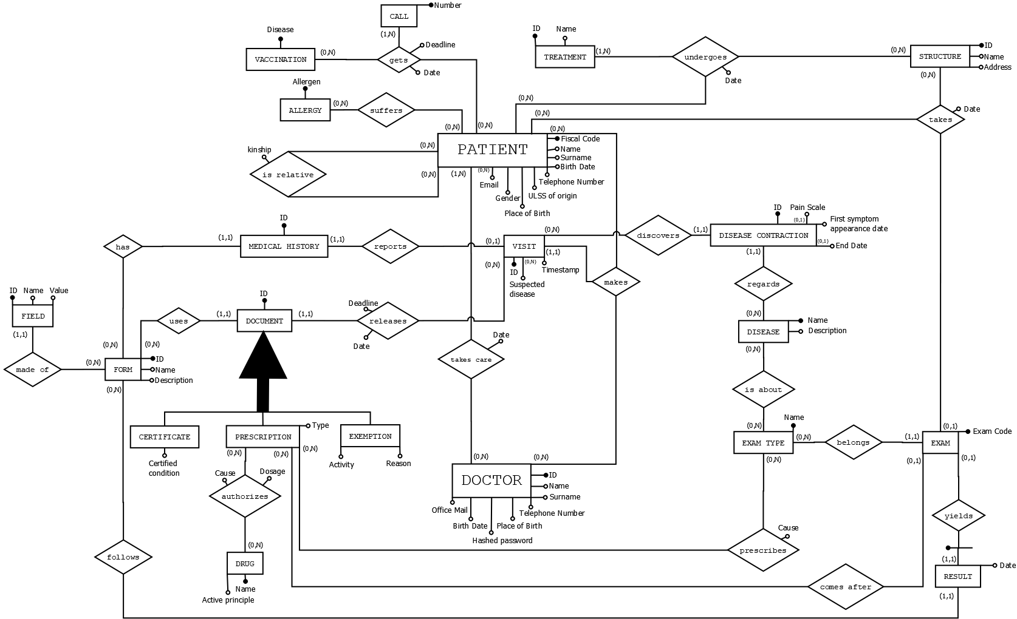

Slide 12
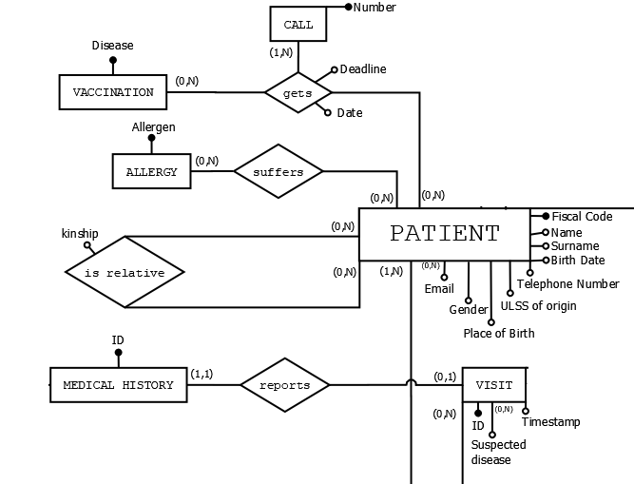
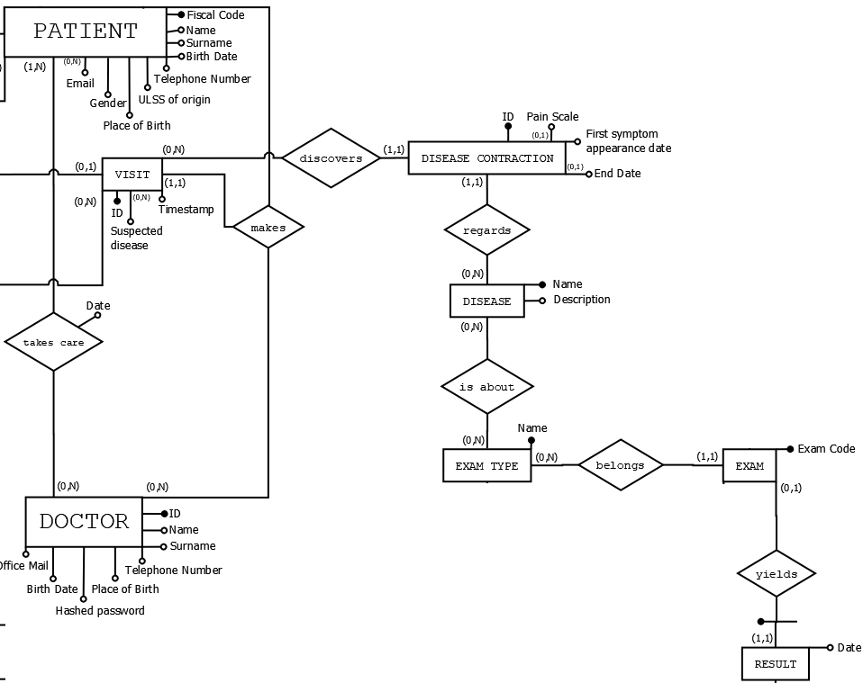
Università degli Studi di Padova
Department of Information Engineering
Masters Degree in ICT for Internet and Multimedia
Master Degree in Computer Science Engineering
ER schema, details

Slide 13
Università degli Studi di Padova
Department of Information Engineering
Masters Degree in ICT for Internet and Multimedia
Master Degree in Computer Science Engineering
Additional external constraints
Doctors must log in
Hospitalization information
Patient History as collection of information
Prescription History as collection of prescriptions (on Doctor side)

Slide 14
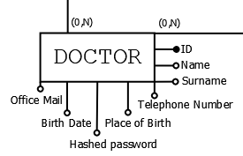
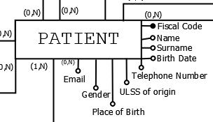
Università degli Studi di Padova
Department of Information Engineering
Masters Degree in ICT for Internet and Multimedia
Master Degree in Computer Science Engineering
Functional requirements check
Patient record fields
Information on doctors
Doctor personal password
Information about patients

Slide 15
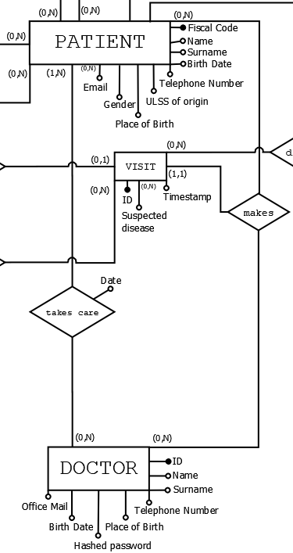
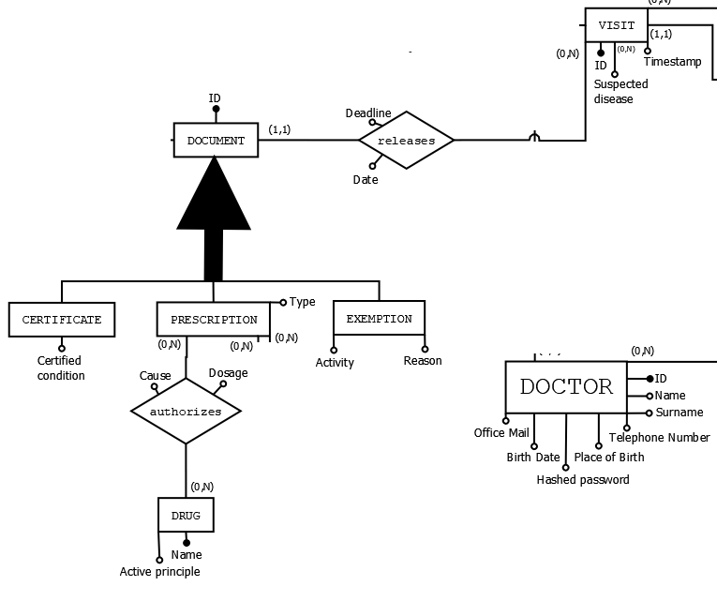
Università degli Studi di Padova
Department of Information Engineering
Masters Degree in ICT for Internet and Multimedia
Master Degree in Computer Science Engineering
Functional requirements check
Medical document creation
Patient-Doctor-Visit
Actions performed by Doctors

Slide 16
Logical Design
Università degli Studi di Padova
Department of Information Engineering
Masters Degree in ICT for Internet and Multimedia
Master Degree in Computer Science Engineering
A journey from the ER schema to the Relational schema

Slide 17
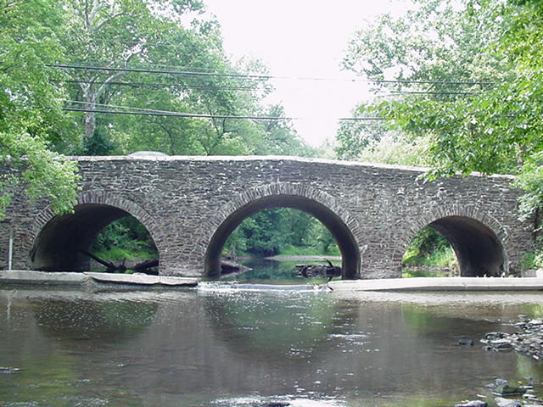
Università degli Studi di Padova
Department of Information Engineering
Masters Degree in ICT for Internet and Multimedia
Master Degree in Computer Science Engineering
ALL WE NEEDED WAS A BRIDGE:
NORMALIZATION’S QUALITY CHECK
ER SCHEMA
TRANSFORMATIONS
ER SCHEMA
MAPPING

Slide 18
Università degli Studi di Padova
Department of Information Engineering
Masters Degree in ICT for Internet and Multimedia
Master Degree in Computer Science Engineering
Redundancy Analysis:
No extensional or intentional redundancy detected
! A derived attribute was added for the sake of performance, as shown in the Load Analysis (documented redundancy)
Removal of two multivalued attributes
(i.e. email and suspected disease)
Removal of Generalization
by pushing everything in the subclasses
After these transformations, the data dictionary
of the ER schema was updated.
ER SCHEMA
TRANSFORMATIONS

Slide 19
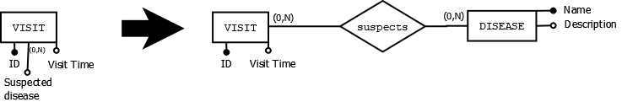
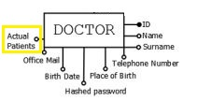
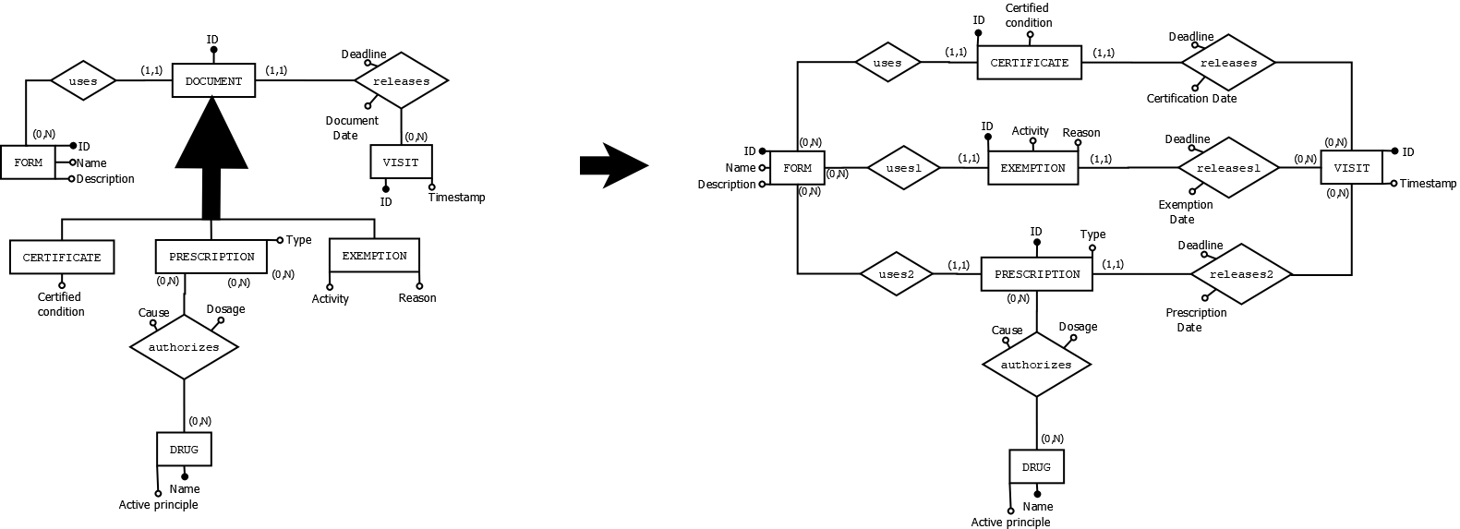
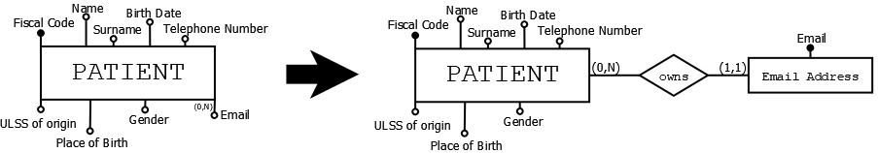
Università degli Studi di Padova
Department of Information Engineering
Masters Degree in ICT for Internet and Multimedia
Master Degree in Computer Science Engineering

Slide 20
Università degli Studi di Padova
Department of Information Engineering
Masters Degree in ICT for Internet and Multimedia
Master Degree in Computer Science Engineering
ER SCHEMA
MAPPING
The mapping was semi-automatic
After this mapping, our relational schema was born!
In order to document it properly, a new Data Dictionary was created.

Slide 21
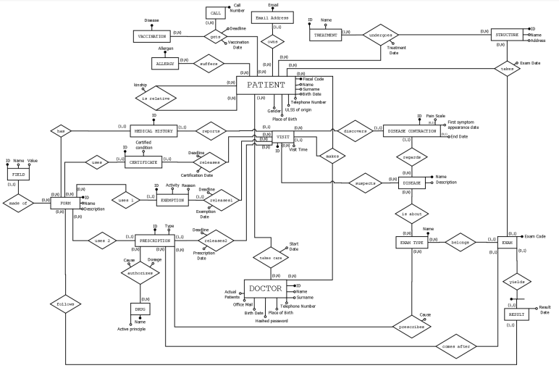
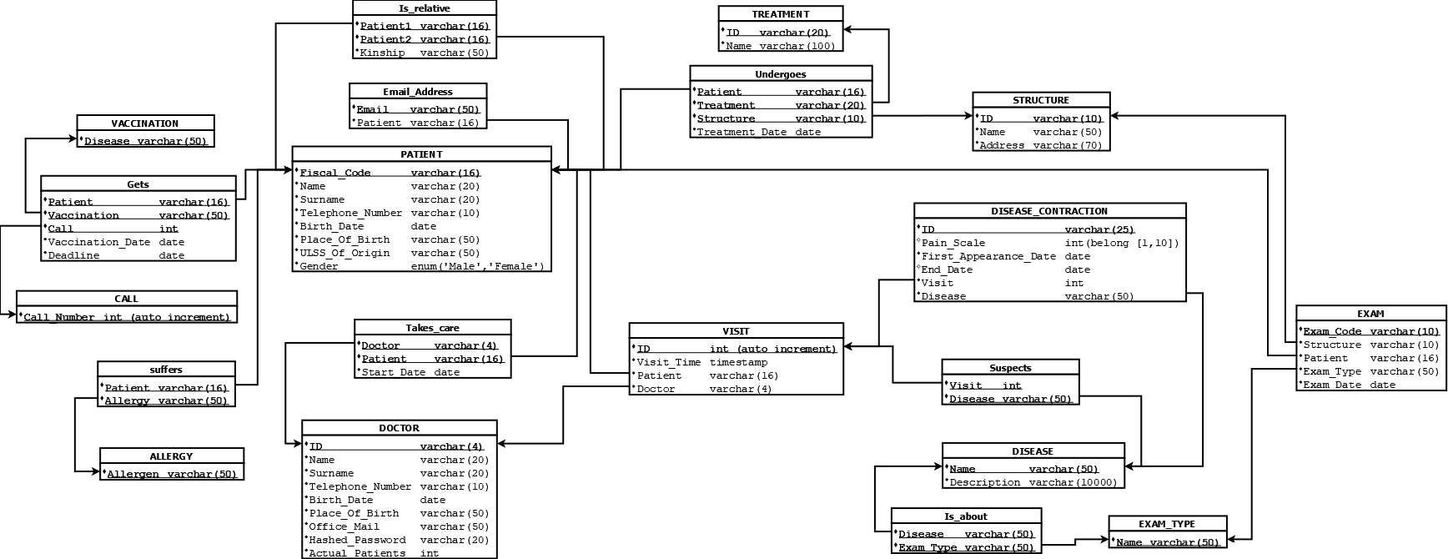
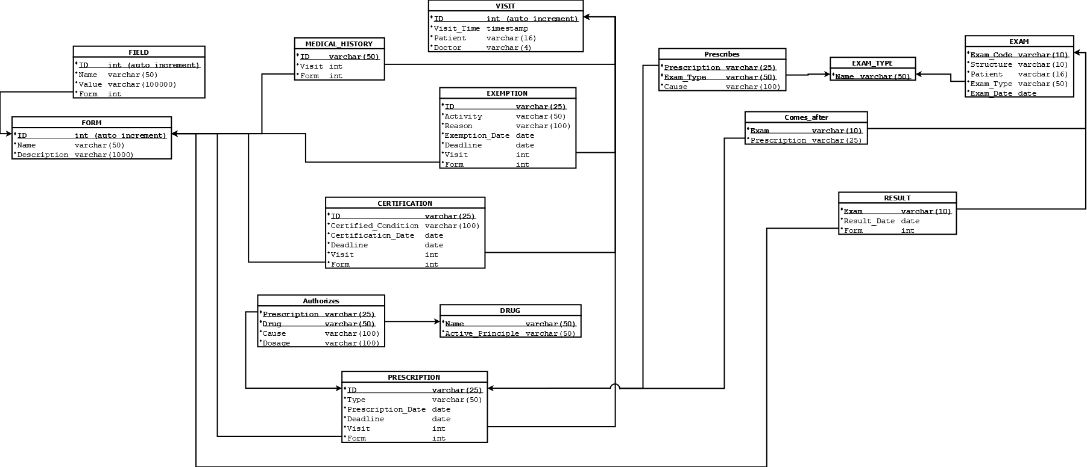
Università degli Studi di Padova
Department of Information Engineering
Masters Degree in ICT for Internet and Multimedia
Master Degree in Computer Science Engineering

Slide 22
Università degli Studi di Padova
Department of Information Engineering
Masters Degree in ICT for Internet and Multimedia
Master Degree in Computer Science Engineering
NORMALIZATION’S QUALITY CHECK
FIRST NORMAL FORM CHECK
No multivalued or composite attributes
BOYCE-CODD NORMAL FORM CHECK
In each non trivial functional dependency X→A, X is always a superkey, since in all our functional dependencies X is the primary key of that relation
SECOND AND THIRD NORMAL FORM CHECKS:
Implied by Boyce-Codd Normal Form check.

Slide 23

Università degli Studi di Padova
Department of Information Engineering
Masters Degree in ICT for Internet and Multimedia
Master Degree in Computer Science Engineering
. . . THE BRIDGE IS READY, LET’S MOVE TOWARDS THE PHYSICAL DESIGN!!
NORMALIZATION’S QUALITY CHECK
ER SCHEMA
TRANSFORMATION
ER SCHEMA
MAPPING

Slide 24
Physical Design
Università degli Studi di Padova
Department of Information Engineering
Masters Degree in ICT for Internet and Multimedia
Master Degree in Computer Science Engineering

Slide 25
Università degli Studi di Padova
Department of Information Engineering
Masters Degree in ICT for Internet and Multimedia
Master Degree in Computer Science Engineering
From relational schema to physical schema
Every table in the relational schema corresponds to a table creation in the physical schema
Every enumeration data type is mapped into the creation of a new enum type in SQL
We added a comment for every column of each table and also a general comment for the table itself

Slide 26
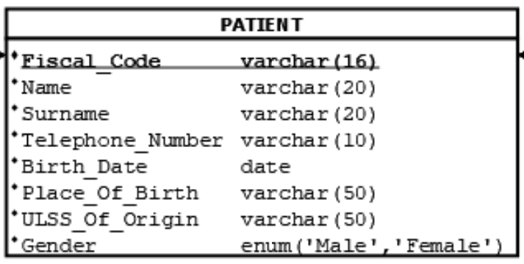
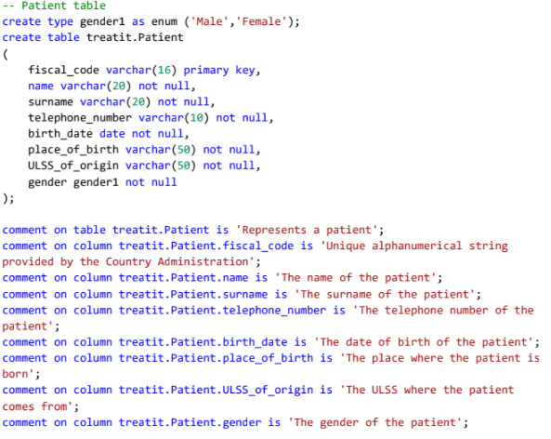
Università degli Studi di Padova
Department of Information Engineering
Masters Degree in ICT for Internet and Multimedia
Master Degree in Computer Science Engineering
From relational schema to physical schema
Patient table in relational schema
Patient table in physical schema

Slide 27
Università degli Studi di Padova
Department of Information Engineering
Masters Degree in ICT for Internet and Multimedia
Master Degree in Computer Science Engineering
Procedure Functions and triggers
Two procedure functions are implemented:
Incrementing the number of actual patients of a doctor.
Decrementing the number of actual patients of a doctor.
Then two triggers are created in order to manage the two procedure functions:
For calling the incrementing function.
For calling the decremented function.

Slide 28
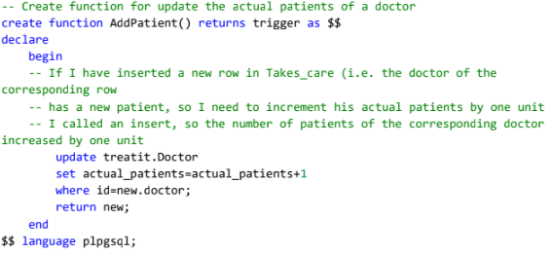

Università degli Studi di Padova
Department of Information Engineering
Masters Degree in ICT for Internet and Multimedia
Master Degree in Computer Science Engineering
Procedure Functions and triggers
Trigger for calling the incrementing function
Incrementing procedure function

Slide 29



Università degli Studi di Padova
Department of Information Engineering
Masters Degree in ICT for Internet and Multimedia
Master Degree in Computer Science Engineering
Database Population
We created an SQL file where we put all the code for the population of the database

Slide 30
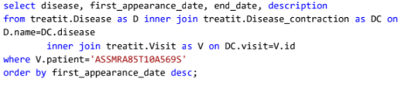
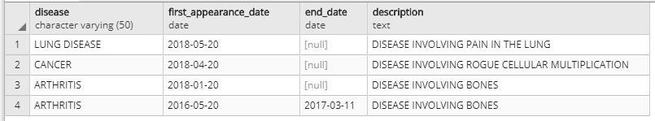
Università degli Studi di Padova
Department of Information Engineering
Masters Degree in ICT for Internet and Multimedia
Master Degree in Computer Science Engineering
Query the database
For testing the database we did some queries on it after the population of the database
Query for retrieving the diseases contracted by a patient
Result of the query

Slide 31
Università degli Studi di Padova
Department of Information Engineering
Masters Degree in ICT for Internet and Multimedia
Master Degree in Computer Science Engineering
HOW ARE WE ACCESSING THE DATABASE ?

Slide 32
Università degli Studi di Padova
Department Information of Engineering
Masters Degree in ICT for Internet and Multimedia
Master Degree in Computer Science Engineering
JDBC …
Back to basics of 4 steps …
Set Preliminaries
Get Connections
Execute Queries
Output Results

Slide 33
Università degli Studi di Padova
Department of Information Engineering
Masters Degree in ICT for Internet and Multimedia
Master Degree in Computer Science Engineering
Preliminary properties
Protocol, Driver, Server, Database
setUrl("jdbc:postgresql://localhost/dbms17”);
Respective drivers
setDriverClassName("org.postgresql.Driver");
User ID
setUsername("leoforfriendsdb");
Password
setPassword("dbmshome");

Slide 34
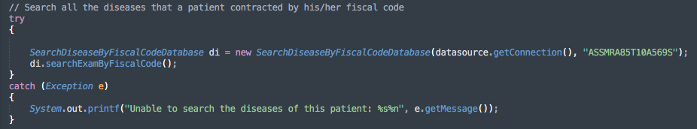
Università degli Studi di Padova
Department of Information Engineering
Masters Degree in ICT for Internet and Multimedia
Master Degree in Computer Science Engineering
Necessary operations

Slide 35
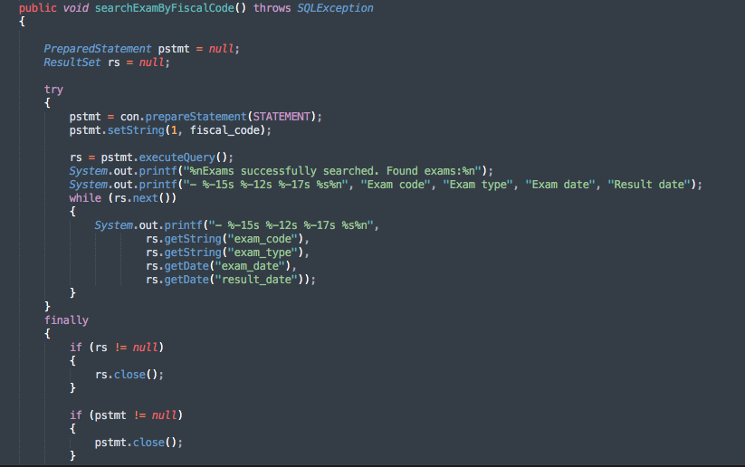
Università degli Studi di Padova
Department of Information Engineering
Masters in ICT for Internet and Multimedia
Necessary operations
20/06/2018

Slide 36
THANK YOU & I Expect Questions…

