Slide 1
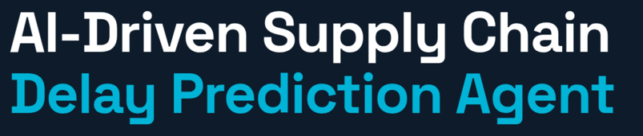
CS336 – AIML
Predicting logistics delays and recommending actions using ML
Pratyush Munda (Btech/10600/23) | Urvil Kalal (Btech/10767/23)
github.com/PratyushMunda/AIML-Project-
CSE (C)

Slide 2


Introduction & Applications 02
PROBLEM UNDERSTANDING
WHERE IT'S USED
–
Delays detected only after occurrence — reactive approach
E-Commerce
–
No system to flag high-risk orders before dispatch
Reroute at-risk shipments before dispatch
–
Manual tracking across 7 suppliers not scalable
Manufacturing
Protect JIT inventory from supplier delays
Our Solution
Predict delay probability per order and prescribe corrective action — automatically
Healthcare
Ensure critical supplies never miss delivery
Approach
Binary classification using Random Forest on 750 historical orders
Retail & FMCG
Prevent stockouts during peak demand periods

Slide 3
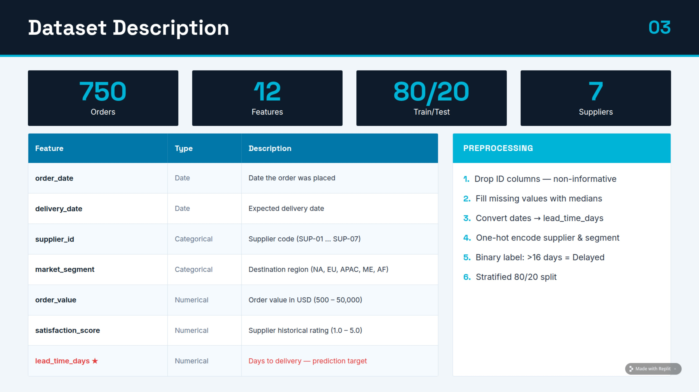


Slide 4

Model Architecture & Working
Input Layer
Feature Eng.
Random Forest
Risk Score
Action Engine
order_value
supplier_id
market_segment
satisfaction_score
lead_time_days
One-hot encode
Date → interval
Binary label
80/20 split
200 trees
max_depth = 10
Majority vote
scikit-learn
Prob. 0–1
High > 0.70
Medium 0.40–0.70
Low < 0.40
P1 Expedite
P2 Monitor
P3 No action
Output CSV
→
→
→
→
WHY RANDOM FOREST?
TOP FEATURE IMPORTANCE
–
Handles mixed features (numerical + categorical) without scaling
lead_time_days
0.72
–
Robust to outliers in order value and lead time
order_value
0.45
–
Built-in feature importance — transparent and explainable
supplier_id
0.30
–
Outperformed Linear Regression and SVR on this dataset
market_segment
0.18

Slide 5
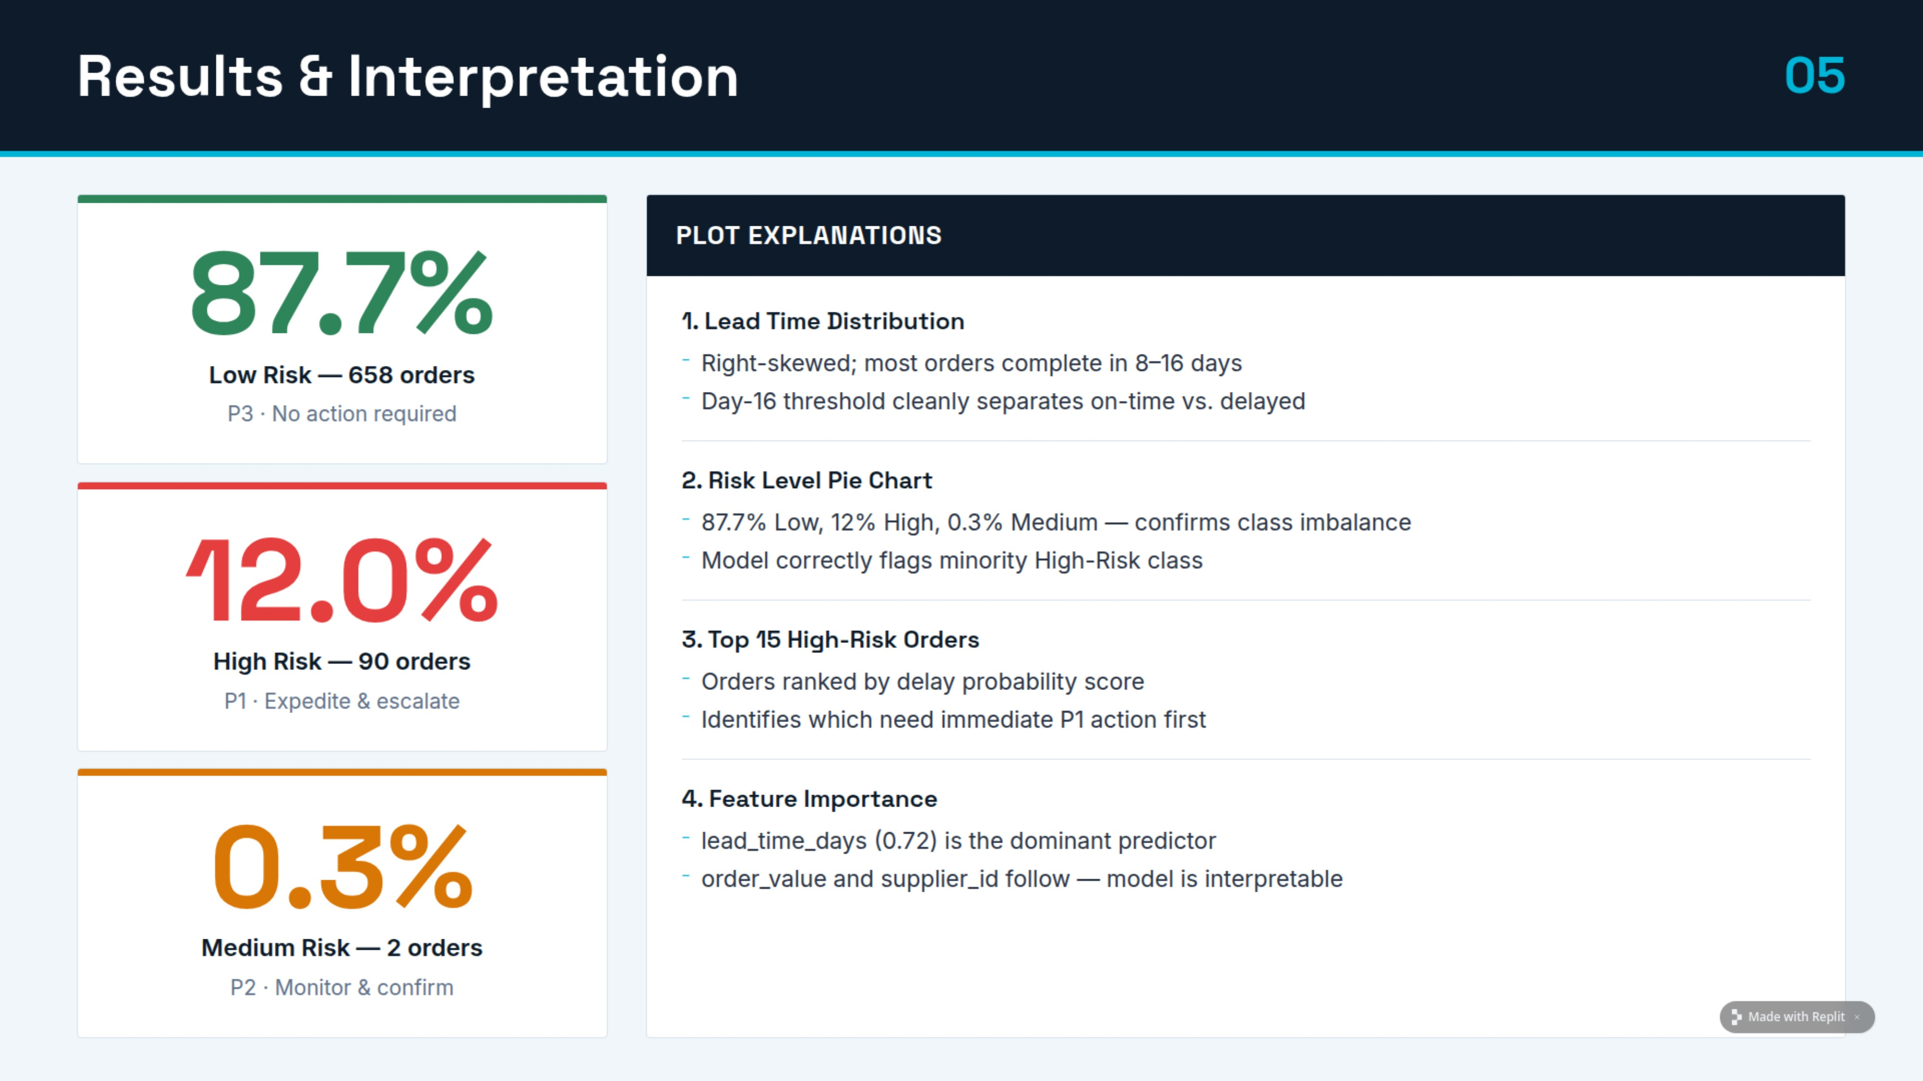

Slide 6



Ethics, Social Benefits & Demo
DEMO — GITHUB LINK
ETHICAL POINTS
–
No personal data — transactional features only
–
Transparent model — feature importance visible
github.com/PratyushMunda/AIML-Project-
–
75th percentile threshold — objective, bias-free
1
Clone repo; install pandas, scikit-learn, matplotlib
–
2
3
Outputs: risk_scored_orders.csv · action_recommendations.csv
4
Call predict_order_risk() to score any new order
SOCIAL BENEFITS & CONCLUSIONS
–
Reduces wasted logistics resources
–
Improves delivery reliability for consumers
–
CS336 AIML · Pratyush Munda (Btech/10600/23) & Urvil Kalal (Btech/10767/23) · CSE (C)

