Slide 1

Multiprocessor Architecture Basics
Companion slides for
The Art of Multiprocessor Programming
by Maurice Herlihy & Nir Shavit
Notes:
© 2003 Herlihy and Shavit

Slide 2
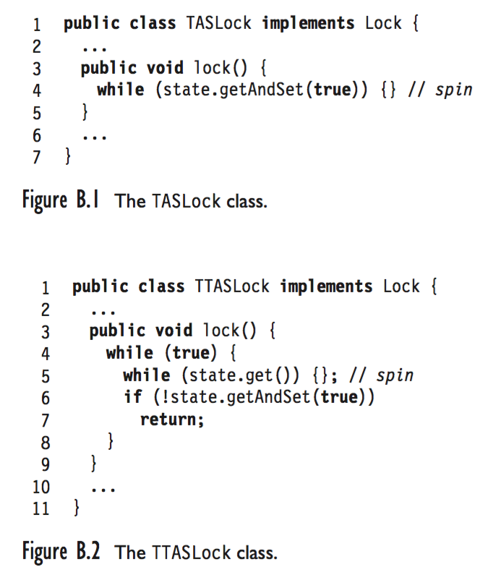
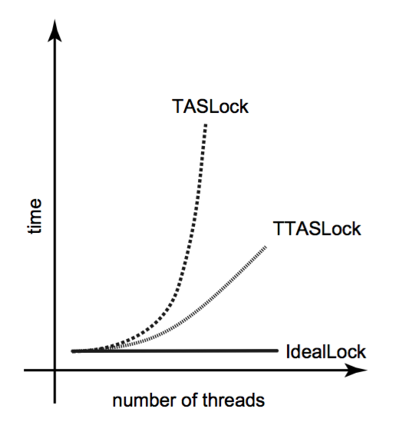
Art of Multiprocessor Programming

Slide 3
Multiprocessor Architecture
Abstract models are (mostly) OK to understand algorithm correctness and progress
To understand how concurrent algorithms actually perform
You need to understand something about multiprocessor architectures
Art of Multiprocessor Programming
Notes:
© 2003 Herlihy and Shavit
We look at how multiprocessor hardware architecture affects the design of efficient concurrent data structures and algorithms. We identify basic components, describe what they do, how they interact, and why some activities that appear fast and simple may sometimes be slow and complex. Mulitprocessors present a nice, simple high-level abstraction:
processors read and write values from a shared memory. Unfortunately, this high-level abstraction can be misleading when trying to understand how concurrent algorithms and data.
structures perform in practice.
Instead, understanding performance requires understanding some of the basic
mechanisms residing ``under the hood'' of modern multiprocessor architectures.

Slide 4
Pieces
Processors
Threads
Interconnect
Memory
Caches
Art of Multiprocessor Programming
Notes:
© 2003 Herlihy and Shavit

Slide 5
Multicore Architecture
cache
cache
cache
cache
Bus
Bus
memory
Art of Multiprocessor Programming
Notes:
© 2003 Herlihy and Shavit
Multicore architectures put multiple processors on a single chop.

Slide 6
Multicore
All Processors on same chip
Processors share on chip memory resources
Communication between processors now very fast
Art of Multiprocessor Programming
Notes:
© 2003 Herlihy and Shavit
The important issue about multicore architectures, however,

Slide 7
SMP vs NUMA
memory
SMP
NUMA
SMP: symmetric multiprocessor
NUMA: non-uniform memory access
CC-NUMA: cache-coherent …
Art of Multiprocessor Programming
(1)
Notes:
© 2003 Herlihy and Shavit
In an SMP architecture, both processors and memory hang off a bus. This works well for small-scale systems. In a NUMA (non-uniform memory access) architecture, each processor has its own piece of the memory. Accessing your own memory is relatively fast, and accessing someone else’s is slower. Usually NUMA machines also have caches, in which case they are called CC-NUMA machines, for cache-coherent NUMA.

Slide 8
Future Multicores
Short term: SMP
Long Term: most likely a combination of SMP and NUMA properties
Art of Multiprocessor Programming
Notes:
© 2003 Herlihy and Shavit
The important issue about multicore architectures, however,

Slide 9
Understanding the Pieces
Lets try to understand what the pieces that make the multiprocessor machine are
And how they fit together
Art of Multiprocessor Programming
Notes:
© 2003 Herlihy and Shavit

Slide 10
Processors
Cycle:
  Fetch and execute one instruction
Cycle times change
  1980: 10 million cycles/sec
  2005: 3,000 million cycles/sec
Art of Multiprocessor Programming
Notes:
© 2003 Herlihy and Shavit
When discussing multiprocessor architectures, the basic unit of time is the cycle: the time it takes a processor to fetch and execute a single instruction. In absolute terms, cycle times change as technology advances (from about 10 million cycles per second in 1980 to about 3,000 million in 2005), and they vary from one platform to another
(Processors that control toasters have longer cycles than processors that control web servers). Nevertheless, the relative cost of operations such as memory access changes slowly when expressed in terms of cycles.

Slide 11
Computer Architecture
Measure time in cycles
  Absolute cycle times change
Memory access: ~100s of cycles
  Changes slowly
  Mostly gets worse
Art of Multiprocessor Programming
Notes:
© 2003 Herlihy and Shavit
We measure memory access times in cycles, not absolute time. Because memory access times

Slide 12
Threads
Execution of a sequential program
Software, not hardware
A processor can run a thread
Put it aside
  Thread does I/O
  Thread runs out of time
Run another thread
Art of Multiprocessor Programming
Notes:
© 2003 Herlihy and Shavit
A thread is a sequential program. While a processor is a hardware device, a thread is a software construct. A processor can run a thread for a while and then set it aside and run another thread. A processor may set aside a thread for a variety of reasons. Perhaps the thread has issued a memory request that will take some time to satisfy, or perhaps that thread has simply run long enough, and it is time for another thread to make progress. When a thread is suspended, it may resume execution on another processor.

Slide 13
Analogy
You work in an office
When you leave for lunch, someone else takes over your office.
If you don’t take a break, a security guard shows up and escorts you to the cafeteria.
When you return, you may get a different office
Art of Multiprocessor Programming
Notes:
© 2003 Herlihy and Shavit
By analogy, you (a thread) are working in an office (a processor). Whenever you step out to eat lunch or mail a letter, someone else moves in and uses your office while you are gone. Every now and then a security guard forcibly escorts you to the cafeteria or
bathroom so someone else can have a chance to use your office. When you return, you may be put in a different office.

Slide 14
Interconnect
Bus
  Like a tiny Ethernet
  Broadcast medium
  Connects
    Processors to memory
    Processors to processors
Network
  Tiny LAN
  Mostly used on
  large machines
memory
SMP
Art of Multiprocessor Programming
Notes:
© 2003 Herlihy and Shavit
Multirprocessors rely on some kind of interconnect. Usually processors and memory are connected by a bus, which you can think of as a tiny Ethernet. It is a broadcast medium: if one processor sends a message, all the processors and the memory can receive it. Larger machines use a network in which packets are sent point-to-point, like a small local area netowrk.

Slide 15
Interconnect
Interconnect is a finite resource
Processors can be delayed if others are consuming too much
Avoid algorithms that use too much bandwidth
Art of Multiprocessor Programming
Notes:
© 2003 Herlihy and Shavit
When you are designing a concurrent algorithm or data structure, you don’t need to know the details of how the interconnect works. All you need to know is that interconnect bandwidth is a finite resource, and if your algorithm causes a lot of traffic, it won’t perform very well.

Slide 16

Processor and Memory are Far Apart
memory
interconnect
processor
Art of Multiprocessor Programming
Notes:
© 2003 Herlihy and Shavit
From our point of view, one architectural principle drives everything else: processors and memory are far apart.

Slide 17
Reading from Memory
address
Art of Multiprocessor Programming
Notes:
© 2003 Herlihy and Shavit
It takes a long time for a processor to read a value from memory. It has to send the address to the memory …

Slide 18
Reading from Memory
zzz…
Art of Multiprocessor Programming
Notes:
© 2003 Herlihy and Shavit
Wait for the message to be delivered …

Slide 19
Reading from Memory
value
Art of Multiprocessor Programming
Notes:
© 2003 Herlihy and Shavit
And wait or the response to come back.

Slide 20
Writing to Memory
address, value
Art of Multiprocessor Programming
Notes:
© 2003 Herlihy and Shavit
Writing is similar, except you send the address and the new value, …

Slide 21
Writing to Memory
zzz…
Art of Multiprocessor Programming
Notes:
© 2003 Herlihy and Shavit
Wait …

Slide 22
Writing to Memory
ack
Art of Multiprocessor Programming
Notes:
© 2003 Herlihy and Shavit
And then get an acknowledgement that the new value was actually installed in the memory.

Slide 23
Cache: Reading from Memory
address
cache
Art of Multiprocessor Programming
Notes:
© 2003 Herlihy and Shavit
We alleviate this problem by introducing one or more caches: small, fast memories situated between main memory and processors.

Slide 24
Cache: Reading from Memory
cache
Art of Multiprocessor Programming
Notes:
© 2003 Herlihy and Shavit
Now, when a processor reads a value from memory, it stores the data in the cache before returning the data to the processor.

Slide 25
Cache: Reading from Memory
cache
Art of Multiprocessor Programming
Notes:
© 2003 Herlihy and Shavit
Later, if the processor wants to use the same data …

Slide 26
Cache Hit
?
cache
Art of Multiprocessor Programming
Notes:
© 2003 Herlihy and Shavit
When a processor wants to read a value, it first checks whether the data is present in the cache …

Slide 27
Cache Hit
Yes!
cache
Art of Multiprocessor Programming
Notes:
© 2003 Herlihy and Shavit
If so, it reads directly from the cache, saving a long round-trip to main memory. We call this a cache hit.

Slide 28
Cache Miss
address
?
No…
cache
Art of Multiprocessor Programming
Notes:
© 2003 Herlihy and Shavit
Sometimes the processor doesn’t find what it is lookin for in the cache.

Slide 29
Cache Miss
cache
Art of Multiprocessor Programming
Notes:
© 2003 Herlihy and Shavit
We call this a cache miss.

Slide 30
Cache Miss
cache
Art of Multiprocessor Programming
Notes:
© 2003 Herlihy and Shavit

Slide 31
Local Spinning
With caches, spinning becomes practical
First time
  Load flag bit into cache
As long as it doesn’t change
  Hit in cache (no interconnect used)
When it changes
  One-time cost
  See cache coherence below
Art of Multiprocessor Programming
Notes:
© 2003 Herlihy and Shavit
We will discuss the ideas in this slide when talking about spin-locks

Slide 32
Granularity
Caches operate at a larger granularity than a word
Cache line: fixed-size block containing the address (today 64 or 128 bytes)
Art of Multiprocessor Programming
Notes:
© 2003 Herlihy and Shavit
caches typically operate at a granularity larger than a single word: a cache holds a group of neighboring words called a cache line. (sometimes called a cache block).

Slide 33
Locality
If you use an address now, you will probably use it again soon
  Fetch from cache, not memory
If you use an address now, you will probably use a nearby address soon
  In the same cache line
Art of Multiprocessor Programming
Notes:
© 2003 Herlihy and Shavit

Slide 34
Hit Ratio
Proportion of requests that hit in the cache
Measure of effectiveness of caching mechanism
Depends on locality of application
Art of Multiprocessor Programming
Notes:
© 2003 Herlihy and Shavit

Slide 35
L1 and L2 Caches
L2
L1
Art of Multiprocessor Programming
Notes:
© 2003 Herlihy and Shavit
In practice, most processors have two levels of caches, called the L1 and L2 caches.

Slide 36
L1 and L2 Caches
L2
Small & fast
1 or 2 cycles
L1
Art of Multiprocessor Programming
Notes:
© 2003 Herlihy and Shavit
The L1 cache typically resides on the same chip as the processor, and takes one or two cycles to access.

Slide 37
L1 and L2 Caches
Larger and slower
10s of cycles
~128 byte line
L2
L1
Art of Multiprocessor Programming
Notes:
© 2003 Herlihy and Shavit
The L2 cache often resides off-chip, and takes tens of cycles to access. Of course, these times vary from platform to platform, and many multiprocessors have even more elaborate cache structures.

Slide 38
When a Cache Becomes Full…
Need to make room for new entry
By evicting an existing entry
Need a replacement policy
  Usually some kind of least recently used heuristic
Art of Multiprocessor Programming
Notes:
© 2003 Herlihy and Shavit
When a cache becomes full, it is necessary to evict a line, discarding it if it has not been modified, and writing it back to memory if it has. A replacement policy determines which cache line to replace. Most replacement policies try to evict the least recently used line.

Slide 39
Fully Associative Cache
Any line can be anywhere in the cache
  Advantage: can replace any line
  Disadvantage: hard to find lines
Art of Multiprocessor Programming
Notes:
© 2003 Herlihy and Shavit

Slide 40
Direct Mapped Cache
Every address has exactly 1 slot
  Advantage: easy to find a line
  Disadvantage: must replace fixed line
Art of Multiprocessor Programming
Notes:
© 2003 Herlihy and Shavit

Slide 41
K-way Set Associative Cache
Each slot holds k lines
  Advantage: pretty easy to find a line
  Advantage: some choice in replacing line
Art of Multiprocessor Programming
Notes:
© 2003 Herlihy and Shavit

Slide 42
Multicore Set Associativity
k is 8 or even 16 and growing…
  Why? Because cores share sets
  Threads cut effective size if accessing different data
Art of Multiprocessor Programming
Notes:
© 2003 Herlihy and Shavit

Slide 43
Cache Coherence
A and B both cache address x
A writes to x
  Updates cache
How does B find out?
Many cache coherence protocols in literature
Art of Multiprocessor Programming
Notes:
© 2003 Herlihy and Shavit

Slide 44
MESI
Modified
  Have modified cached data, must write back to memory
Exclusive
  Not modified, I have only copy
Shared
  Not modified, may be cached elsewhere
Invalid
  Cache contents not meaningful
Art of Multiprocessor Programming
Notes:
© 2003 Herlihy and Shavit
Finally, the cache line may be invalid, meaning that the cached value is no longer meaningful (perhaps because some other processor updated it).

Slide 45
Processor Issues Load Request
load x
cache
cache
cache
Bus
Bus
memory
data
Art of Multiprocessor Programming
Notes:
© 2003 Herlihy and Shavit

Slide 46
Memory Responds
E
cache
cache
cache
Bus
Bus
Got it!
memory
data
data
Art of Multiprocessor Programming
Notes:
© 2003 Herlihy and Shavit
When a processor loads a data value x, it broadcasts the request on the bus. The memory controller picks up the message and sends the data back. The processor marks the cache line as exclusive.

Slide 47
Processor Issues Load Request
Load x
E
data
cache
cache
Bus
Bus
memory
data
Art of Multiprocessor Programming
Notes:
© 2003 Herlihy and Shavit
Now a second processor wants to load the same address, so it broadcasts a request.

Slide 48
Other Processor Responds
Got it
S
S
E
data
data
cache
cache
Bus
Bus
memory
data
Art of Multiprocessor Programming
Notes:
© 2003 Herlihy and Shavit
When the second processor asks for x, the first one, who is snooping on the bus, responds with the data. (It can respond faster than the memory). Both processors mark that cache line as shared.

Slide 49
Modify Cached Data
S
S
data
data
data
cache
Bus
memory
data
Art of Multiprocessor Programming
Notes:
© 2003 Herlihy and Shavit

Slide 50
Write-Through Cache
Write x!
S
S
data
data
cache
data
data
Bus
Bus
memory
data
Art of Multiprocessor Programming
Notes:
© 2003 Herlihy and Shavit

Slide 51
Write-Through Caches
Immediately broadcast changes
Good
  Memory, caches always agree
  More read hits, maybe
Bad
  Bus traffic on all writes
  Most writes to unshared data
  For example, loop indexes …
Art of Multiprocessor Programming
Notes:
© 2003 Herlihy and Shavit

Slide 52
Write-Through Caches
Immediately broadcast changes
Good
  Memory, caches always agree
  More read hits, maybe
Bad
  Bus traffic on all writes
  Most writes to unshared data
  For example, loop indexes …
“show stoppers”
Art of Multiprocessor Programming
Notes:
© 2003 Herlihy and Shavit

Slide 53
Write-Back Caches
Accumulate changes in cache
Write back when line evicted
  Need the cache for something else
  Another processor wants it
Art of Multiprocessor Programming
Notes:
© 2003 Herlihy and Shavit

Slide 54
Invalidate
Invalidate x
S
S
M
I
data
data
cache
cache
Bus
Bus
memory
data
Art of Multiprocessor Programming
Notes:
© 2003 Herlihy and Shavit

Slide 55
Caution
Sometimes the compiler reorders memory operations
Can improve
  cache performance
  interconnect use
But unexpected concurrent interactions
Art of Multiprocessor Programming
Notes:
© 2003 Herlihy and Shavit

Slide 56
Write Buffers
address
Absorbing
Batching
Art of Multiprocessor Programming
Notes:
© 2003 Herlihy and Shavit
Many processors have write buffers. When a processor issues a write, it isn’t necessarily sent to memory right away. Instead it may be queued up in a write (or store) buffer. If the processor writes twice to the same location, the earlier write can be absorbed, that is, overwritten without

Slide 57
Volatile
In Java, if a variable is declared volatile, operations won’t be reordered
Write buffer always spilled to memory before thread is allowed to continue a write
Expensive, so use it only when needed
Art of Multiprocessor Programming
Notes:
© 2003 Herlihy and Shavit

Slide 58
Art of Multiprocessor Programming

Slide 59
This work is licensed under a Creative Commons Attribution-ShareAlike 2.5 License.
You are free:
  to Share — to copy, distribute and transmit the work
  to Remix — to adapt the work
Under the following conditions:
  Attribution. You must attribute the work to “The Art of Multiprocessor Programming” (but not in any way that suggests that the authors endorse you or your use of the work).
  Share Alike. If you alter, transform, or build upon this work, you may distribute the resulting work only under the same, similar or a compatible license.
For any reuse or distribution, you must make clear to others the license terms of this work. The best way to do this is with a link to
  http://creativecommons.org/licenses/by-sa/3.0/.
Any of the above conditions can be waived if you get permission from the copyright holder.
Nothing in this license impairs or restricts the author's moral rights.
Art of Multiprocessor Programming
Notes:
© 2003 Herlihy and Shavit

