Slide 1

Hashing and Natural Parallism
Companion slides for
The Art of Multiprocessor Programming
by Maurice Herlihy & Nir Shavit

Slide 2
Sequential Closed Hash Map
0
16
buckets
1
9
2
3
2 Items
h(k) = k mod 4
Art of Multiprocessor Programming
Notes:
What’s an extensible hash table? We’re looking at closed addressing table. Here’s the most popular implementation. The table is implemented as an array of buckets, each pointing to a constant size list of elements. Where the number of buckets is a power of two, and the hash function maps an item to the respective bucket of key modulo size.
Seven is inserted to bucket 3,…
As items are added, the total itemcount increases, and when it passes a certain threshold the table is extended.

Slide 3
Add an Item
0
16
1
9
2
3
7
3 Items
h(k) = k mod 4
Art of Multiprocessor Programming

Slide 4
Add Another: Collision
0
16
4
1
9
2
3
7
4 Items
h(k) = k mod 4
Art of Multiprocessor Programming

Slide 5
More Collisions
0
16
4
1
9
2
3
7
15
5 Items
h(k) = k mod 4
Art of Multiprocessor Programming

Slide 6
More Collisions
0
16
4
1
9
2
3
7
15
5 Items
Problem:
buckets getting too long
h(k) = k mod 4
Art of Multiprocessor Programming

Slide 7
Resizing
0
16
4
1
9
2
3
7
15
4
5 Items
5
h(k) = k mod 8
6
7
Grow the array
Art of Multiprocessor Programming
Notes:
To extend the table one allocates a new bucket array and redistributes the items using the new hash function, which now uses the new size.

Slide 8
Resizing
0
16
4
1
9
Adjust hash function
2
3
7
15
4
5 Items
5
h(k) = k mod 8
6
7
Art of Multiprocessor Programming
Notes:
To extend the table one allocates a new bucket array and redistributes the items using the new hash function, which now uses the new size.

Slide 9
Resizing
0
16
4
h(4) = 0 mod 8
1
9
2
3
7
15
4
5
h(k) = k mod 8
6
7
Art of Multiprocessor Programming
Notes:
The four must move the bucket four, and 7 and 15 must moveto bucket 7.

Slide 10
Resizing
0
16
h(4) = 4 mod 8
1
9
2
3
7
15
4
4
5
h(k) = k mod 8
6
7
Art of Multiprocessor Programming

Slide 11
Resizing
0
16
h(15) = 7 mod 8
1
9
2
3
7
15
4
4
5
h(k) = k mod 8
6
7
Art of Multiprocessor Programming

Slide 12
Resizing
0
16
h(15) = 7 mod 8
1
9
2
3
4
4
5
h(k) = k mod 8
6
7
7
15
Art of Multiprocessor Programming

Slide 13
Fields
public class SimpleHashSet {
protected LockFreeList[] table;
public SimpleHashSet(int capacity) {
table = new LockFreeList[capacity];
for (int i = 0; i < capacity; i++)
table[i] = new LockFreeList();
}
…
Array of lock-free lists
Art of Multiprocessor Programming

Slide 14
Constructor
public class SimpleHashSet {
protected LockFreeList[] table;
public SimpleHashSet(int capacity) {
table = new LockFreeList[capacity];
for (int i = 0; i < capacity; i++)
table[i] = new LockFreeList();
}
…
Initial size
Art of Multiprocessor Programming

Slide 15
Constructor
public class SimpleHashSet {
protected LockFreeList[] table;
public SimpleHashSet(int capacity) {
table = new LockFreeList[capacity];
for (int i = 0; i < capacity; i++)
table[i] = new LockFreeList();
}
…
Allocate memory
Art of Multiprocessor Programming

Slide 16
Constructor
public class SimpleHashSet {
protected LockFreeList[] table;
public SimpleHashSet(int capacity) {
table = new LockFreeList[capacity];
for (int i = 0; i < capacity; i++)
table[i] = new LockFreeList();
}
…
Initialization
Art of Multiprocessor Programming

Slide 17
Add Method
public boolean add(Object key) {
int hash =
key.hashCode() % table.length;
return table[hash].add(key);
}
Art of Multiprocessor Programming

Slide 18
Add Method
public boolean add(Object key) {
int hash =
key.hashCode() % table.length;
return table[hash].add(key);
}
Use object hash code to pick a bucket
Art of Multiprocessor Programming

Slide 19
Add Method
public boolean add(Object key) {
int hash =
key.hashCode() % table.length;
return table[hash].add(key);
}
Call bucket’s add() method
Art of Multiprocessor Programming

Slide 20
No Brainer?
We just saw a
  Simple
  Lock-free
  Concurrent hash-based set implementation
What’s not to like?
Art of Multiprocessor Programming

Slide 21
No Brainer?
We just saw a
  Simple
  Lock-free
  Concurrent hash-based set implementation
What’s not to like?
We don’t know how to resize …
Art of Multiprocessor Programming

Slide 22
Is Resizing Necessary?
Constant-time method calls require
  Constant-length buckets
  Table size proportional to set size
  As set grows, must be able to resize
Art of Multiprocessor Programming

Slide 23
Set Method Mix
Typical load
  90% contains()
  9% add ()
  1% remove()
Growing is important
Shrinking not so much
Art of Multiprocessor Programming

Slide 24
When to Resize?
Many reasonable policies. Here’s one.
Pick a threshold on num of items in a bucket
Global threshold
  When ≥ ¼ buckets exceed this value
Bucket threshold
  When any bucket exceeds this value
Art of Multiprocessor Programming
Notes:
Java: .75 load factor threshold

Slide 25
Coarse-Grained Locking
Good parts
  Simple
  Hard to mess up
Bad parts
  Sequential bottleneck
Art of Multiprocessor Programming

Slide 26
Fine-grained Locking
0
4
8
1
9
17
2
3
7
11
Each lock associated with one bucket
Art of Multiprocessor Programming

Slide 27
Resize This
Make sure table reference didn’t change between resize decision and lock acquisition
0
4
8
1
9
17
2
3
7
11
Acquire locks in ascending order
Art of Multiprocessor Programming

Slide 28
Resize This
0
4
8
0
1
9
17
1
2
2
3
7
11
3
4
Allocate new super-sized table
5
6
7
Art of Multiprocessor Programming

Slide 29
Resize This
0
4
8
0
8
1
9
17
1
9
17
2
2
3
7
11
3
11
4
4
5
6
7
7
Art of Multiprocessor Programming
Notes:
Dashed lines?

Slide 30
Resize This
0
8
0
1
9
17
1
2
2
3
11
3
4
4
5
6
7
7
Art of Multiprocessor Programming

Slide 31
Resize This
Striped Locks: each lock now associated with two buckets
0
8
0
1
9
17
1
2
2
3
11
3
4
4
5
6
7
7
Art of Multiprocessor Programming
Notes:
Seems one lock to sequentialize resizes might be a good idea .. somebody else having the lock already … don’t do anything
Yossi: why not a single lock? If someone have the first lock in the array we block as well…

Slide 32
Observations
We grow the table, but not locks
  Resizing lock array is tricky …
We use sequential lists
  Not LockFreeList lists
  If we’re locking anyway, why pay?
Art of Multiprocessor Programming
Notes:
tricky: need to communicate that waiting threads need to recompute the bucket .. with interrupts … disable old locks..

Slide 33
Fine-Grained Hash Set
public class FGHashSet {
protected RangeLock[] lock;
protected List[] table;
public FGHashSet(int capacity) {
table = new List[capacity];
lock = new RangeLock[capacity];
for (int i = 0; i < capacity; i++) {
lock[i] = new RangeLock();
table[i] = new LinkedList();
}} …
Art of Multiprocessor Programming

Slide 34
Fine-Grained Hash Set
public class FGHashSet {
protected RangeLock[] lock;
protected List[] table;
public FGHashSet(int capacity) {
table = new List[capacity];
lock = new RangeLock[capacity];
for (int i = 0; i < capacity; i++) {
lock[i] = new RangeLock();
table[i] = new LinkedList();
}} …
Array of locks
Art of Multiprocessor Programming

Slide 35
Fine-Grained Hash Set
public class FGHashSet {
protected RangeLock[] lock;
protected List[] table;
public FGHashSet(int capacity) {
table = new List[capacity];
lock = new RangeLock[capacity];
for (int i = 0; i < capacity; i++) {
lock[i] = new RangeLock();
table[i] = new LinkedList();
}} …
Array of buckets
Art of Multiprocessor Programming

Slide 36
Fine-Grained Hash Set
Initially same number of locks and buckets
public class FGHashSet {
protected RangeLock[] lock;
protected List[] table;
public FGHashSet(int capacity) {
table = new List[capacity];
lock = new RangeLock[capacity];
for (int i = 0; i < capacity; i++) {
lock[i] = new RangeLock();
table[i] = new LinkedList();
}} …
Art of Multiprocessor Programming

Slide 37
The add() method
public boolean add(Object key) {
int keyHash
= key.hashCode() % lock.length;
synchronized (lock[keyHash]) {
int tabHash = key.hashCode() %
table.length;
return table[tabHash].add(key);
}
}
Art of Multiprocessor Programming

Slide 38
Fine-Grained Locking
public boolean add(Object key) {
int keyHash
= key.hashCode() % lock.length;
synchronized (lock[keyHash]) {
int tabHash = key.hashCode() %
table.length;
return table[tabHash].add(key);
}
}
Which lock?
Art of Multiprocessor Programming

Slide 39
The add() method
public boolean add(Object key) {
int keyHash
= key.hashCode() % lock.length;
synchronized (lock[keyHash]) {
int tabHash = key.hashCode() %
table.length;
return table[tabHash].add(key);
}
}
Acquire the lock
Art of Multiprocessor Programming

Slide 40
Fine-Grained Locking
public boolean add(Object key) {
int keyHash
= key.hashCode() % lock.length;
synchronized (lock[keyHash]) {
int tabHash = key.hashCode() %
table.length;
return table[tabHash].add(key);
}
}
Which bucket?
Art of Multiprocessor Programming

Slide 41
The add() method
public boolean add(Object key) {
int keyHash
= key.hashCode() % lock.length;
synchronized (lock[keyHash]) {
int tabHash = key.hashCode() %
table.length;
return table[tabHash].add(key);
}
}
Call that bucket’s add() method
Art of Multiprocessor Programming

Slide 42
Fine-Grained Locking
private void resize(int depth,
List[] oldTab) {
synchronized (lock[depth]) {
if (oldTab == this.table){
int next = depth + 1;
if (next < lock.length)
resize (next, oldTab);
else
sequentialResize();
}}}
resize() calls resize(0,this.table)
Art of Multiprocessor Programming

Slide 43
Resizing
private void resize(int depth,
List[] oldTab) {
synchronized (lock[depth]) {
if (oldTab == this.table){
int next = depth + 1;
if (next < lock.length)
resize (next, oldTab);
else
sequentialResize();
}}}
Art of Multiprocessor Programming

Slide 44
Resizing
private void resize(int depth,
List[] oldTab) {
synchronized (lock[depth]) {
if (oldTab == this.table){
int next = depth + 1;
if (next < lock.length)
resize (next, oldTab);
else
sequentialResize();
}}}
Acquire next lock
Art of Multiprocessor Programming

Slide 45
Resizing
private void resize(int depth,
List[] oldTab) {
synchronized (lock[depth]) {
if (oldTab == this.table) {
int next = depth + 1;
if (next < lock.length)
resize (next, oldTab);
else
sequentialResize();
}}}
Check that no one else has resized
Art of Multiprocessor Programming

Slide 46
Resizing
private void resize(int depth,
List[] oldTab) {
synchronized (lock[depth]) {
if (oldTab == this.table){
int next = depth + 1;
if (next < lock.length)
resize (next, oldTab);
else
sequentialResize();
}}}
Recursively acquire next lock
Art of Multiprocessor Programming

Slide 47
Resizing
private void resize(int depth,
List[] oldTab) {
synchronized (lock[depth]) {
if (oldTab == this.table){
int next = depth + 1;
if (next < lock.length)
resize (next, oldTab);
else
sequentialResize();
}}}
Locks acquired, do the work
Art of Multiprocessor Programming

Slide 48
Read/Write Locks
public interface ReadWriteLock {
Lock readLock();
Lock writeLock();
}
Art of Multiprocessor Programming

Slide 49
Read/Write Locks
Returns associated read lock
public interface ReadWriteLock {
Lock readLock();
Lock writeLock();
}
Art of Multiprocessor Programming

Slide 50
Read/Write Locks
Returns associated read lock
public interface ReadWriteLock {
Lock readLock();
Lock writeLock();
}
Returns associated write lock
Art of Multiprocessor Programming

Slide 51
Lock Safety Properties
Read lock:
  Locks out writers
  Allows concurrent readers
Write lock
  Locks out writers
  Locks out readers
Art of Multiprocessor Programming

Slide 52
Read/Write Lock
Safety
  If readers > 0 then writer == false
  If writer == true then readers == 0
Liveness?
  Will a continual stream of readers …
  Lock out writers?
Art of Multiprocessor Programming

Slide 53
FIFO R/W Lock
As soon as a writer requests a lock
No more readers accepted
Current readers “drain” from lock
Writer gets in
Art of Multiprocessor Programming

Slide 54
The Story So Far
Resizing is the hard part
Fine-grained locks
  Striped locks cover a range (not resized)
Read/Write locks
  FIFO property tricky
Art of Multiprocessor Programming
Notes:
Yossi: why tricky? (because they don’t know much)

Slide 55
Optimistic Synchronization
Let the contains() method
  Scan without locking
If it finds the key
  OK to return true
  Actually requires a proof ….
What if it doesn’t find the key?
Art of Multiprocessor Programming

Slide 56
Optimistic Synchronization
If it doesn’t find the key
  May be victim of resizing
Must try again
  Getting a read lock this time
Makes sense if
  Keys are present
  Resizes are rare
Art of Multiprocessor Programming
Notes:
Yossi: makes sense if most of the time you look for something that is likely to be in the set.

Slide 57
Stop The World Resizing
Resizing stops all concurrent operations
What about an incremental resize?
Must avoid locking the table
A lock-free table + incremental resizing?
Art of Multiprocessor Programming

Slide 58
Lock-Free Resizing Problem
0
4
8
1
9
2
3
7
15
Art of Multiprocessor Programming
Notes:
Add 12 to bucket 0 and decide to extend.
Double the table
Try to move 4

Slide 59
Lock-Free Resizing Problem
4
4
8
12
0
12
1
9
Need to extend table
2
3
7
15
4
5
6
7
Art of Multiprocessor Programming
Notes:
Add 12 to bucket 0 and decide to extend.
Double the table
Try to move 4

Slide 60
Lock-Free Resizing Problem
0
4
8
12
1
9
2
3
7
15
4
4
12
5
6
7
Art of Multiprocessor Programming
Notes:
Add 12 to bucket 0 and decide to extend.
Double the table
Try to move 4

Slide 61
Lock-Free Resizing Problem
0
4
8
12
1
9
to remove and
then add even a
single item single
location CAS
not enough
2
3
7
15
4
4
12
5
6
We need a new idea…
7
Art of Multiprocessor Programming
Notes:
Moving items, it doesn’t matter if its one or many, from one bucket to the other, cannot be done efficiently using CAS operations. If you first remove it from the old bucket and only then put it in the new bucket then concurrent threads might not find it. If you first copy it and then remove it from the old bucket that you got a copy management problem, it’s not clear how to manage the inconsistencies.
Building an efficient double-compare-and-swap using primitives existing on today’s machines is also unknown.
So we need a new idea.
Yossi: what copy-management problem? Each thread knows which entries it needs to remove.

Slide 62
Don’t move the items
Move the buckets instead
Keep all items in a single lock-free list
Buckets become “shortcut pointers” into the list
16
4
9
7
15
0
1
2
3
Art of Multiprocessor Programming
Notes:
Since moving items among buckets is what’s hard, our idea was not to move them. Instead, we will flip the idea of bucket-based hashing on its head. We keep the items fixed and move the buckets. As you can see from the picture, we keep the items in an ordered linked list, which will be implemented using Michael’s technique. Even though all the items are reachable from the top bucket, the additional buckets are shortcuts that allow us to reach items in constant time.

Slide 63
Recursive Split Ordering
0
4
2
6
1
5
3
7
0
Art of Multiprocessor Programming
Notes:
Let’s look at a simple example, Suppose the items 0 through 7 need to be hashed into the table. If we have one bucket, it can only point to the head of the list. Once we have another bucket, we expect it to split the list in 2, and with 4 buckets, each of the two new buckets will recursively split each of those halves, so that in the end, there are only a constant number of items between any two bucket pointers.
In order to allow us to redirect the bucket pointers in this recursive manner, we haveto insert the items in such a special order, and order that allows to trecursively split buckets.
What is this magical order?

Slide 64
Recursive Split Ordering
1/2
0
4
2
6
1
5
3
7
0
1
Art of Multiprocessor Programming

Slide 65
Recursive Split Ordering
1/4
1/2
3/4
0
4
2
6
1
5
3
7
0
1
2
3
Art of Multiprocessor Programming

Slide 66
Recursive Split Ordering
1/4
1/2
3/4
0
4
2
6
1
5
3
7
0
1
2
3
List entries sorted in order that allows recursive splitting. How?
Art of Multiprocessor Programming

Slide 67
Recursive Split Ordering
0
4
2
6
1
5
3
7
0
Art of Multiprocessor Programming

Slide 68
Recursive Split Ordering
LSB 0
LSB 1
0
4
2
6
1
5
3
7
0
1
LSB = Least significant Bit
Art of Multiprocessor Programming

Slide 69
Recursive Split Ordering
LSB 00
LSB 10
LSB 01
LSB 11
0
4
2
6
1
5
3
7
0
1
2
3
Art of Multiprocessor Programming

Slide 70
Split-Order
If the table size is 2^{i},
  Bucket b contains keys k
    k = b (mod 2^{i})
  bucket index consists of key's i LSBs
Art of Multiprocessor Programming

Slide 71
When Table Splits
Some keys stay
  b = k mod(2^{i+1})
Some move
  b+2^{i} = k mod(2^{i+1})
Determined by (i+1)^{st} bit
  Counting backwards
Key must be accessible from both
  Keys that will move must come later
Art of Multiprocessor Programming

Slide 72
A Bit of Magic
Real keys:
0
4
2
6
1
5
3
7
Art of Multiprocessor Programming
Notes:
Here are the real keys in the list. And here are their indices in the list. We need to map the real keys to the split-order. How do we do that? Look at the binary representation of the real keys. And look at the binary representations of the desired indices. Magically, but not surprisingly, the map simply needs to reverse the order of the bits. That is, the split-order according to which any two keys should be inserted into the list is given by comparing the binary reversed representations of the keys.

Slide 73
A Bit of Magic
Real keys:
0
4
2
6
1
5
3
7
Real key 1 is in the 4th location
Split-order:
0
1
2
3
4
5
6
7
Art of Multiprocessor Programming
Notes:
Here are the real keys in the list. And here are their indexes in the list. We need to map the real keys to the split-order. How do we do that? Look at the binary representation of the real keys. And look at the binary representations of the desired indexes. Magically, but not surprisingly, the map simply needs to reverse the order of the bits. That is, the split-order according to which any two keys should be inserted into the list is given by comparing the binary reveresed representations of the keys.

Slide 74
A Bit of Magic
Real keys:
0
4
2
6
1
5
3
7
000
100
010
110
001
101
011
111
Real key 1 is in 4th location
Split-order:
0
1
2
3
4
5
6
7
000
001
010
011
100
101
110
111
Art of Multiprocessor Programming

Slide 75
A Bit of Magic
Real keys:
000
100
010
110
001
101
011
111
Split-order:
000
001
010
011
100
101
110
111
Art of Multiprocessor Programming
Notes:
So if you have, two keys – a and b, a precedes b if and only if the bit-reversed value of a is smaller than the bit-reversed value of b.

Slide 76
A Bit of Magic
Real keys:
000
100
010
110
001
101
011
111
Split-order:
000
001
010
011
100
101
110
111
Just reverse the order of the key bits
Art of Multiprocessor Programming
Notes:
So if you have, two keys – a and b, a precedes b if and only if the bit-reversed value of a is smaller than the bit-reversed value of b.

Slide 77
Split Ordered Hashing
Order according to reversed bits
000
001
010
011
100
101
110
111
0
4
2
6
1
5
3
7
0
1
2
3
Art of Multiprocessor Programming

Slide 78
Parent Always Provides a Short Cut
0
4
2
6
1
5
3
7
0
search
1
2
3
Art of Multiprocessor Programming

Slide 79
Sentinel Nodes
16
4
9
7
15
0
1
2
3
Problem: how to remove a node pointed by 2 sources using CAS
Art of Multiprocessor Programming
Notes:
There are a few other technical details. If you notice, in our implementations have two incoming pointers. This complicated deletions using CAS since we must keep track of how many pointer there are to a given node. To avoid this problem we had logical dummy nodes, one per bucket. That is, as if each bucket points to a dummy and not to a real item in the list and the dummy nodes are never deletes. In reality we need only and additional 4 bytes for the array entries.

Slide 80
Sentinel Nodes
0
16
4
1
9
3
7
15
0
1
2
3
Solution: use a Sentinel node for each bucket
Art of Multiprocessor Programming

Slide 81
Sentinel vs Regular Keys
Want sentinel key for i ordered
  before all keys that hash to bucket i
  after all keys that hash to bucket (i-1)
Art of Multiprocessor Programming

Slide 82
Splitting a Bucket
We can now split a bucket
In a lock-free manner
Using two CAS() calls ...
  One to add the sentinel to the list
  The other to point from the bucket to the sentinel
Art of Multiprocessor Programming

Slide 83
Initialization of Buckets
0
16
4
1
9
7
15
0
1
Art of Multiprocessor Programming
Notes:
When we allocate a new block of buckets they’re uninitialized, and the work of initializing a bucket and redirecting it’s pointer is done incrementally. Buckets are initialized when they are first accessed. This is important in realtime applications since it means that there is no prolonged resized phase.
explain

Slide 84
Initialization of Buckets
0
16
4
1
9
7
15
0
3
1
2
3
Need to initialize bucket 3 to split bucket 1
Art of Multiprocessor Programming
Notes:
When we allocate a new block of buckets they’re uninitialized, and the work of initializing a bucket and redirecting it’s pointer is done incrementally. Buckets are initialized when they are first accessed. This is important in realtime applications since it means that there is no prolonged resized phase.
explain

Slide 85
Adding 10
10
= 2 mod 4
0
16
4
1
9
3
7
0
2
2
1
2
3
Must initialize bucket 2
Before adding 10
Art of Multiprocessor Programming
Notes:
When we allocate a new block of buckets they’re uninitialized, and the work of initializing a bucket and redirecting its pointer is done incrementally. Buckets are initialized when they are first accessed. This is important in real-time applications since it means that there is no prolonged resized phase.
explain

Slide 86
Recursive Initialization
To add 7 to the list
7
= 3 mod 4
0
8
12
1
3
= 1 mod 2
0
1
Could be log n depth
But expected depth is constant
2
Must initialize bucket 1
3
Must initialize bucket 3
Art of Multiprocessor Programming
Notes:
When we allocate a new block of buckets they’re uninitialized, and the work of initializing a bucket and redirecting it’s pointer is done incrementally. Buckets are initialized when they are first accessed. This is important in realtime applications since it means that there is no prolonged resized phase.
Explain
Yossi: we can’t pospone initializing bucket 1 because 7 is 1 modulo 2, and someone may look for 7 thinking that there are only 2 buckets.

Slide 87
Lock-Free List
int makeRegularKey(int key) {
return reverse(key | 0x80000000);
}
int makeSentinelKey(int key) {
return reverse(key);
}
Art of Multiprocessor Programming

Slide 88
Lock-Free List
int makeRegularKey(int key) {
return reverse(key | 0x80000000);
}
int makeSentinelKey(int key) {
return reverse(key);
}
Regular key: set high-order bit to 1 and reverse
Art of Multiprocessor Programming

Slide 89
Lock-Free List
int makeRegularKey(int key) {
return reverse(key | 0x80000000);
}
int makeSentinelKey(int key) {
return reverse(key);
}
Sentinel key: simply reverse (high-order bit is 0)
Art of Multiprocessor Programming

Slide 90
Main List
Lock-Free List from earlier class
With some minor variations
Art of Multiprocessor Programming

Slide 91
Lock-Free List
public class LockFreeList {
public boolean add(Object object,
int key) {...}
public boolean remove(int k) {...}
public boolean contains(int k) {...}
public
LockFreeList(LockFreeList parent,
int key) {...};
}
Art of Multiprocessor Programming

Slide 92
Lock-Free List
public class LockFreeList {
public boolean add(Object object,
int key) {...}
public boolean remove(int k) {...}
public boolean contains(int k) {...}
public
LockFreeList(LockFreeList parent,
int key) {...};
}
Change: add takes key argument
Art of Multiprocessor Programming

Slide 93
Lock-Free List
Inserts sentinel with key if not already present …
public class LockFreeList {
public boolean add(Object object,
int key) {...}
public boolean remove(int k) {...}
public boolean contains(int k) {...}
public
LockFreeList(LockFreeList parent,
int key) {...};
}
Art of Multiprocessor Programming

Slide 94
Lock-Free List
… returns new list starting with sentinel (shares with parent)
public class LockFreeList {
public boolean add(Object object,
int key) {...}
public boolean remove(int k) {...}
public boolean contains(int k) {...}
public
LockFreeList(LockFreeList parent,
int key) {...};
}
Art of Multiprocessor Programming

Slide 95
Split-Ordered Set: Fields
public class SOSet {
protected LockFreeList[] table;
protected AtomicInteger tableSize;
protected AtomicInteger setSize;
public SOSet(int capacity) {
table = new LockFreeList[capacity];
table[0] = new LockFreeList();
tableSize = new AtomicInteger(2);
setSize = new AtomicInteger(0);
}
Art of Multiprocessor Programming

Slide 96
Fields
public class SOSet {
protected LockFreeList[] table;
protected AtomicInteger tableSize;
protected AtomicInteger setSize;
public SOSet(int capacity) {
table = new LockFreeList[capacity];
table[0] = new LockFreeList();
tableSize = new AtomicInteger(2);
setSize = new AtomicInteger(0);
}
For simplicity treat table as big array …
Art of Multiprocessor Programming

Slide 97
Fields
public class SOSet {
protected LockFreeList[] table;
protected AtomicInteger tableSize;
protected AtomicInteger setSize;
public SOSet(int capacity) {
table = new LockFreeList[capacity];
table[0] = new LockFreeList();
tableSize = new AtomicInteger(2);
setSize = new AtomicInteger(0);
}
In practice, want something that grows dynamically
Art of Multiprocessor Programming

Slide 98
Fields
public class SOSet {
protected LockFreeList[] table;
protected AtomicInteger tableSize;
protected AtomicInteger setSize;
public SOSet(int capacity) {
table = new LockFreeList[capacity];
table[0] = new LockFreeList();
tableSize = new AtomicInteger(2);
setSize = new AtomicInteger(0);
}
How much of table array are we actually using?
Art of Multiprocessor Programming

Slide 99
Fields
public class SOSet {
protected LockFreeList[] table;
protected AtomicInteger tableSize;
protected AtomicInteger setSize;
public SOSet(int capacity) {
table = new LockFreeList[capacity];
table[0] = new LockFreeList();
tableSize = new AtomicInteger(2);
setSize = new AtomicInteger(0);
}
Track set size
so we know when to resize
Art of Multiprocessor Programming

Slide 100
Fields
Initially use single bucket,
and size is zero
public class SOSet {
protected LockFreeList[] table;
protected AtomicInteger tableSize;
protected AtomicInteger setSize;
public SOSet(int capacity) {
table = new LockFreeList[capacity];
table[0] = new LockFreeList();
tableSize = new AtomicInteger(1);
setSize = new AtomicInteger(0);
}
Art of Multiprocessor Programming

Slide 101
add()
public boolean add(Object object) {
int hash = object.hashCode();
int bucket = hash % tableSize.get();
int key = makeRegularKey(hash);
LockFreeList list
= getBucketList(bucket);
if (!list.add(object, key))
return false;
resizeCheck();
return true;
}
Art of Multiprocessor Programming

Slide 102
add()
public boolean add(Object object) {
int hash = object.hashCode();
int bucket = hash % tableSize.get();
int key = makeRegularKey(hash);
LockFreeList list
= getBucketList(bucket);
if (!list.add(object, key))
return false;
resizeCheck();
return true;
}
Pick a bucket
Art of Multiprocessor Programming

Slide 103
add()
public boolean add(Object object) {
int hash = object.hashCode();
int bucket = hash % tableSize.get();
int key = makeRegularKey(hash);
LockFreeList list
= getBucketList(bucket);
if (!list.add(object, key))
return false;
resizeCheck();
return true;
}
Non-Sentinel split-ordered key
Art of Multiprocessor Programming

Slide 104
add()
public boolean add(Object object) {
int hash = object.hashCode();
int bucket = hash % tableSize.get();
int key = makeRegularKey(hash);
LockFreeList list
= getBucketList(bucket);
if (!list.add(object, key))
return false;
resizeCheck();
return true;
}
Get reference to bucket’s sentinel, initializing if necessary
Art of Multiprocessor Programming

Slide 105
add()
Call bucket’s add() method with reversed key
public boolean add(Object object) {
int hash = object.hashCode();
int bucket = hash % tableSize.get();
int key = makeRegularKey(hash);
LockFreeList list
= getBucketList(bucket);
if (!list.add(object, key))
return false;
resizeCheck();
return true;
}
Art of Multiprocessor Programming

Slide 106
add()
No change? We’re done.
public boolean add(Object object) {
int hash = object.hashCode();
int bucket = hash % tableSize.get();
int key = makeRegularKey(hash);
LockFreeList list
= getBucketList(bucket);
if (!list.add(object, key))
return false;
resizeCheck();
return true;
}
Art of Multiprocessor Programming

Slide 107
add()
Time to resize?
public boolean add(Object object) {
int hash = object.hashCode();
int bucket = hash % tableSize.get();
int key = makeRegularKey(hash);
LockFreeList list
= getBucketList(bucket);
if (!list.add(object, key))
return false;
resizeCheck();
return true;
}
Art of Multiprocessor Programming

Slide 108
Resize
Divide set size by total number of buckets
If quotient exceeds threshold
  Double tableSize field
  Up to fixed limit
Art of Multiprocessor Programming

Slide 109
Initialize Buckets
Buckets originally null
If you find one, initialize it
Go to bucket’s parent
  Earlier nearby bucket
  Recursively initialize if necessary
Constant expected work
Art of Multiprocessor Programming
Notes:
MENTION PARENT PROVIDES SHORT CUT

Slide 110
Recall: Recursive Initialization
To add 7 to the list
7
= 3 mod 4
0
8
12
1
3
= 1 mod 2
0
expected depth is constant
1
Could be log n depth
2
Must initialize bucket 1
3
Must initialize bucket 3
Art of Multiprocessor Programming
Notes:
When we allocate a new block of buckets they’re uninitialized, and the work of initializing a bucket and redirecting it’s pointer is done incrementally. Buckets are initialized when they are first accessed. This is important in realtime applications since it means that there is no prolonged resized phase.
explain

Slide 111
Initialize Bucket
void initializeBucket(int bucket) {
int parent = getParent(bucket);
if (table[parent] == null)
initializeBucket(parent);
int key = makeSentinelKey(bucket);
LockFreeList list =
new LockFreeList(table[parent],
key);
}
Art of Multiprocessor Programming

Slide 112
Initialize Bucket
void initializeBucket(int bucket) {
int parent = getParent(bucket);
if (table[parent] == null)
initializeBucket(parent);
int key = makeSentinelKey(bucket);
LockFreeList list =
new LockFreeList(table[parent],
key);
}
Find parent, recursively initialize if needed
Art of Multiprocessor Programming

Slide 113
Initialize Bucket
void initializeBucket(int bucket) {
int parent = getParent(bucket);
if (table[parent] == null)
initializeBucket(parent);
int key = makeSentinelKey(bucket);
LockFreeList list =
new LockFreeList(table[parent],
key);
}
Prepare key for new sentinel
Art of Multiprocessor Programming

Slide 114
Initialize Bucket
void initializeBucket(int bucket) {
int parent = getParent(bucket);
if (table[parent] == null)
initializeBucket(parent);
int key = makeSentinelKey(bucket);
LockFreeList list =
new LockFreeList(table[parent],
key);
}
Insert sentinel if not present, and get back reference to rest of list
Art of Multiprocessor Programming

Slide 115
Correctness
Linearizable concurrent set
Theorem: O(1) expected time
  No more than O(1) items expected between two dummy nodes on average
  Lazy initialization causes at most O(1) expected recursion depth in initializeBucket()
Art of Multiprocessor Programming
Notes:
What we showed is that we implemented a linearizable set and that the expected number items in any bucket is constant. Lazy initialization can happen recursively. You can a chain of up to log n recursive initialization, but that’s the worst case. As we showed, the expected length of such a sequence is constant

Slide 116
Closed (Chained) Hashing
Advantages:
  with N buckets, M items, Uniform h
  retains good performance as table density (M/N) increases → less resizing
Disadvantages:
  dynamic memory allocation
  bad cache behavior (no locality)
Oh, did we mention that cache behavior matters on a multicore?

Slide 117
Linear Probing*
h(x)
z
x
1
2
3
4
5
6
7
8
9
10
11
12
13
14
15
16
17
18
19
20
z
H
=7
contains(x) – search linearly from h(x)
to h(x) + H recorded in bucket.
*Attributed to Amdahl…
Notes:
Closed address

Slide 118
Linear Probing
h(x)
z
z
z
z
z
z
z
z
z
x
z
z
z
z
1
2
3
4
5
6
7
8
9
10
11
12
13
14
15
16
17
18
19
20
z
=3
H
=6
add(x) – put in first empty bucket, and update H.
Notes:
Closed address

Slide 119
Linear Probing
Open address means M · N
Expected items in bucket same as Chaining
Expected distance till open slot:
½(1+(1/(1-M/N)) ²
M/N = 0.5 ➔ search 2.5 buckets
M/N = 0.9 ➔ search 50 buckets

Slide 120
Linear Probing
Advantages:
  Good locality ➔ fewer cache misses
Disadvantages:
  As M/N increases more cache misses
    searching 10s of unrelated buckets
    “Clustering” of keys into neighboring buckets
  As computation proceeds “Contamination” by deleted items ➔ more cache misses

Slide 121
Cuckoo Hashing
But cycles
can form
h₁(x)
z
z
z
z
z
y
z
z
z
z
z
z
z
x
1
2
3
4
5
6
7
8
9
10
11
12
13
14
15
16
17
18
19
20
z
z
z
z
z
z
z
w
z
z
z
z
z
1
2
3
4
5
6
7
8
9
10
11
12
13
14
15
16
17
18
19
20
h₂(x)
h₂(y)
Add(x) – if h₁(x) and h₂(x) full evict y and move it to h₂(y) ≠ h₂(x). Then place x in its place.
Notes:
Closed address

Slide 122
Cuckoo Hashing
Advantages:
  contains() : deterministic 2 buckets
  No clustering or contamination
Disadvantages:
  2 tables
  h_{i}(x) are complex
  As M/N increases ➔ relocation cycles
  Above M/N = 0.5 Add() does not work!

Slide 123
Hopscotch Hashing
Single Array, Simple hash function
Idea: define neighborhood of original bucket
In neighborhood items found quickly
Use sequences of displacements to move items into their neighborhood

Slide 124
Hopscotch Hashing
h(x)
z
x
1
2
3
4
5
6
7
8
9
10
11
12
13
14
15
16
17
18
19
20
1
0
1
0
H=4
contains(x) – search in at most H buckets
(the hop-range) based on hop-info bitmap.
In practice pick H to be 32.
Notes:
The material on Hopscotch hashing is not in the textbook and appears at http://mcg.cs.tau.ac.il/projects/hopscotch-hashing-1/

Slide 125

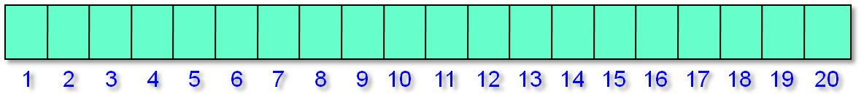
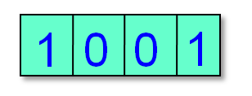
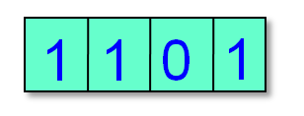
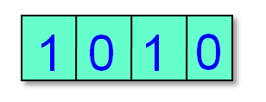
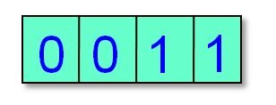
Hopscotch Hashing
h(x)
u
v
z
w
r
s
x
add(x) – probe linearly to find open slot.
Move the empty slot via sequence of
displacements into the hop-range of h(x).
Notes:
Closed address

Slide 126
Hopscotch Hashing
contains
  wait-free, just look in neighborhood
Notes:
Lemma 5. The probability of probing for an empty slot, with length bigger then
H is ®H¡1.

Slide 127
Hopscotch Hashing
contains
  wait-free, just look in neighborhood
add
  expected distance same as in linear probing
Notes:
Lemma 5. The probability of probing for an empty slot, with length bigger then
H is ®H¡1.

Slide 128
Hopscotch Hashing
contains
  wait-free, just look in neighborhood
add
  Expected distance same as in linear probing
resize
  neighborhood full less likely as H → log n
  one word hop-info bitmap, or use smaller H and default to linear probing
Notes:
Lemma 5. The probability of probing for an empty slot, with length bigger then
H is ®H¡1.

Slide 129
Advantages
Good locality and cache behavior
As table density (M/N) increases → less resizing
Move cost to add() from contains()
Easy to parallelize

Slide 130
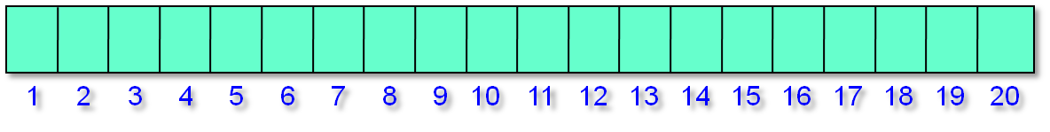
Recall: Concurrent Chained Hashing
Lock for add()
and unsuccessful
contains()
Striped Locks
Notes:
Closed address

Slide 131
Concurrent Simple Hopscotch
h(x)
contains() is wait-free
Notes:
Closed address

Slide 132

Concurrent Simple Hopscotch
u
z
v
r
x
ts
Add(x) – lock bucket, mark empty slot using CAS, add x erasing mark
Notes:
Closed address

Slide 133
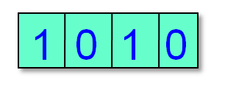
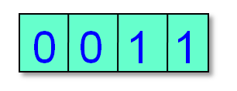
Concurrent Simple Hopscotch
u
z
v
r
s
s
ts+1
ts
ts
ts
add(x) – lock bucket, mark empty slot using CAS, lock bucket and update timestamp of bucket being displaced before erasing old value
Notes:
There are many entries that could potentially have the given entry in their hop-
information, but, as we prove, there can only be one that actually has it at any
given point. To add() or remove() an item, only one lock, the lock of the location
with the hop information is acquired. Then, to move an item, while the lock is
held, the full-empty bit of the empty location is set, and then a key and its data
are moved. No thread ever spins on this full-empty information, so it cannot be
a source of deadlock. Since only one lock is ever taken at a time, there cannot be
deadlock. The algorithm is however not starvation-free: it trusts the natural distri-
bution of hashed values to prevent starvation, and if this distribution is unfair, one
can replace the simple locks we use with more expensive fair locks.

Slide 134

Concurrent Simple Hopscotch
x not found
u
z
v
s
r
ts
A
Notes:
Closed address

Slide 135
Is performance dominated by cache behavior?
Run algs on state of the art multicores and uniprocessors:
  Sun 64 way Niagara II, and
  Intel 3GHz Xeon
Benchmarks pre-allocated memory to eliminate effects of memory management

Slide 136
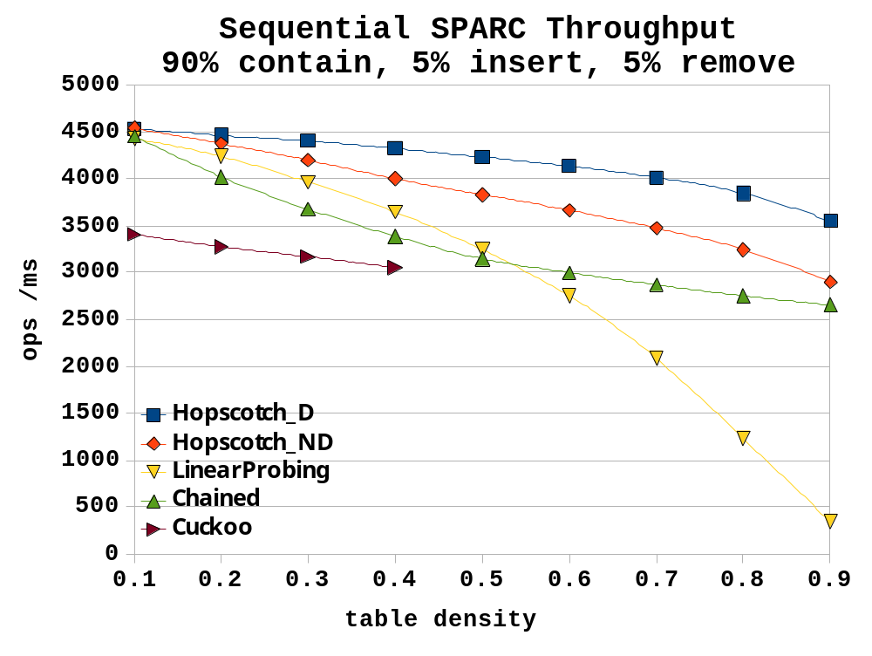
with memory pre-allocated

Slide 137
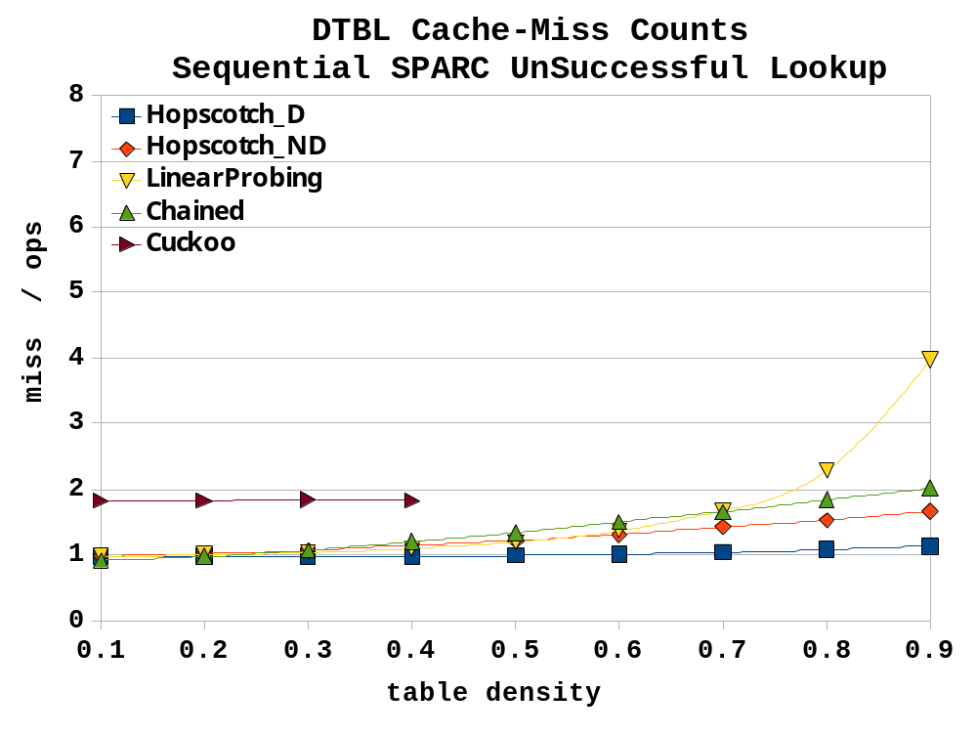

Slide 138
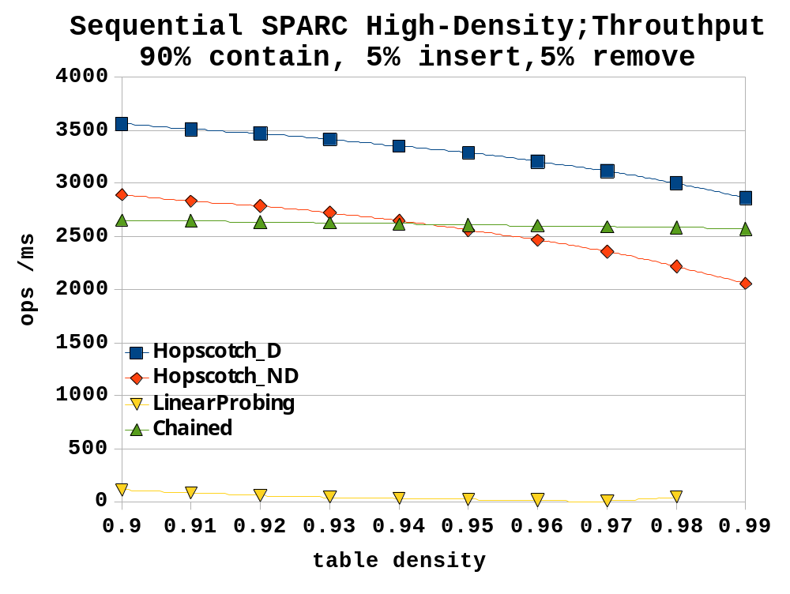

Slide 139
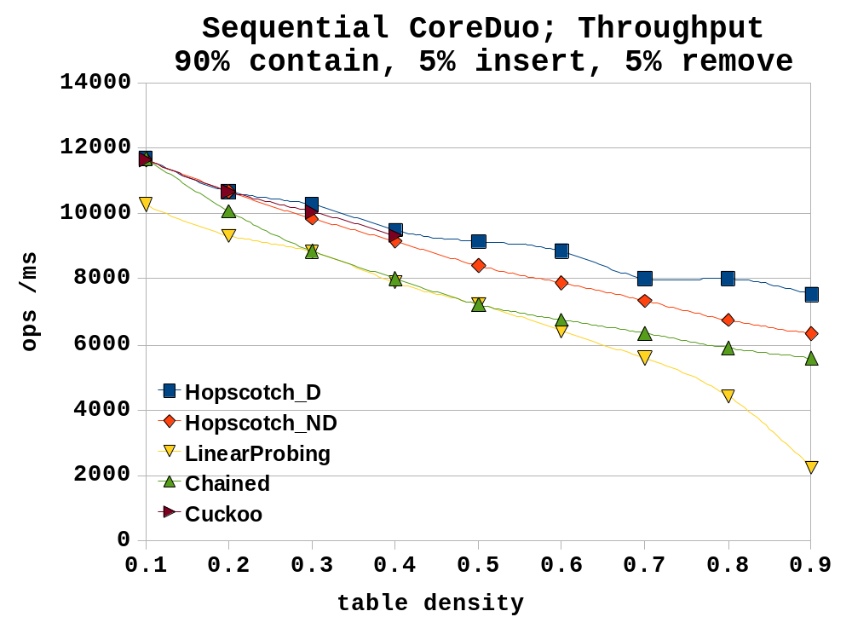
Cuckoo stops here

Slide 140
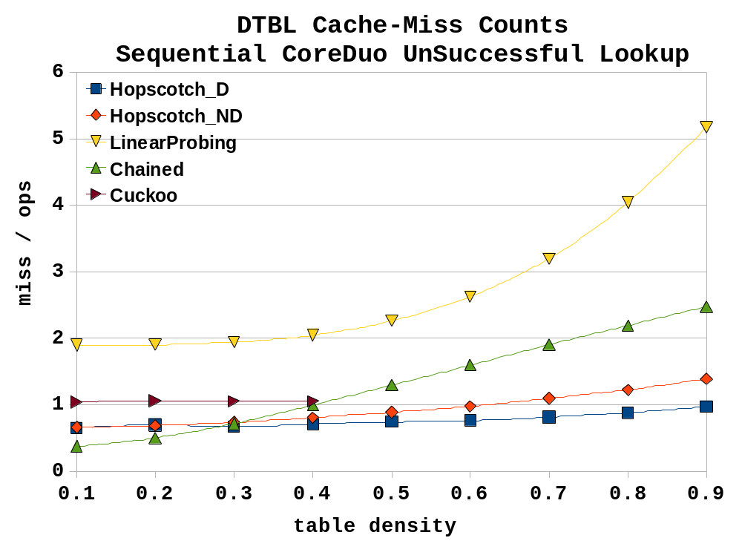

Slide 141
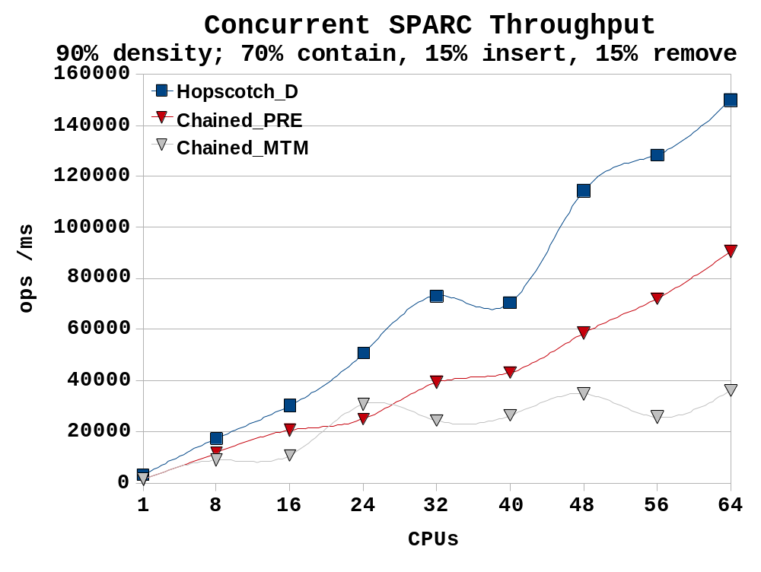
with memory pre-allocated
with allocation

Slide 142
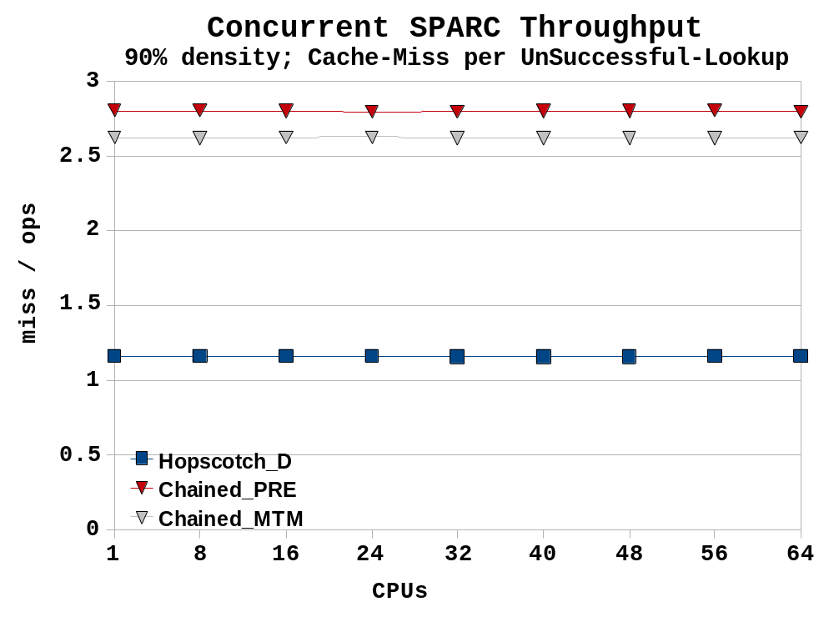

Slide 143
Summary
Chained hash with striped locking is simple and effective in many cases
Hopscotch with striped locking great cache behavior
If incremental resizing needed go for split-ordered

Slide 144
This work is licensed under a Creative Commons Attribution-ShareAlike 2.5 License.
You are free:
  to Share — to copy, distribute and transmit the work
  to Remix — to adapt the work
Under the following conditions:
  Attribution. You must attribute the work to “The Art of Multiprocessor Programming” (but not in any way that suggests that the authors endorse you or your use of the work).
  Share Alike. If you alter, transform, or build upon this work, you may distribute the resulting work only under the same, similar or a compatible license.
For any reuse or distribution, you must make clear to others the license terms of this work. The best way to do this is with a link to
  http://creativecommons.org/licenses/by-sa/3.0/.
Any of the above conditions can be waived if you get permission from the copyright holder.
Nothing in this license impairs or restricts the author's moral rights.
Art of Multiprocessor Programming

