Slide 1
Red Vs. Blue Team
Capstone Engagement
Assessment, Analysis, and Hardening of a Vulnerable System
Report by
Faisal Kalam

Slide 2
Preface
This report comprehends the engagement conducted for the purpose of identifying critical vulnerabilities on the client’s network.
As the Red Team, have attacked a vulnerable VM within the environment, ultimately gained root access to the machine.
As Blue Team, have used Kibana to review logs taken during activities performed by the Red Team.
Review logs to extract hard data and visualizations for this report.
Further, interpreted log data to suggest
mitigation measures for each vulnerability that have been exploited

Slide 3
Table of Contents
This document contains the following sections:
- Purpose
- Methodology
- Network Topology
- Vulnerability Assessment (Red Team - Blue Team)
- Risk Mitigation through Security Control Implementation

Slide 4
Purpose
The Purpose of this engagement is to perform Vulnerability / Risk Assessment for identification of weakness that exposes to threats, later conduct through exercise to exploit the identified vulnerabilities, resulted in magnitude of the Impact leading towards Risk. Finally Recommend Security Controls as part of Risk Mitigation Plan.

Slide 5
Methodology
This report presents the Vulnerability Assessment, risk identification on the Network & exploitation of targeted Web Domain (WebDAV). The action plan undertaken is to launch an attack by RedTeam to identify open risks and threats while penetrating as a hacker.
Once the vulnerabilities are exposed, the BlueTeam takes measures in logging incidents and identifying threats followed by recommended security controls and hardening measures of the system on the network.

Slide 6
Network Topology
6

Slide 7
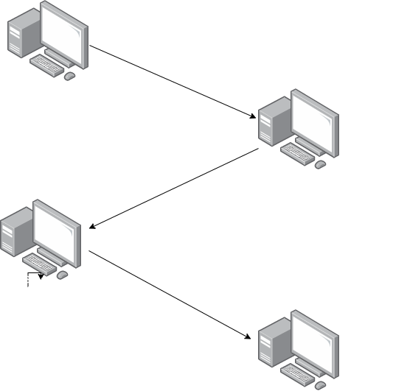
Network Topology
Network
Address Range:
192.168.1.0/24
Netmask:
255.255.255.0
Gateway:
10.0.0.76
Machines
IPv4: 192.168.1.1
OS: Windows 10
Hostname:
Azure Hyper-V
IPv4:192.168.1.90
OS: Linux 2.6.32
Hostname: Kali
IPv4:192.168.1.100
OS:Linux
Hostname:ELK –Stack

Slide 8

Red Team
Security Assessment
8

Slide 9
Recon: Describing the Target
Nmap identified the following hosts on the network:
Hostname | IP Address | Role on Network
Hyper-V Azure Machine | 192.168.1.1 | Host Machine Cloud Based
Kali | 192.168.1.90 | Attacking Machine
ELK – Stack | 192.168.1.100 | Network Monitoring Machine (Kibana)
Capstone | 192.168.1.105 | Target Machine

Slide 10
Vulnerability Assessment
The assessment uncovered the following critical vulnerabilities in the target:
Vulnerability | Description | Impact
CVE-2019-6579 Open & Accessible Port 80 & 22 | Easy & Non restricted Access via open Ports | Easy & Non restricted Access via open Ports
Root User Accessibility | Root user accessibility gives authorization to execute commands, access all available resources on the vulnerable devices | Any unauthorized Root user can change, delete, edit and misconfigure any level of User Data & System settings
Simple Usernames | Names can be easily socially engineered | Usernames allowed on the WebDAV (ashton, Hannah & Ryan) are predictable & commonly socially engineered

Slide 11
Vulnerability Assessment
The assessment uncovered the following critical vulnerabilities in the target:
Vulnerability | Description | Impact
Simple Passwords | Simple password (without the inclusion of Capital Alphabets, Numeric & Characters are highly vulnerable | Access to systems via commonly used files like rockyou.txt, Brute Force Tools like Hydra, John the Ripper, Medusa, Brutus & Etc.
Directory Indexing vulnerability | Attacker can browse the intranet, different directories trees of the Domain | Attackers can gain access to source code and device other exploits. This can compromise private and confidential data
Local File Intrusion | LFI allows access of files and folders on the local machine | Through LFI, the attacker can read, write & execute command on the vulnerable machine

Slide 12
Vulnerability Assessment
The assessment uncovered the following critical vulnerabilities in the target:
Vulnerability | Description | Impact
WebDAV Vulnerability | WebDAV doesn’t seems to be configured properly, It can allow hacker to remotely changed contents on the machine | WebDAV doesn’t seems to be configured properly, It can allow hacker to remotely changed contents on the machine

Slide 13
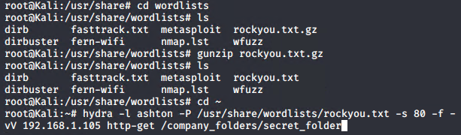
Exploitation: Brute Force Password
01
Tools & Processes
- Used Hydra (preinstalled in Kali) to brute forced the password.
- Used rockyou.txt to pull off password listing.
Achievements
Exploit provided the following information used to brute force successfully;
Username: ashton
Password: leopoldo

Slide 14
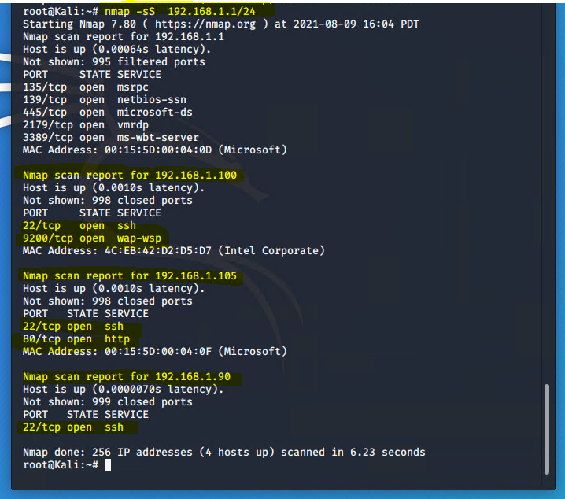
Exploitation: Port 80 Open to Public Access
02
Tools & Processes
Used Nmap to scan for Open Ports
on the Victim Machine
Achievements
Results showed Port 80 & 22 were open
to public access

Slide 15
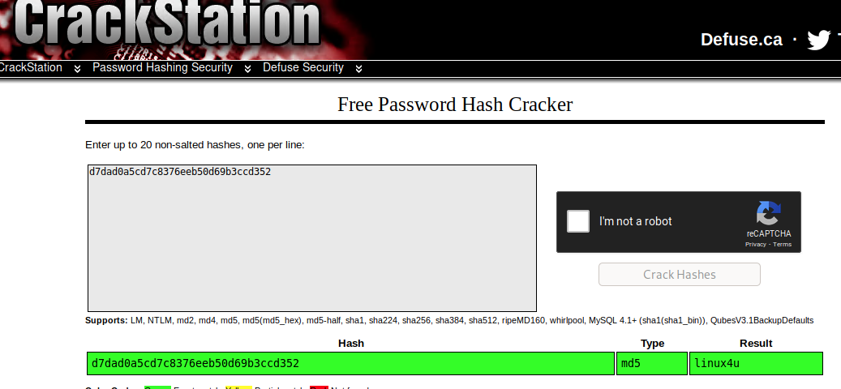
Exploitation: Hashed Password
03
Tools & Processes
- Used crackstation.net to crack the hash password
Achievements
Exploit provided the following information to access WebDav folder;
Username: ryan
Password: linux4u

Slide 16

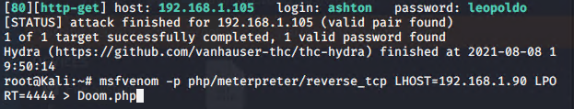
Exploitation: LFI Vulnerability
04
Tools & Processes
- Used msfvenom and meterpreter to deliver the payload in the target machine (Capstone)
Achievements
Used multi/handler exploit to avail access to the machine

Slide 17
BlueTeam
Blue Team (Logs & Attack Vectors Analysis)

Slide 18
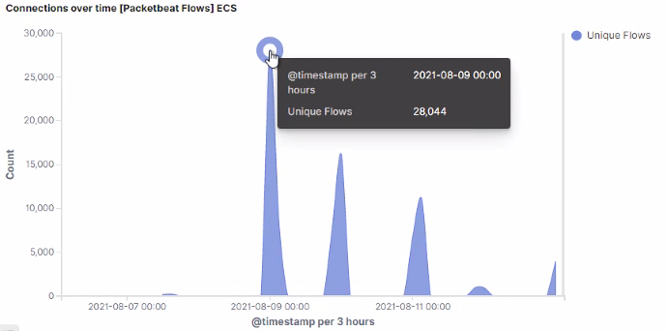
Analysis: Identifying the Port Scan
01
The Port Scan started 9th Aug 2021 00:00hrs on a time stamp of 3 hours
28,044 connections occurred at the peak, the source IP 192.168.1.90
The sudden hike in the network traffic indicates the port scan

Slide 19
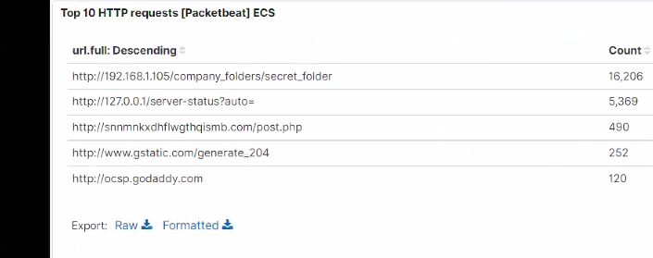
Analysis: Finding the Request for the Hidden Directory
02
The request started at 9th August , 2021 00:00hrs
16,206 requests were made to access the /secret_folder
The secret folder contained Hash for another employee ‘Ryan’
Cracking into the secret folder also allowed to upload the payload to exploit other vulnerabilities

Slide 20
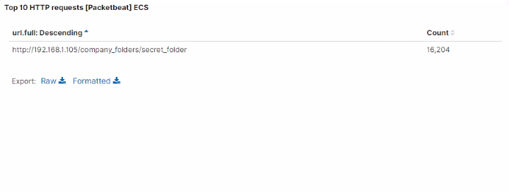
Analysis: Uncovering Brute Force Attack
03
Brute Force was started at 00:00 hrs (on the time stamp of 3 hrs) with the response status code of 401
16,204 requests were made to access the /secret_folder
The http method used in this brute attack was GET-Pull

Slide 21
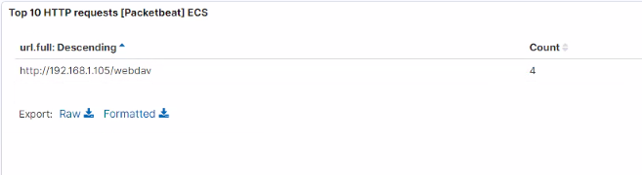
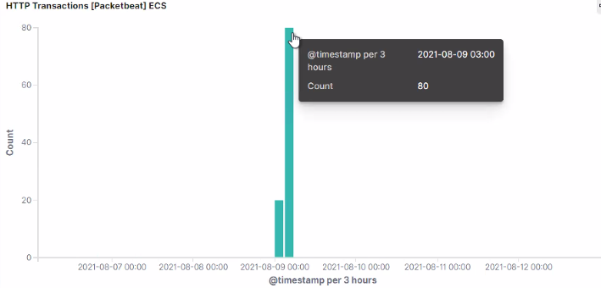
Analysis: Finding the WebDAV connection
04
80 requests were made to this directory
Doom.php is the payload file loaded via WebDav connection as a Payload

Slide 22
BlueTeam
Proposed Alarms and Mitigation Strategies

Slide 23
Risk Mitigation: Blocking the Port Scan
I would recommend an Alert to be set to every 1,000 connections occur in every 30 mins
Regular Intervals of Port Scans needs to be scheduled
Set server to drop packets traffic automatically after reaching the mentioned thresholds are exceeded
To avoid Zero-Day attacks, Firewall needs to be regularly attached
Real-time detection needs to be implemented to detect such scan attempts

Slide 24
Risk Mitigation: Finding the Request for the Hidden Directory
I would suggest an Alert on Unauthorized Access request for files & folders (including hidden) should be set to 5 attempts per 30 minutes
Confidential folders should not be shared for public access
Encryption is mandatory for confidential files and folders
IP whitelisting should be implemented

Slide 25
Risk Mitigation: Detecting the WebDAV Connection
Whitelist of Trusted Data Sources should be created followed by a quarterly Audit of systems and User Identity Access (ACL)
Alert on HTTP Methods such as GET, PULL & HEAD needs to be set other than the ones in the whitelist
Whitelist of the Trusted Data Sources needs to be part of Firewall security policy
Accessible ID & Password on WebDAV needs to be more complex

Slide 26
Risk Mitigation: Preventing Brute Force Attack
Account Lockouts After Failed Attempts.
Make the Root User Inaccessible via SSH.
Create unique login URLs for different user groups.
Employ 2-Factor Authentication (2FA).
Limit Logins to a Specified IP Address or Range. Use CAPTCHA. Modify the Default Port. Password needs to be more complex and user should be prevented from using historical passwords.
HTTP 401 specifies Unauthorized Client Error as it lacks authentication credentials for the target source. I would set an alarm for 401 error to return to avoid future brute force attacks
The threshold would be set to 5 error are returned.

Slide 27
Risk Mitigation: Identifying Reverse Shell Uploads
I recommend to set an Alert on the port 4444 for any traffic attempting to access
I recommend to set an Alert for any data uploaded into the WebDAV folder.
Blocking all Ports other than the Whitelisted ones
Block all Ip Addresses other than the Whitelisted ones
Set permissions on the WebDAV to read only

Slide 28

End of Report

