Slide 1

Logistics Optimization for Delivery Routes – FedEx
Problem statement
Build a SQL-driven logistics analytics system to analyse shipment performance, optimize routes, and enhance delivery efficiency across FedEx’s global network. The project aims to:
Identify delay patterns and operational inefficiencies.
Optimize hub and route combinations for improved transit times.
Analyse agent- and warehouse-level performance.
Identifying the root causes of transit and delivery delays (e.g., customs clearance, weather disruptions, route congestion).

Slide 2
Task 1: Data Cleaning & Preparation
There are no duplicate records in orders and shipments tables
In shipments table there are no records having delay hours as null
All date columns (Order_Date, Pickup_Date, Delivery_Date) are in date time format.
And, there is no such data in shipments having pickup date greater than delivery date.
select Order_ID, count(*) as count from fedex_orders group by Order_ID having count(*)>1;
select Shipment_ID, count(*) as count from fedex_shipments group by Shipment_ID having count(*)>1;
select * from fedex_shipments where delay_hours is null;
select * from fedex_shipments where Pickup_Date > Delivery_Date;

Slide 3
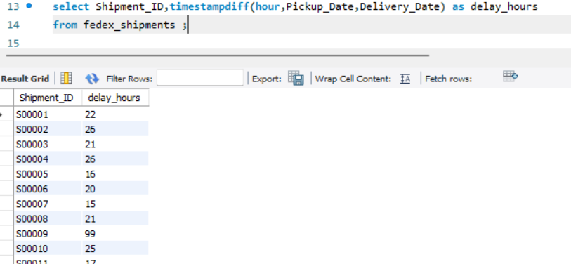
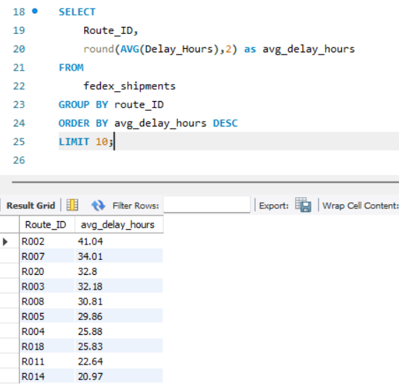
Task 2: Delivery Delay Analysis
Delivery delay (in hours) for each shipment using Delivery_Date – Pickup_Date.
select Shipment_ID,
timestampdiff(hour,Pickup_Date,Delivery_Date) as delay_hoursfrom fedex_shipments ;
Find the Top 10 delayed routes based on average delay hours.
SELECT Route_ID, round(AVG(Delay_Hours),2) as avg_delay_hours
FROM fedex_shipments
GROUP BY route_ID ORDER BY avg_delay_hours DESC LIMIT 10;

Slide 4
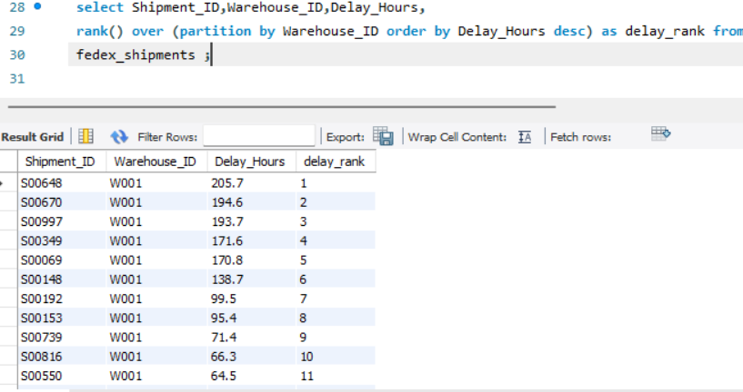
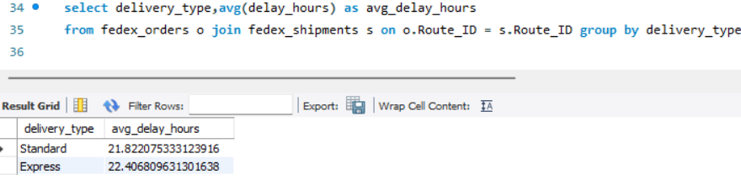
Task 2: Delivery Delay Analysis
Use SQL window functions to rank shipments by delay within each Warehouse_ID.
select Shipment_ID,Warehouse_ID,Delay_Hours,
rank() over (partition by Warehouse_ID order by Delay_Hours desc) as delay_rank from fedex_shipments ;
The average delay per Delivery_Type (Express / Standard) to compare service-level efficiency.
select delivery_type, avg(delay_hours) as avg_delay_hours from fedex_orders o join fedex_shipments s
on o.Route_ID = s.Route_ID group by delivery_type;

Slide 5
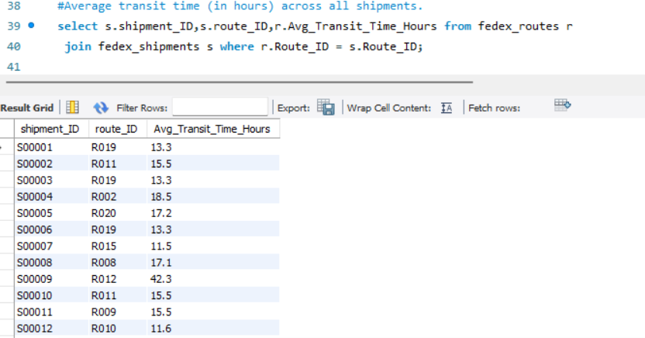
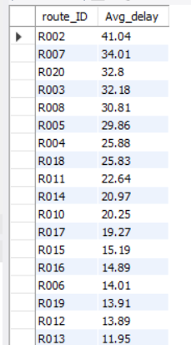
Task 3: Route Optimization Insights
Average transit time (in hours) across all shipments.
select s.shipment_ID,s.route_ID,r.Avg_Transit_Time_Hours from fedex_routes r join fedex_shipments s where r.Route_ID = s.Route_ID;
Average delay (in hours) per route
select route_ID, round(avg(delay_hours),2) as Avg_delay from fedex_shipments group by route_ID order by Avg_delay desc;

Slide 6
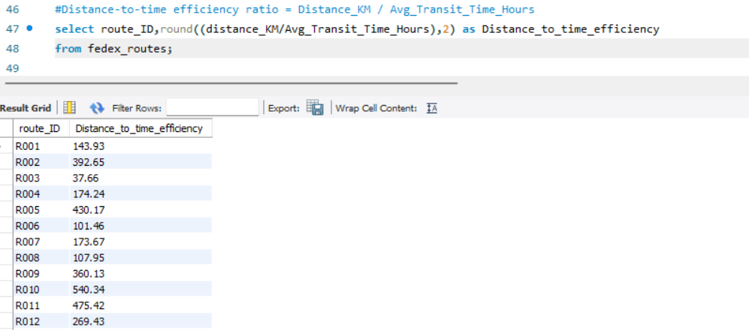
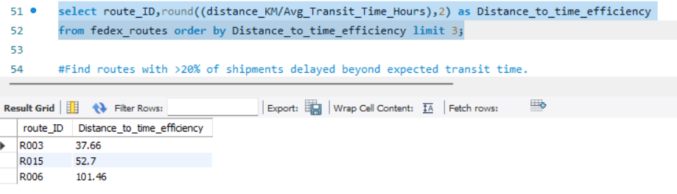
Task 3: Route Optimization Insights
Distance-to-time efficiency ratio = Distance_KM / Avg_Transit_Time_Hours
select route_ID,round((distance_KM/Avg_Transit_Time_Hours),2) as Distance_to_time_efficiency from fedex_routes;
Identify 3 routes with the worst efficiency ratio (lowest distance-to-time).
select route_ID,round((distance_KM/Avg_Transit_Time_Hours),2) as Distance_to_time_efficiency from fedex_routes order by Distance_to_time_efficiency limit 3;

Slide 7
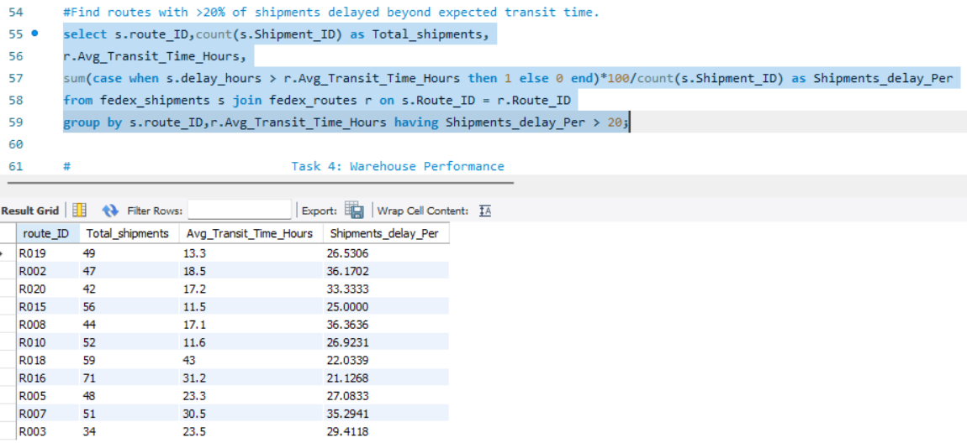
Task 3: Route Optimization Insights
Find routes with >20% of shipments delayed beyond expected transit time.
select s.route_ID,count(s.Shipment_ID) as Total_shipments,r.Avg_Transit_Time_Hours,sum(case when s.delay_hours > r.Avg_Transit_Time_Hours then 1 else 0 end)*100/count(s.Shipment_ID) as Shipments_delay_Perfrom fedex_shipments s join fedex_routes r on s.Route_ID = r.Route_IDgroup by s.route_ID,r.Avg_Transit_Time_Hours having Shipments_delay_Per > 20;
Recommend potential routes or hub pairs for optimization.
Routes having low distance to time efficiency i.e.,R003,R015 and R006 are taking long time for shorter distance. Reroute these ones with faster hubs.
Routes with >20% shipments delayed need to be optimized by introducing alternative or intermediate hubs
Additionally, reallocating experienced delivery agents and improving line-haul scheduling on these routes can significantly reduce delays.

Slide 8
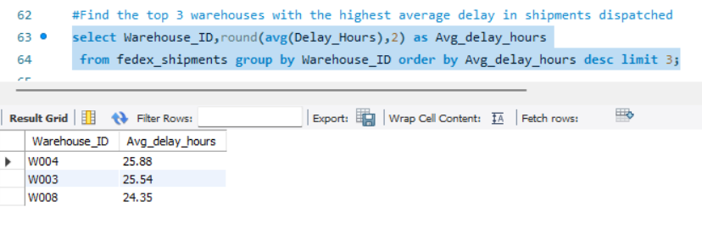
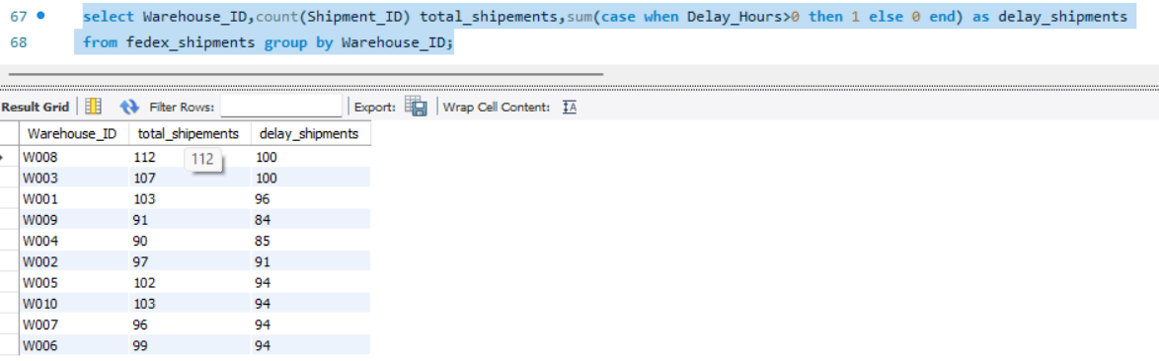
Task 4: Warehouse Performance
Find the top 3 warehouses with the highest average delay in shipments dispatched
select Warehouse_ID,round(avg(Delay_Hours),2) as Avg_delay_hours from fedex_shipments group by Warehouse_ID order by Avg_delay_hours desc limit 3;
Total shipments vs delayed shipments for each warehouse.
select Warehouse_ID,count(Shipment_ID) total_shipements,sum(case when Delay_Hours>0 then 1 else 0 end) as delay_shipments from fedex_shipments group by Warehouse_ID;

Slide 9
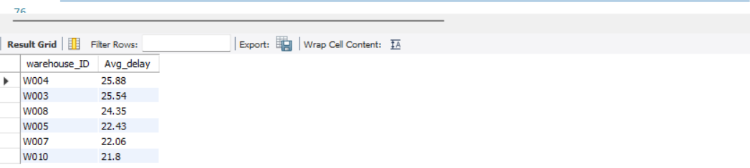
Task 4: Warehouse Performance
CTEs to identify warehouses where average delay exceeds the global average delay.
With CTE_Avg_delay as (select Warehouse_ID,round(avg(Delay_Hours),2) as Avg_delay from fedex_shipments group by Warehouse_ID)
select warehouse_ID,Avg_delay from CTE_Avg_delaywhere Avg_delay > (select avg(Delay_Hours) as global_avg_delay from fedex_shipments) order by Avg_delay desc;

Slide 10
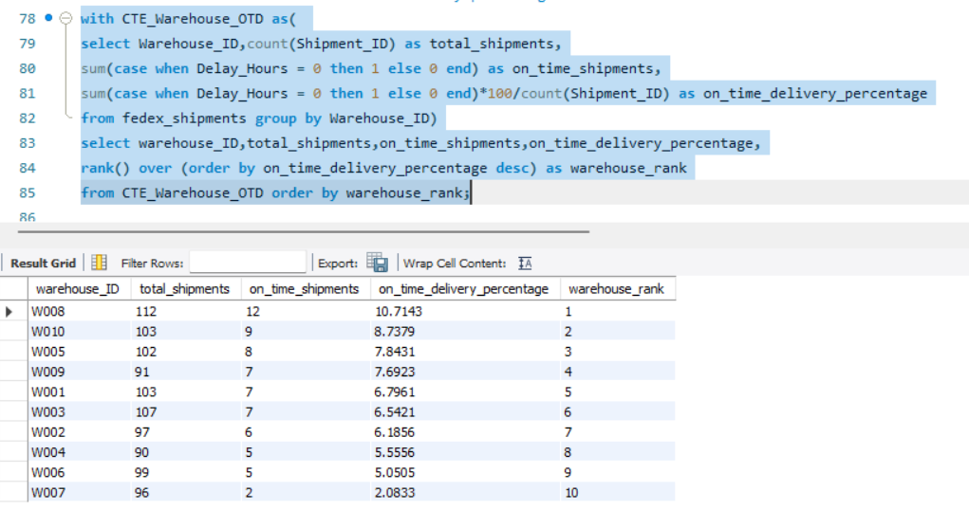
Task 4: Warehouse Performance
Rank all warehouses based on on-time delivery percentage.
with CTE_Warehouse_OTD as( select Warehouse_ID,count(Shipment_ID) as total_shipments,sum(case when Delay_Hours = 0 then 1 else 0 end) as on_time_shipments,sum(case when Delay_Hours = 0 then 1 else 0 end)*100/count(Shipment_ID) as on_time_delivery_percentage from fedex_shipments group by Warehouse_ID)
select warehouse_ID,total_shipments,on_time_shipments,on_time_delivery_percentage,rank() over (order by on_time_delivery_percentage desc) as warehouse_rankfrom CTE_Warehouse_OTD order by warehouse_rank;

Slide 11
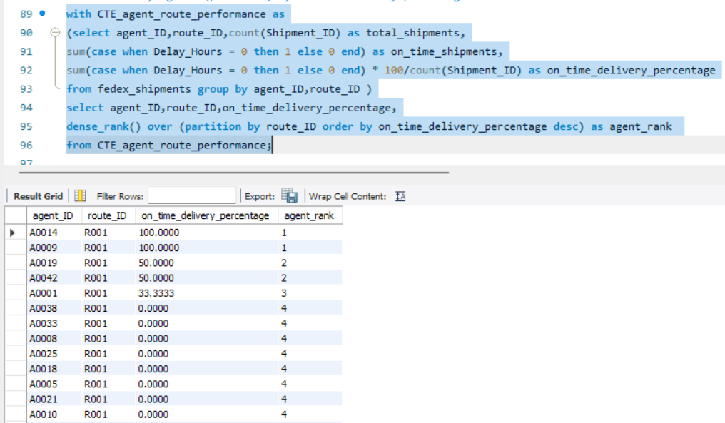
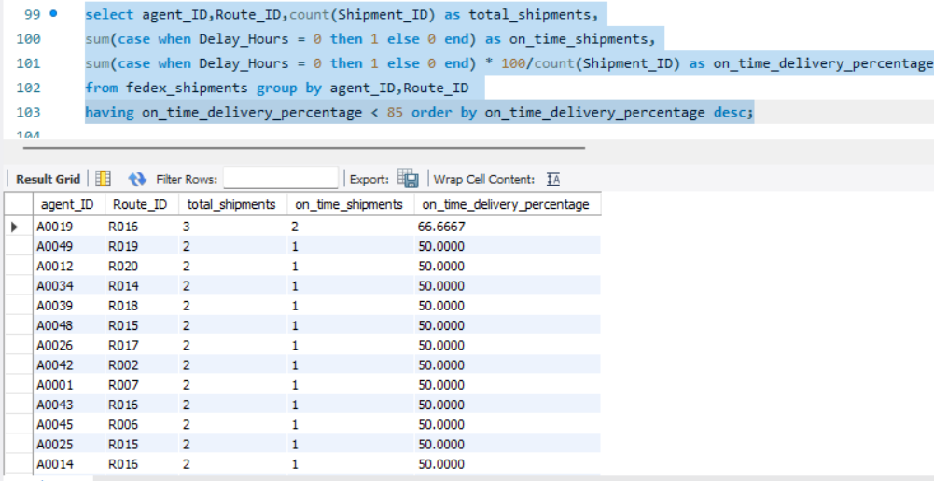
Task 5: Delivery Agent Performance
Rank delivery agents (per route) by on-time delivery percentage.
with CTE_agent_route_performance as (select agent_ID,route_ID,count(Shipment_ID) as total_shipments,sum(case when Delay_Hours = 0 then 1 else 0 end) as on_time_shipments,sum(case when Delay_Hours = 0 then 1 else 0 end) * 100/count(Shipment_ID) as on_time_delivery_percentagefrom fedex_shipments group by agent_ID,route_ID )
Select agent_ID,route_ID,on_time_delivery_percentage,dense_rank() over (partition by route_ID order by on_time_delivery_percentage desc) as agent_rank from CTE_agent_route_performance;
Find agents whose on-time % is below 85%
select agent_ID, Route_ID, count(Shipment_ID) as total_shipments, sum(case when Delay_Hours = 0 then 1 else 0 end) as on_time_shipments, sum(case when Delay_Hours = 0 then 1 else 0 end) * 100/count(Shipment_ID) as on_time_delivery_percentage from fedex_shipments group by agent_ID,Route_ID having on_time_delivery_percentage < 85 order by on_time_delivery_percentage desc;

Slide 12
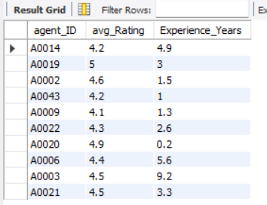
Task 5: Delivery Agent Performance
Compare the average rating and experience (in years) of the top 5 vs bottom 5 agents using subqueries.
with CTE_agent_performance as (SELECT da.agent_ID,da.avg_Rating,da.Experience_Years,ROUND(SUM(CASE WHEN Delay_Hours = 0 THEN 1 ELSE 0 END) * 100.0 / COUNT(*),2) AS on_time_pct from fedex_shipments s join fedex_delivery_agents da on s.agent_ID = da.Agent_ID group by s.agent_ID,da.Avg_Rating,da.Experience_Years)
select agent_ID,avg_Rating,Experience_Years from(select agent_ID,avg_Rating,Experience_Years,dense_rank() over (order by on_time_pct desc) as Agent_Rank from CTE_agent_performance order by Agent_Rank asc limit 5 ) a
union all
select agent_ID,avg_Rating,Experience_Years from(select agent_ID,avg_Rating,Experience_Years,dense_rank() over (order by on_time_pct desc) as Agent_Rankfrom CTE_agent_performance order by Agent_Rank desc limit 5 ) b;
Suggest training or workload balancing strategies for low-performing agents based on insights.
Agents with <85% on time delivery percentage have lower avg rating and experience years when compared to top 5 agents. his indicates a skill gap, so focused training on route planning, time management, and exception handling is recommended.
Assign simpler or lower-volume routes to low-performing agents while redistributing complex or high-congestion routes to experienced agents and continuously monitor KPIs to ensure performance improvement

Slide 13
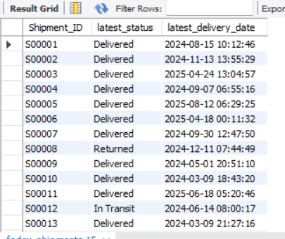
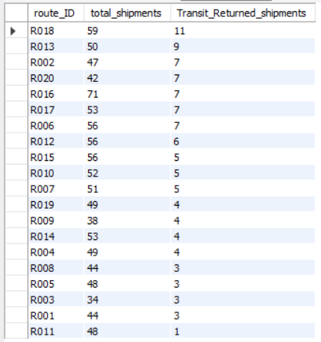
Task 6: Shipment Tracking Analytics
For each shipment, display the latest status (Delivered, In Transit, or Returned) along with the latest Delivery_Date.
SELECT Shipment_ID, Delivery_Status AS latest_status, Delivery_Date AS latest_delivery_date FROM fedex_shipments;
Identify routes where the majority of shipments are still “In Transit” or “Returned”.
select route_ID,count(shipment_ID) as total_shipments,sum(case when delivery_status in ('In Transit','Returned') then 1 else 0 end) as Transit_Returned_shipmentsfrom fedex_shipments group by route_ID order by Transit_returned_shipments desc;

Slide 14
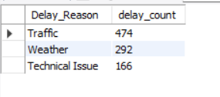
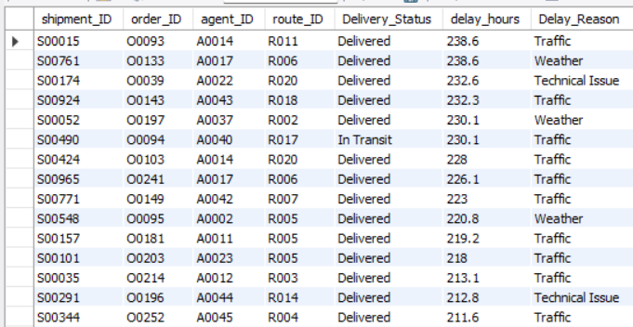
Find the most frequent delay reasons (if available in delay-related columns or flags).
SELECT Delay_Reason, COUNT(*) AS delay_count FROM fedex_shipments WHERE Delay_Hours > 0 GROUP BY Delay_Reason ORDER BY delay_count DESC;
Identify orders with exceptionally high delay (>120 hours) to investigate potential bottlenecks.
select shipment_ID,order_ID,agent_ID,route_ID,Delivery_Status,delay_hours, Delay_Reason from fedex_shipments where delay_hours > 120 order by delay_hours desc ;

Slide 15
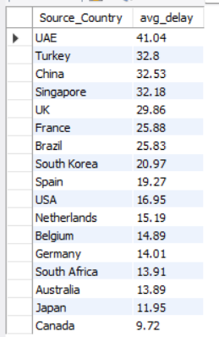

Task 7: Advanced KPI Reporting
Average Delivery Delay per Source_Country.
select r.Source_Country,round(avg(s.Delay_Hours),2) as avg_delay from fedex_shipments s inner join fedex_routes r on s.route_ID = r.route_ID group by r.Source_Country order by avg_delay desc;
On-Time Delivery % = (Total On-Time Deliveries / Total Deliveries) * 100
select (sum(case when Delay_Hours = 0 then 1 else 0 end)/count(*)) * 100 as on_time_delivery_pct from fedex_shipments;

Slide 16
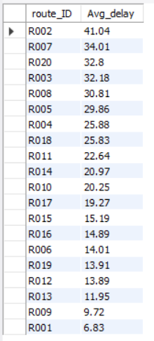
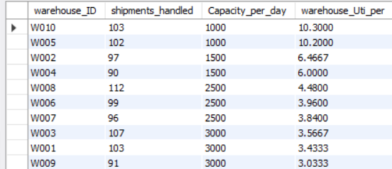
Average Delay (in hours) per Route_ID
select route_ID,round(avg(Delay_Hours),2) as Avg_delay from fedex_shipments group by route_ID order by Avg_delay desc;.
Warehouse Utilization % = (Shipments_Handled / Capacity_per_day) * 100
select s.warehouse_ID,count(s.Shipment_ID) as shipments_handled,w.Capacity_per_day,(count(s.Shipment_ID)/w.Capacity_per_day) * 100 as warehouse_Uti_perfrom fedex_warehouses w inner join fedex_shipments s on w.Warehouse_ID = s.Warehouse_ID group by s.warehouse_ID,w.Capacity_per_day order by warehouse_Uti_per desc;

Slide 17
key insights and business recommendations
Perform root cause analysis on the top 10 delayed routes based on avg delay hours.
Implement escalation rules for delayed shipments
Track recurring delay reasons to prevent repeat issues
Reconfigure low-efficiency routes using alternate or intermediate hubs
Use historical data to predict and flag high-risk shipments early
Provide targeted training for agents with on-time delivery <85%
Introduce mentoring by pairing bottom performers with top agents
Balance workloads by assigning simpler routes to low performers
Redistribute shipment volumes to reduce warehouse congestion

