Slide 1
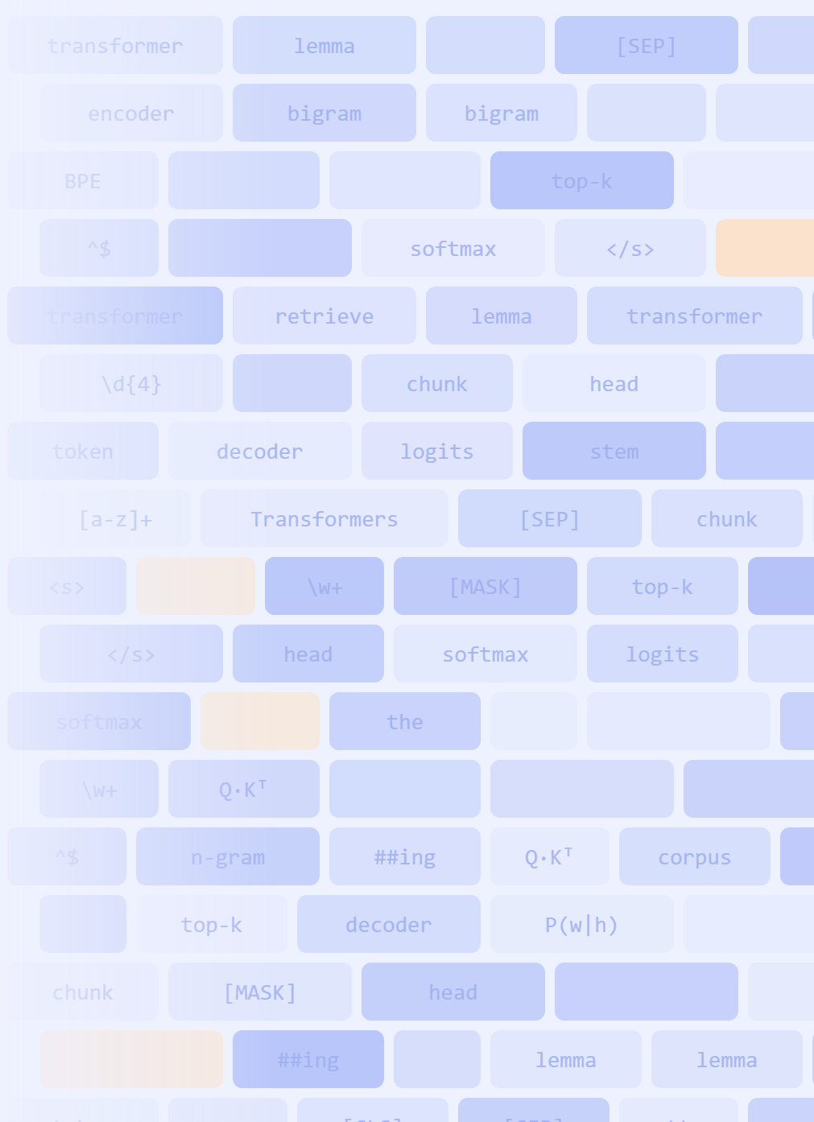



Web and Text Analytics 2026-27
Week 3
Evangelos Kalampokis
kalampokis.github.io
© Information Systems Lab

Slide 2
Special Characters (1/3)
Character
Description
*
Causes the resulting RE to match 0 or more repetitions of the preceding RE, as many repetitions as are possible.
.
(Dot.) In the default mode, this matches any character except a newline.
^
(Caret.) Matches the start of the string
$
Matches the end of the string
+
Causes the resulting RE to match 1 or more repetitions of the preceding RE.
?
Causes the resulting RE to match 0 or 1 repetitions of the preceding RE.
*?, +?, ??
The '*', '+', and '?' qualifiers are all greedy; they match as much text as possible. Adding ? after the qualifier makes it perform the match in non-greedy or minimal fashion; as few characters as possible will be matched.
If the RE <.*> is matched against '<a> b <c>', it will match the entire string, and not just '<a>'. Using the RE <.*?> will match only '<a>'.
Web and Text Analytics 2026-27 – Week 3 · © Information Systems Lab
2

Slide 3
Special Characters (2/3)
Character
Description
{m}
Specifies that exactly m copies of the previous RE should be matched; fewer matches cause the entire RE not to match. For example, a{6} will match exactly six 'a' characters, but not five
{m,n}
Causes the resulting RE to match from m to n repetitions of the preceding RE, attempting to match as many repetitions as possible
[ ]
Used to indicate a set of characters, for example [a-z] will match any lowercase ASCII letter
[^ ]
Matches a character that is not in the set, e.g. [^a-z] will match a character that is not a lowercase ASCII letter
(...)
Matches whatever regular expression is inside the parentheses, and indicates the start and end of a group
(?:…)
A non-capturing version of regular parentheses. This does not create a new group.
Web and Text Analytics 2026-27 – Week 3 · © Information Systems Lab
3

Slide 4
Special Characters (3/3)
Pattern
Matches
Example
\w+
word
‘Magic’
\d
digit
9
\s
space
` `
.*
wildcard
‘username74’
+ or *
greedy match
'aaaaaa’
\S
not space
'no_spaces’
[a-z]
lowercase group
'abcdefg'
\w
Alphanumeric character
Equivalent to [a-zA-Z0-9_]
\b
Matches the empty string, but only at the beginning or end of a word
Web and Text Analytics 2026-27 – Week 3 · © Information Systems Lab
4

Slide 5
Meta-characters: Repetitions
Character
Description
*
matches zero or more occurances
+
matches one or more occurances
?
matches zero or one occurances
{n}
exactly n repetitions, n>=0
{n, }
at least n repetitions
{ ,n}
at most n repetitions
{m,n}
at least m and at most n repetitions
Web and Text Analytics 2026-27 – Week 3 · © Information Systems Lab
5

Slide 6
re library in Python
Function
Description
re.search(pattern, string, flags=0)
Scan through string looking for the first location where the regular expression pattern produces a match and return a corresponding match object.
re.findall(pattern, string, flags=0)
Return all non-overlapping matches of pattern in string, as a list of strings
Web and Text Analytics 2026-27 – Week 3 · © Information Systems Lab
6

Slide 7
PART
IV
How to Read Regular Expressions

Slide 8
How to read regular expressions
1
Cut
Split the pattern into pieces, left to right
2
Label
Tag each piece: WHAT / HOW MANY / WHERE / HOW GROUPED
3
Say it
Describe the whole pattern in one plain sentence
4
Check
Find one string that matches and one that does not
Reading regex is a separate skill from writing it, and the one you need to check an LLM.
Web and Text Analytics 2026-27 – Week 3 · © Information Systems Lab
8

Slide 9
Regular expression for Dates
We need a regular expression to match all the different dates formats
23-10-2002
23 Oct 2002
23/10/2002
23 October 2002
Date variations for 23rd October 2002
23/10/02
Oct 23, 2002
10/23/2002
October 23, 2002
Web and Text Analytics 2026-27 – Week 3 · © Information Systems Lab
9

Slide 10
Regular expression for Dates
A simple RE captures three dates types
\d{2}[/-]\d{2}[/-]\d{4}
Web and Text Analytics 2026-27 – Week 3 · © Information Systems Lab
10

Slide 11
Regular expression for Dates
In the previous we missed the year having only two digits e.g. 23/10/02
Or we might miss the one-digit days or months
Web and Text Analytics 2026-27 – Week 3 · © Information Systems Lab
11

Slide 12
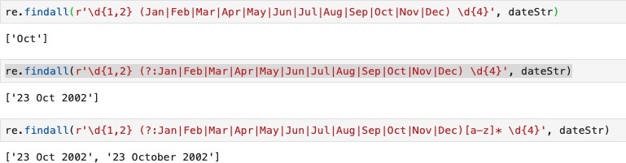
Regular expression for Dates
What about the text months (e.g., Jan, Feb etc.)
Recall that (...) matches whatever regular expression is inside the parentheses, and indicates the start and end of a group
But (?:…) does not create a new group.
Web and Text Analytics 2026-27 – Week 3 · © Information Systems Lab
12

Slide 13
Regular expression for Dates
Capture both Oct and October
Web and Text Analytics 2026-27 – Week 3 · © Information Systems Lab
13

Slide 14
Regex in Python
V

Slide 15
re library in Python
Function
What it does
Example
Result
re.match(pattern, string)
Matches only at the beginning of the string
re.match(r"\d+", "3 apples") re.match(r"\d+", "eat 3")
'3' None
re.search(pattern, string)
Scans the string for the first location where the pattern matches, anywhere
re.search(r"\d+", "eat 3 apples")
'3'
re.split(pattern, string, maxsplit=0)
Splits the string by the occurrences of the pattern
re.split(r"\W+", "a, b; c")
['a', 'b', 'c']
re.findall(pattern, string)
Returns all non-overlapping matches as a list of strings, not just the first one
re.findall(r"\d+", "3 apples, 12 pears")
['3', '12']
split(): capturing parentheses also return the text of each group · a nonzero maxsplit leaves the remainder as the last element · \W = any character that is not a letter, digit or underscore

Slide 16
Working with text in Pandas
Pandas provides handy string methods, accessed through the str attribute and applied to each element of a Series.
Method
What it does
Series.str.replace(a, b)
Replaces the value a with the value b
Series.str.count(pat)
Counts the appearances of a character or pattern in each element
Series.str.match(pat)
Determines if each string starts with a match of a regular expression
Series.str.strip()
Removes leading and trailing whitespace, newlines or specified characters from both sides
Series.str.find(pat)
Returns the position of the first occurrence of the pattern
Series.str.findall(pat)
Returns a list with all occurrences of the pattern in each element
Series.str.split(' ')
Splits each string with the given pattern
Web and Text Analytics 2026-27 – Week 3 · © Information Systems Lab
16

Slide 17
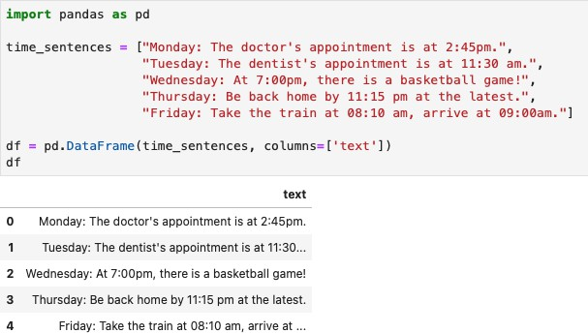
Working with text in Pandas

Slide 18
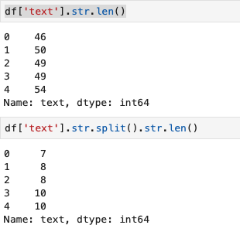
String methods
Using the str attribute we access the set of string processing methods, which operate on each element of the Series.
Number of characters
Number of tokens

Slide 19
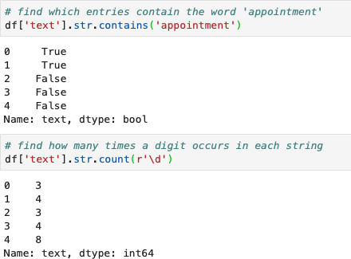

String methods

Slide 20
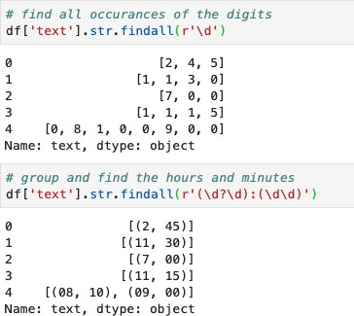
String methods: findall()

Slide 21
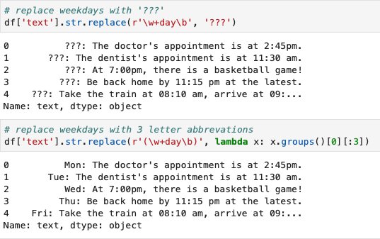
String methods: replace ()
lambda function An anonymous function (defined without a name) that can take any number of arguments but, unlike normal functions, evaluates and returns only one expression.

Slide 22
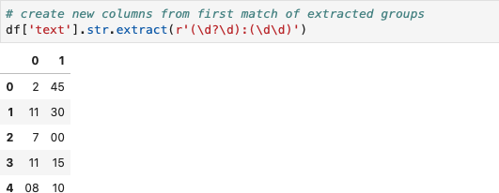
String methods: extract()
The extract method accepts a regular expression with at least one capture group .
Extracting a regular expression with more than one group returns a DataFrame with one column per group.
extract() returns only the first match.

Slide 23
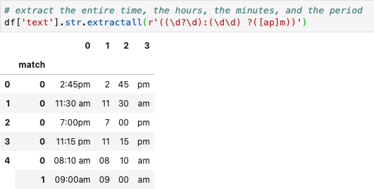
String methods: extractall()
The extractall method returns every match.
The result of extractall is always a DataFrame with a MultiIndex on its rows. The last level of the MultiIndex is named match and indicates the order in the subject.

Slide 24
PART
VI
Case Studies
Writing and evaluating regex

Slide 25
The data behind both case studies
Data Exploration
Amazon Reviews: Unlocked Mobile Phones
Public dataset on Kaggle, collected by PromptCloud by scraping the “unlocked phones” category of Amazon.com
400,000+ customer reviews
1 row = 1 review, file Amazon_Unlocked_Mobile.csv
Column | What it holds
Product Name | full product title, e.g. phone model and colour
Brand Name | Apple, Samsung, BLU, …
Price | price in USD
Rating | 1–5 stars
Reviews | free text by the customer
Review Votes | how many people found it helpful
We take small samples by hand (10 and 30 reviews), so we can check every answer.
Source: Kaggle, “Amazon Reviews: Unlocked Mobile Phones” (Amazon_Unlocked_Mobile.csv)
https://www.kaggle.com/datasets/nehasontakke/amazon-unlocked-mobilecsv
Web and Text Analytics 2026-27 – Week 3 · © Information Systems Lab
25

Slide 26
Case study 1: the scenario
THE QUESTION
“Which reviews mention the SIM card?”
1
2
3
4
Sample
Label
Write
Measure & fix
Take 10 real reviews: some about the SIM card, some that only look like it
A human reads each review and writes yes / no: the ground truth
Write a regex, run it on all 10 reviews
Count the errors, compute precision and recall, improve the regex, repeat
Steps 3 and 4 repeat: the regex is written in versions, each one fixing the last one’s errors.
Web and Text Analytics 2026-27 – Week 3 · © Information Systems Lab
26

Slide 27
The 10 reviews and their ground truth
# | Review (excerpt) | How “sim” appears | Mentions SIM?
1 | …We just took the sim card from the old Verizon Samsung and put it in this one… | sim card | yes
2 | …My husband put his old iPhones SIM card in it and it now works with AT&T | SIM card | yes
3 | I did not get a Sim card with phone | Sim card | yes
4 | …a non-verizon machine. which doesn't work with verizon simcard… | simcard | yes
5 | …it came with sims card, charger, and headphones. | sims card | yes
6 | …connected thru Verizon service and their free SIMM Card… | SIMM Card | yes
7 | …Super reliable and simple to use. Battery life could be better… | simple | no
8 | Phone purchased as replacement for similar phone… | similar | no
9 | Simple to use. Easy set up. Amazing! | Simple | no
10 | It was simply awesome. No complaints at all. | simply | no
■ the SIM card, in 6 different spellings ■ other words that only contain the letters “sim”
Web and Text Analytics 2026-27 – Week 3 · © Information Systems Lab
27

Slide 28
How we score a regex
FOR EVERY REVIEW, TWO QUESTIONS
TWO NUMBERS FROM THE COUNTS
Did the regex match? (the regex’s answer)
Should it have matched? (the ground truth)
Precision = TP / (TP + FP)
Of everything the regex found, how much was right?
Hurt by false positives: “simple” counted as SIM
Ground truth: mentions SIM?
yes
no
TP
FP
Recall = TP / (TP + FN)
Of everything that should be found, how much did it find?
Hurt by false negatives: “SIM card” missed
Regex matched
found it, correct
found it, wrong
FN
TN
Regex silent
missed it
ignored, correct
TN is not used: in search tasks most texts are TN, so it says little.
Web and Text Analytics 2026-27 – Week 3 · © Information Systems Lab
28

Slide 29
Case study 1: The iterative process of writing regex
Task: find every review that mentions the SIM card.
sim
Misses “SIM card”, “Sim card”
Finds “simple”, “similar”, “simply”
[sS][iI][mM]
Finds every SIM review, in any case
Still finds “simple”, “Simple”, “similar”, “simply”
\b[sS][iI][mM][sS]?\b
No more “simple” or “similar”
But now misses “verizon simcard” and “free SIMM Card”
Each fix removes one kind of error, and can let in the other.
Web and Text Analytics 2026-27 – Week 3 · © Information Systems Lab
29

Slide 30
Case study 1: the reasoning behind each version
v1
sim
v2
[sS][iI][mM]
v3
\b[sS][iI][mM][sS]?\b
THOUGHT
THOUGHT
THOUGHT
Start with the obvious
The misses are about letter case
The false hits are longer words
The word we want is “sim”, so search for exactly that text.
Allow each letter in both cases with a set: [sS] = s or S.
“sim” must be a whole word: \b on both sides, and [sS]? for “sims”.
RESULT
RESULT
RESULT
Regex is case-sensitive and does not know about words: misses “SIM”, finds “simple”.
All six SIM reviews found. But “Simple” now matches too.
No more simple / similar. But “simcard” and “SIMM” are no longer whole words.
TP 3 · FP 3 · FN 3
P 50% · R 50%
TP 6 · FP 4 · FN 0
P 60% · R 100%
TP 4 · FP 0 · FN 2
P 100% · R 67%
Web and Text Analytics 2026-27 – Week 3 · © Information Systems Lab
30

Slide 31
False positives and false negatives
v1 = sim v2 = [sS][iI][mM] v3 = \b[sS][iI][mM][sS]?\b
#
Review (excerpt)
SIM?
v1
v2
v3
1
…took the sim card from the old Verizon Samsung…
yes
TP
TP
TP
2
…put his old iPhones SIM card in it…
yes
FN
TP
TP
False negative (FN)
3
I did not get a Sim card with phone
yes
FN
TP
TP
Not matching a review we should have matched: “SIM card” in v1
4
…doesn't work with verizon simcard…
yes
TP
TP
FN
5
…it came with sims card, charger…
yes
TP
TP
TP
6
…their free SIMM Card…
yes
FN
TP
FN
False positive (FP)
7
…Super reliable and simple to use…
no
FP
FP
–
Matching a review we should not have matched: “simple” in v1 and v2
8
…replacement for similar phone…
no
FP
FP
–
9
Simple to use. Easy set up. Amazing!
no
–
FP
–
Data: 10 real reviews from Amazon Unlocked Mobile (Kaggle)
10
It was simply awesome. No complaints at all.
no
FP
FP
–
Web and Text Analytics 2026-27 – Week 3 · © Information Systems Lab
31

Slide 32
Characterizing work on NLP
Pattern
TP
FP
FN
Precision
Recall
v1 sim
3
3
3
3/6 = 50%
3/6 = 50%
v2 [sS][iI][mM]
6
4
0
6/10 = 60%
6/6 = 100%
v3 \b[sS][iI][mM][sS]?\b
4
0
2
4/4 = 100%
4/6 = 67%
Reducing errors means two antagonistic efforts:
Recall (coverage) = minimizing false negatives. v1 → v2 fixed the FNs: recall 50% → 100%
Precision (accuracy) = minimizing false positives. v2 → v3 fixed the FPs: precision 60% → 100%
…and recall fell back to 67%. simcard and SIMM are typos: chase them, or accept them?
Which one matters more depends on the task. Decide first, then tune the regex.
Web and Text Analytics 2026-27 – Week 3· © Information Systems Lab
32

Slide 33
Case study 2: storage in customer reviews
THE PRODUCT MANAGER ASKS
STORAGE OR NOT?
“Find out which storage size each customer mentions in their review, so we can see which phones appeal more to customers.”
...unlocked iPhone 5s 16gb!
...about 38 GB of free space!
...six-core GPU, 2GB RAM...
...supports AT&T 4G LTE.
...It has 64 gigs, runs fast...
30 real reviews from Amazon Unlocked Mobile (Kaggle), the same data as our SIM-card example
Your job: one regex that finds the storage size
Web and Text Analytics 2026-27 – Week 3 · © Information Systems Lab
33

Slide 34
Case study 2: the data and the goal
THE DATA: 30 REVIEWS, TWO COLUMNS
WHAT THE PRODUCT MANAGER NEEDS
rating | review
5 | …brand new factory GSM unlocked iPhone 5s 16gb!
5 | …It has 64 gigs, runs fast…
1 | i did not receive 32GB.. but received a 16,,…
5 | …supports AT&T 4G LTE.
… | … 30 rows in total
review text
free text, any spelling
regex
pulls out the storage size
storage column
16, 32, 64 … GB
group by storage
average star rating per size
Same Kaggle dataset as case study 1, but now we also use the Rating column (1–5 stars).
Web and Text Analytics 2026-27 – Week 3 · © Information Systems Lab
34

Slide 35
Step 1 · Read the data before you write anything
# | ★ | Review (1–15)
1 | 5 | Apple iPhone 5s Verizon Wireless, 16GB, Space Gray
2 | 5 | The phone was just as described: brand new factory GSM unlocked iPhone 5s 16gb!
3 | 5 | I purchased the gold 16 GB variation of the iPhone 5s and it is so beautiful for a device.
4 | 5 | I bought the iPhone 5s (16GB) in Space Gray from Express Mobile
5 | 5 | I purchased a refurbished iPhone 5s, 32gb. The phone is as good as new.
6 | 5 | This is a great Iphone 5S 64GB Factory Unlocked, had no problem getting it to fire up on Verizon
7 | 5 | I still have about 38 GB of free space! I am EXTREMELY pleased!
8 | 5 | PowerVR GT7600 six-core GPU, 2GB RAM, 1624 mAh battery.
9 | 5 | ...the one I purchased fully supports AT&T 4G LTE.
10 | 5 | Expect 3G during international use because this phone likely will not be capable of LTE
11 | 5 | ...they offer the 16GB 5s at the full retail price of $649.99 (plus tax, of course).
12 | 5 | Great condition
13 | 4 | As of November 2015 this phones memory is just about full. 16 GB is simply NOT enough space.
14 | 5 | I was fortunate to purchase a like-new 64gb iPhone 5s for 265USD in absolutely pristine condition
15 | 1 | Verizon indicates that the phone is not compatible with their system
STORAGE OR NOT?
■ Storage size
16GB, 16gb, 16 GB, (16GB), 32gb, 64GB
■ Looks like it, but is not
38 GB free space left
2GB RAM, not storage
4G, 3G mobile network
$649.99, 265USD prices
2015 a year
Reading first tells you which numbers the regex must skip, not only which to find.
Web and Text Analytics 2026-27 – Week 3 · © Information Systems Lab
35

Slide 36
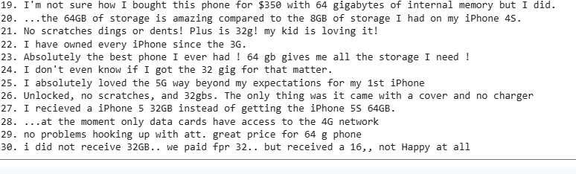
Debrief
The one idea: phones are sold only in 8 / 16 / 32 / 64 / 128 / 256 GB. That one list removes 38, 2, 4G, 3G and 1g at once
No regex can tell: review 20, “64GB ... compared to the 8GB I had on my iPhone 4S”. Which phone? That needs meaning: NER, LLMs
Web and Text Analytics 2026-27 – Week 3 · © Information Systems Lab
36

Slide 37
Regex, spaCy or LLM? All three
Regex
clean & mask: links, e-mails, phones, person data
Tool
Speed & cost
Best at
Regex
microseconds · free · same answer every time
fixed text formats
spaCy
structure: tokens, lemmas, names, places
LLM
meaning: intent, sentiment, summary
spaCy / NLTK
milliseconds · free · runs locally
language structure, entities
Code
validate: check digits, real dates, JSON schema
LLM
seconds · paid per token · answers can vary
meaning and context
Example: 10,000 customer e-mails. Regex masks phones and before any text leaves the company, spaCy finds product names, the LLM labels each complaint, code checks the LLM’s JSON.
Cheapest tool that is good enough goes first. The LLM sees only what the others cannot handle.
Web and Text Analytics 2026-27 – Week 3 · © Information Systems Lab
37

Slide 38
GPT-2 starts with a regex
import regex # not re: it understands \p{L} (any letter) and \p{N} (any number)
pat = r"""'s|'t|'re|'ve|'m|'ll|'d| ?\p{L}+| ?\p{N}+| ?[^\s\p{L}\p{N}]+|\s+(?!\S)|\s+"""
regex.findall(pat, "The model's accuracy was 98.5%! Τέλεια.")
# ['The', ' model', "'s", ' accuracy', ' was', ' 98', '.', '5', '%!', ' ', ' Τέλεια', '.']
Before GPT-2 sees any text, this regex cuts it into pieces: pre-tokenization
You can read it now: what does \s+(?!\S) do? Why does 98.5 become three pieces?
Next week: what happens after the cut. Tokens, stop words, lemmas
Web and Text Analytics 2026-27 – Week 3 · © Information Systems Lab
38

Slide 39
Key takeaways
What
A regex is a small language for describing text patterns
Why
It describes variations where string methods need endless if-statements
Read
Cut, label, say it, check
Judge
Positive and negative tests, then precision and recall
LLMs
The LLM drafts; you read it, test it and count the fixes
When
For text formats.
Web and Text Analytics 2026-27 – Week 3 · © Information Systems Lab
39

Slide 40
Next week
The NLP preprocessing pipeline
Tokenization with NLTK, stop words, stemming, lemmatization, cleaning real tweets
Everything next week builds on today’s patterns, groups and re.sub.
Web and Text Analytics 2026-27 – Week 3 · © Information Systems Lab
40

Slide 41
Regex
More practice on regular expressions (links)
https://regexone.com/
https://regexlearn.com/learn
Web and Text Analytics 2026-27 – Week 3 · © Information Systems Lab
41

Slide 42
Questions?
WEB AND TEXT ANALYTICS 2026-27
Evangelos Kalampokis
kalampokis.github.io

