Slide 1
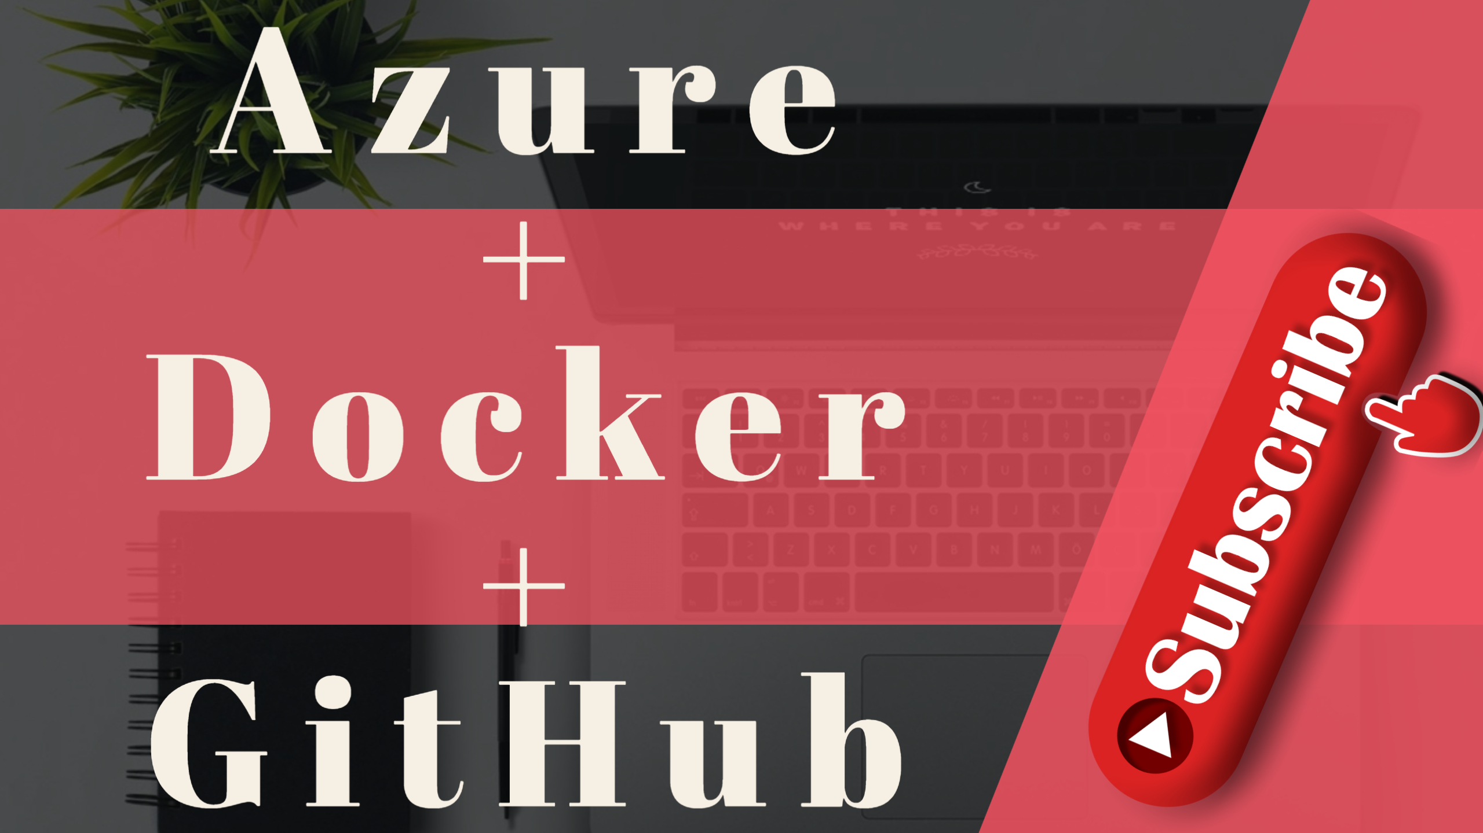

Slide 2
Agenda
What Is Docker ?
Features of docker.
Docker setup in windows server.
Docker Basic Commands.
Docker + Azure App Service.
Docker + GitHub.

Slide 3
prerequisites
Git Bash
Docker setup for windows
Visual Studio Code.
Azure CLI setup.
Azure ,Github and Docker Account signup.

Slide 4
Introduction
Description | Docker Swarm
Developed by | Docker Inc
Year Released | 2013
Scaling | No Autoscaling
Cluster Setup | Setting up the cluster is challenging & complicated. Cluster Strength is stronger.
Installation | Easy & fast
Data volume | Shares storage volumes between multiple containers in the same Pod.
Container Limit | Limited to 95000 container

Slide 5
What Is Docker ?
Docker is an open source project launched in 2013.
Docker is a tool designed to make it easier to create, deploy, and run applications by using containers.
Docker is a tool that is designed to benefit both developers and system administrators, making it a part of many DevOps (developers + operations) toolchains.
popularize the technology, and has helped drive the trend towards containerization and microservices in software development that has come to be known as cloud-native development.
It allows you to automate the deployment of applications in lightweight and portable containers.

Slide 6
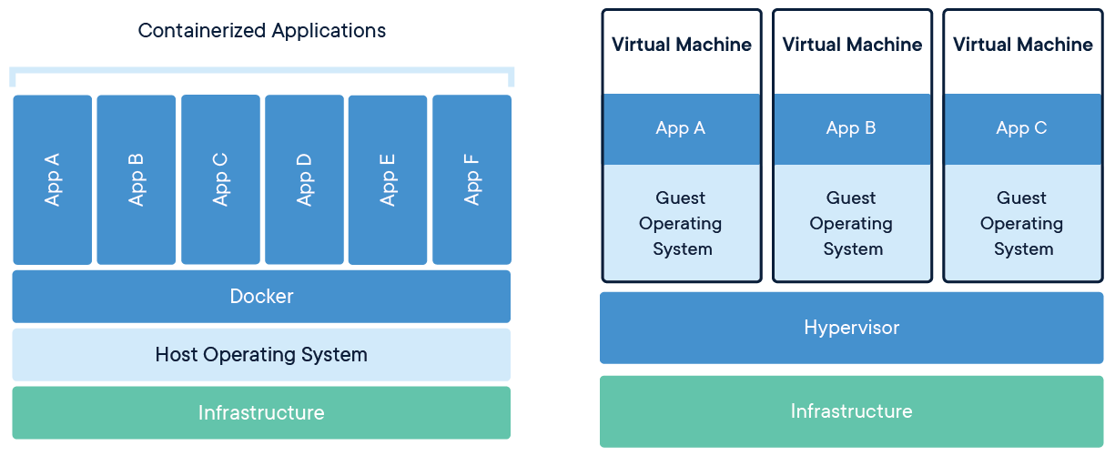
What Is Docker ?

Slide 7
essential features of Docker:
Isolated environments for managing your applications
Easy Modeling
Version control
Placement/Affinity
Application Agility
Developer Productivity
Operational Efficiencies

Slide 8
What Is Docker Containers ?
Containers are the organizational units of Docker.
The container analogy is used because of the portability of the software we have running in our container. in other words, "ship" the software, modify, manage, create or get rid of it, destroy it, just as cargo ships can do with real containers.

Slide 9
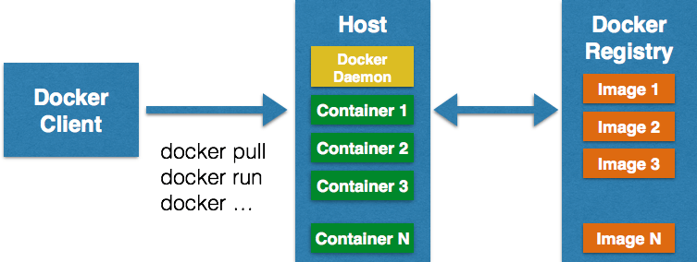
What Is Docker Containers ?

Slide 10
What Is BASIC Commands ?
Command | Description
docker info | Information Command
docker pull | Download an image
docker run -i -t image_name /bin/bash | Run image as a container
docker start our_container | Start container
docker stop container_name | Stop container
docker ps | List of al running containers
docker stats | Container information
docker images | List of images downloaded

Slide 11
What is Docker Engine?
Docker Engine is the core of Docker, the underlying client-server technology that creates and runs the containers. Generally speaking, when someone says Docker generically and isn’t talking about the company or the overall project, they mean Docker Engine. There are two different versions of Docker Engine on offer: Docker Engine Enterprise and Docker Engine Community.

Slide 12
What is Docker hub?
Docker hub is a cloud-based registry that which helps you to link to code repositories. It allows you to build, test, store your image in Docker cloud. You can also deploy the image to your host with the help of Docker hub.
There are two types of registry :
Public Registry
Private Registry
Docker's public registry is called Docker hub, which allows you to store images privately. In Docker hub, you can store millions of images.

Slide 13
steps for the Docker container life cycle
Below are the steps for Docker life cycle:
Build
Pull
Run

Slide 14
Advantages of Docker
Offers an efficient and easier initial set up
Integrates and works with existing Docker tools
Allows you to describe your application lifecycle in detail
Docker allows the user to track their container versions with ease to examine discrepancies between prior versions.
Simples configuration, interact with Docker Compose.
Docker offers a quick-paced environment that boots up a virtual machine and lets an app run in a virtual environment quickly.
Documentation provides every bit of information.
Provides simple and fast configuration to boost your business
Ensures that application is isolated

Slide 15
Disadvantages of Docker
Doesn't provide a storage option and has poor monitoring option.
No automatic rescheduling of inactive Nodes
Complicated automatic horizontal scaling set up
All the actions have to be performed in CLI.
Basic infrastructure handling
Manual handling multiple instances
Need support for other tools for production aspects - monitoring, healing, scaling
Complicated manual cluster deployment
No support of health-checks
Docker is for-profit SaaS company. Many critical components like Docker Engine, Docker Desktop are not open-source.

Slide 16


