Slide 1
The Technology Value Stream
Kypton Lantz • CSD 380 DevOps • August 15, 2025

Slide 2
What is the Technology Value Stream?
End-to-end flow that transforms a business idea into a technology-enabled product or service
Value Stream Mapping (VSM) identifies waste, delays, and bottlenecks to improve flow (IT Revolution, 2024)
Optimized with Lean, DevOps, and continuous delivery to accelerate value delivery.
Idea
Build
Test
Code
Deploy
Operate
Measure
Learn

Slide 3
Lead Time Vs. Processing Time
Lead Time:
Clock time from request to value delivered to the customer
Processing Time:
Hands-0n work time only (excludes waiting/queues)
Reality in most organizations:
the gap between the two is often in waiting, not working

Slide 4
Common Scenario: Months-long Deployment Lead Times
Organizations often deploy infrequently due to manual approvals, siloed teams, and overburdened specialists
VSM reveals 80-90% of total lead time can be idle time
Long cycles delay feedback, increase integration risk, and slow market responsiveness
High utilization at bottlenecks
Queue growth
Long waits and risky “big-bang” releases

Slide 5
DevOps Ideal: Deployment Lead Times of Minutes
Target: Commit to production in minutes with small, frequent changes
Enablers: CI/CD, automated testing, trunk-based development, and infrastructure-as-code
Outcome: lower change risk and fast feedback result in faster learning and recovery

Slide 6
How to Compress Lead Time (practical moves)
Map the value stream (current and future) to measure lead and processing times
1
Remove waste: reduce batch size, limit work-in-process (WIP), and remove handoffs/approvals that don’t add value
2
Automate build, test, deploy, and environment setups
3
Shift left: integrate testing and security early
4
Work as cross-functional product teams owning code through operations

Slide 7
Measuring Progress with DORA (Four Keys)
Elite performers: on-demand deploys, lead time under a day (minutes is the bar)
Implement automated measurement via Four Keys pipelines and platform analytics
Deployment Frequency
Lead Time for Changes
Change Failure Rate
Time to Restore

Slide 8
How to: Setup a VSM Workshop
Define the value and boundary (from request to customer-visible outcome)
Capture actual times per step: processing, wait/queue, rework, failure loops
Identify the constraint; design a future state that removes it first
Convert findings to a small, time-boxed experiment (e.g., “automate smoke tests”)

Slide 9
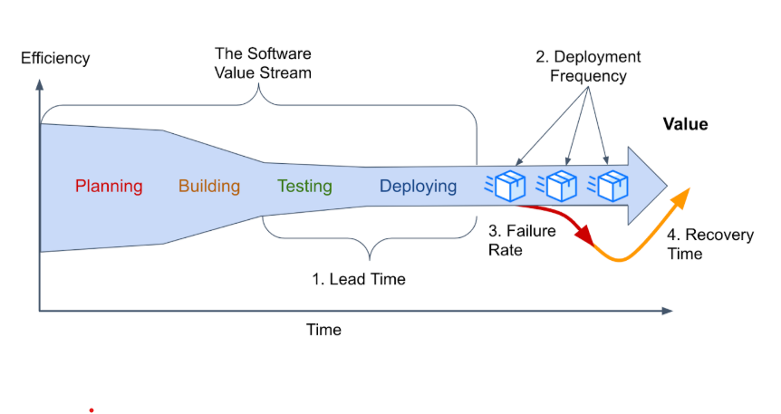
Simple Technology Value Stream Map
Source: DORA’s software delivery metrics: The four keys. https://dora.dev/guides/dora-metrics-four-keys/

Slide 10
Sources:
Kim, G., Humble, J., Debois, P., Willis, J., & Forsgren, N. (2021). The DevOps handbook (2nd ed.)
ASQ. (n.d.). Value stream mapping (VSM). https://asq.org/quality-resources/lean/value-stream-mapping
DORA. (2025). DORA’s software delivery metrics: The four keys. https://dora.dev/guides/dora-metrics-four-keys/
DORA. (2024). Value stream mapping for software delivery. https://dora.dev/guides/value-stream-management/
Google Cloud. (2020). Using the Four Keys to measure your DevOps performance. https://cloud.google.com/blog/products/devops-sre/using-the-four-keys-to-measure-your-devops-performance
IT Revolution. (2021). Understanding the work in our value stream and improving flow. https://itrevolution.com/articles/improve-flow-devops-value-stream/
IT Revolution. (2023). Value stream mapping: Unveiling the path to efficiency and performance. https://itrevolution.com/articles/value-stream-mapping/

Slide 11

Thank you!
Researched and created by:
Kypton Lantz

