Slide 1

MEDITRACK
6049 Kalash Pandey
23106077 Samhita Vadlamudi
23106022 Bhoomi Yadav
23106011 Disha Yadav
Project Guide
Mr. Mahesh Pawaskar
Academic year 2024-25
Notes:
1

Slide 2
Introduction
A web-based platform designed for managing personal health records in one secure place.
Enables users to:
Store and organize medical history, prescriptions, and test results.
Schedule and manage doctor appointments with reminders.
Export and share records easily when needed.
Combines user-friendly features with secure data storage to empower individuals to take control of their health effortlessly.

Slide 3
Problem statement
Many individuals struggle to keep track of their health data.
Difficulty in managing health records and medical appointments.
Challenges in tracking medications and symptoms.
Lack of a platform for effective health management for patients and caregivers

Slide 4
Overview of System Design
Start
Sign-In
Medical History
Prescription
Appointment
Test Results
Store details of past diagnosis, treatment, allergies and chronic conditions
Enables the user to add, delete, file upload their prescription, scan and know more about their medicines
Reminds the user when their next appointment is scheduled
Add, view and download their test results
Notes:
4

Slide 5
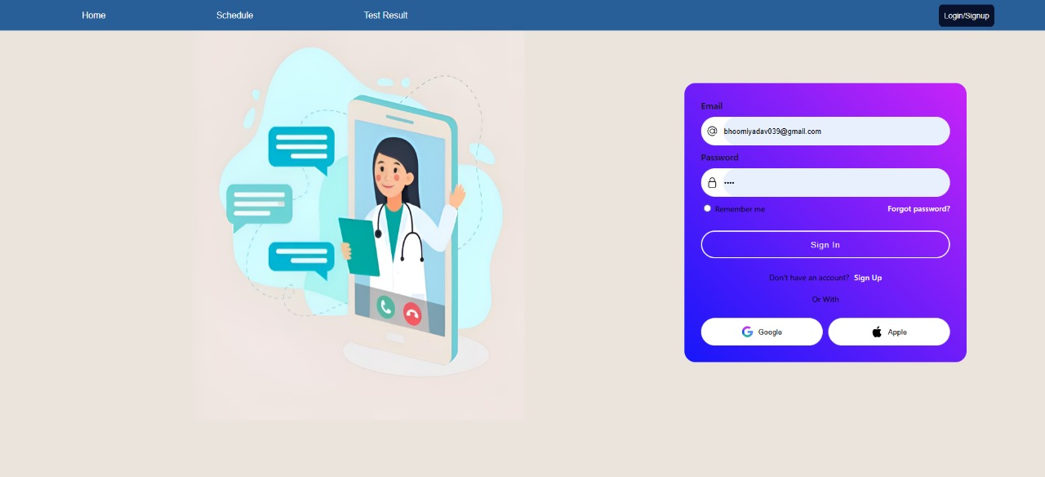
Implementation

Slide 6
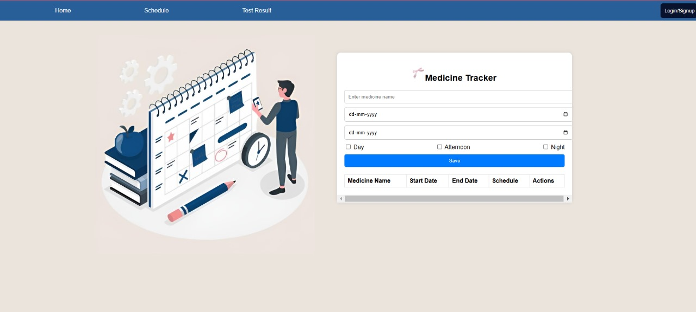
Implementation

Slide 7
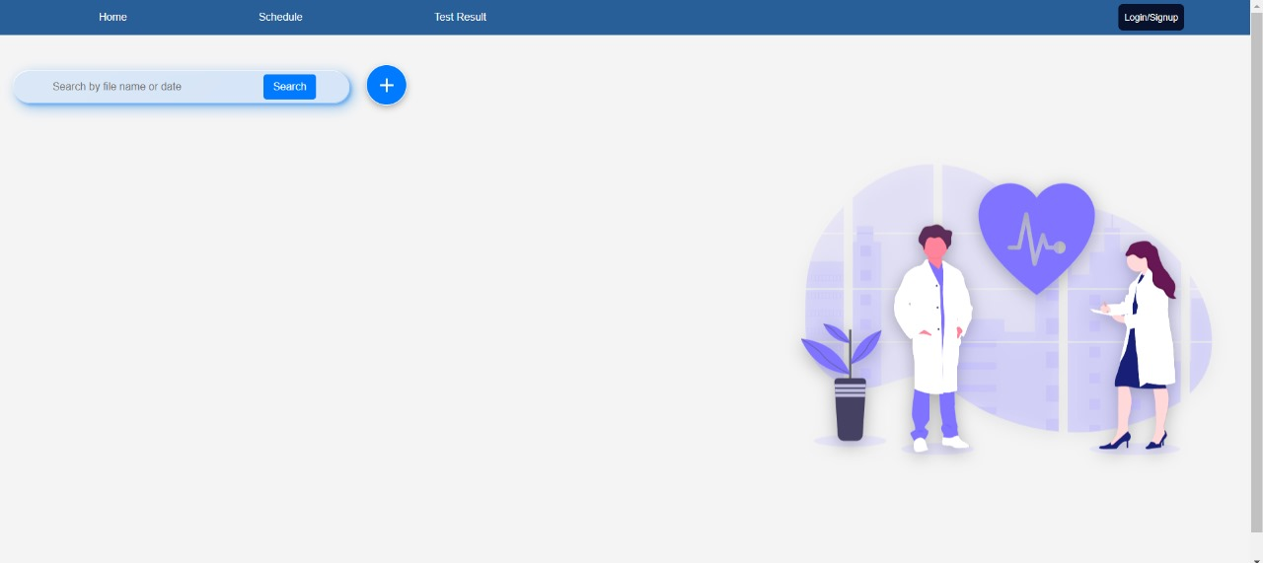
Implementation

Slide 8
Technology Stack
Frontend:
HTML, CSS, JavaScript
Backend:
Django
Database:
SQLite

Slide 9
Thank You
Notes:
9

