Slide 1

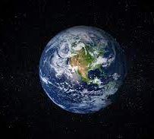
Analysis: The World Happiness Report
By Julian Hafza and Julien Counts

Slide 2
OVERVIEW
The World Happiness Report studied happiness in 165 countries from 2005 to 2022
Goal of The Happiness Report is to make happiness a worldwide objective of central policy
making.
Respondents in each nation are randomly surveyed and asked to rank their happiness level
based on a scale of 0-10, with 0 being the worst life and 10 being the best life. These are
aggregated and averaged by country as the "life ladder".
Conducted via the use of surveys that ask individuals in each nation questions across 6 dimensions:
1. GDP per capita (log converted)
2. Healthy life expectancy at birth (From the World Health Organization)
3. Social support (0-1 scale, 0= no, 1=yes)
4. Freedom to make life choices (0-1 scale, 0= no, 1=yes)
5. Generosity (residual of regressing the national average of Gallop World Poll responses to
the Gallup World Poll question "Have you donated money to a charity in the past month?")
6. Perceptions of corruption (0-1 scale, 0= no, 1=yes)

Slide 3
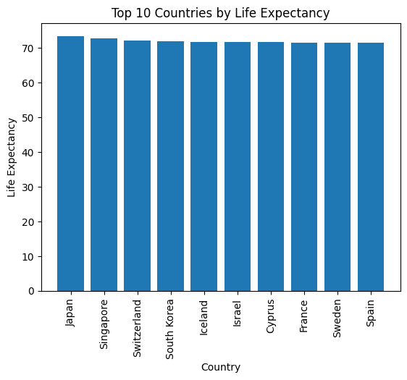
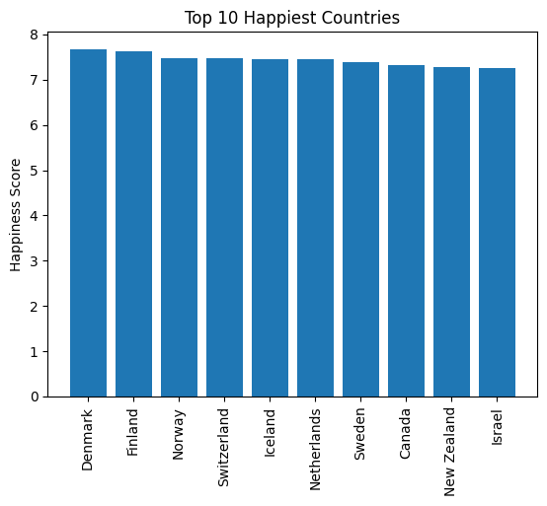
Top 10 Happiest Countries & Highest Life Expectancy

Slide 4
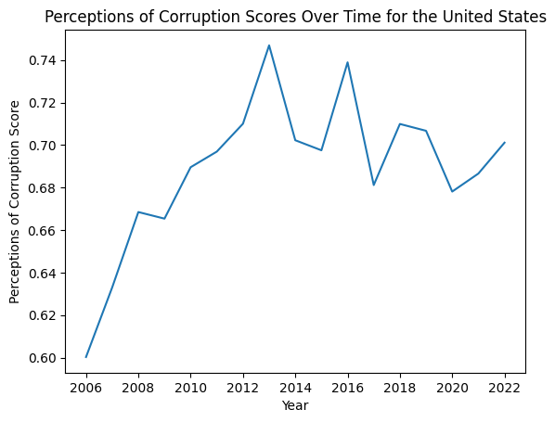
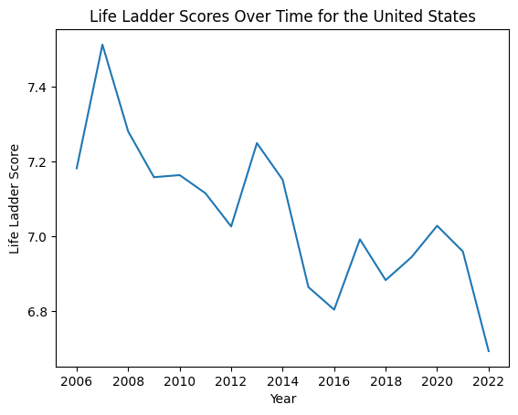
Relationship Between Perception of Government Corruption on Happiness

Slide 5
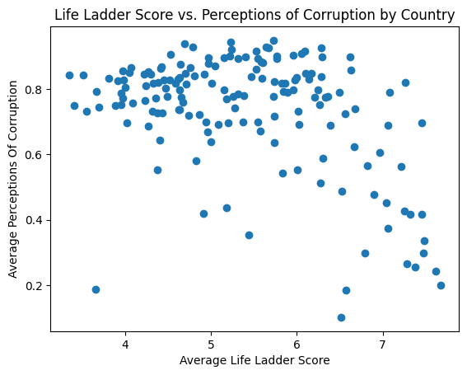
Life Ladder Score vs. Perceptions of Corruption by Country

Slide 6
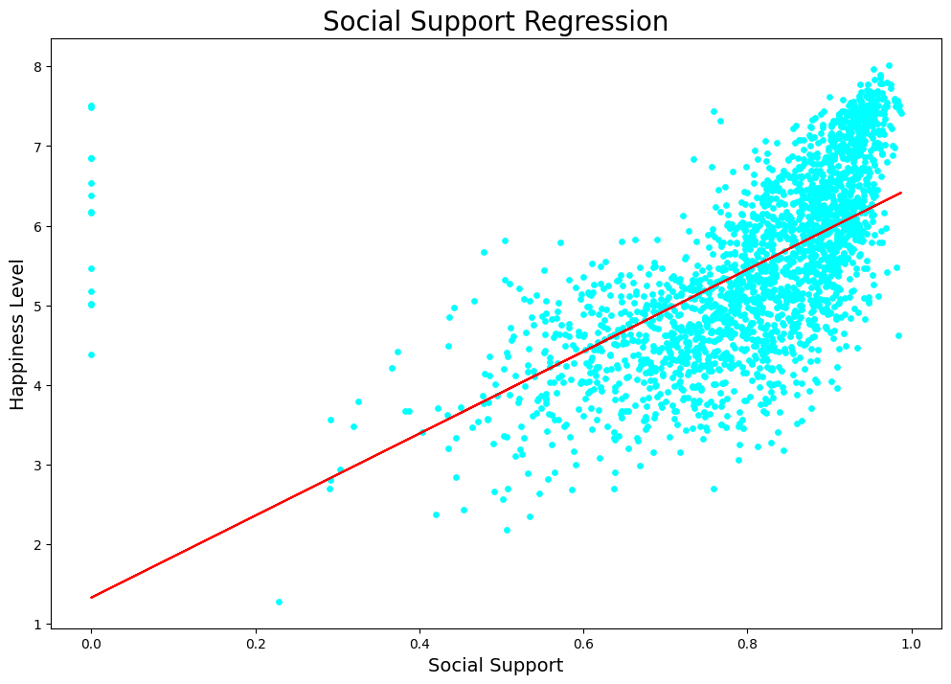
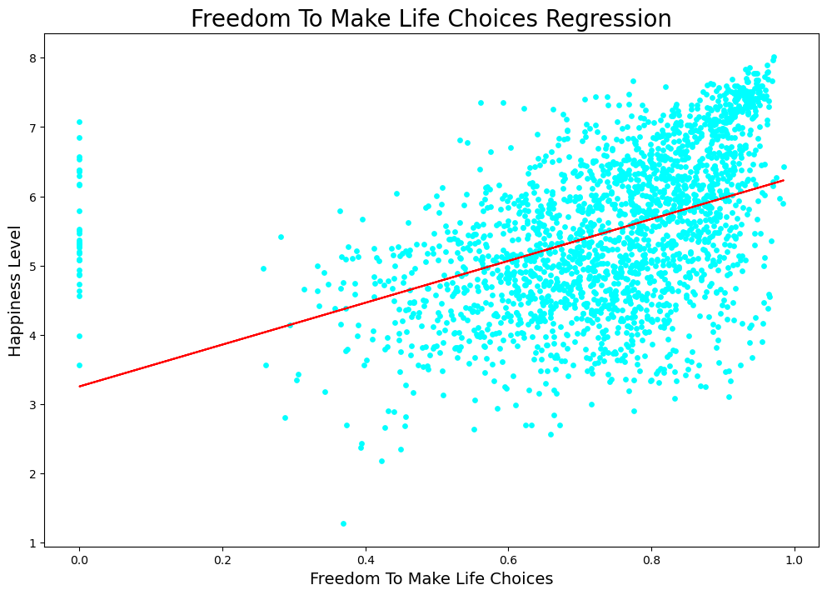
Relationship Between the Freedom to Make Life Choices vs Social Support and its Impact on Happiness
Social Support = 5.15x + 1.33
Happiness Level = 3.02x + 3.25

Slide 7
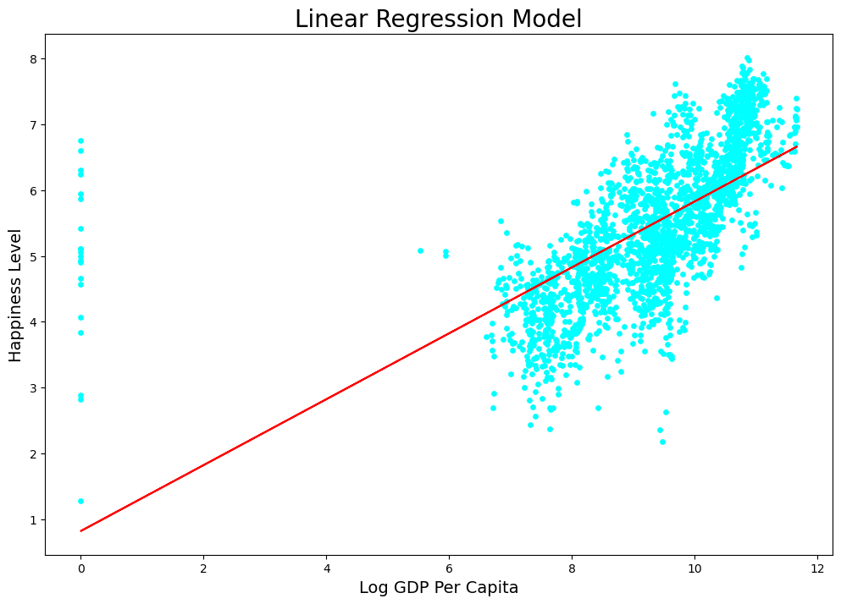
Relationship Between GDP and Happiness
Happiness Level = 0.5x + 0.82

Slide 8
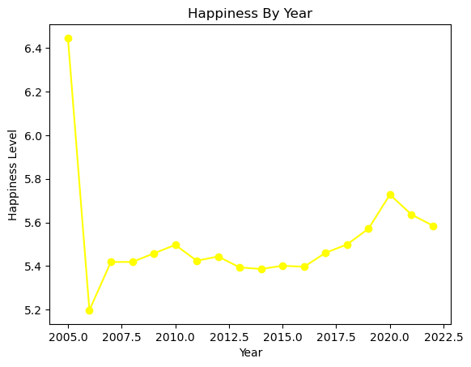
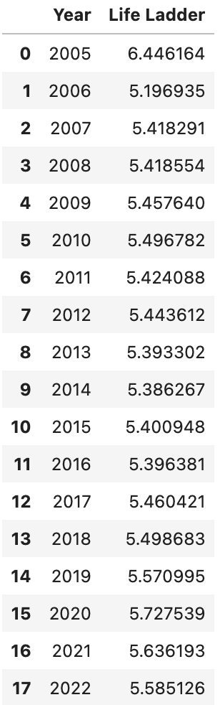
Total Happiness Trends from 2005-2022

Slide 9


Thank you for your attention! Choose Happiness
Questions?

