Slide 1
Machine Learning Project
Book Recommender
Made and Presented by:
Camille Floyd,
Julien Counts,
Tyler Allen

Slide 2
The data cleaning process

Slide 3
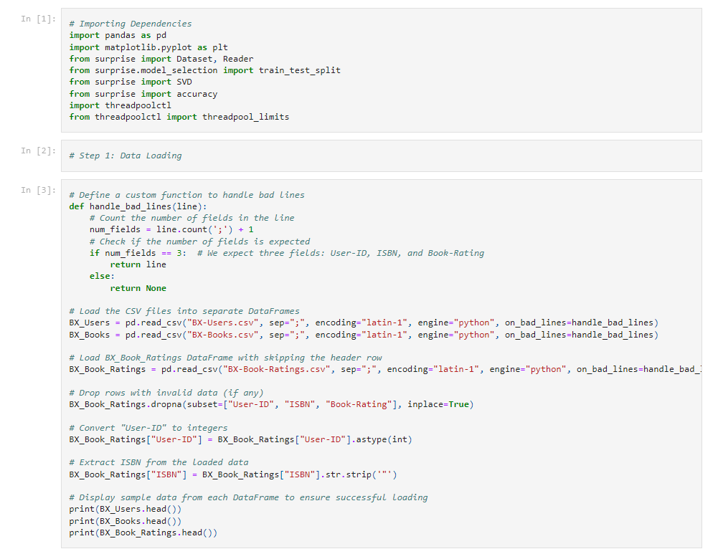
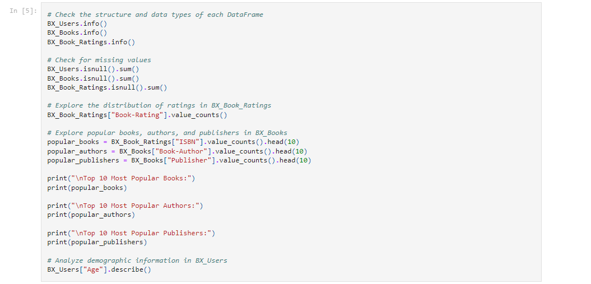

Creating an ETL

Slide 4

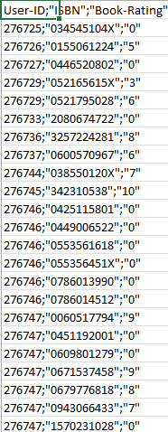
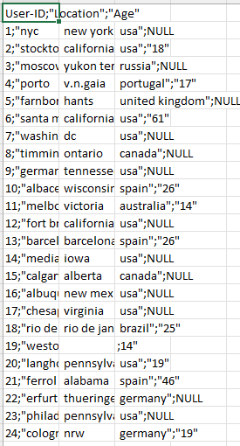
Cleaning our data

Slide 5
The Data

Slide 6
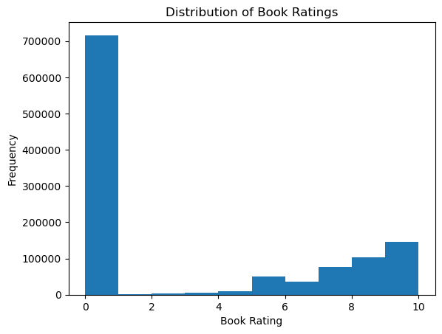
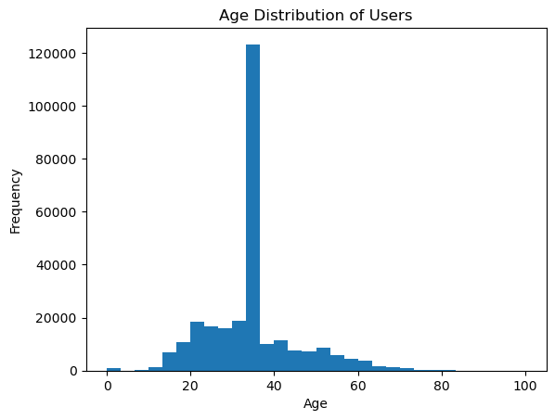
Distribution Histograms

Slide 7
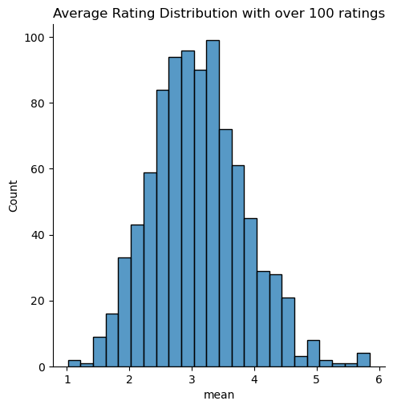
Continued, Average Ratings

Slide 8
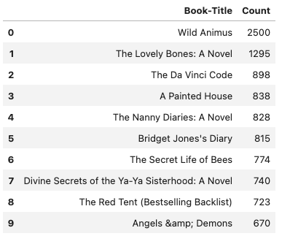
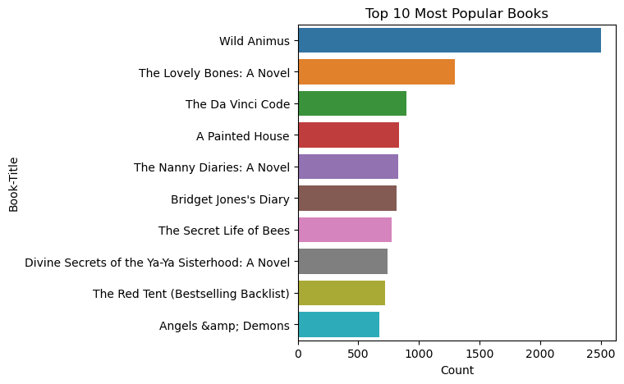
Most Popular Books

Slide 9
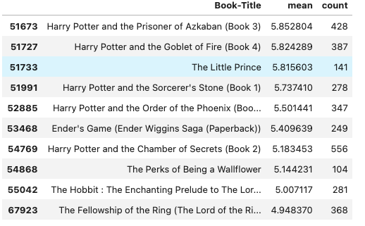
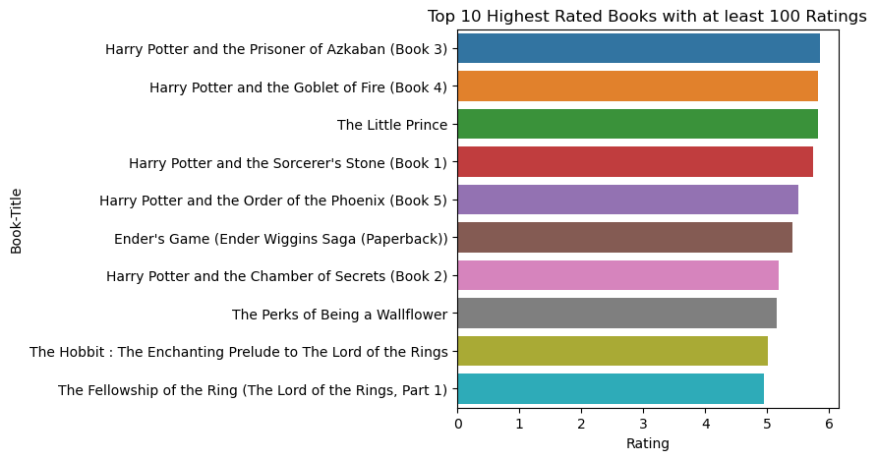
Highest Rated Books

Slide 10
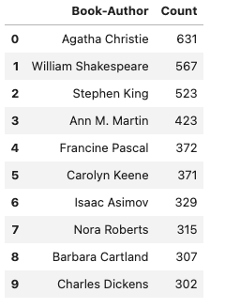
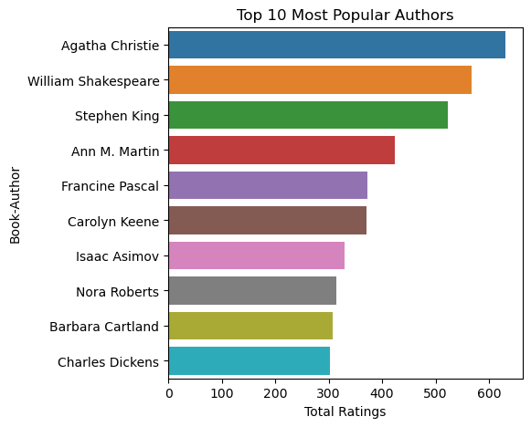
Most Popular Authors

Slide 11
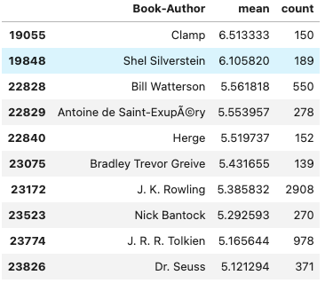
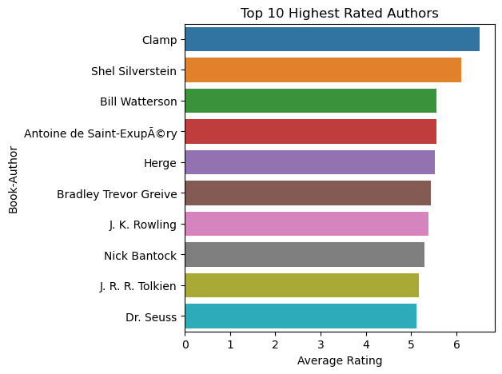
Highest Rated Authors

Slide 12
The Model

Slide 13
Why talk about it when we can see it!!

Slide 14

Final Questions?

